Slide 1
Convergence, Mimicry and Deceit in the Oncidiinae
James Diffily
Dallas Judging Center
December 2016

Slide 2
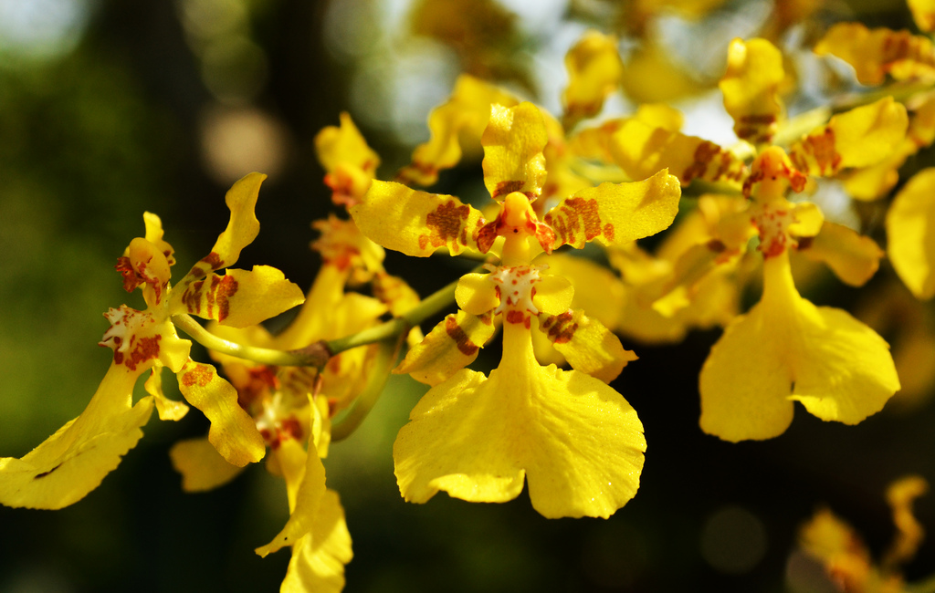
Oncidium isthmii
For almost two centuries, the Subtribe Oncidiinae has been a contentious
battleground for taxonomists.

Slide 3
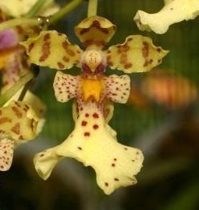
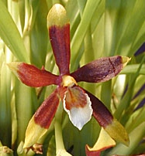
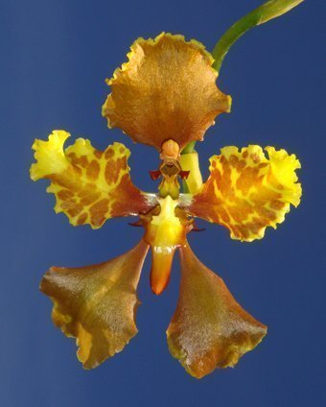
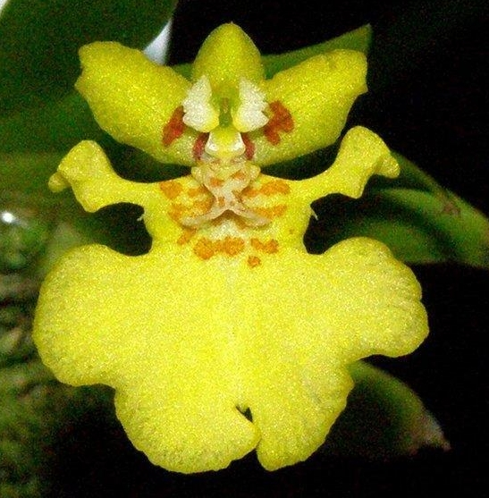
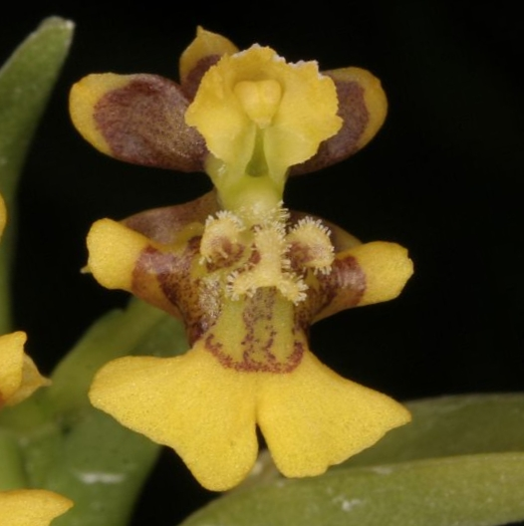
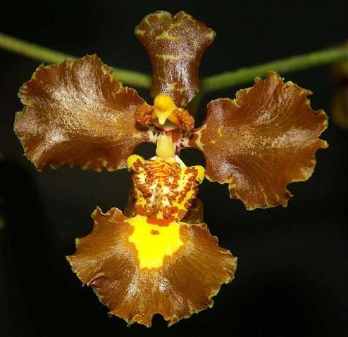
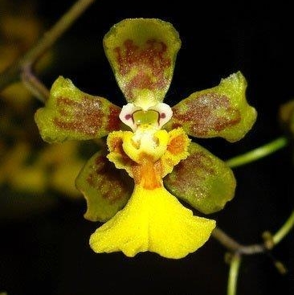
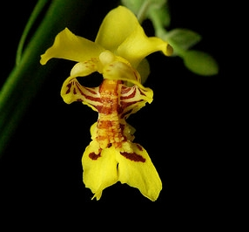
Cischweinfia pusilla
(ki-SWINE-fee-a)
Caucaea andigena
(kow-KAY-ah)
Cyrtochilum cumandae
Erycina pusilla
Lockhartia oerstedii
Fernandezia ecuadorensis
Gomesa gardernii
Grandiphyllum auricular

Slide 4
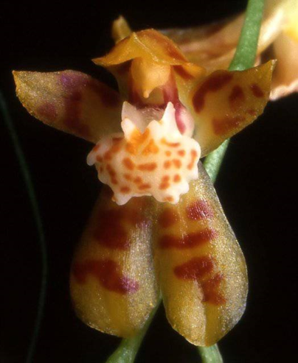
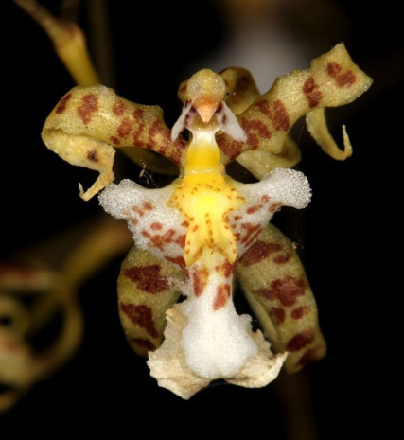
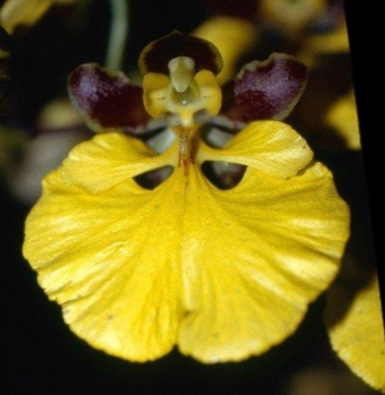
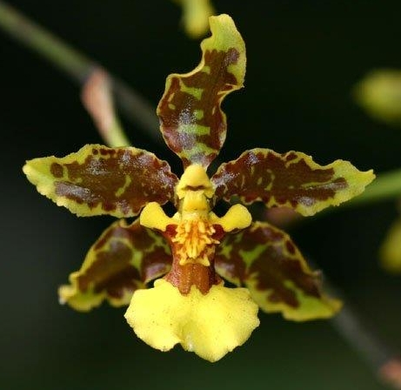
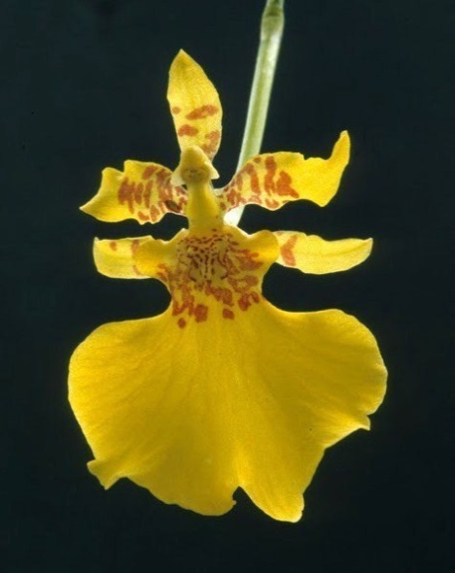
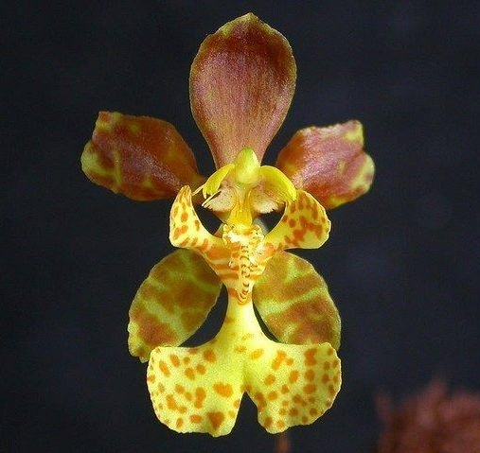
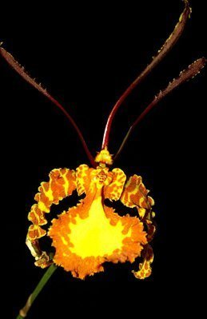
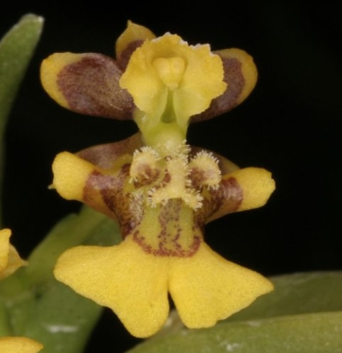
Miltonia phymatochila
Mesospinidium incantans
Oncidium altissimum
Nohawilliamsia pirarense
Psychopsiella limminghei
Raycadenco ecuadorensis
Otoglossum globuliferum
Psychopsis krameriana

Slide 5
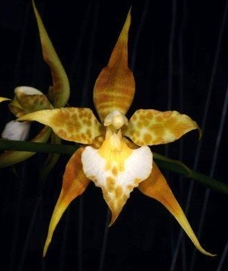
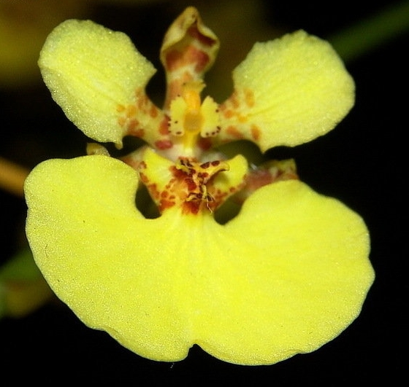
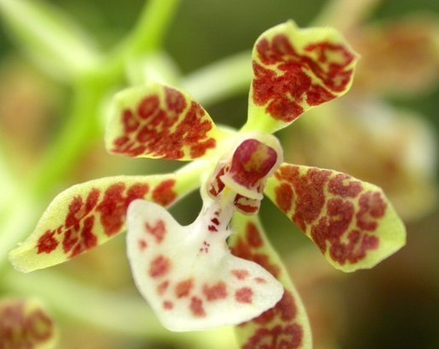
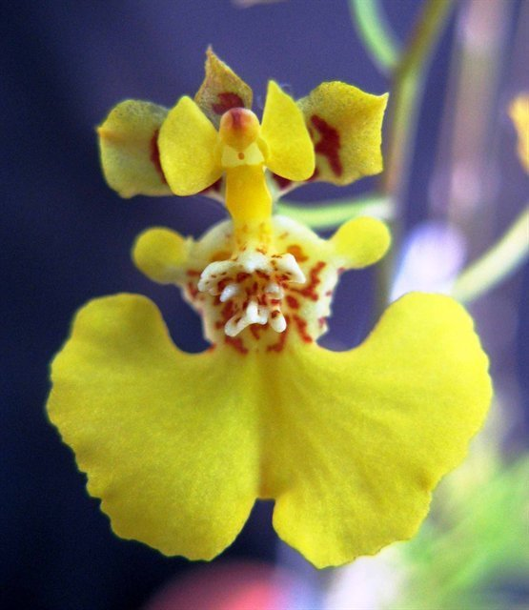
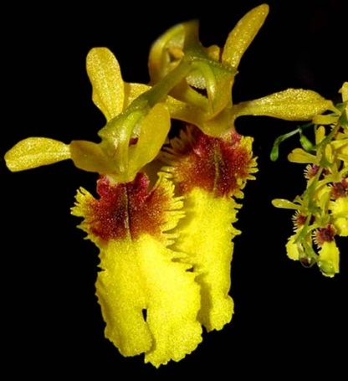
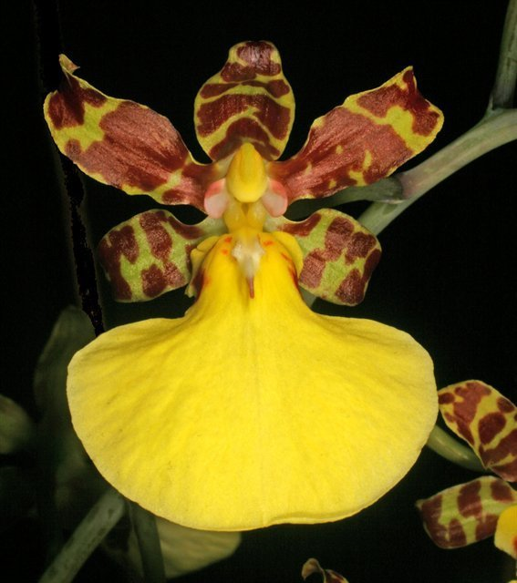
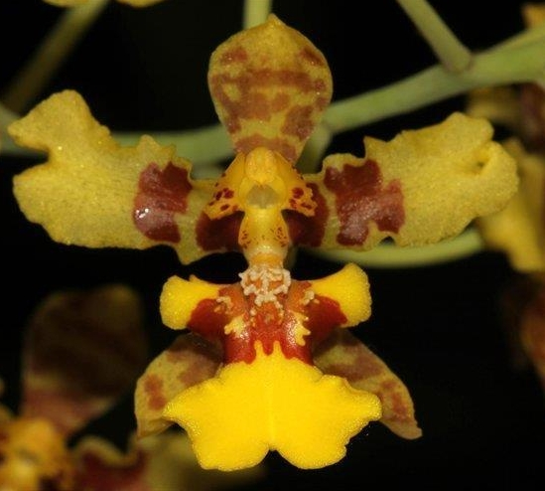
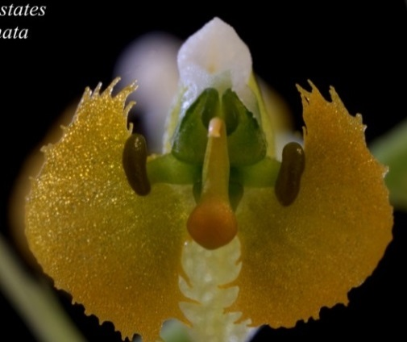
Solenidium lunatum
Rossioglossum ampliatum
Tolumnia urophylla
Rhynchostele cordata
Zygostates lunata
Trichocentrum splendidum
Thysanoglossa jordanensis
Vitekorchis excavate

Slide 6
Something very significant has happened in the Oncidiinae

Slide 7
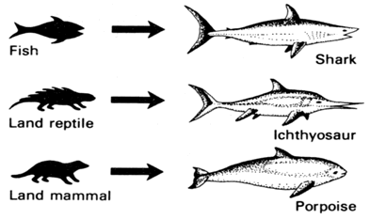
Something very significant has happened in the Oncidiinae
Convergence
Convergent evolution is the independent evolution of similar features
in species of different lineages.

Slide 8
Something very significant has happened in the Oncidiinae
Convergence
Convergent evolution is the independent evolution of similar features
in species of different lineages.
In the Oncidiinae, there are approximately 14 independent
lineages leading to the Oncidium-type floral morphology

Slide 9
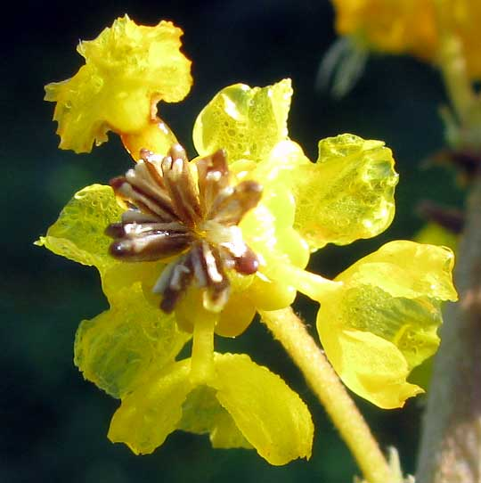
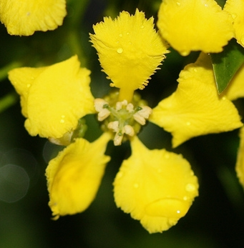
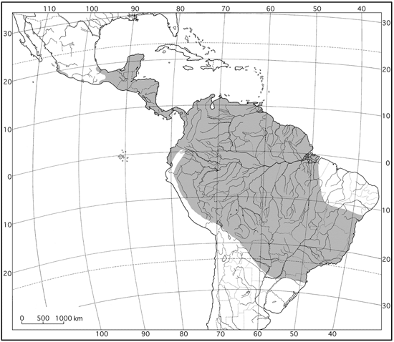
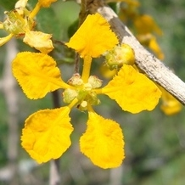
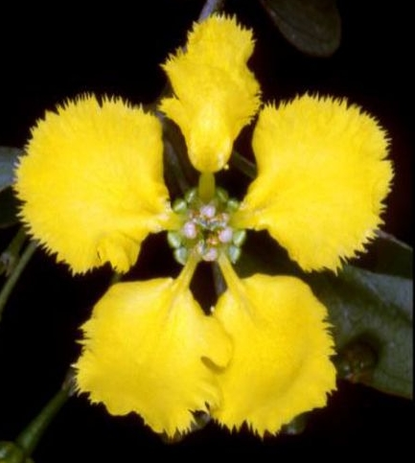
The Driving Force - Mimicry
Brysonima crassifolia
Nancy Tree, Golden Spoon
Mascagnia macroptera
Yellow Orchid Vine
Gaudichaudia cynanchoide
(go-dih-SHAW-dee-uh)
Stigmaphylum ciliatum
Orchid Vine
Family Malpighiaceae Distribution

Slide 10
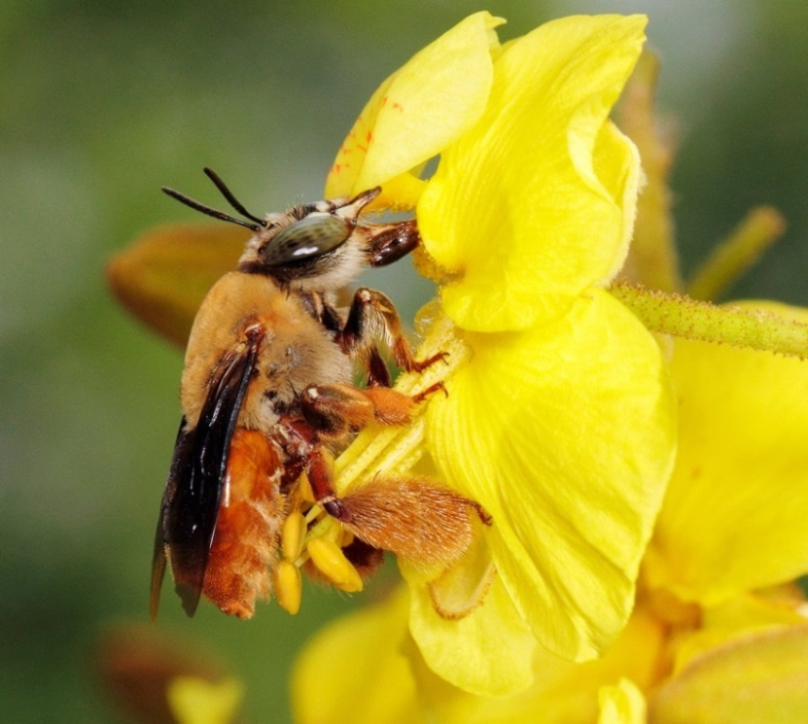
Malpigs employ an extremely effective pollination strategy
using oil as a reward.
Centris nitida

Slide 11
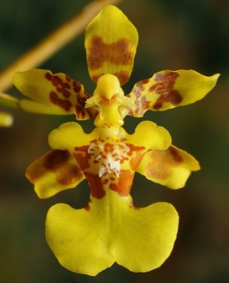
Malpigs employ an extremely effective pollination strategy
using oil as a reward.
Many Oncidiinae mimic this.
Tabula
infrastigmatica
Callus with
elaiophores
Centris nitida
Oncidium baueri.

Slide 12
Malpigs employ an extremely effective pollination strategy
using oil as a reward.
Many Oncidiinae mimic this.
Tabula
infrastigmatica
Callus with
elaiophores
Centris nitida
Oncidium baueri.
The bee grasps the claw of the banner petal or the tabula infrastigmatica freeing
the front 2 pair of legs to scrape oil from the elaiophores. The oil is transferred
to the brush-like structures on the hind legs. The pollinia stick to the bee’s head.

Slide 13
Deceit
The majority of the Oncidiinae with oil-bee flowers produce little
or no oil reward.
This is form of Batesian Mimicry wherein an organism (the mimic) gains
an advantage by imitating the characteristics of another successful
organism (the model).

Slide 14
Deceit
The majority of the Oncidiinae with oil-bee flowers produce little
or no oil reward.
This is form of Batesian Mimicry wherein an organism (the mimic) gains
an advantage by imitating the characteristics of another successful
organism (the model).
The mimic’s floral reflectance spectrum is the same, the shape is similar and there is a structure in the right place for the
bee to grasp.
Bees spend less time on these flowers, but pollination success is still adequate .

Slide 15
In the Oncidiinae, floral morphology is very plastic, i.e.
floral traits are subject to modification without
much genetic change.
Species can readily adapt their floral morphology
to changes in pollinators.

Slide 16
In the Oncidiinae, floral morphology is very plastic, i.e.
floral traits are subject to modification without
much genetic change.
Species can readily adapt their floral morphology
to changes in pollinators.
This ability masks the true relationships.
Sequencing the DNA of the Oncidiinae has provided a tool for understanding these complex relationships.

Slide 17
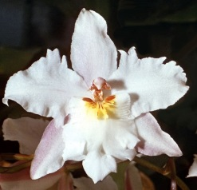
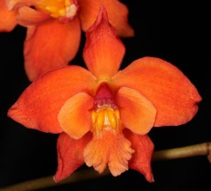
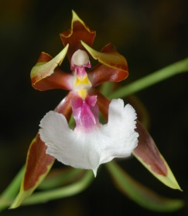
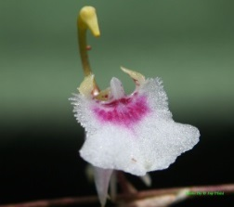
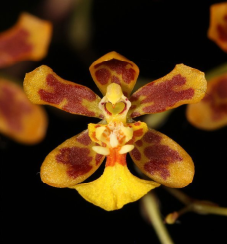
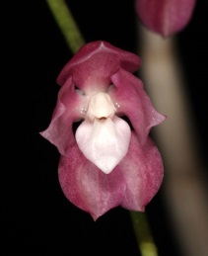
Oncidium Recircumscription
Out – unrelated look-alikes
Do not share a recent common ancestor
In – related look-unlikes
Share a recent common ancestor
Trichocentrum
Odontoglossum
Rat-tail and Mule-ear
Oncidiums
Cyrtochilum
Macranthum Group
of Oncidium
Cochlioda
Gomesa
Brazilian Oncidiums
Miltoniodes
Tolumnia
Equitant or Variegata
Oncidiums
Sigmatostylix
Grandiphyllum
Brazilian Mule-ears
Symphyglossum

Slide 18
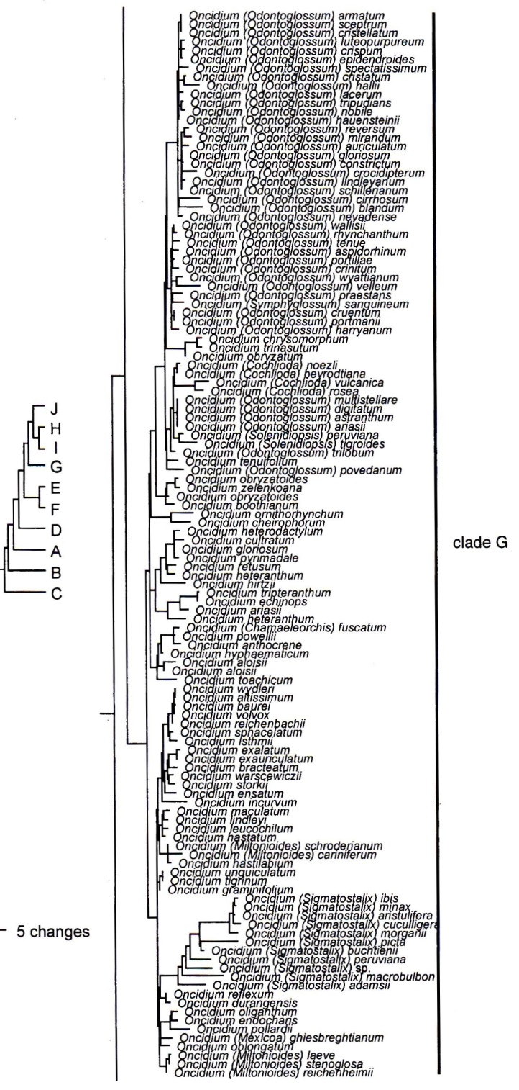
Genus A
Genus B
Genus A
Genus C
Genus D
Genus E
Splitters
Lumpers
Neubig et.al. 2012

Slide 19
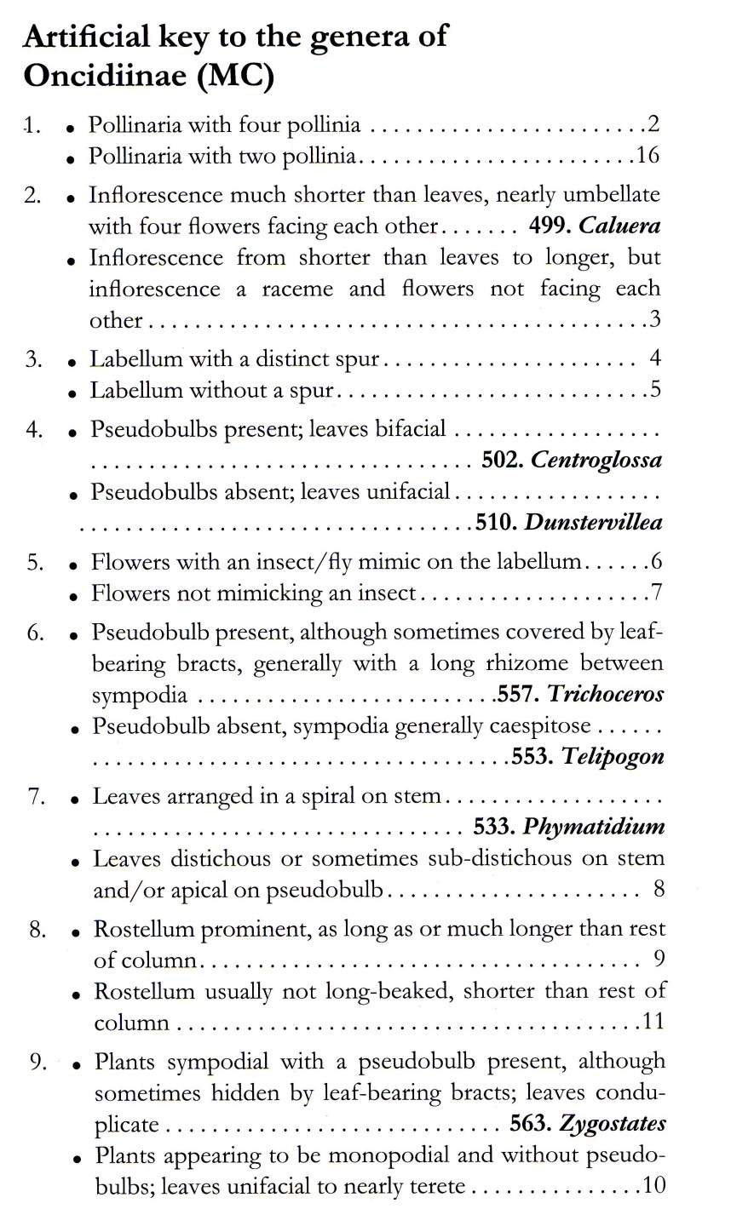
Be glad the lumpers prevailed.
In the Oncidiinae, floral morphology alone
does not work in setting generic limits.
Trying has bedeviled taxonomists for 170 years.
Because vegetative traits are more conservative,
they better reflect the deeper relationships.
The use of a combination of traits in identifying
these broadly circumscribed genera works well.
Neubig et.al. 2012

Slide 20
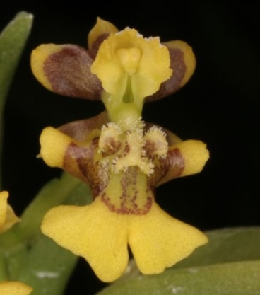
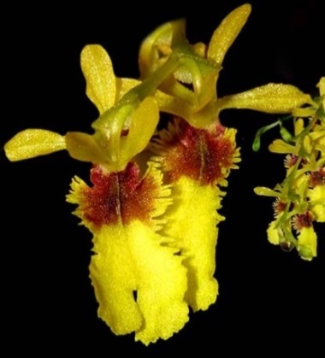

Slide 21
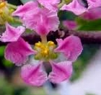
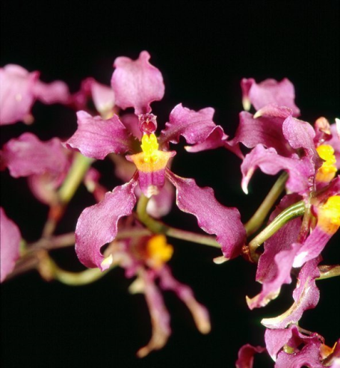
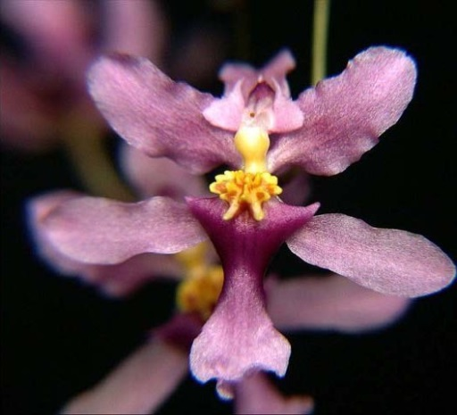
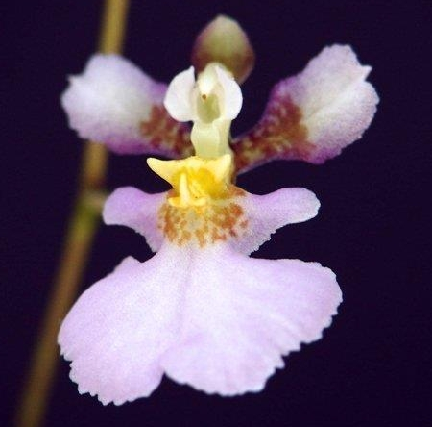
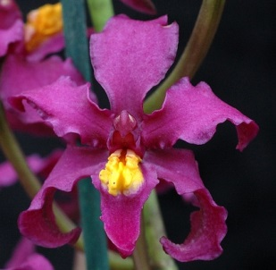
Malpighia glabra Barbados Cherry
When yellow fatigue sets in,
go for the color.
.
Cyrtochilum ioplocon
Oncidium sotoanum
Cyrtochilum edwardii
Tolumnia hawkesiana
Pink/Purple Malpighiaceae Mimics
Oil bee Pollinated

Slide 22
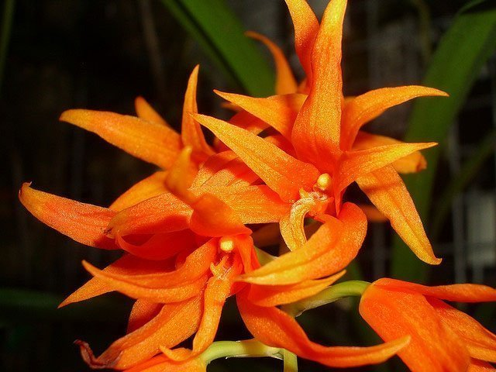
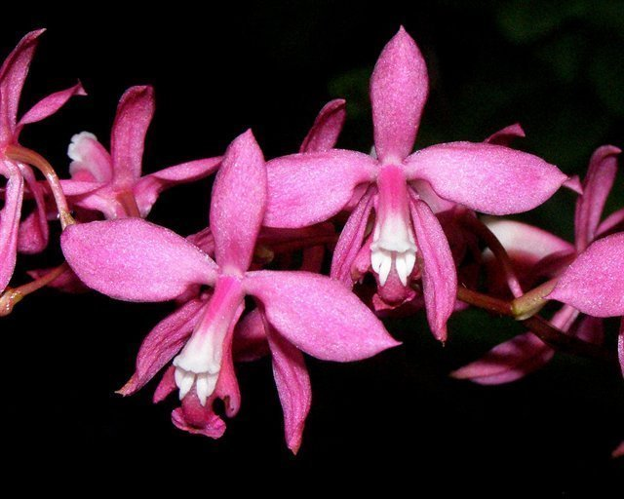
Brassia aurantiaca
Cochlioda bayrodtinia
Comparettia falcata
Rodriguezia lanceolata
Symphyglossum sanguineum
Andean Emerald Hummingbird
Hummingbird Pollinated
Oncidium (Cochlioda) noezlianum

Slide 23
Trichopilia fragrans
Cischweinfia parva
Miltoniopsis phalaenopsis
Rodriguezia obtusifolia
Rhynchostele bictonensis
Nectar Reward Flowers
Bee Pollinated
Macradenia multiflora

Slide 24
Oncidium maculatum
104 F-1, 359 Progeny
Oncidium leucochilum
100 F-1, 747 Progeny
Oncidium fuscatum
129 F-1, 841 Progeny
Oncidium cariniferum
25 F-1, 387 Progeny
Comparettia falcata
16 F-1, 222 Progeny
Trichocentrum lanceanum
53 F-1, 146 Progeny
Tolumnia triquetra
102 F-1, 1771 Progeny
Oncidium alexandrae
474 F-1, 8263 Progeny
Other Colorful Building Block Oncidiinae

Slide 25
References
Chase MW, Williams NH, de Faria AD, Neubig KM, Amaral MDCE, Whitten WM. 2009a. Floral convergence in Oncidiinae (Cymbidieae; Orchidaceae): an expanded
concept of Gomesa and a new genus Nohawilliamsia. Annals of Botany 104: 387–402.
Dodson CH. 1962. The importance of pollination in the evolution of the orchids of tropical America. American Orchid Society Bulletin 31: 525–534 641–649,731–735.
Neubig KM, Whitten WM, Williams NH, Blanco MA, Endara L, Burleigh JG, Silvera K, Cushman JC, Chase MW. 2012. Generic recircumscriptions of Oncidiinae (Orchidaceae:
Cymbidieae) based on maximum likelihood analysis of combined DNA datasets. Botanical Journal of the Linnean Society 168: 117–146.
Papadopulos AST, Powell MP, Pupulin F, Warner J, Hawkins JA, Salamin N, Chittka L, Williams NH, Whitten WM, Loader D, Valente LM, Chase MW, Savolainen V. 2013. Convergent evolution of floral signals underlies the success of Neotropical orchids. Proceedings of the Royal Society B 280: 20130960.
Pridgeon AM, Cribb PJ, Chase MW, Rasmussen FN. 2009. Genera orchidacearum, Vol. 5. Oxford: Oxford University Press.
Williams NH, Chase MW, Fulcher T, Whitten WM. 2001a. Molecular systematics of the Oncidiinae based on evidence from four DNA sequence regions: expanded circumscriptions of Cyrtochilum, Erycina, Otoglossum, and Trichocentrum
and a new genus (Orchidaceae). Lindleyana 16: 113–139.
Williams NH, Chase MW, Whitten WM. 2001b. Phylogenetic positions of Miltoniopsis,
Caucaea, a new genus, Cyrtochiloides, and Oncidium phymatochilum (Orchidaceae:
Oncidiinae). Lindleyana 16: 272–285.

