Slide 1
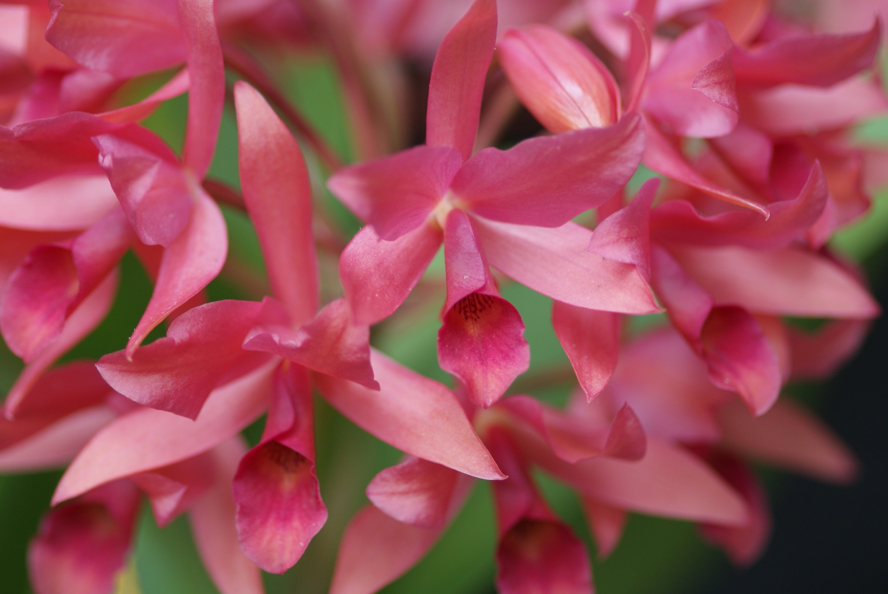
Guarianthe
James Diffily Dallas Judging Center July 2018

Slide 2
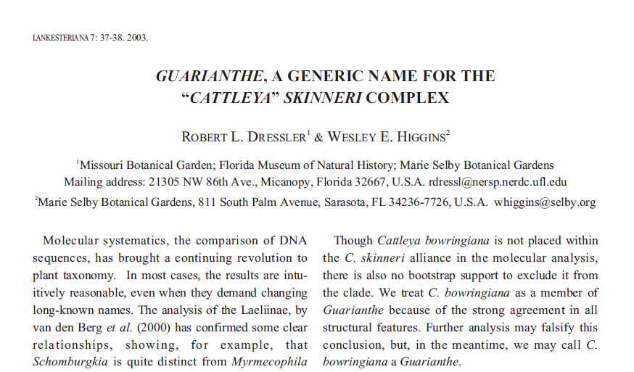
Created in 2003 based on:

Slide 3
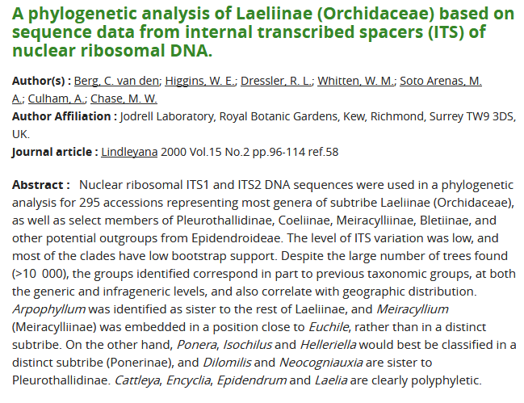
Withner, Carl L., The Cattleyas and Their Relatives, Volume 1, The Cattleyas, Timber Press, 1988

Slide 4
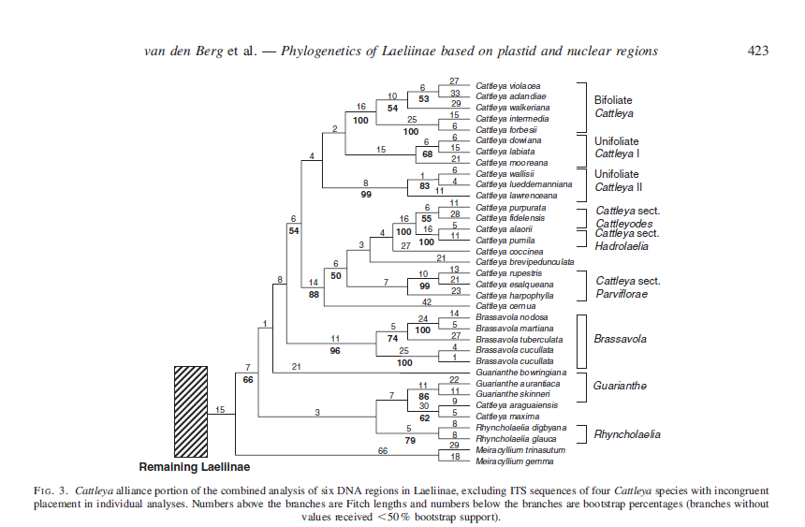

Slide 5
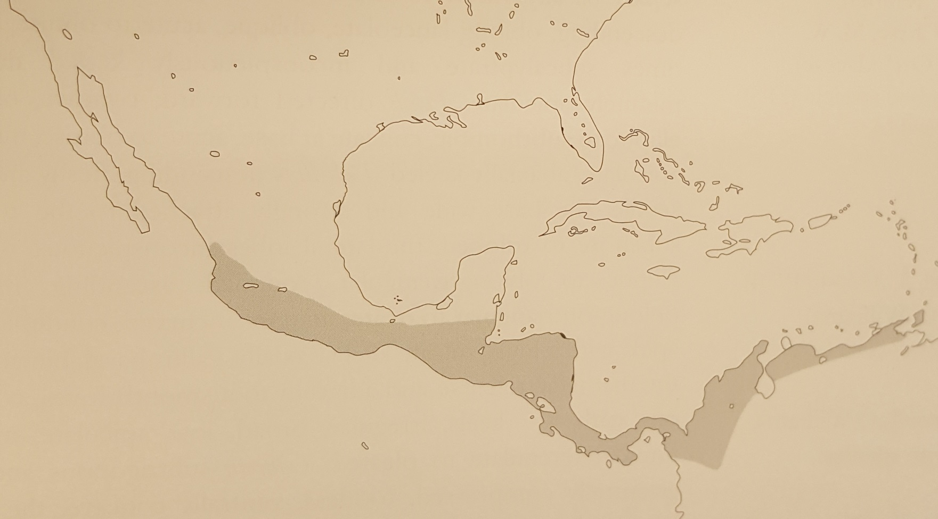
Guarianthe Distribution
Four species and l natural hybrid grow as epiphytes & lithophytes in lower- to
middle-elevation wet forests from Mexico to Venezuela, and in Trinidad.

Slide 6
Guarianthe
Species

Slide 7
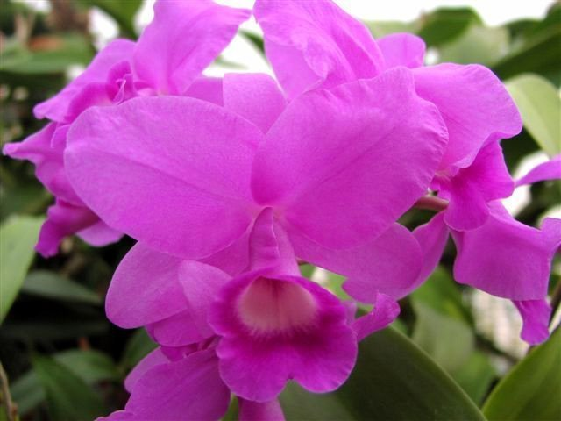
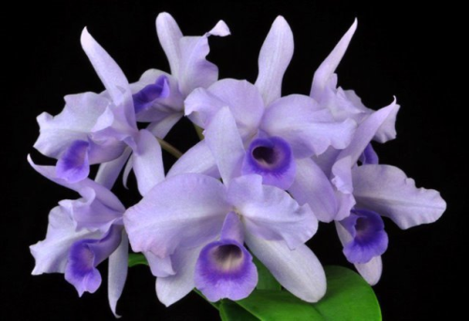
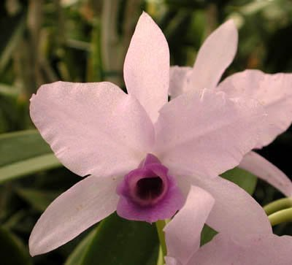
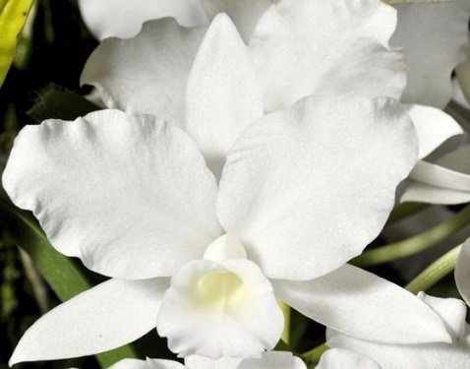
Guarianthe skinneri
Mexico to Costa Rica
National Flower of Costa Rica
Distinct white or
yellow in throat
140 AOS Awards
8 FCC’s
‘Heiti Jacobs’ FCC
‘Orchid Eros’ HCC
‘Blue Angel’
‘Carlos Solis’ AM

Slide 8
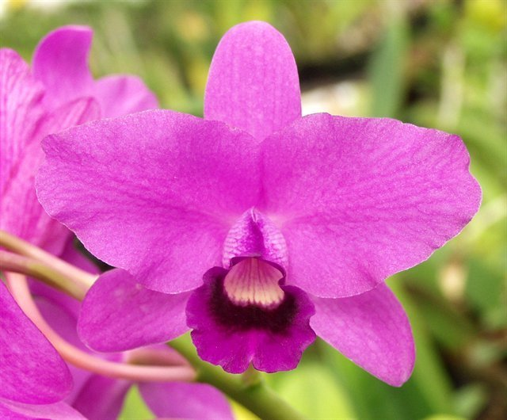
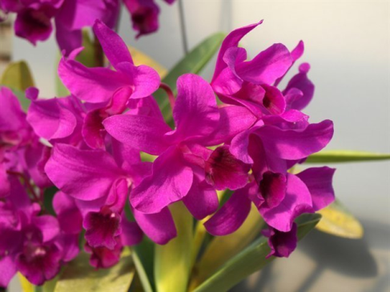
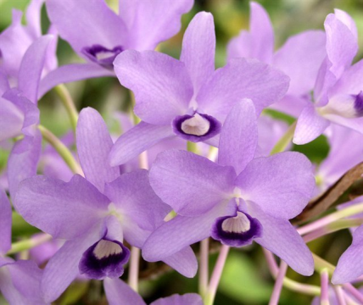
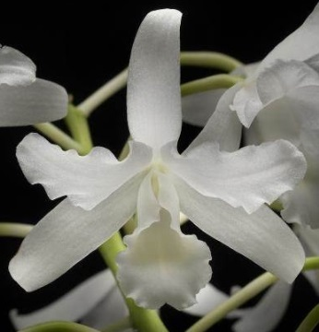
Guarianthe bowringiana
Mexico to Honduras
Lithophytic or epiphytic in
very moist environments
25 AOS Awards
Guarianthe bowringiana ‘Augusta’ AM
‘Purple Prince’
‘Blue Smoke’ HCC
‘Summit Snow’ AM

Slide 9
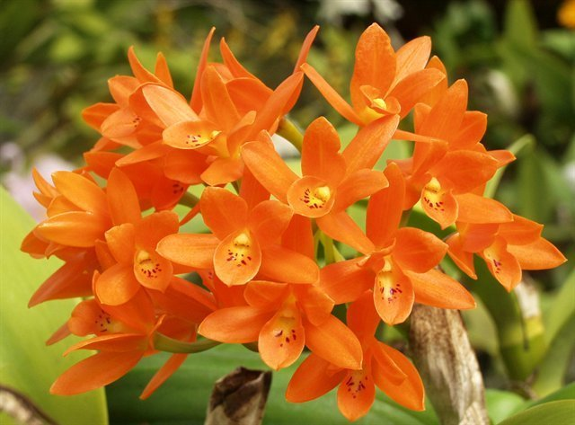
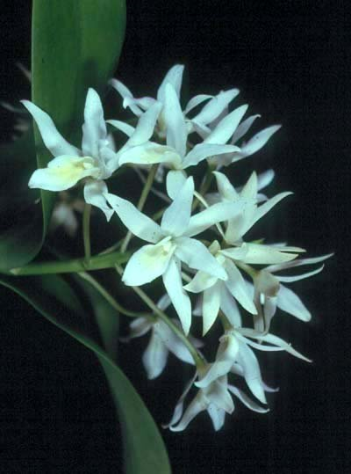
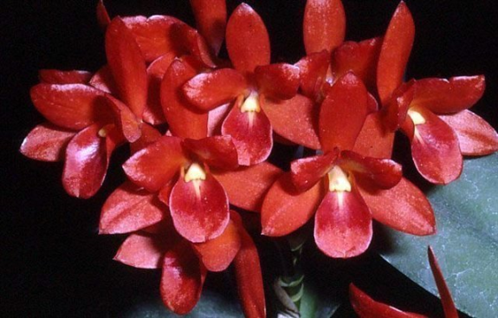
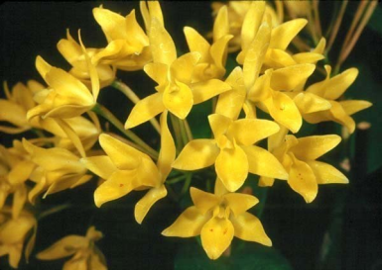
Guarianthe aurantiaca
Mexico to Nicaragua
Epiphytic on trees on the
Pacific slope
8 to 10 flowers per
inflorescence
59 AOS Awards
1 FCC
Guarianthe aurantiaca ‘Gold Country’
‘Citronella’ HCC
‘Orchid Jungle’ AM
‘White Magic’ FCC

Slide 10
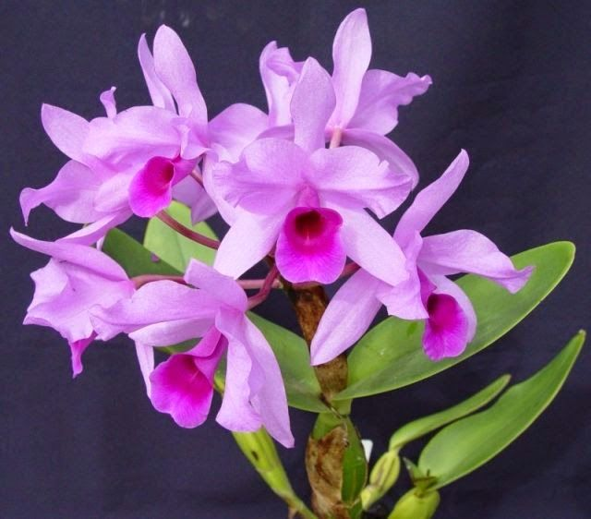
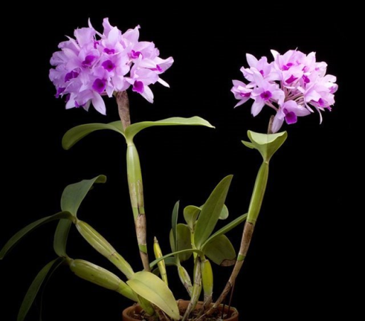
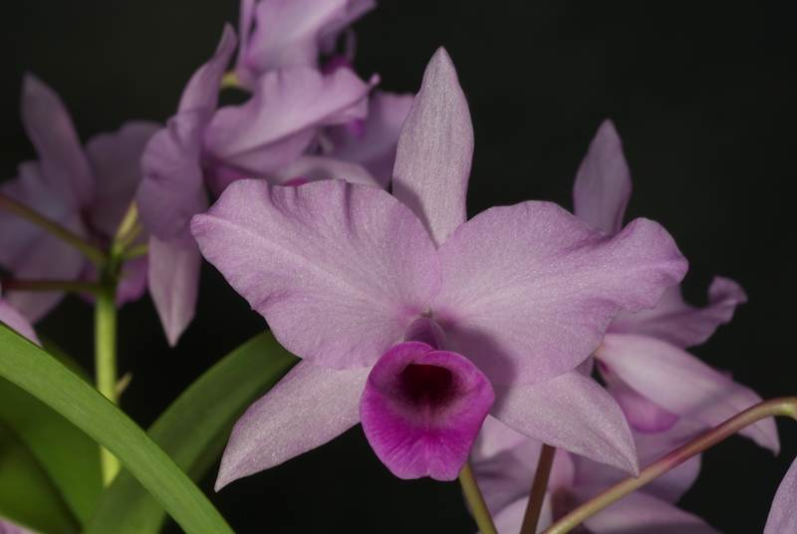
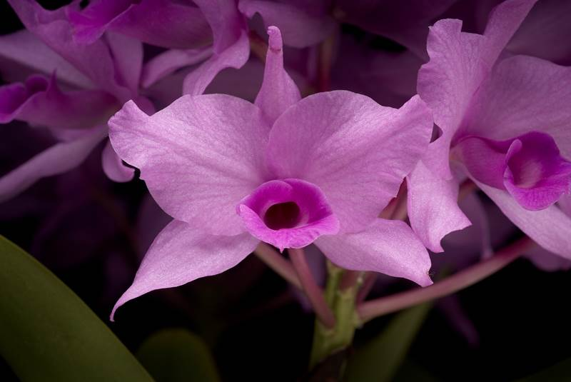
Guarianthe hennisiana
Costa Rica to Venezuela
& N Colombia
Fall blooming
No white in the throat
Lip purple
4 AOS Awards
‘Carol Marine’ AM
‘Jill M’ CHM
‘Munjeet’ AM & CCM

Slide 11
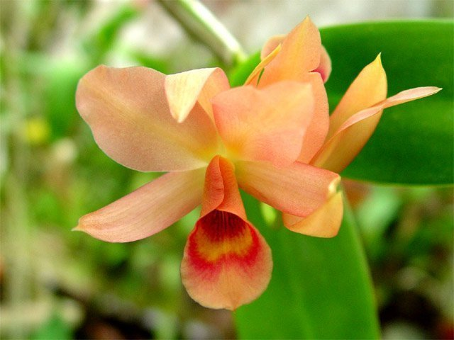
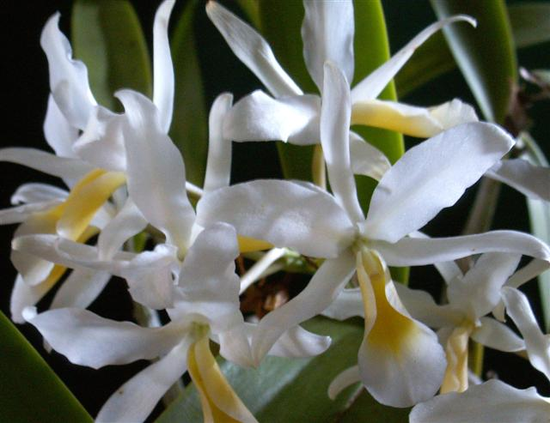
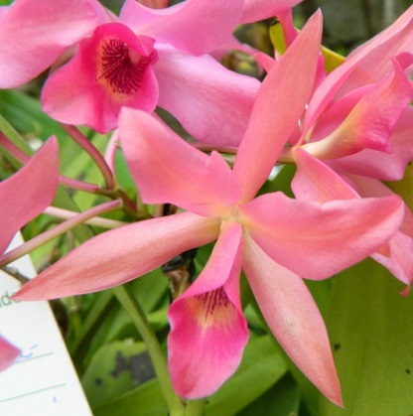
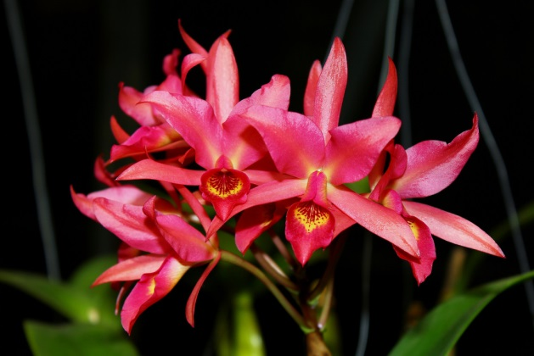
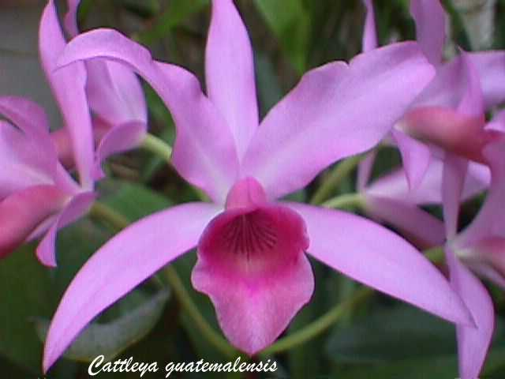
Guarianthe x laelioides
Overlap of Gur. skinneri and
Gur. aurantiaca range
A highly variable
hybrid swarm

Slide 12
Guarianthe
Hybrids

Slide 13
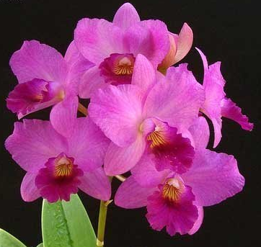
Guarianthe bowringiana Hybrids
Wide petals, full flowers
Great multifloral presentation
272 F-1
2,143 Progeny
Guaritonia Rosy Jewell ‘Vera Stella’
Gur. bowringianai x Bro. sanguineaa

Slide 14
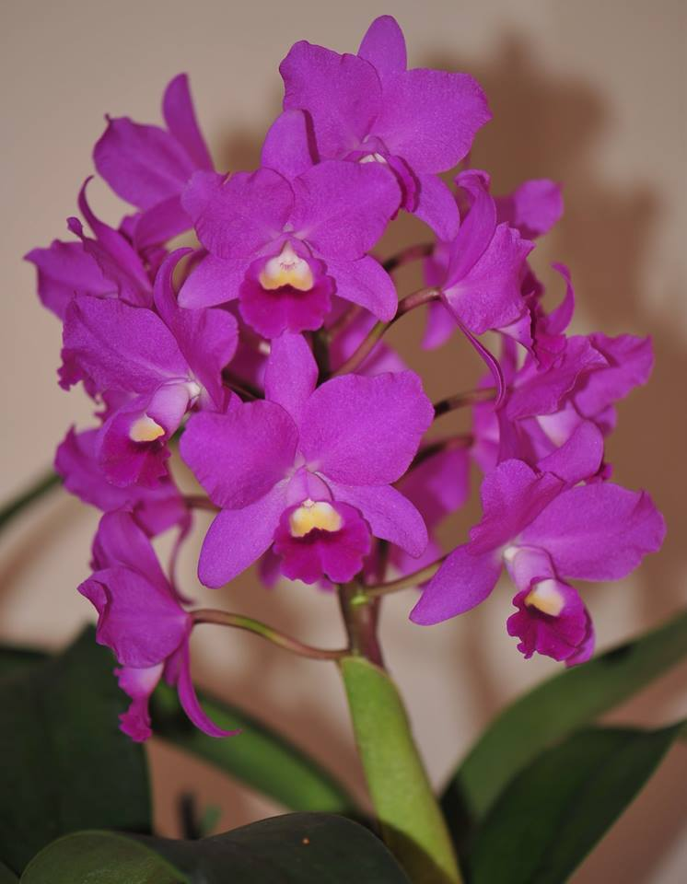
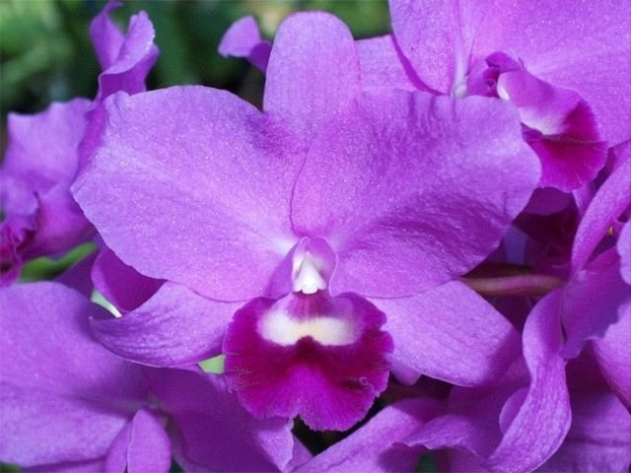
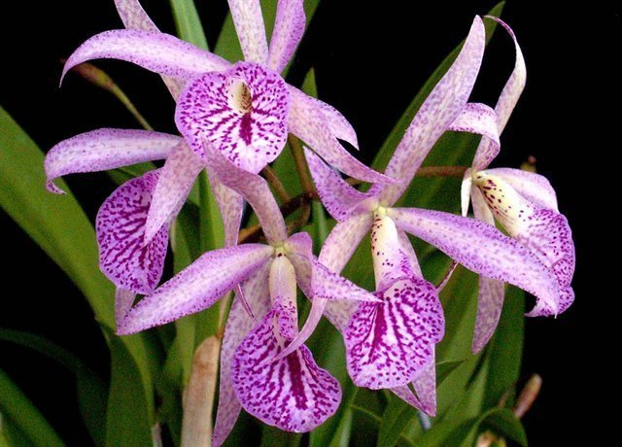
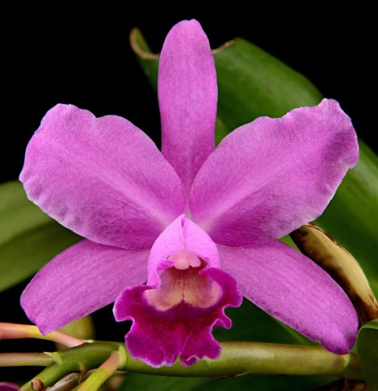
Guarianthe bowringiana Hybrids
Cattlianthe Portia ‘Westerbert’
Cattlianthe Little Suzie AM
Brassanthe Maikai ‘Louise’ AM
Cattlianthe Porcia ‘Canizaro’ FCC

Slide 15
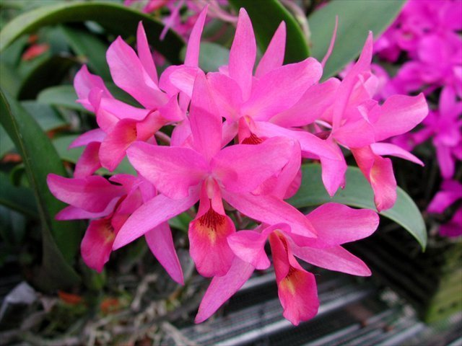
Guarianthe skinneri Hybrids
An easy, rewarding species
to grow
Not a great parent for
hybridizing
103 F-1
207 Progeny
Guarianthe Guatemalensis
Gur. skinneri x Gur. aurantiaca

Slide 16
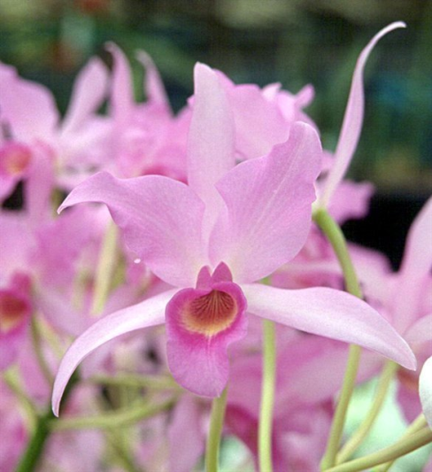
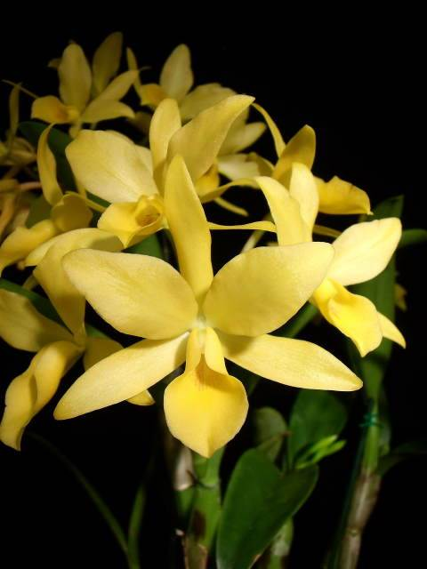
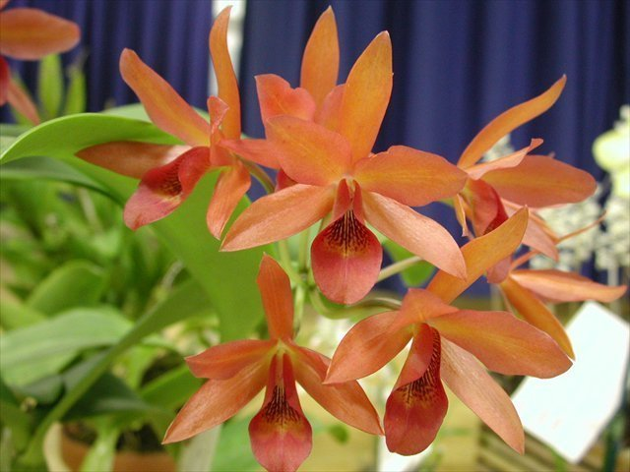
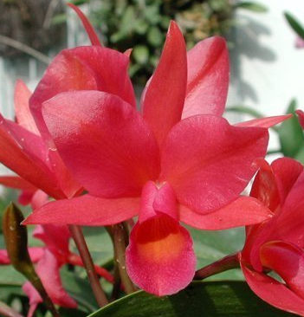
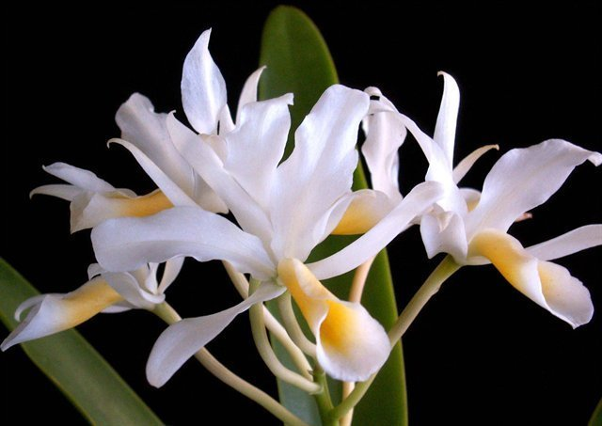
Guarianthe Guatemalensis Colors
‘D’Bush’
‘Sol de Borinquen’ AM
‘Elenor’s’
‘Tampixque’ AM
Albescens

Slide 17
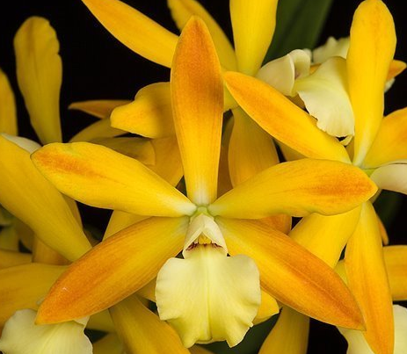
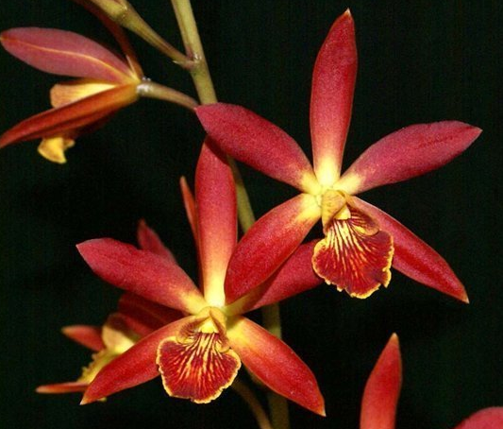
Guarianthe skinneri 3rd Gen. Hybrids
Enanthlea Banana Split
Enanthlea Pixie Charm
Cattlianthe Pixie x Encyclia cordigera
Cattlianthe Pixie x Encyclia alata

Slide 18
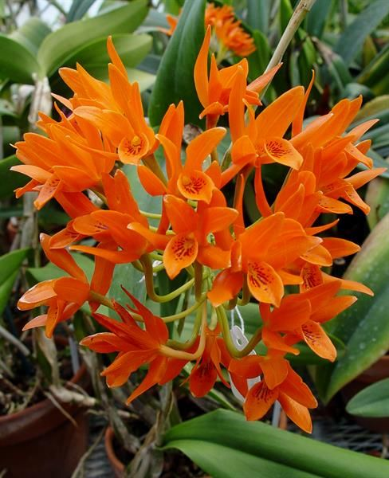
Guarianthe aurantiaca Hybrids
Great color, persists
for generations
Long lasting flowers
290 F-1
4,902 Progeny

Slide 19
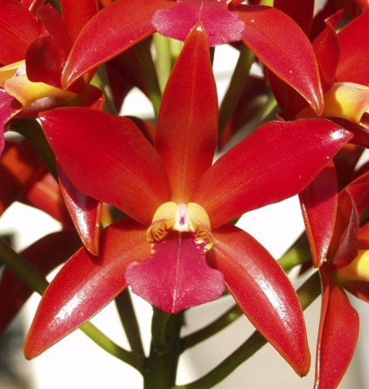
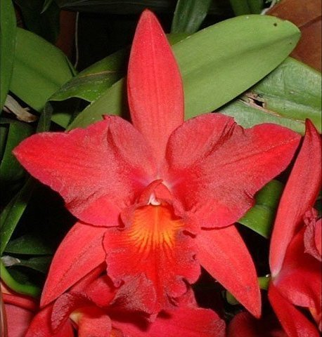
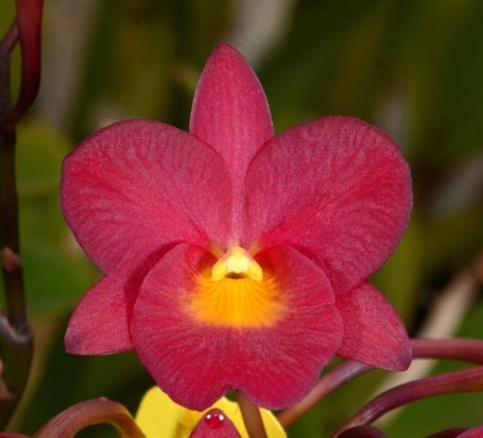
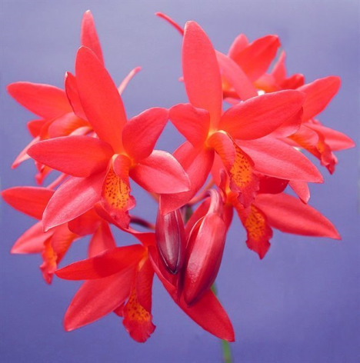
Guarianthe aurantiaca F-1 Hybrids
Ctt. Chocolate Drop
‘Sunset Valley Orchids’ AM
Ctt. Jewell Box
‘Scheherazade’ AM
Grt. Why Not
‘Red Gold’
Cattlianthe Rojo
‘Barbara’ HCC/AOS

Slide 20
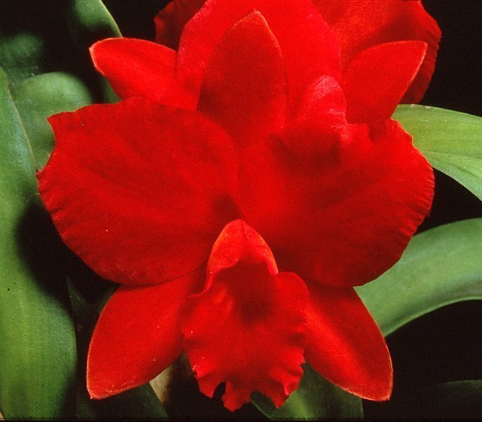
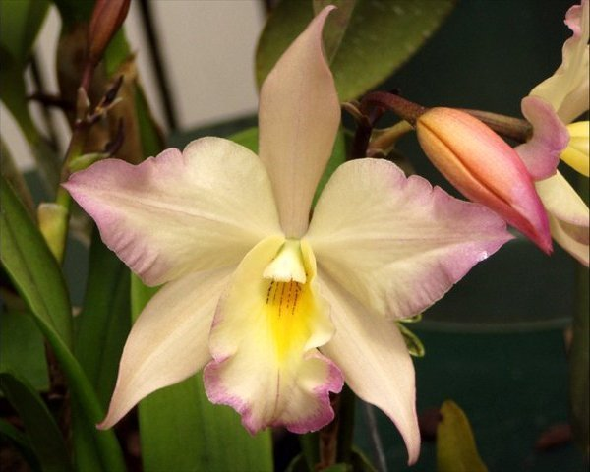
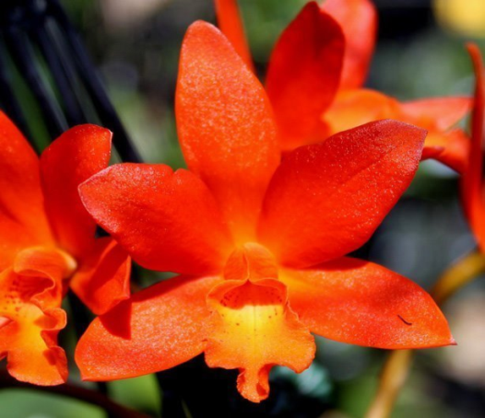
Other Guarianthe aurantiaca Hybrids
Cattlianthe Hazel Boyd
‘Cathy’ HCC/AOS 2nd Gen
Jackfowlieara Appleblossom
AM/AOS 3rd Gen
Cattlianthe Trick or Treat
AM/AOS 2nd Gen

Slide 21
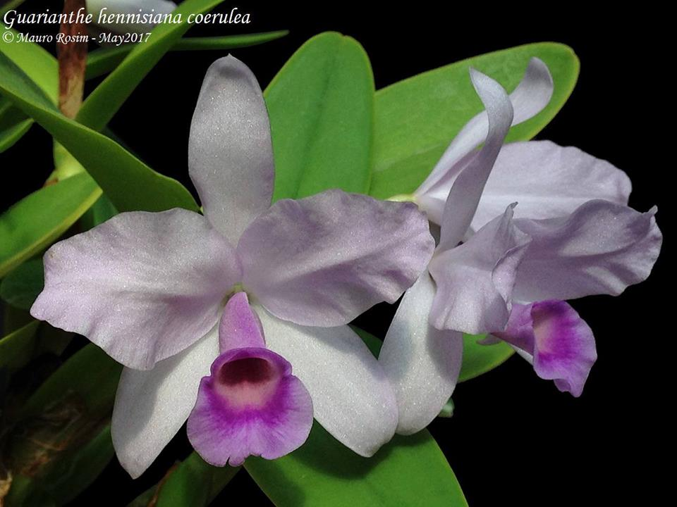
Guarianthe hennisiana Hybrids
Only 2 registered
Brassanthe Sophia
B. nodosa x Gur. hennisiana
Laelianthe Eugenia Locioni
Gur. patinii x L. anceps

Slide 22
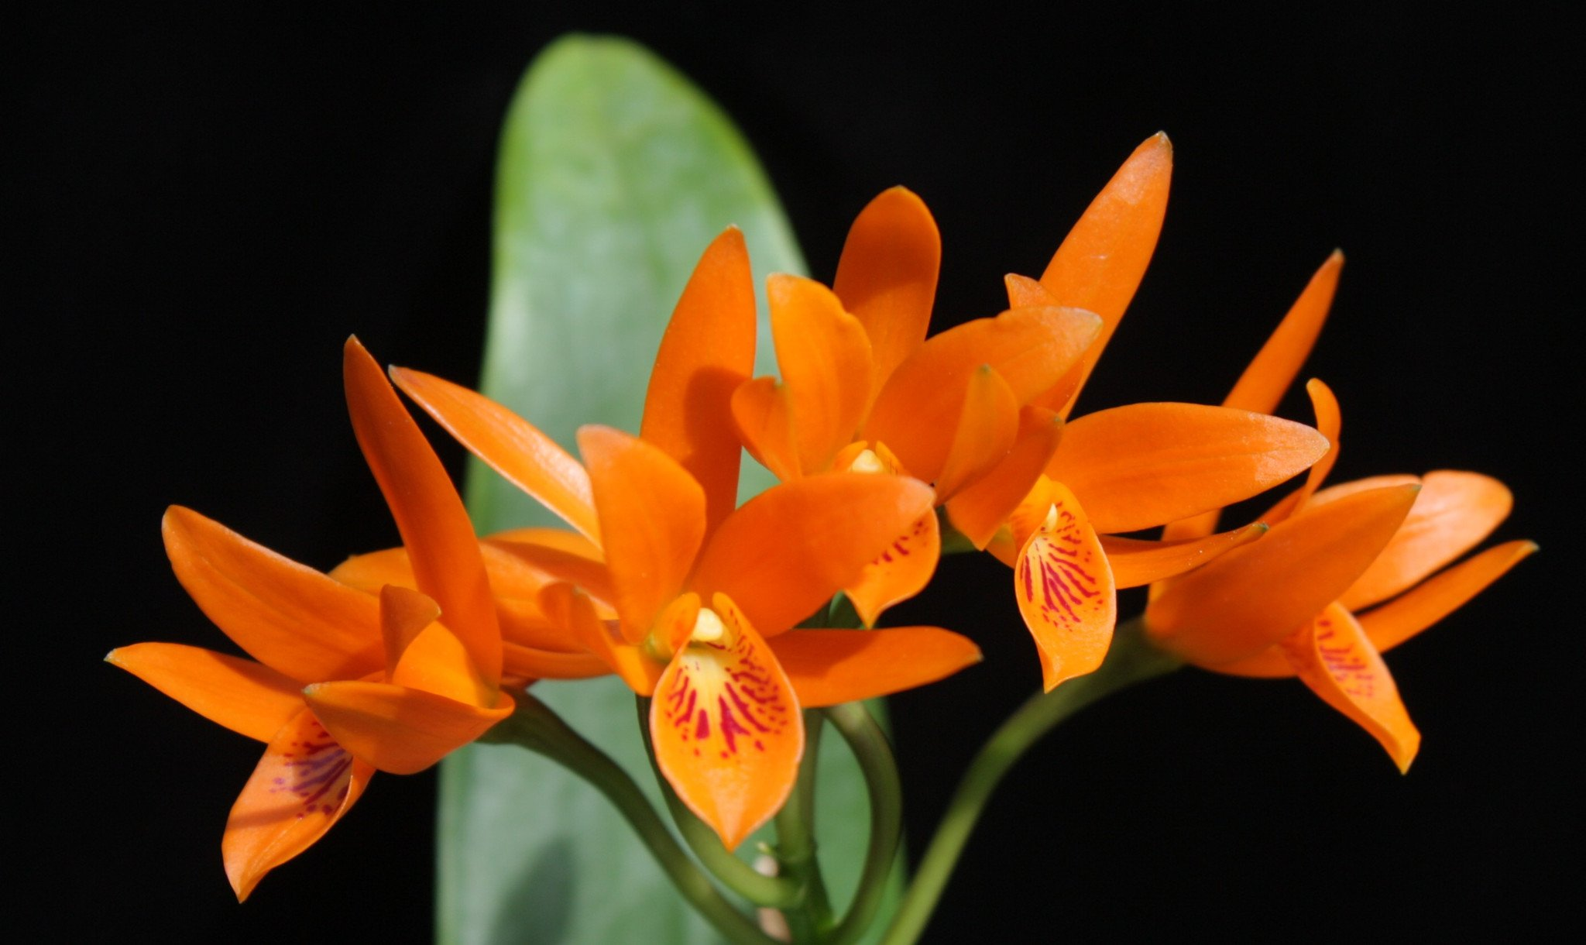
The End

Slide 23
Chase MW. 2006. Tribe Epidendreae. In: Pridgeon AM, Cribb PJ,
Chase MW, Rasmussen F, eds. Genera Orchidacearum, Vol. 4. Oxford: Oxford
University Press, 443-449.
Dusidieker, MD, Nile. “The Genus Guarianthe”, Orchids, American Orchid
Society, March 2015: 164 -176
OrchidWiz.Database X4.3
Withner, C.L. 1999. Cattleya x guatemalensis. Its history, close relatives, and
problems relating to its identity. Orch. Dig. 63: 53-61.
Withner, Carl L., The Cattleyas and Their Relatives, Volume 1, The Cattleyas,
Timber Press, 1988
van den Berg, C., W.E. Higgins, R. L. Dressler, W.M. Whitten, M.A. Soto Arenas,
A. Culham, & M.W. Chase. 2000. A phylogenetic analysis of Laeliinae
(Orchidaceae) based on sequence data from internal transcribed spacers (ITS)
of nuclear ribosomal DNA. Lindleyana 15: 96-114.

