Slide 1
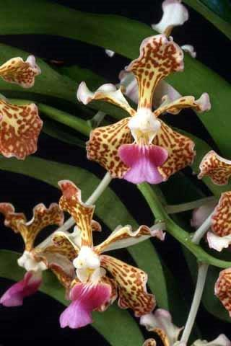
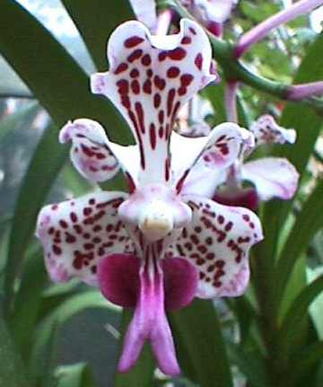
Vanda tricolor
Jim Diffily
Dallas Judging Center
July 2020

Slide 2
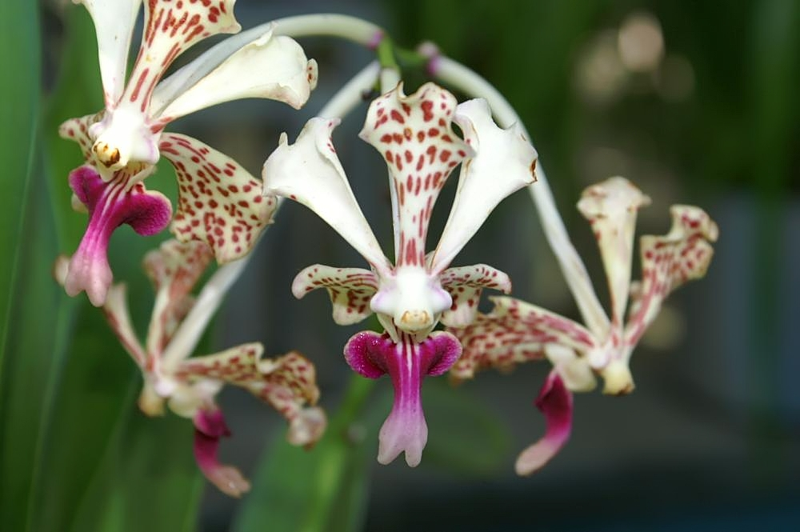
Vanda tricolor was described by Lindley in 1847. Two years later he described
another species from Java called Vanda suavis
In 1864, Reichenbach settled V. suavis as a variety of V. tricolor. In 2000, Salguero
and Pupulin elevated variety suavis to a subspecies.
1

Slide 3
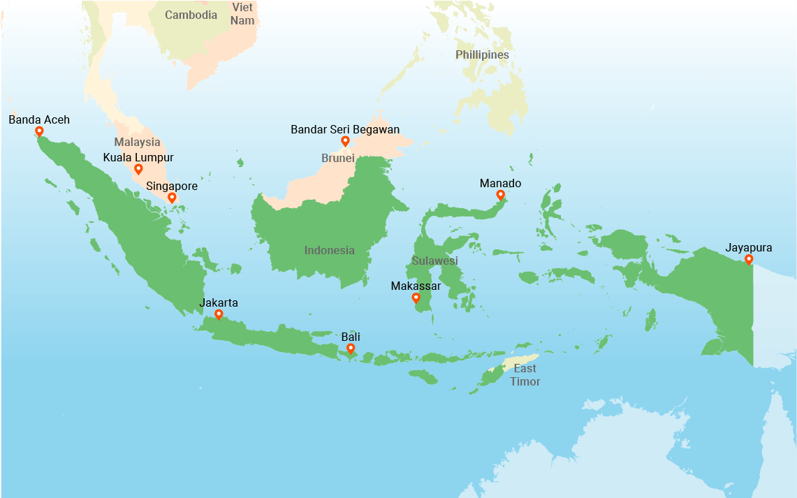
Range
The typical form is found in western Java.
The suavis form is found in central to eastern Java and Bali.
The two forms of Vanda tricolor occupy different
geographical ranges and different ecological niches.
2

Slide 4
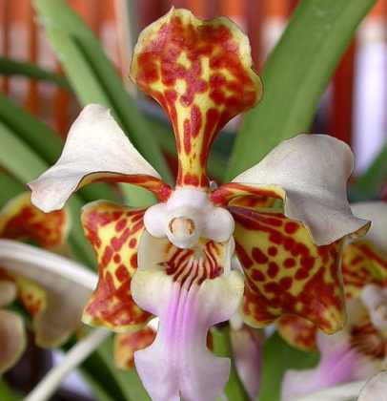
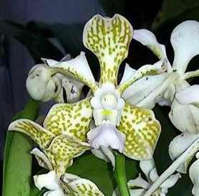
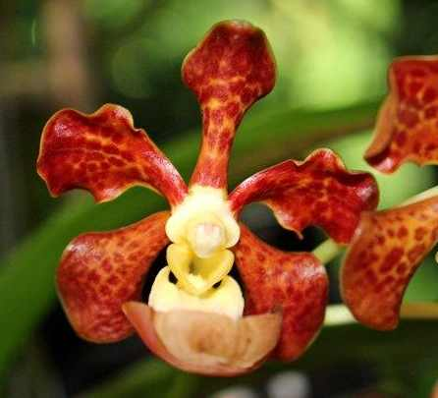
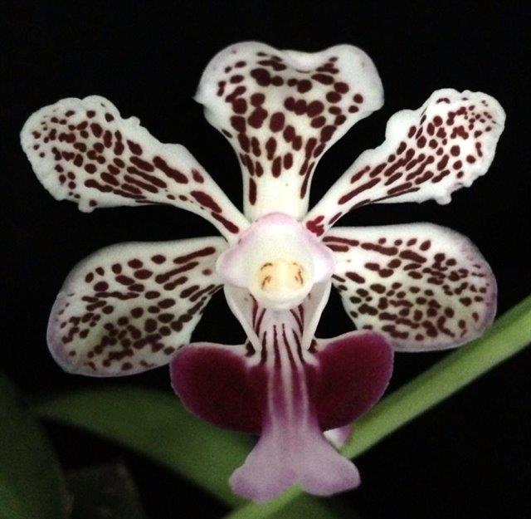
A Variable Species
Breeding efforts have improved the form
Awards
25 AOS Awards
1 FCC
10 AM
7 CCM
3 HCC
3 JC
Superficially, Vanda tricolor does not seem very significant
3

Slide 5
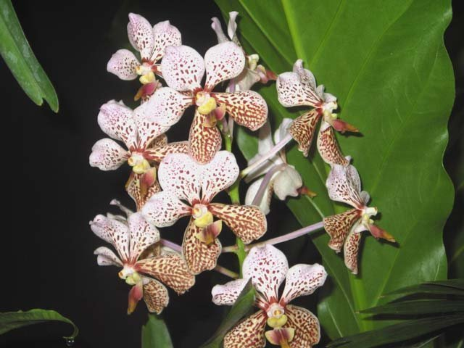
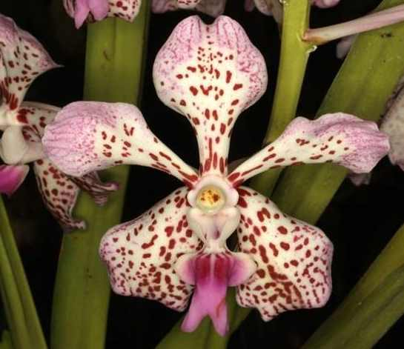
EarlyF-1 Hybrids
Vanda Tatzeri 1919
V sanderiana x V tricolor
Vanda Burgeffii 1928
V sanderiana x V suavis (tricolor)
AOS Awards – 0
F-1 – 49
Progeny – 3,321
AOS Awards – 1
F-1 – 26
Progeny – 94
4

Slide 6
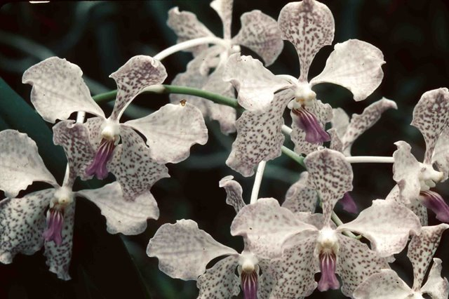
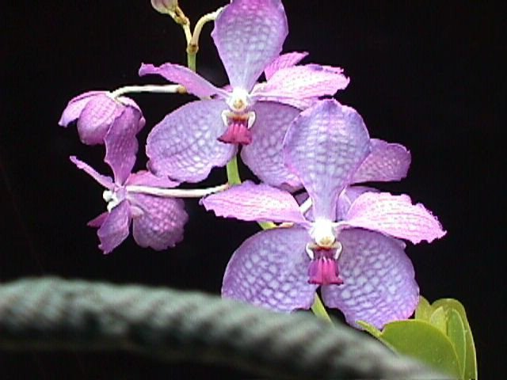
F-1 Hybrids
Vanda Gilbert Triboulet 1919
V coerulea x V tricolor
Vanda Herziana 1921
V coerulea x V suavis (tricolor)
AOS Awards – 1
F-1 – 27
Progeny – 1,711
AOS Awards – 2
F-1 – 25
Progeny – 53
5

Slide 7
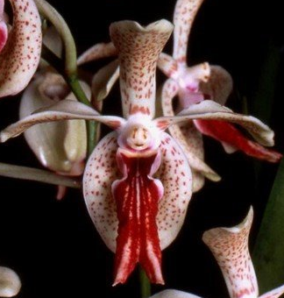
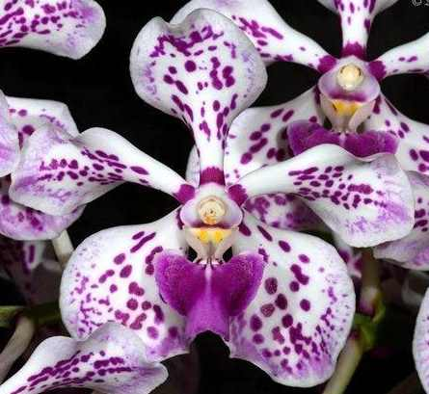
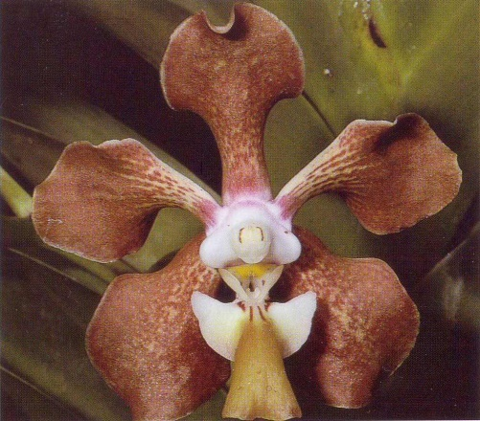
Notable F-1 Hybrids
Vanda Boschii 1928
V luzonica x V tricolor
Vanda Paki 1944
V cristata x V tricolor
AOS Awards – 4
F-1 – 16
Progeny – 1,014
AOS Awards – 9
F-1 – 17
Progeny – 51
Vanda Memoria T Iwasaki 1934
V dearei x V tricolor
AOS Awards – 1
F-1 – 20
Progeny – 2,342
6

Slide 8
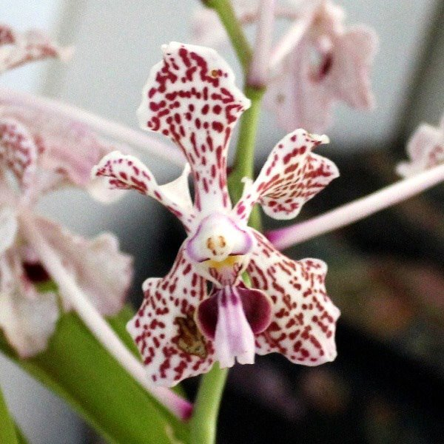
Relatively Poor Form
Low Number of Awards – 25
BUT
F-1 Offspring – 137
Progeny – 5,287
(cf. V. sanderiana - 6,831
V. coerulea – 6,171)
There must be something to account for the numbers
7

Slide 9
The genus Vanda has been a challenge for hybridizers from the beginning
The majority of species lack good color
They generally have poor shape and arrangement and small flowers
Good form was achieved with Vanda sanderiana - Vanda coerulea crosses
Range of colors and quality of color was still illusive
Until Vanda tricolor was added to the mix…
8

Slide 10
“Vanda tricolor genes generate interactions with color
controlling genes of other species to produce flowers
with suffused, saturated and sparkling red and pink
pigmentation as well as striking speckling” Grove 1995
“By adding Vanda tricolor genes, the range of Vanda
flower colors from pink through purple and their
patterns were greatly broadened and clarity
of color was improved.” Grove 1995
9

Slide 11
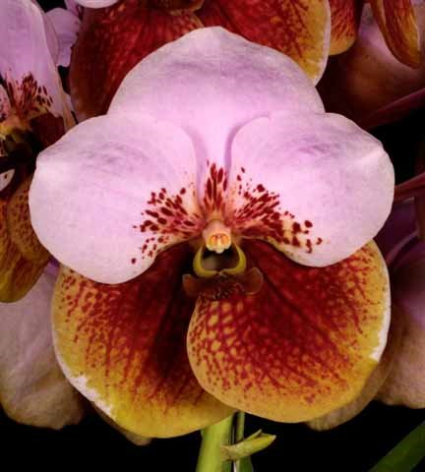
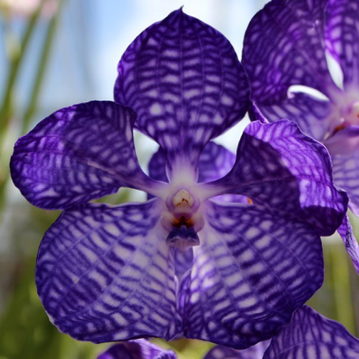
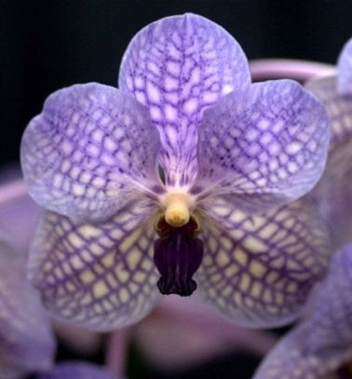
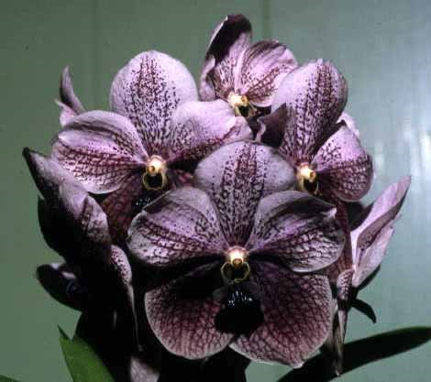
Color Enhancement plus Spots
+
=
Vanda sanderiana
Vanda coerulea
Vanda Rothschildiana
+
=
Vanda Judy Miyamoto
10

Slide 12
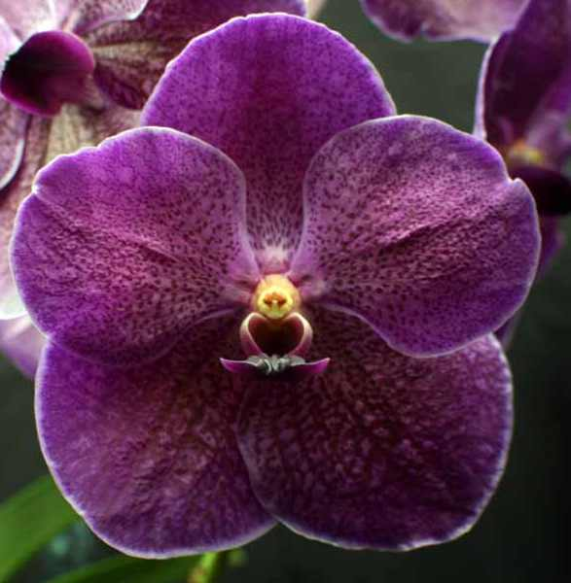
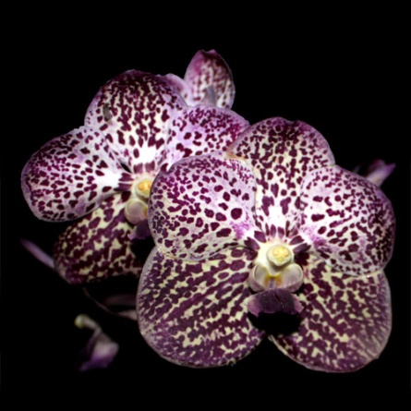
Inheritable Traits
Long lasting influence – Gene influence lasts through
multiple generations
“The color of these flowers shows their V. tricolor
genetics in the characteristic white border” Motes 1997
V. Kasem’s Delight
Patterning…”is patterned exactly as in its
six-generation-removed progenitor” Motes 2001
V. Gordon Dillon ‘Lea’
11

Slide 13
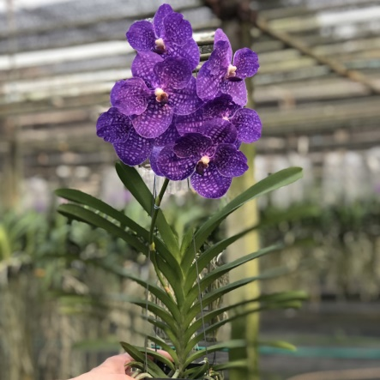
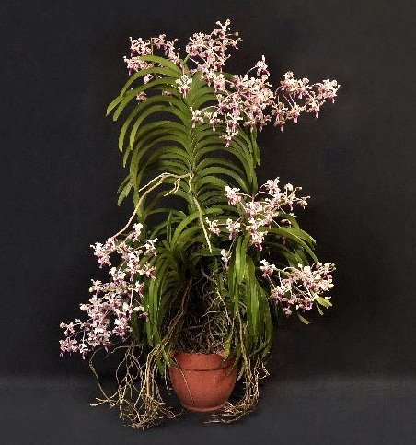
Inheritable Traits
Precociousness – Hybrids bloom more quickly
and on smaller plants
Vanda Somsri
Vigorousness – Hybrids produce longer stems with
more leaf axils for more inflorescences.
Vanda tricolor
12

Slide 14
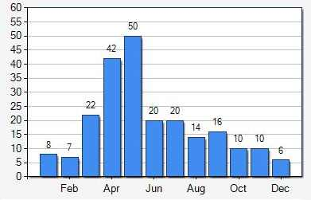
Inheritable Traits
Free flowering – Especially when crossed with fall
flowering species
Cold Tolerance
V. tricolor
Firm Substance
Fragrance
13

Slide 15
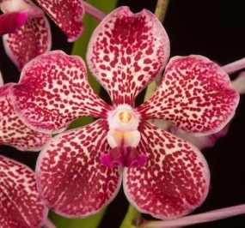
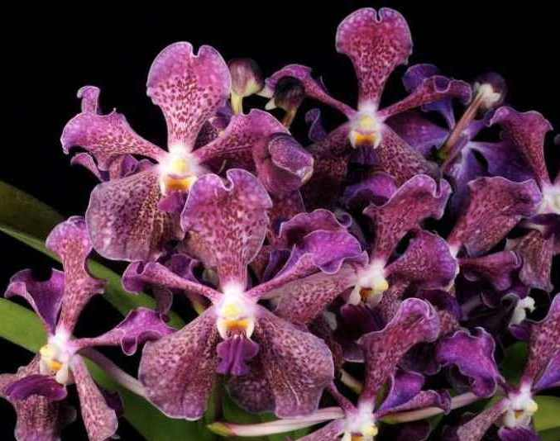
Recent Hybrids
18 F-1 offspring and 1,039 progeny registered since 2010
Vanda Sweet Spot
V. Fuchs Fuchsia x V. tricolor
HCC/AOS 76 Pts 2013
Vanda Santa Barbara Fizz
V. suavis x V. Tokyo Blue
AM/AOS 82 Pts 2017
14

Slide 16
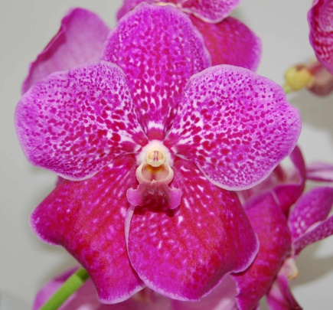
Recent Hybrids
18 F-1 offspring and 1,039 progeny registered since 2010
Vanda Sweet Spot
V. Fuchs Fuchsia x V. tricolor
HCC/AOS 76 Pts 2013
Vanda Santa Barbara Fizz
V. suavis x V. Tokyo Blue
AM/AOS 82 Pts 2017
Judging
V. Fuchs Fuchsia
14

Slide 17
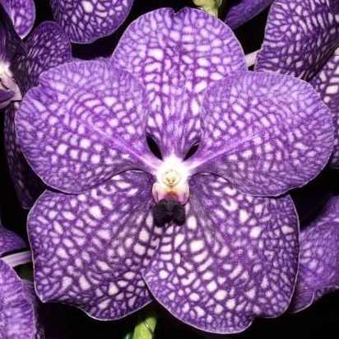
Recent Hybrids
18 F-1 offspring and 1,039 progeny registered since 2010
Vanda Sweet Spot
V. Fuchs Fuchsia x V. tricolor
HCC/AOS 76 Pts 2013
Vanda Santa Barbara Fizz
V. suavis x V. Tokyo Blue
AM/AOS 82 Pts 2017
Judging
V. Fuchs Fuchsia
V. Tokyo Blue
14

Slide 18
Recent Hybrids
18 F-1 offspring and 1,039 progeny registered since 2010
Vanda Sweet Spot
V. Fuchs Fuchsia x V. tricolor
HCC/AOS 76 Pts 2013
Vanda Santa Barbara Fizz
V. suavis x V. Tokyo Blue
AM/AOS 82 Pts 2017
Judging
Form – take into account open form, twisting and undulations
Expect good symmetry
Color – Expect suffused, saturated color and exceptional patterning
Other – Size, cut some slack; Substance & Texture, high expectations;
Habit & Floriferousness, high expectations
14

Slide 19
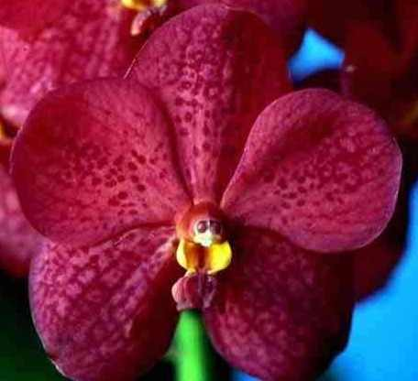
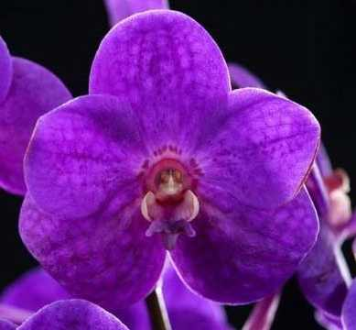
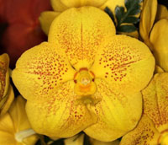
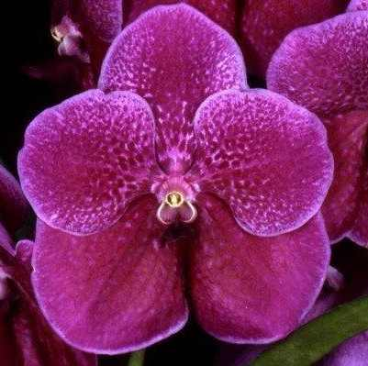
Notable Progeny
Vanda Yip Sum Wah
Vanda John De Biase
Vanda Robert’s Delight
Vanda Kultana Gold
15

Slide 20
Selected References
Grove, David L., 1995; Vandas and Ascocendas and Their Combinations with Other Genera. Timber Press
Motes, Martin R., 1997; Vandas Their Botany, History and Culture. Timber Press
Motes, Martin R., 2001, Hybridizing with Lesser-known Vandas, Orchids. 70; 934-943
Pridgeon, A. M.; Cribb, P. J.; Chase, M. W.; Rasmussen, F. N.; Genera Orchidacearum, Volume 6, 2014. Oxford University Press
Jay Pfahl's IOSPE at www.orchidspecies.com
OrchidPro X1.0, American Orchid Society
OrchidWiz.Database X6.3
http://apps.kew.org/wcsp/qsearch.do

