Slide 1
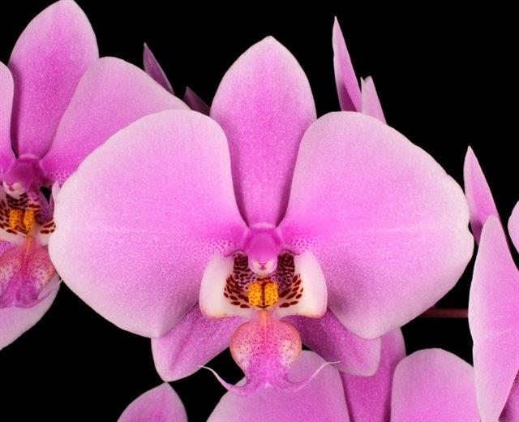
Pink Phalaenopsis
Jim Diffily
Dallas Judging Center
July 2021

Slide 2
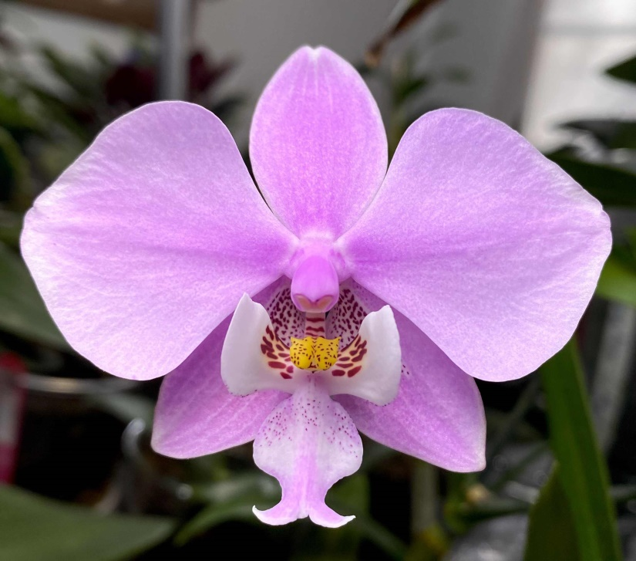
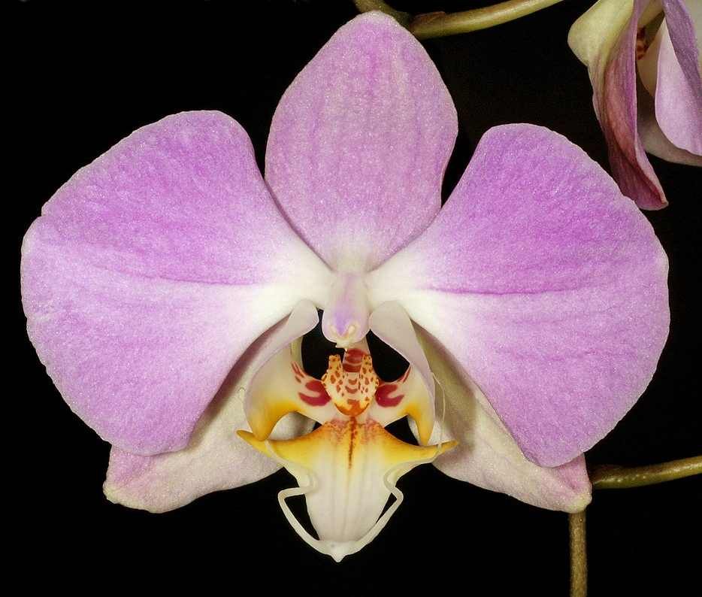
Pink Phalaenopsis Starting Point
Phalaenopsis schilleriana Rchb. 1860
Philippines – Southern Mindanao
Phalaenopsis sanderiana Rchb. 1882
Philippines - Luzon
1

Slide 3
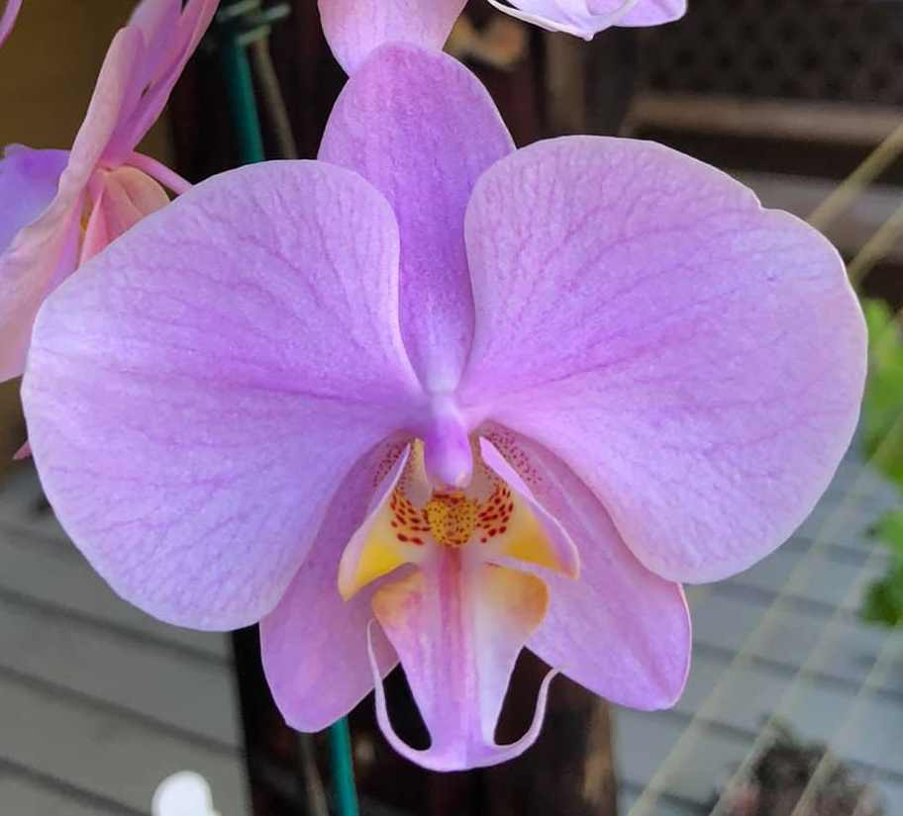
Good Start but….
Light substance
Open Form
Short Life
Size
Breeding for improved pinks started in earnest
in the late 1920’s by Vacherot-Lacoufle
An additional 15 pinks were registered
P. Reve Rose 1932
P. Marmouset 1943
Phalaenopsis Grand Conde 1929
P. schilleriana x P. sanderiana
2

Slide 4
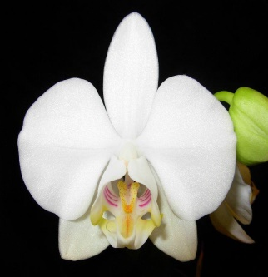
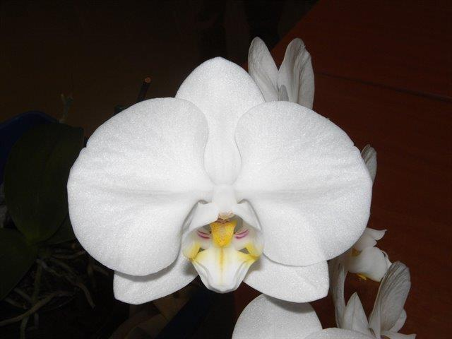
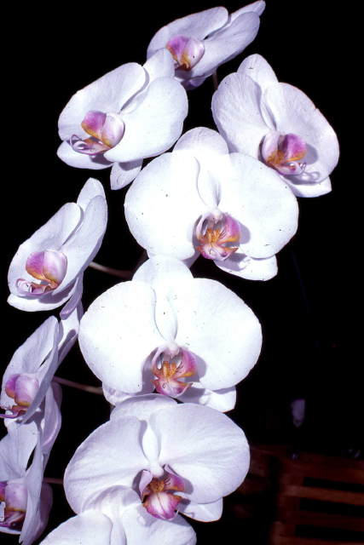
Bring in the Big Whites
P. amabilis
P. aphrodite
P. Alger 1930
P. aphrodite x P. sanderiana
Larger Flowers
Rounder Flowers
Better Presentation
Substance ?
Flower Life?
P. Reve Rose 1932
P. Alger x P. schilleriana
P. Versalles 1929
P. amabilis x P. sanderiana
3

Slide 5
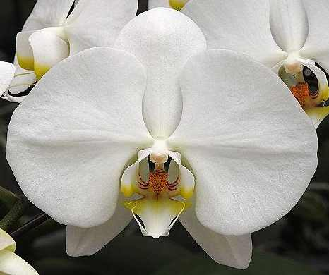
Along Came Doris
Phalaenopsis Doris
Duke Farms 1940
P. Elizabethae x P. Katherine Siegwart
AOS Awards – 29
F-1 – 262
Progeny – 32,093
P. amabilis
P. Elizabethae
P. rimestadiana
P. amabilis
P. Katherine Siegwart
P. aphrodite
P. Gilles Gratiot
P. rimestadiana
4

Slide 6
Along Came Doris
Phalaenopsis Doris
Duke Farms 1940
P. Elizabethae x P. Katherine Siegwart
AOS Awards – 29
F-1 – 262
Progeny – 32,093
37% P. rimestadiana - a tetraploid
form of P. amabilis
P. amabilis
P. Elizabethae
P. rimestadiana
P. amabilis
P. Katherine Siegwart
P. aphrodite
P. Gilles Gratiot
P. rimestadiana
4

Slide 7
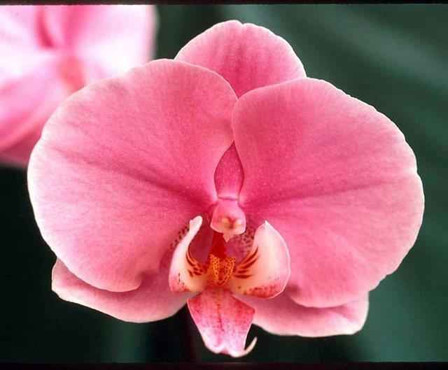
Phalaenopsis Doris ‘Shapely’
P. Doris is 87% P. amabilis.
P. amabilis typically has a pink
blush on the reverse.
Intensive line breeding to enhance
the pink pigmentation has produced
Pink flowered plants.
5

Slide 8
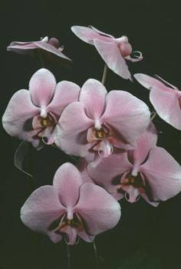
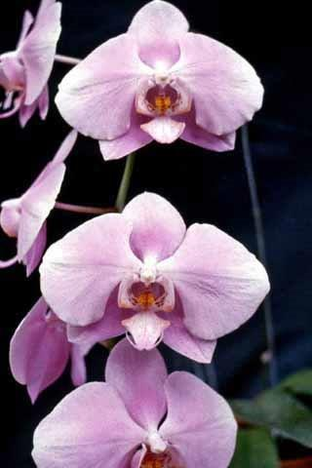
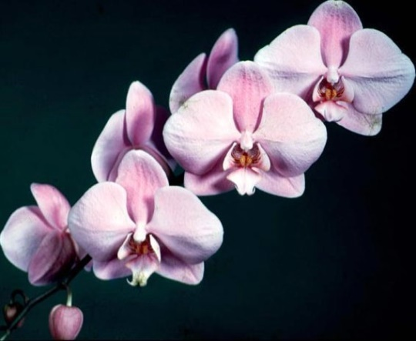
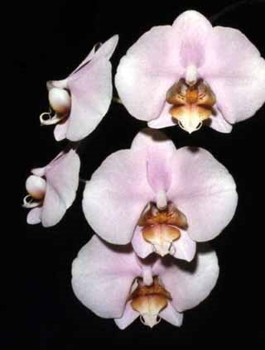
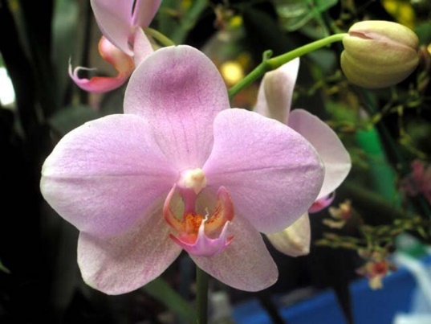
1950’s and 1960’s – Decades of Refinement
Breeders worked on Form, Size and Color
P. Ann Lovelace 1962
P. Best Girl 1961
P. Sunrise 1956
Mrs. L. McCoy
AOS Awards – 2
F-1 – 21
Progeny – 9,219
P. Pink Vision 1959
P. Jackie 1962
6

Slide 9
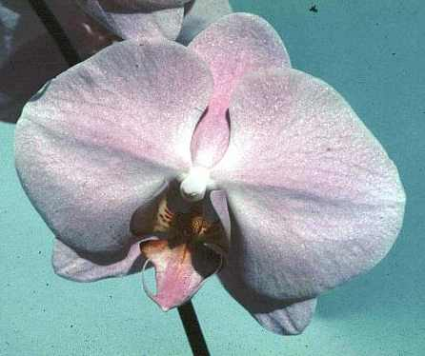
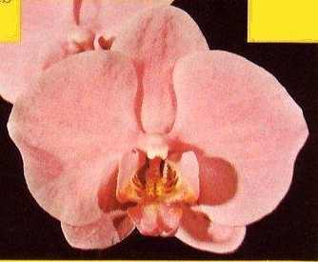
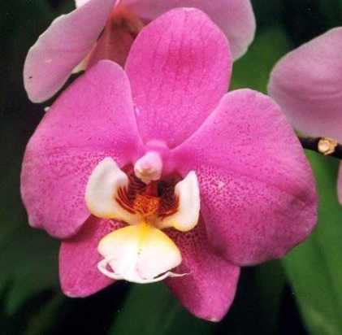
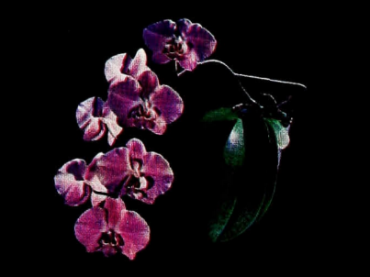
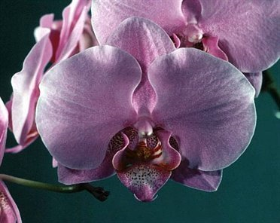
1950’s and 1960’s – Decades of Refinement
Breeders worked on Form, Size and Color
Phalaenopsis Zeda
San Songer x Doris
Large Size
Good Form
Uniform Pigmentation
P. Zada 1958
Roy Fields
AOS Awards – 7
F-1 – 206
Progeny – 16,352
F-1’s
7
Lipperrose
Barbara Beard
Flor de Mato

Slide 10
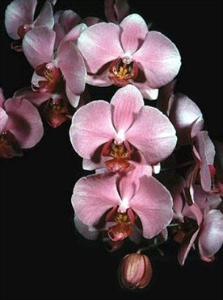
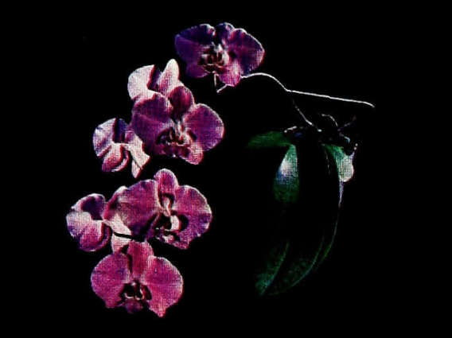
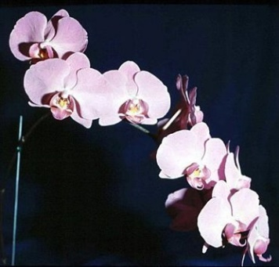
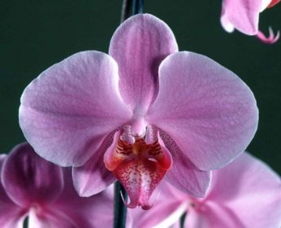
1950’s and 1960’s – Decades of Refinement
Breeders worked on Form, Size and Color
Charles Beard 1966
P. Ann Marie Beard
AOS Awards – 2
F-1 – 53
Progeny – 4,118
Selected F-1’s
P. Barbara Beard
Virginia x Zada
AOS Awards – 2
F-1 – 48
Progeny – 9,547
P. Malibu Dignitary
Raycraft x Ann Marie Beard
P. Patti Logan
8

Slide 11
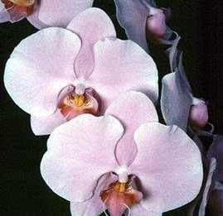
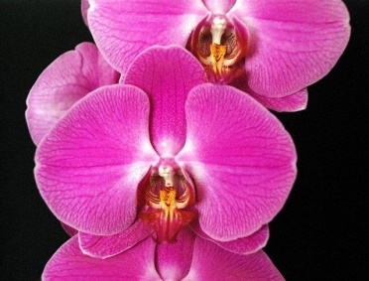
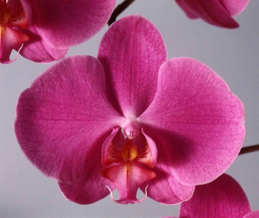
1950’s and 1960’s – Decades of Refinement
Phalaenopsis Lipperose Breeding – The German Pinks
P. Lipperose
Fritz Hark 1968
AOS Awards – 0
F-1 – 141
Progeny – 10,260
Warms up lavender tones
Intensifies color
Produces smooth, velvety texture
Hark had an extensive program of
line breeding siblings and back crosses
Ruby Wells x Zada
Lippezauber x Lippstadt = Abendrott x Lippstadt = Lippegruss
P. Lippstadt
53 F-1, 6,817 Progeny
P. Abendrott
229 F-1, 4,504 Progeny
P. Lippegruss
60 F-1, 908 Progeny
9

Slide 12
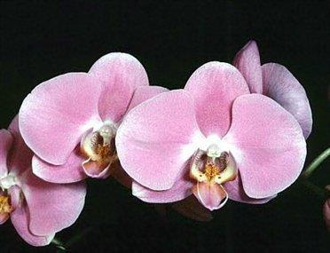
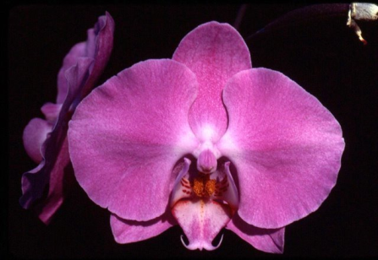
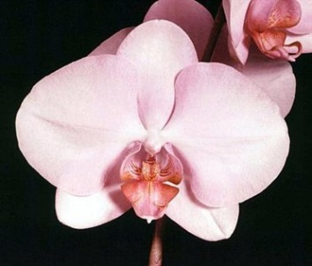
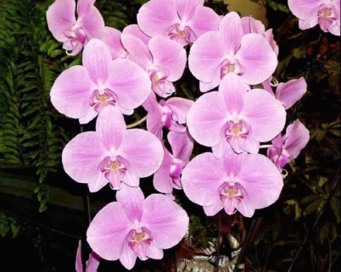
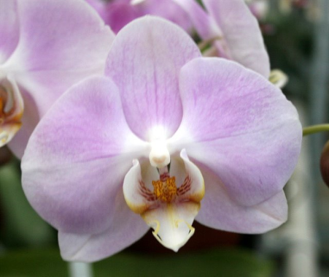
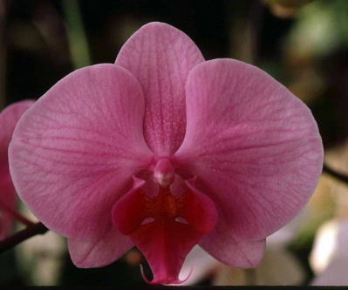
Phalaenopsis Lipperose F-1 Generation
P. Zauberrose 1972
(x Lippezauber)
146 F-1, 3,388 Progeny
P. Rose Heart 1978
(x Dear Heart)
60 F-1, 611 Progeny
P. Spring Silk 1972
(x Quiescence)
79 F-1, 405 Progeny
P. Margit Moses 1982
(x Magdalene Acker)
41 F-1, 57 Progeny
P. Morgenrot 1974
(x Lippstadt)
24 F-1, 2,818 Progeny
P. Comanche Rose 1983
(x Terry-Beth Ballard)
6 F-1, 610 Progeny
10

Slide 13
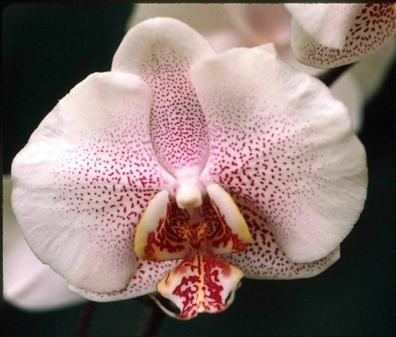
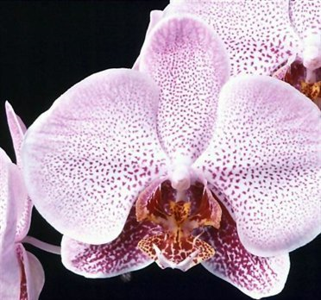
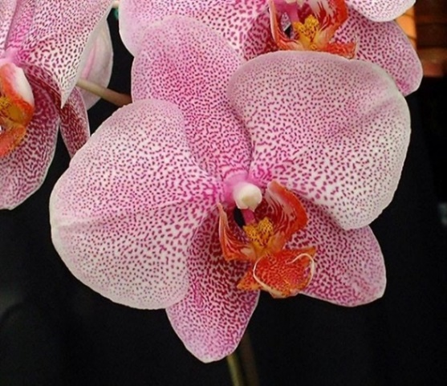
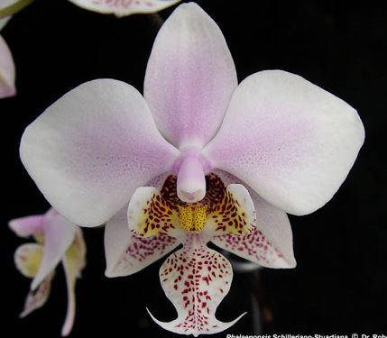
Pinks with Patterns – French Spots
P. Melinda Nan 1979
Shaffer’s
30 F-1, 368 Progeny
P. Coquinette 1983
M. Lecoufle
40 F-1, 1,214 Progeny
Introduce P. stuartiana by way of Wiganiae
P. schilleriana x P. stuartiana
P. Carmela’s Spots 1989
Carmela Orchids
73 F-1, 1,300 Progeny
11

Slide 14
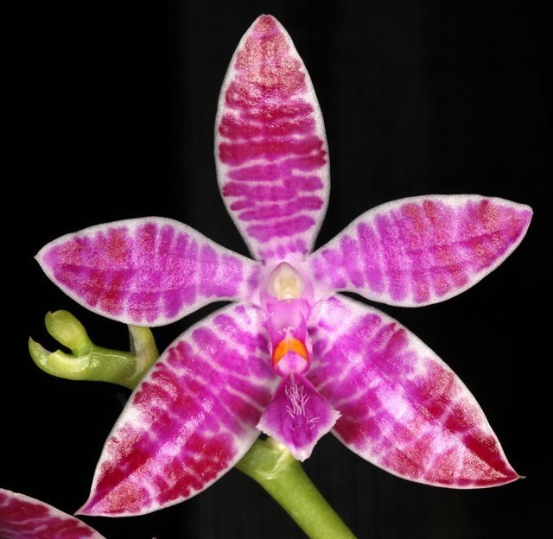
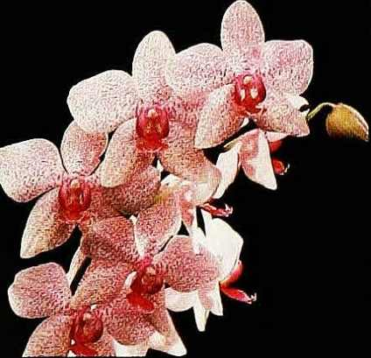
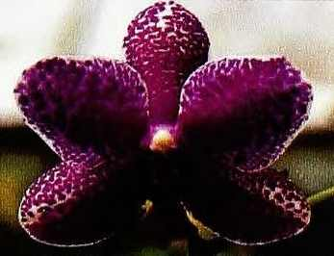
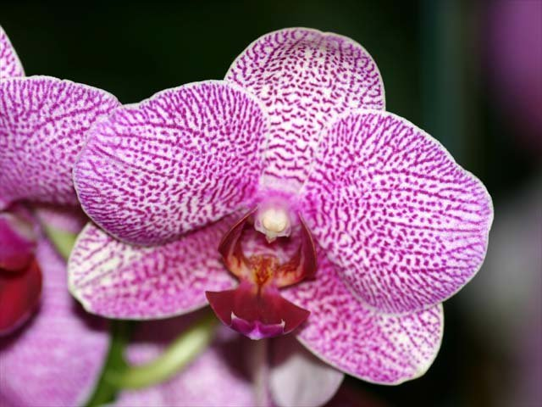
Pinks with Patterns – Spots from P. lueddemanniana
P. Texas Star 1958
P. Evening Star x
P. lueddemanniana
P. Paifang’s Queen 1977
P. Mount Kaala x
P. lueddemanniana ‘Woodlawn’
Hybrids derived from Paifang’s Queen
are often boldly and darkly spotted.
13
P. Ever-Spring Spot 1990

Slide 15
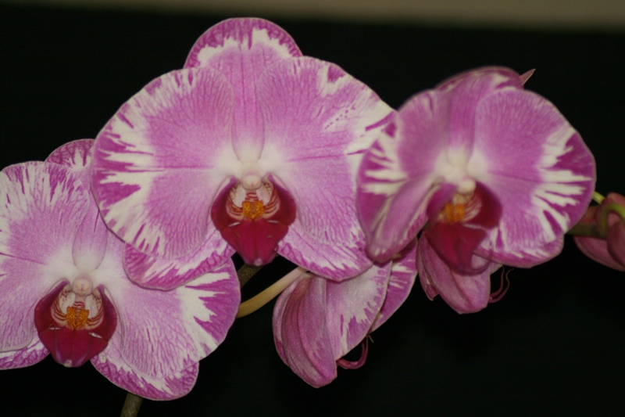
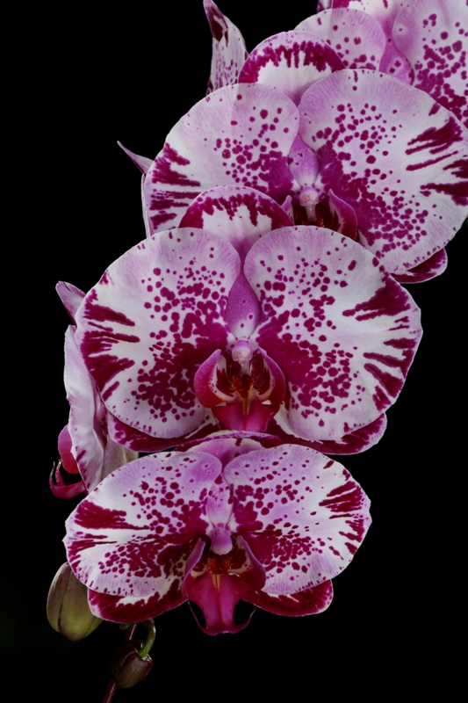
Pinks with patterns – Harlequin Spots and Feathering
P. Ever Spring Prince ‘Wilda Faulk’ 1997
P. Younghome New York ‘KA01801’ 1997
14

Slide 16
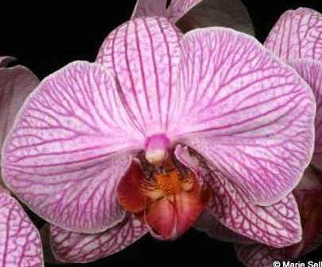
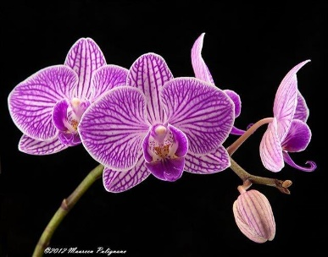
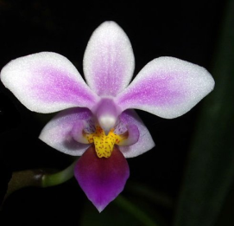
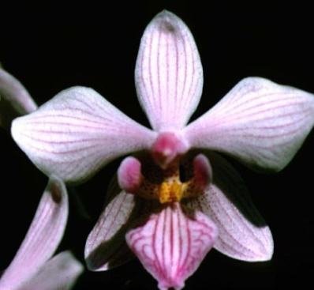
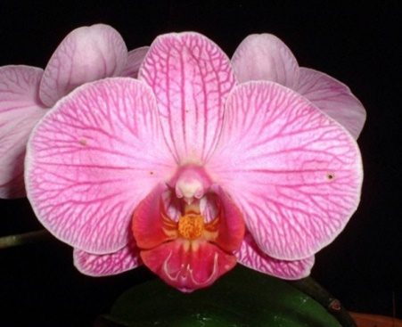
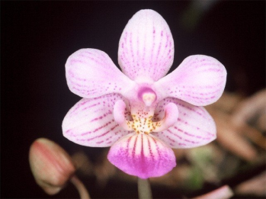
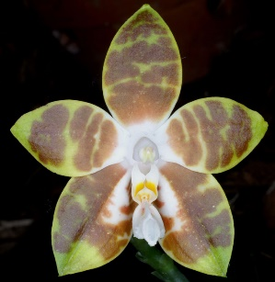
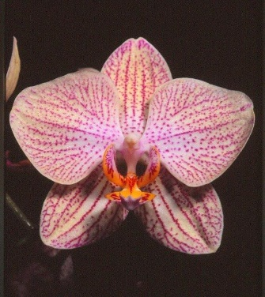
Pinks with Patterns - Stripes
P. equestris
P. Chih Shang’s Stripes 1989
Little Gem Stripes 1997
P. lindenii
P. Baguio 1966
P. Pink Zebra 1974
P. venosa
15
Bonnie Vasquez 1985

Slide 17
Pink over Yellow - Layering
P. Painted Desert 1966
P. Cinnamon Candy 1973
P. Flight of Birds 1988
P. Jackie 1962
16

Slide 18
Other Pink Breeding – Small Multiflorals
P. Carmela’s Pixie 1990
JC/AOS 1998
P. Rainbow Chip1985
CCM/AOS 2016
P. Silbergrube 1989
AM/AOS 2019
P. Be Glad1978
AM/AOS 1999
P. Fangmei Sweet 2009
AM/AOS 2021
17

Slide 19
Other Pink Breeding – Novelties
P. Smiley Bluebird 2019
HCC/AOS 2019
P. Florida Rainbow2019
AM/AOS 2021
P. Penang Belle 2012
AM/AOS 2019
P. Samera 2003
AM/AOS 2018
P. Pylo’s Sweet Purple 2012
18

Slide 20
Recent Award Trends
Many Pink Novelties
Quite a few Pink Harlequins
A few Patterned Pinks
A few Unusual Pink Hybrids
Very few Standard Pinks
19

Slide 21
Selected References
Christenson, Eric A. 2001; Phalaenopsis A Monograph, Timber Press
Davis, Diane and Finkelstein, Phyllis; Phalaenopsis Lipperose and Its Influence
On Modern Pink Hybridizing. AOS Bulletin, Vol 59, No 4, April 1990
Freed, Hugo, Novas of the Phalaenopsis World – 1; AOS Bulletin, Vol 53, No 9, September 1984
Freed, Hugo, Novas of the Phalaenopsis World – 3; AOS Bulletin, Vol 53, No 11, November 1984
Frowine, Steven A. 2008; Moth Orchids, The Complete Guide to Phalaenopsis, Timber Press
Moses, John R.; Phalaenopsis – The Search for Pink; AOS Bulletin, Vol 49, No 4, April 1980
Takasaki, Sheldon; Recent Phalaenopsis Breeding on the Hawaiian Islands, AOS Bulletin, 58: 8-15
OrchidPro X1.0, American Orchid Society
OrchidWiz.Database X7.1

