Slide 1
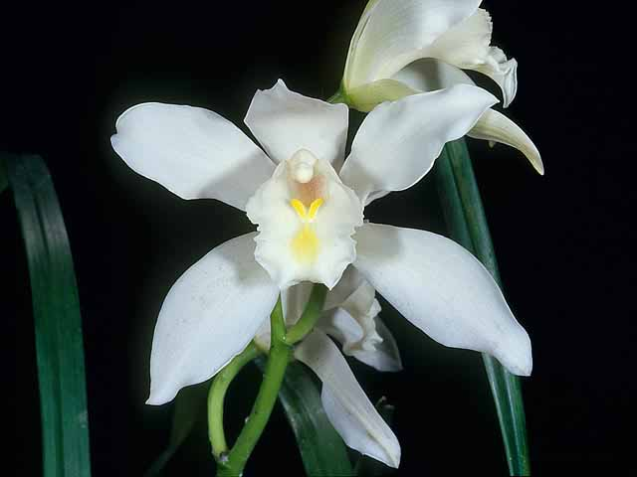
Cymbidium eburneum “The Ivory-Colored Cymbidium”
Cymbidium eburneum ‘Monica’ AM/AOS, 81 points, 2005
Exhibitor John Dunkelberger, Photography by Armon Latour
Dallas Judging Center
Student Assignment June 2023
Tim Brown

Slide 2
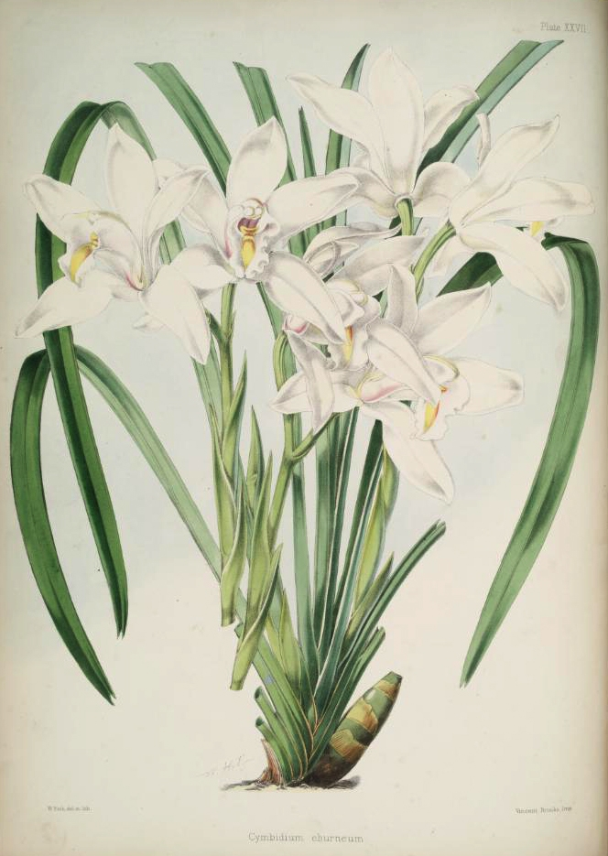
Cymbidium eburneum found in Select Orchidaceous Plants,
Illustrator Walter Hood Finch
Cymbidium eburneum was first described by John Lindley (1847) in the Botanical Register. 33: t. 67. Type reported ‘East Indies’
From specimen cultivated by Loddiges nursery -
(The Loddiges family managed one of the most
notable of the 18th and 19th century exotic plant nurseries.)
Sir Joseph Paxton (1849) described Cymbidium eburneum in Botanical Magazine. 145 – 146. Type: India, Khasia Hills

Slide 3
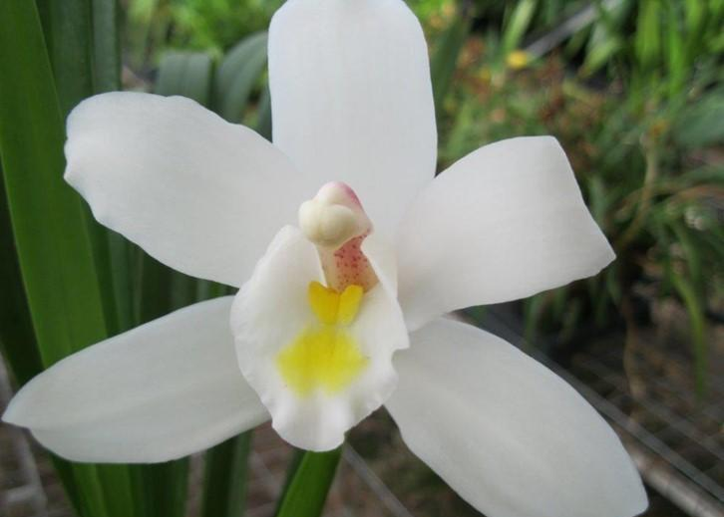
Cymbidium eburneum, photography by Andy Easton
William Griffith (1851) described C. syringodorum in Notulae Ad Plantas Asiaticas. 3: 338. Type: Northern India, Khasia Hills
Referred to as the Lilac-scented Cymbidium
Provided precise locality – Khasia Hills in Assam
John Lindley (1858) reduced the Cymbidium syringodorum to synonymy with Cymbidium eburneum
George King and Robert Pantling (1898) collected Cymbidium eburneum from Darjeeling and Sikkim - India
Phillip Du Puy and David Cribb (1988) placed in section Eburnea

Slide 4
Distribution of Cymbidium eburneum
Natural Habitat of Cymbidium eburneum
Native to northern India (Sikkim, Assam, Khasian Hills), Nepal, norther Myanmar, Vietnam and China (southwest Yunnan, Guanxi, Hainan)

Slide 5
Cymbidium eburneum in situ, photography by Jungle Man
C. eburneum habitat: on trees in warm, damp forest, and on rocks in shaded ravines

Slide 6
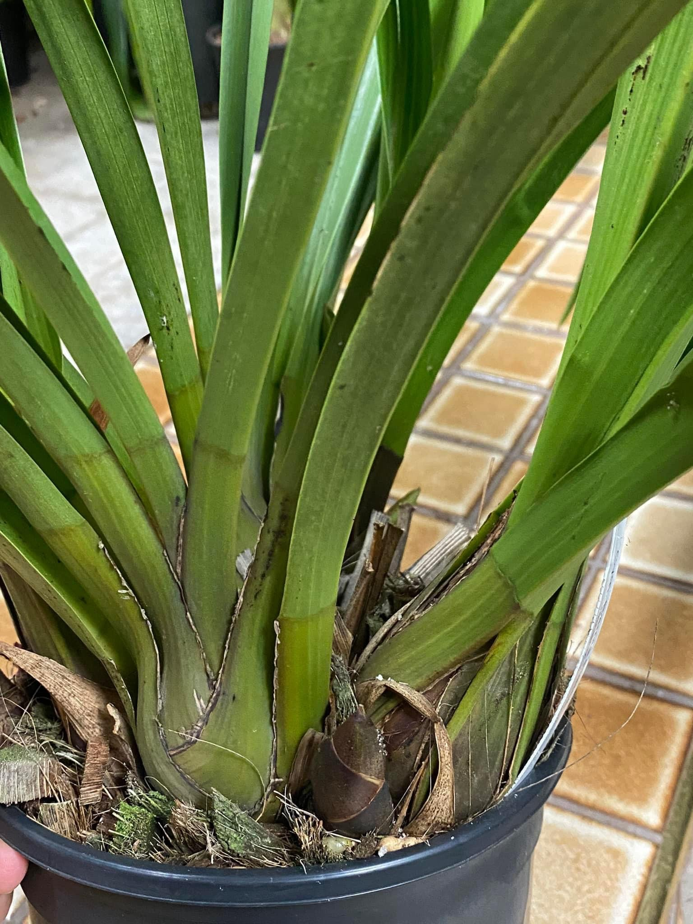
C. eburneum Characteristics
A moderately large perennial epiphyte to twenty-four inches tall.
Slender and fusiform pseudobulbs
clustered, rather ovoid, somewhat
compressed, and about four inches
tall. They are not produced
annually, but continue to grow in
an indeterminate fashion for about
three years before a new growth
is produced.
Leaf apex tend to be acutely bilobed with a small mucro (short sharp point) in the sinus. There are five to seven fresh leaves produced annually that are about twenty-four inches long and grow in a distichous manner. Each pseudobulb will produce a total of fifteen to seventeen leaves during its active life.
Inflorescences are approximately twelve inches long, arising from the axils of the leaves.

Slide 7
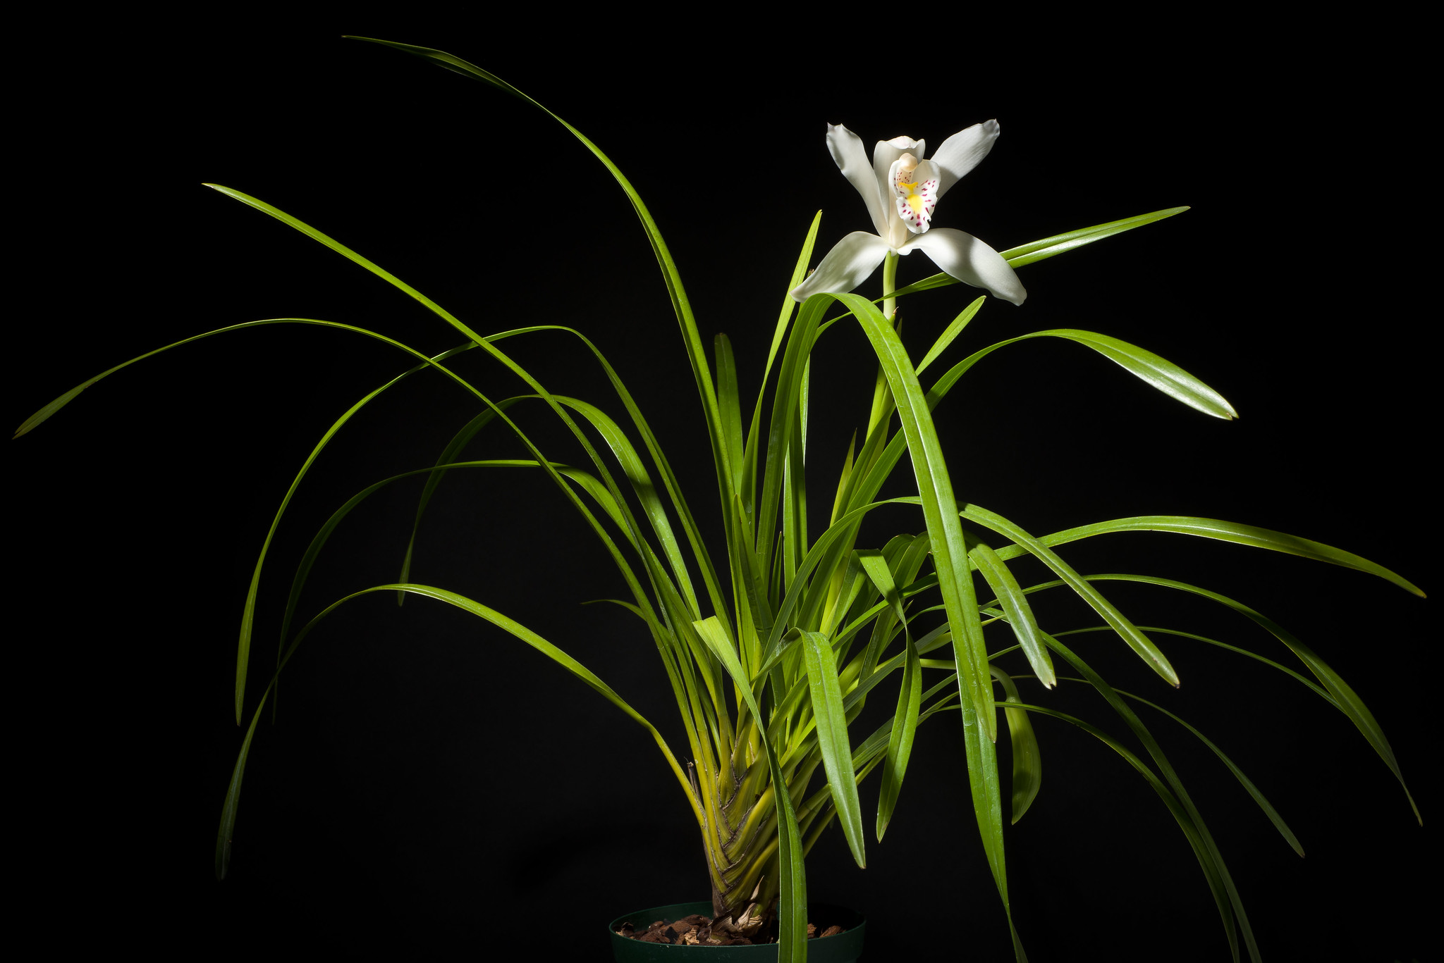
Cymbidium eburneum, photography by Motohiro Sunouchi
Normally one to two flowers are produced per inflorescence. They are three to five inches across, waxy, long lasting, and very fragrant. The sepals and petals are white or faintly pink, and the lip is white with a bright yellow central and basal patch on the mid-lobe. There are occasionally some pale purple-pink spots on the mid-lobe.
Yellow callus ridges fused into one single, inflated, wedge-shape structure at the apex.

Slide 9
Varieties and Synonyms
Varieties
C. eburneum Lindl. var. dayi. Samuel Jennings (1875) Orchids: t. 16 - pale purple-pink spots on the mid-lobe of the lip
C. eburneum Lindl. var. williamsianum. Heinrich Reichenbach (1881) Gardener’s Chronicle. ser. 2, 15: 530 - pink-tinged with yellow callus
C. eburneum Lindl. var. phibrickianum. Heinrich Reichebach (1886) Gardener’s Chronicle. ser., 25: 585 - pure white with yellow callus
C. eburneum Lindl. var. longzhouense. A. J. Liu and S. C. Chen (2006) Acta Phytotaxonomica et Geobotanica. Sin. 44: 179 – spots on the lip
Synonyms
Cyperorchids eburnean Lindl. Rudolf Schlechter (1924) Repertorium Specierum Novanum Regni Vegetabilis. 20: 107

Slide 10
Cymbidium eburneum var. longzhouense
Liu, Z. and Chen, S. 2006. Acta Phyto tax. Sin. 44 179. Photography by Motohiro Sunouchi

Slide 11
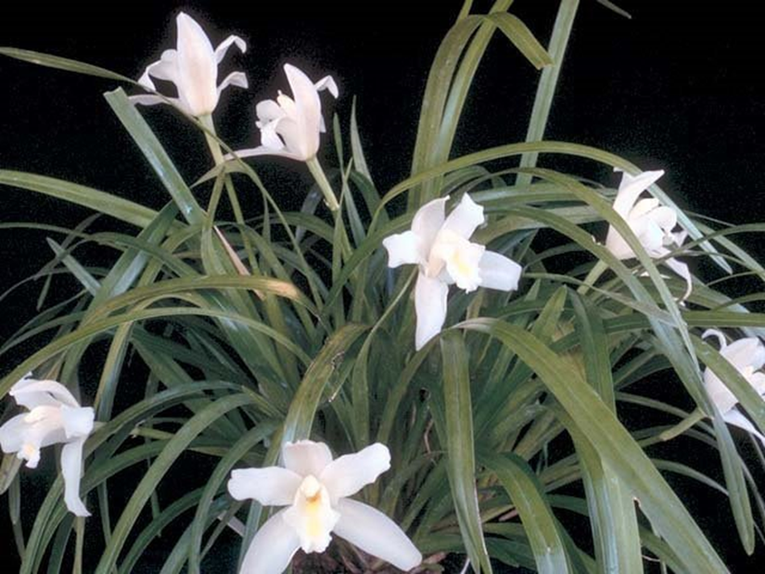
Awards
 | FCC | AM | HCC | AQ | CBM | CCE | CCM | CHM | JC
AOS | - | 1 | 2 | - |  |  | 3 |  | 2
Year |  | 2005 | 1991 1998 |  |  |  | 1981 1982 2008 |  | 1969 1981
Cymbidium eburneum ‘Kaiji’ CCM/AOS, 84 points, 1981 Photography OWZ Lib

Slide 12
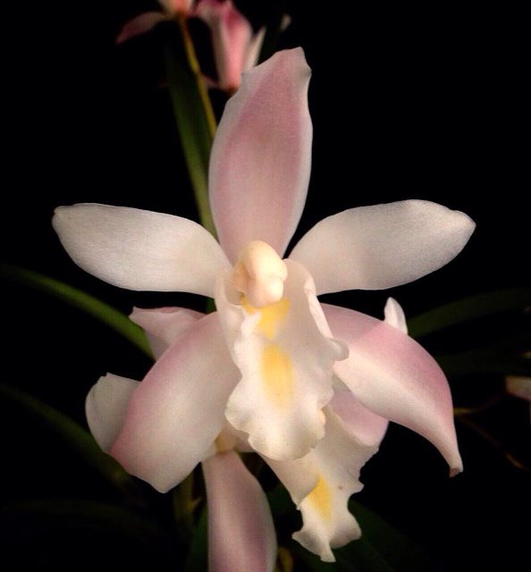
Hybridizing
Cymbidium eburneum has been used 26 times as the seed parent and 34 times as the pollen parent.
60 F1 generation offspring
16,528 progeny
Inherited Traits
Positive – large flower size, white color, erect inflorescence, long lasting flowers, and compact grower
Negative – low flower count, fenestration, rolling lip, reflex of petals, and dorsal sepal cupping tendency, short inflorescence
Cymbidium eburneum
Photography by Manot Qualphanit

Slide 13
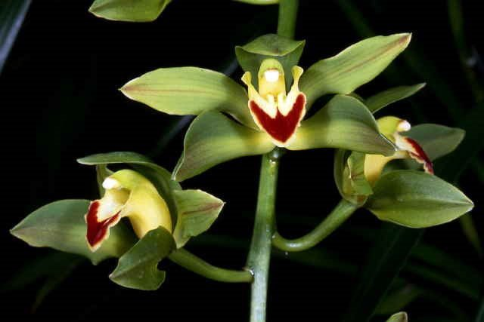
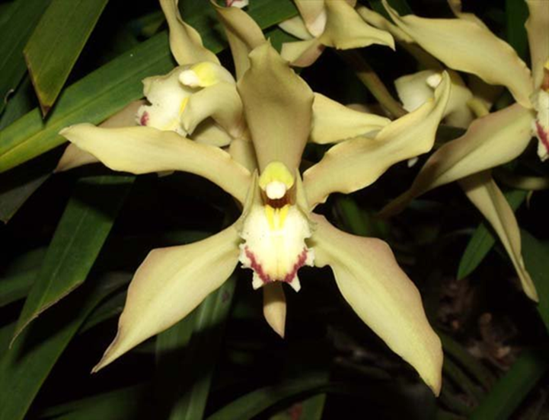
First Cymbidium hybrid made in cultivation was Cymbidium Eburneo-lowianum (C. eburneum x C. lowianum), originated and registered by Harry Veitch in 1889
X
Cymbidium eburneum ‘Gillian’ HCC/AOS
79 points, 1991, Photography by OWZ Lib
Cymbidium lowianum, ‘Compte d’
Hemptinne’ HCC/CHM/AOS
77 points, 2015; 82 points, 1992.
Photography by OWZ Lib
Cymbidium Eburneo-lowianum, Photography by L. Batchman
No awarded clones
42 offspring, 16,109 progeny

Slide 14
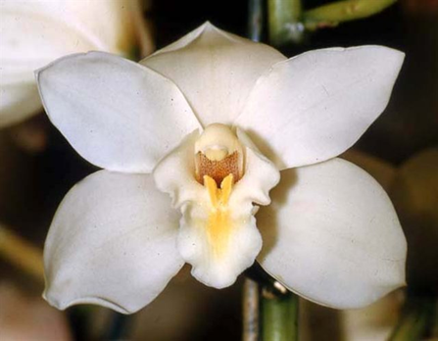
First Generation of Cymbidium Eburneo-lowianum
X
Cymbidium Eburneo-lowianum, Photography by L. Batchman
Cymbidium insigne ‘Winter Rose’ BM/CSA, 71 points, 1998, Photography CSA
Cymbidium Alexanderi ‘Sixty’ HCC/AOS
76 points, 1958, Photography CSA
427 offspring, 15,905 prodigy
Six awards (AD -1; AM-1; CC-1; CCM-1; FCC-1; and HCC-1)

Slide 15
Cymbidium Alexanderi Progeny
Eight Generations of Progeny
G | Grexes | Awarded | % Awarded | Awards
1 | 427 | 98 | 23.0% | 719
2 | 2,160 | 326 | 15.1% | 1,503
3 | 3,525 | 509 | 14.4% | 1,589
4 | 4,293 | 517 | 12.0% | 1,497
5 | 3,728 | 480 | 12.9% | 1,319
6 | 1,548 | 150 | 9.7% | 451
7 | 211 | 26 | 12.3% | 63
8 | 13 | 2 | 15.4% | 11
Total | 15,905 | 2,108 | 13.3% | 7,152

Slide 16
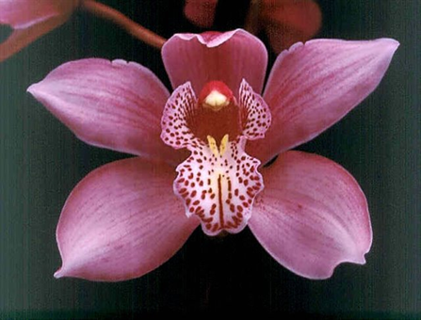
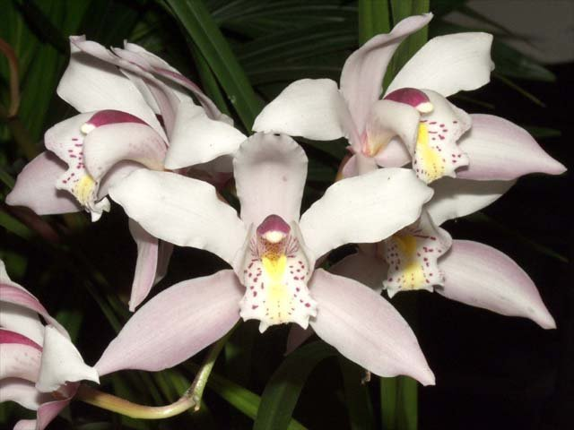
Cymbidium Gottianum (C. eburneum x C. insigne), originated and registered by Sanders (St. Albans) in 1911
X
Cymbidium eburneum ‘Gillian’ HCC/AOS
79 points, 1991, Photography by OWZ Lib
Cymbidium insigne ‘Winter Rose’ BM/CSA, 71 points, 1998, Photography CSA
Cymbidium Gottianum, Photography by L. Batchman
No awarded clones
70 offspring, 9,908 progeny

Slide 17
First Generation of Cymbidium Gottianum
Cymbidium Gottianum, Unawarded
Photography by L. Batchman
Cymbidium Alexanderi ‘Sixty’ HCC/AOS
76 points, 1958, Photography CSA
Cymbidium Eagle, unawarded
Photographer unknown
34 offspring, 1,132 prodigy
Two awards (AM-1 and FCC-1)

Slide 18
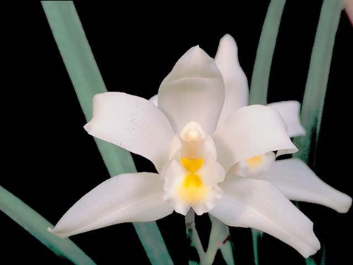
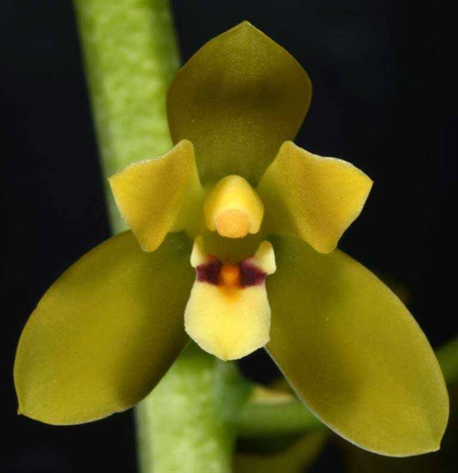
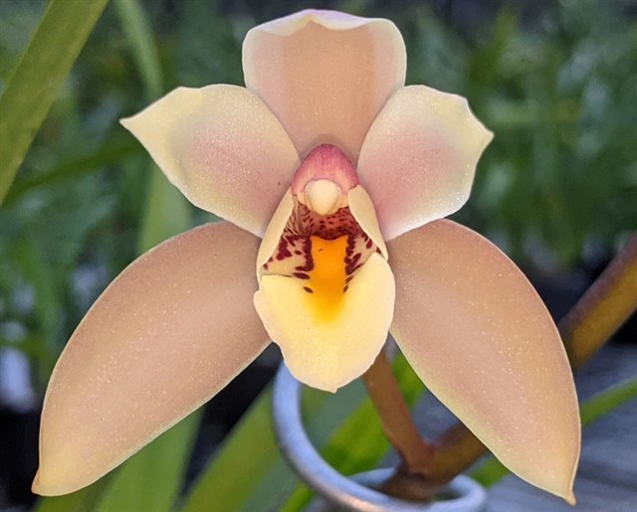
Post 2000 Cymbidium eburneum Primary Hybrid
X
Cymbidium eburneum ‘Gillian’ HCC/AOS
79 points, 1991, Photography by OWZ Lib
Cymbidium madidum ‘Leroy’ AM/AOS
80 points, 1998, Photography Bob Harris
Cymbidium Madurneum, unawarded
Photography by Nado Lenkic
No offspring found
Originated and Registered in 2021by N. Lenkic

Slide 19
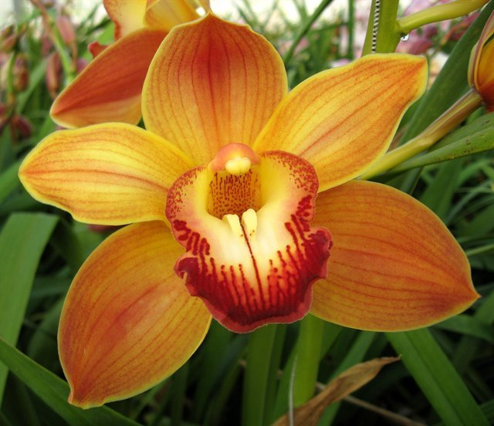
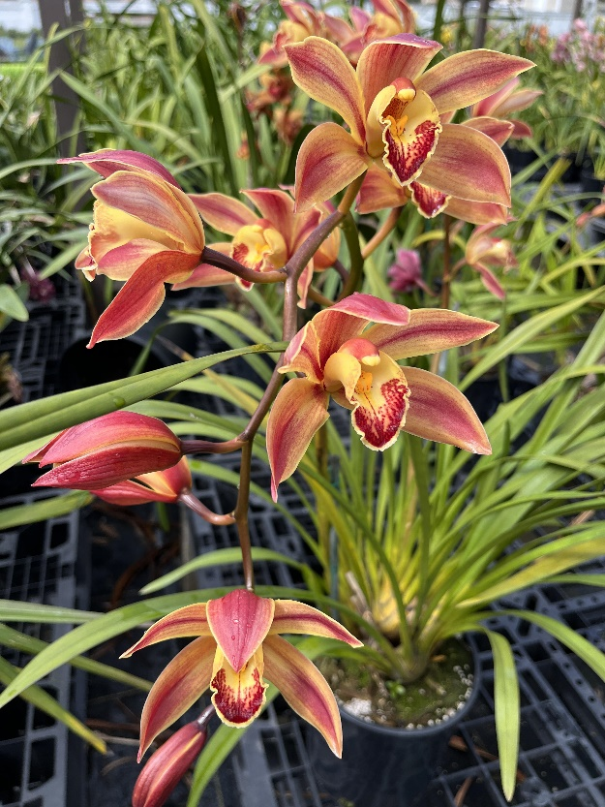
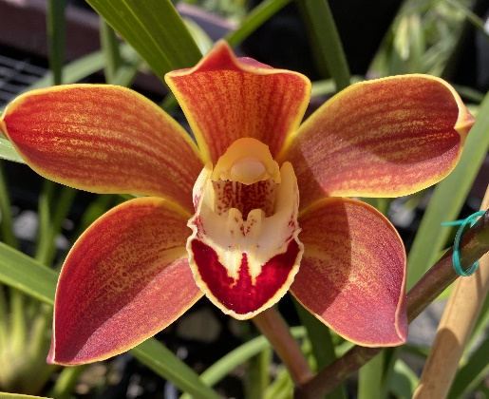
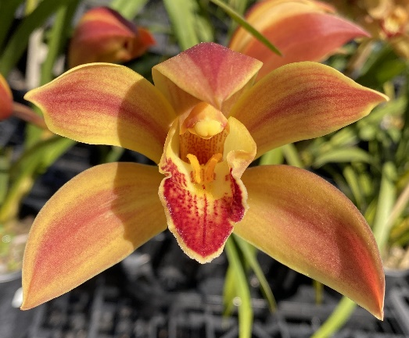
Post 2000 Cymbidium eburneum Hybrid Species x Complex
X
Cymbidium eburneum ‘Gillian’ HCC/AOS
79 points, 1991, Photography by OWZ Lib
Cymbidium Wallacia ‘Cecil Park’ unawarded
Originated and Registered in 1974 by Wondabah, Photography by Wayman Bussey
C. Eburneum Gold ‘1’
C. Eburneum Gold ‘2’
C. Eburneum Gold ‘Santy’
Originated and Registered in 2021 by Joe Santy
Photography by Joe Santy

Slide 20
Traits to Consider When Judging Cymbidium eburneum
Fullness of flower segments
Flatness – lip must be visible when viewing flower perpendicularly
Number of flowers, if hybrid
Balance – overall proportions
Lack of fenestration
Absence of overly cupped flowers
Rolling lip missing
Inflorescence height
’

Slide 21
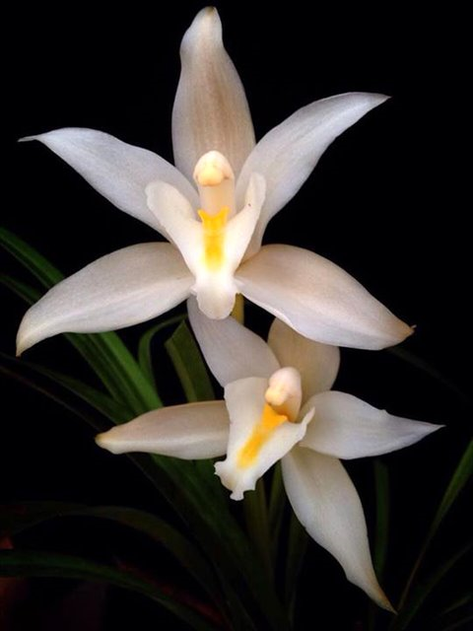
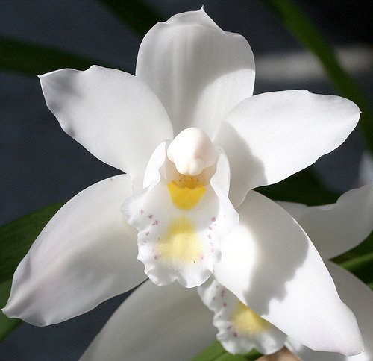
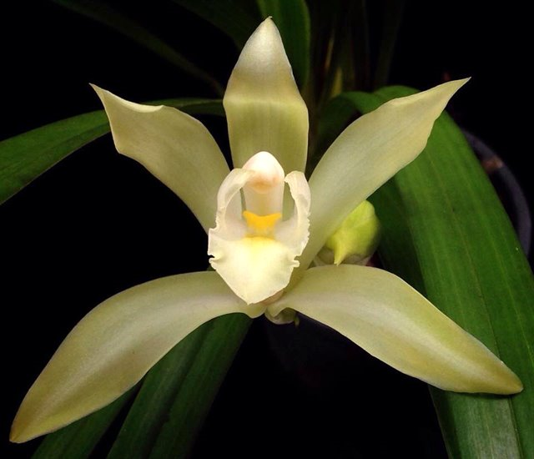
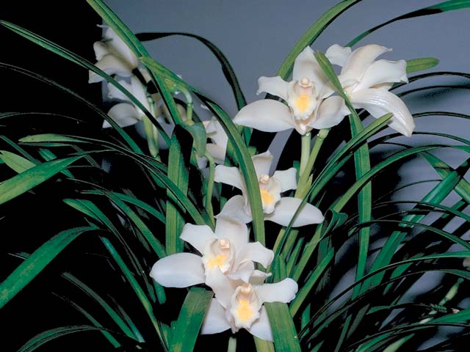
Questions and Answers
C. eburneum, Photography by Manot Quahphanit
C. eburneum, Photography by Andy Easton
C. eburneum, Photography by Manot Quahphanit
C. eburneum ‘Renee Wayland’ JC/AOS, 0 pts, 1969, Photographer unknown

Slide 22
References
Arora, C. 1985. Flowering of some orchids in Dehra Dun, India, American Orchid Society Bulletin 54(3):322.
Chen, S. 1999. Cymbidium: Flora reipublicae poularis sinicae. Beijing: Science Press. 18: 191 – 227.
Du Puy, D. and Crib, P. 1988. The Genus Cymbidium. Timber Press. Portland, Oregon.
Hawkes, A. 1987. Encyclopedia of cultivated orchids. Faber and Faber, London.
Liu, F. 1996. Two new species of Orchidaceae from Yunnan. Actua Botanica Yunnanica. 18: 411 – 414.
Neptuen, W. 1982. The rewarding and easy-to-grow Cymbidiums, American Orchid Society Bulletin 51(4):367.
Orchid Pro Online
OrchidWiz X9.0
Seth, S., and Cribb, P. 1984. A reassessment of the sectional limits in the genus Cymbidium. Orchid Biology, Reviews and Prospectives. 3: 283 – 322 Cornell University Press. Ithaca, New York.
Zhong-Jian, I., and Zheng-Zhong. 2006. Notes on some taxa of cymbidium sect. eburnean. Acta Phytotaxonomica Sinica. 44 (2): 178 – 183.

