Slide 1
Cattleya cinnabarina “The Cinnabar Laelia”
Tim Brown
Dallas Judging Center
June 8, 2024
Cattleya cinnabarina ‘Amazon’ FCC/AOS, 90 points, 1980
Photograph by Plato Peter Matthews
Orchid Society of Southern California

Slide 2
Cattleya cinnabarina
First described by James Bateman ex Lindley (1838) as Laelia cinnabarina
Moved to Amalias, Cattleya, and Bletia all during the 1800’s, and later Hoffmannsegella and Sophronitis
Carl Withner described as Laelia cinnabarina (1990)
Current description Cattleya cinnabarina by Cassio Van den Berg, published in: Neodiversity 3: 6 (2008) – Journal of Neotropical Biodiversity

Slide 3
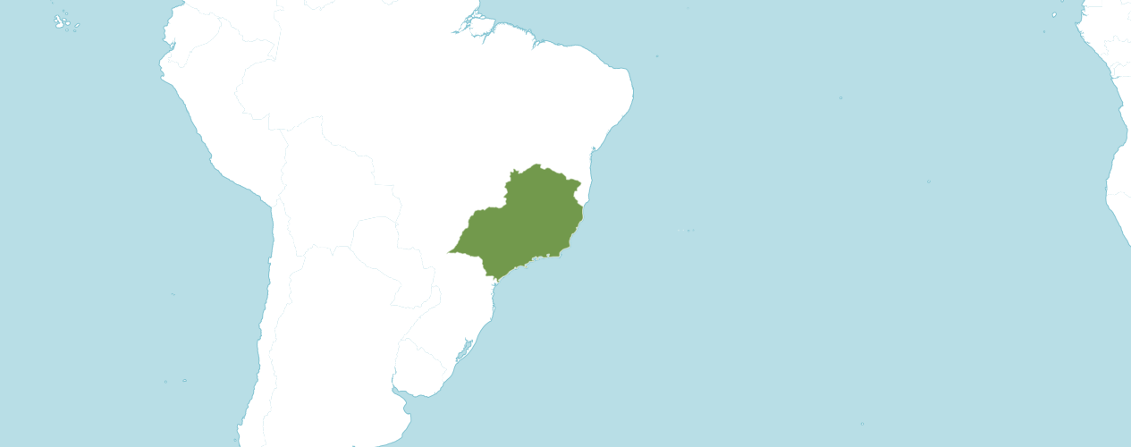
Distribution of Cattleya cinnabarina
Southeast Brazil: States of Minas Gerias, Sao Paulo and Rio de Janeiro Photograph from Kew Online

Slide 4
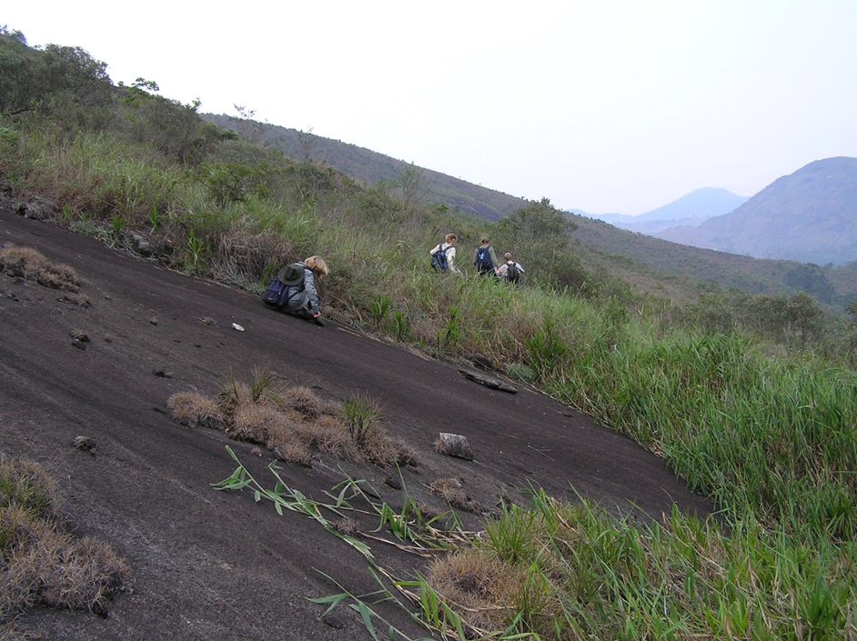
Cattleya cinnabarina in situ: scrubby granite slopes
Photograph by Simon Pugh-Jones of the Writhlington Orchid Project

Slide 5
Cattleya cinnabarina Characteristics
Lithophyte, Rupicolous
Pseudobulbs grow to 45 cm (18 inches) tall and cylindrical with swollen base
Pseudobulbs bases are covered in dried papery sheaths with one dark green, leathery leaf
Inflorescences emerges from the top of new pseudobulbs
Photograph by Writhlington Orchid Project

Slide 6
Cattleya cinnabarina Characteristics continued
Inflorescences grow to approximately 60 cm (2 feet) long
Each inflorescence holds between 5 and 15 flowers
Flower Size: approximately 6.25 cm (2 1/2 to 3 inches)
Bloom Season - Spring
Photograph by Writhlington Orchid Project

Slide 7
When Cattleya cinnabarina Flowers: n = 103
Southern Hemisphere
Northern Hemisphere

Slide 8
Cattleya cinnabarina - AOS Awards
Cultivar | Flowers | Buds | Inflorescences | Average | Award | Points | Year
‘Penn Valley’ | 0 | 0 | 8 | 9.5 | CCM | 80 | 1959/1965
‘Crestwood’ | 9 | 0 | 1 | 9.0 | AM | 82 | 1977
‘Amazon’ | 8 | 0 | 1 | 8.0 | FCC | 90 | 1980
‘Santa Barbara’ | 13 | 2 | 2 | 7.5 | HCC | 77 | 1980
‘Stephanie Vodicnik’ | 11 | 7 | 1 | 18.0 | AM | 84 | 2008
‘Winter Sunrise’ | 17 | 1 | 2 | 9.0 | CHM | 82 | 2014
No Name | 19 | 8 | 3 | 9.0 | CBR | - | 2017
‘OrchidFix Thanks Ben’ | 20 | 26 | 16 | 3.0 | CCM | 83 | 2022

Slide 9
Cattleya cinnabarina Flower Data 8 AOS Awards Averaging 11.1 Flowers and Buds Per Inflorescence; 7.7 cm Median Natural Spread
Number of Flowers | Number of Buds | Number of Inflorescences | Inflorescences Length
11.1 | 5.1 | 3.3 | 55.0 cm
Natural Spread Horizontal | Natural Spread Vertical | Dorsal Sepal Width | Dorsal Sepal Length
7.7 cm | 3.2 cm | 1.1 cm | 3.6 cm
Petal Width | Petal Length | Lateral Sepal Width | Lateral Sepal Length
0.7 cm | 4.0 cm | 0.7 cm | 3.6 cm
Lip Width | Lip Length | Plant Height | Plant Width
0.9 cm | 2.4 cm | n/a | n/a

Slide 10
Cattleya cinnabarina Awards Locations
Cultivar | Location Awarded
‘Penn Valley’ | Wilmington, NC
‘Crestwood’ | Atlanta Regional Supplemental Monthly Judging, Atlanta, GA
‘Amazon’ | Orchid Society of Southern CA Show, Los Angeles, CA
‘Santa Barbara’ | Pacific South Regional Monthly Judging, Los Angeles, CA
‘Stephanie Vodicnik’ | Chicago Center Monthly Judging, Glencoe, IL
‘Winter Sunrise’ | Mid-Atlantic Center Monthly Judging Center, Bryn Mawr, PA
‘OrchidFix’ Thanks Ben | Hawaii Center Monthly Judging, Big Island
‘no name‘ | Hawaii Center Monthly Judging, Big Island

Slide 11
Cattleya cinnabarina Offspring and Progeny
158 F1 Offspring
Used as Seed Parent 46X
Used as Pollen Parent 112X
15,769 Total Progeny
Photograph by unknown

Slide 12
Fourteen Generations of Progeny
Generation | Grexes | Awarded | % Awarded | Awards
1 | 158 | 26 | 16.5% | 52
2 | 703 | 76 | 10.8% | 229
3 | 1,371 | 207 | 15.1% | 653
4 | 1,962 | 307 | 15.6% | 805
5 | 2,050 | 298 | 14.5% | 826
6 | 2,138 | 282 | 13.2% | 663
7 | 2,302 | 316 | 13.7% | 792
8 | 2,301 | 316 | 13.7% | 790
9 | 1,693 | 197 | 11.6% | 381
10 | 538 | 69 | 12.8% | 165
11 | 342 | 23 | 8.2% | 70
12 | 149 | 18 | 12.1% | 107
13 | 35 | 7 | 20.0% | 17
14 | 27 | 2 | 7.4% | 3

Slide 13
Cattleya cinnabarina - Hybridizing
Chromosome count is 2n = 40
Dominant colors – yellow, orange to cinnabar red
Long inflorescences, holding flowers above plant
Long lasting flowers – offspring inherit trait
Temperature tolerant
Smaller growth habit
Small, elongated lip
Lip curls back under – takes up to 4 generations to outbreed characteristic

Slide 14
Cattleya cinnabarina Lip
Photograph by unknown
Photography by Mauro Rosim

Slide 15
Cattleya cinnabarina Cross Originator With Two Or Greater Crosses Registered
Originator | Number | Dates Registered
A.De Prins | 2 | 2000 & 2001
Bracey | 6 | 1958 to 1968
Charlesworth Lt. | 17 | 1898 to 1939
D. Pitchard | 2 | 1977 & 1986
Eustace Clark | 4 | 1902 to 1908
J. Grezaffi | 2 | 1971 & 1983
Redlinger | 2 | 1966 & 1966
Mr. / Mrs. J. L. Fresh | 2 | 1971 & 1971
Rex Foster Orchid | 2 | 1957 & 2003
Rod McLellan Co. | 5 | 1960 to 1965
Ruben in Orchids | 3 | 1968, 1968 & 1970
Sanders / St. Alba | 5 | 1902 to 1962
Santa Barbara | 3 | 2016 to 2020
Sea God Nursery | 2 | 1985 & 2002
Veitch | 14 | 1874 to 1907
W. Badin | 2 | 2009 & 2009

Slide 16
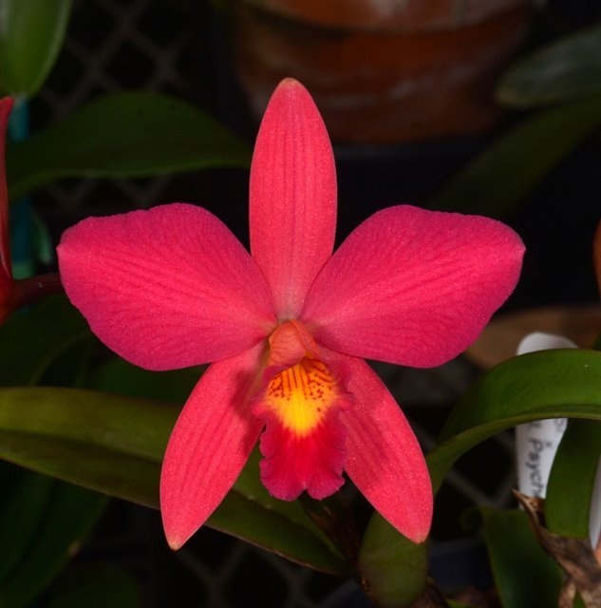
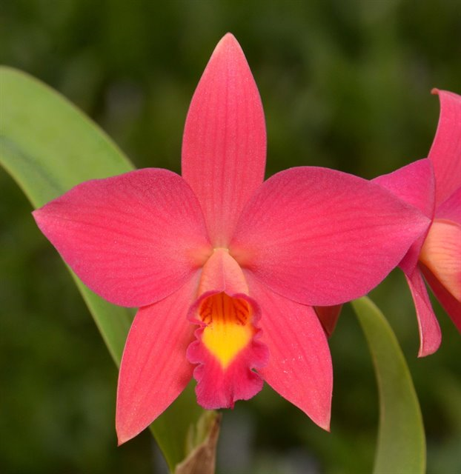
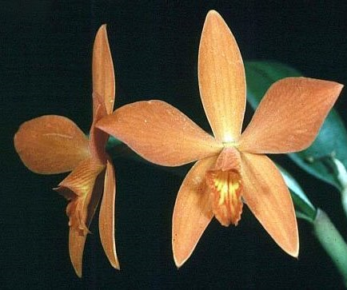
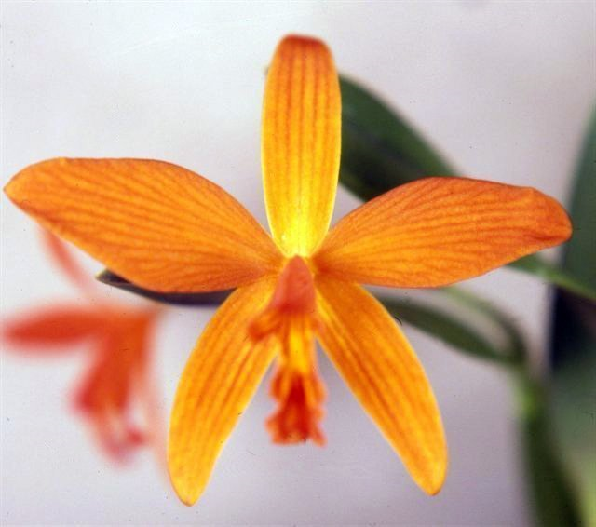
Cattleya cinnabarina Hybrid With Largest Number of Offspring
Cattleya Psyche (C. cinnabarina x C. coccinea)
Originated and Registered (1902) – Charlesworth Ltd
184 Offspring, 7,016 Progeny over 12 generations
Seed Parent 91x; Pollen Parent 93x
Received six AOS awards: AM – 3; HCC – 2; and CCM – 1
Averaging 2.8 flowers and buds per inflorescence, 7.4 cm median natural spread
C. Psyche; Fred Clarke
C. Psyche; Fred Clarke
C. Psyche ‘China’ AM/AOS, 1977
C. Psyche, Photograph Don Lindabury

Slide 17
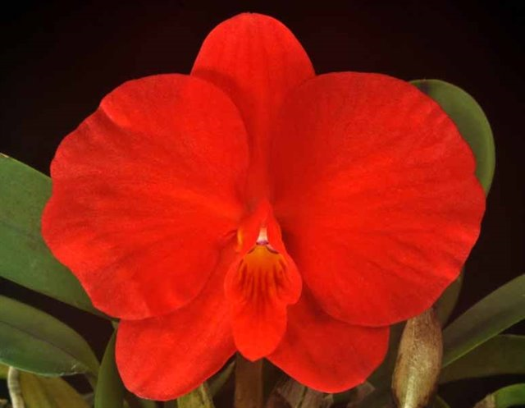
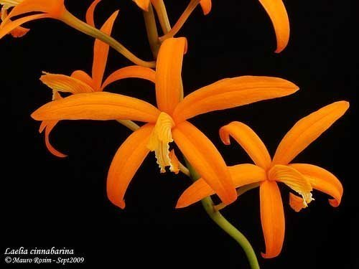
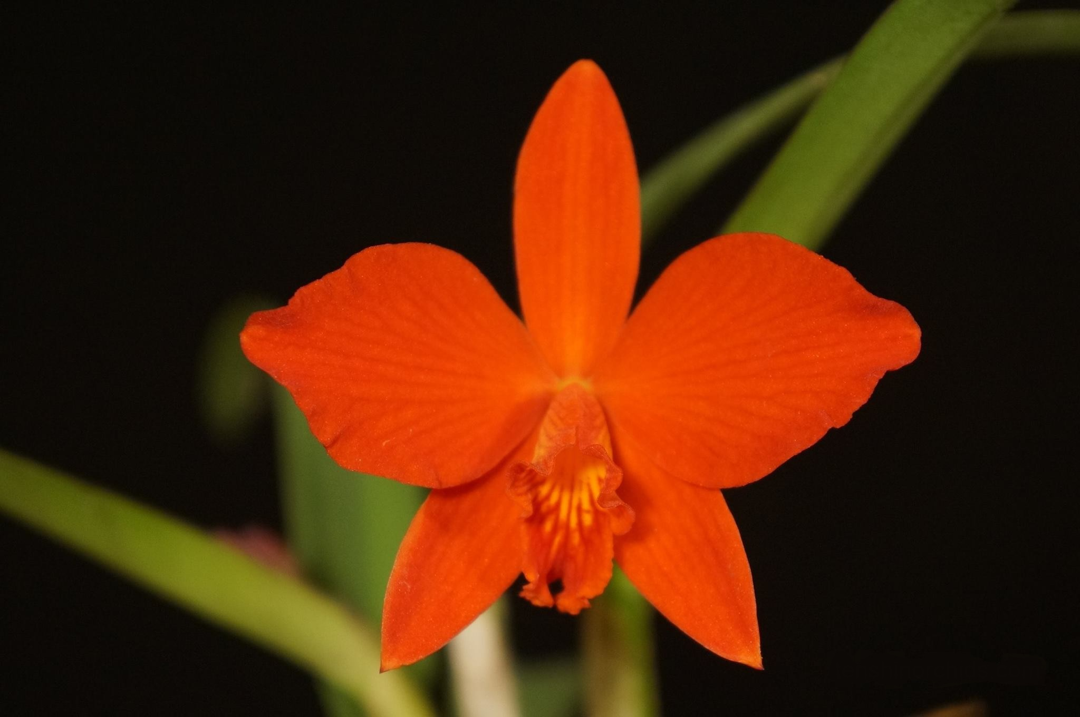
+
=
Cattleya coccinea
Photograph by G. Barfield
Cattleya cinnabarina
Photograph by M. Rosim
Cattleya Psyche
Photograph by Fred Clark
Two Cattleya species, both with dominant forms: C. coccinea – round with small lip and C. cinnabarina - spindly, long under curled lip.
Creates a small flower with the form like a “standard” Cattleya
Expectation would be for one parent to dominate over the other

Slide 18
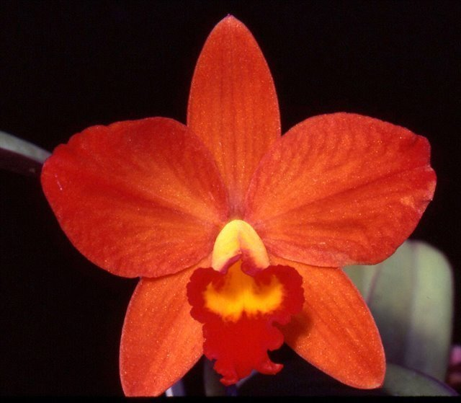
Cattleya Psyche Hybrids
C. Precious Stones (C. Psyche x C. aclandiae)
Originated and Registered (1971) by Steward’s
Offspring – 82; AOS Awards - 5
C. Deborah Off (C. Psyche x C. Beaufort)
Originated and Registered (1985) by Off and Sons
Offspring – 7; AOS Awards- 8
Photography by Fred Clarke
Photography by Plato Peter Matthews

Slide 19
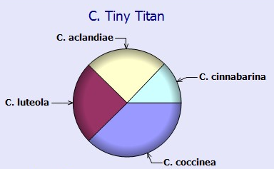
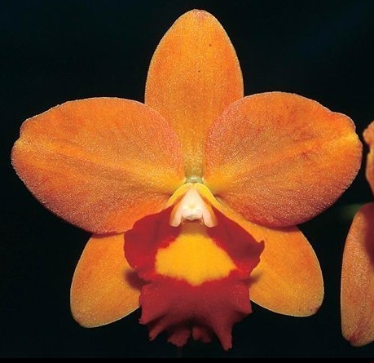
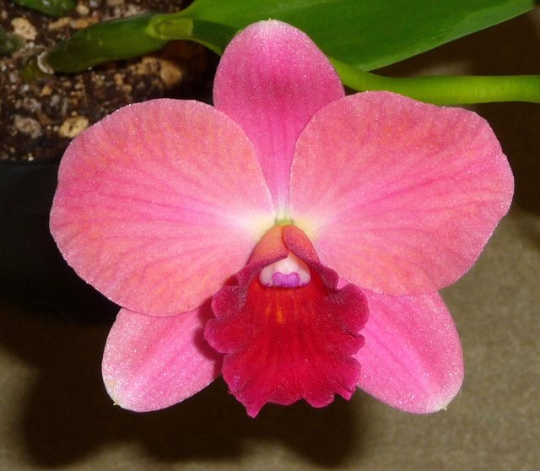
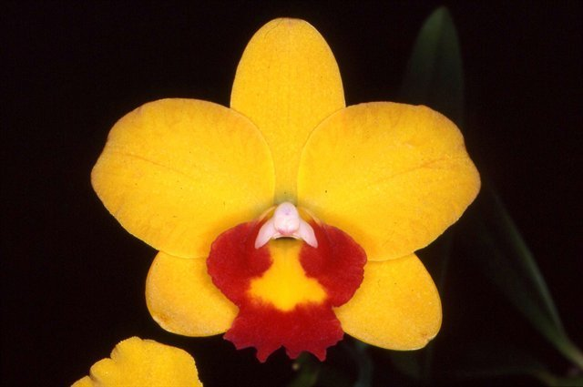
C. Tiny Titan (C. Precious Stones x C. Beaufort) Offspring – 30 F1; AOS Awards – 45 Originated and Registered (1988) L. Farnsworth
C. Tiny Titan ‘Just Peachy’
Photography by Colin Silver
C. Tiny Titan
Photography by F. Thomas Ott
C. Tiny Titan ‘Cat’s Paw’
Photography by Craig Plahn

Slide 20
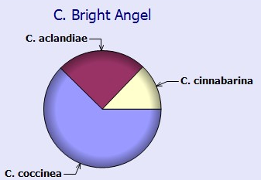
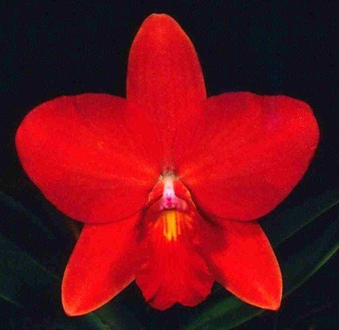
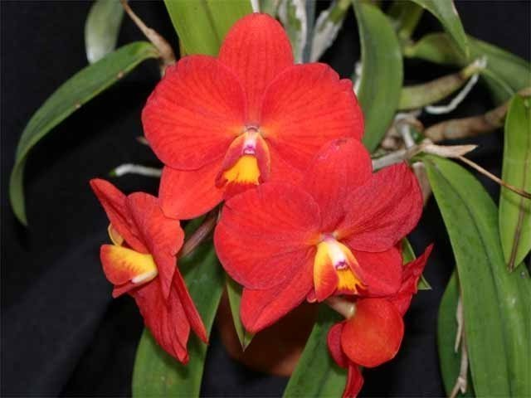
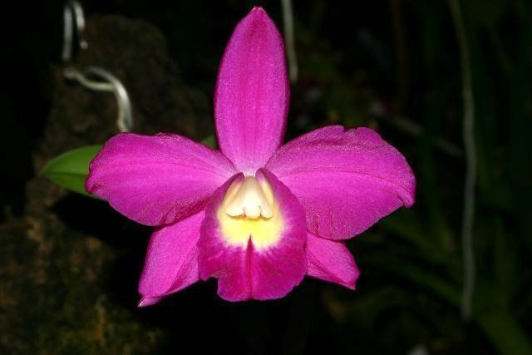
C. Bright Angel (C. Precious Stones x C. coccinea) Offspring – 67 F1; AOS Awards – 23 Originated and Registered (1986) Stewart’s
C. Bright Angel ‘Texas Sunset’
Photography by Rod Gabriel
C. Bright Angel ‘Red Gold’
Photography by Tom Larkin
C. Bright Angel ‘Cat’s Paw’
Photography by Patricia Harding

Slide 21
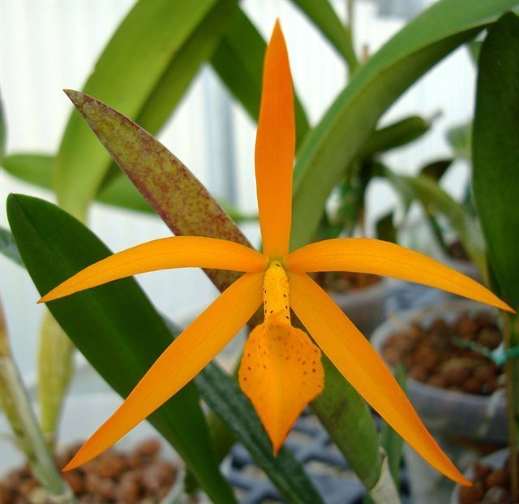
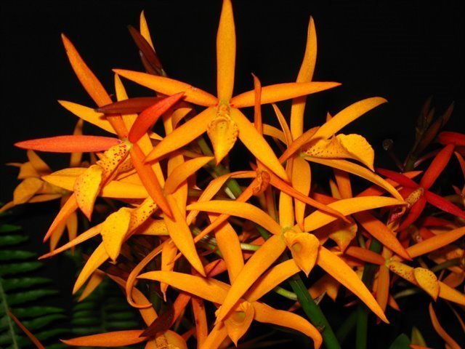
Cattleya cinnabarina Hybrid With Largest Number of AOS Awards
Brassocatanthe Robert Randall (C. cinnabarina x Brassanthe Bill Worsley)
Bsn. Bill Worsley (B. nodosa x Gur. aurantiaca)
Originated by unknown and Registered (2006) – C. Hamilton
1 Offspring, 1 Progeny over 1 generation
Seed Parent 1x; Pollen Parent 0x
Received seven AOS awards: AM – 3; HCC – 3; and CCM – 1
Bct. Robert Randall ‘D’;
Photograph by Isabelle Lindroos
Bct. Robert Randall
Photograph by Vern Bloch

Slide 22
Positive and Negative Characteristics of Cattleya cinnabarina and It’s Hybrids
Positive
Negative
Color limited to yellow, orange to cinnabar red
Stellate flower shape
Lip elongated and small
Rolling of the lip posteriorly – F1 to F4 generations
Floriferousness – 5 to 15 flowers
Rich flower color
Inflorescence holds flowers nicely above plant foliage
Long lasting flowers
Heat tolerant
Plant size

Slide 23
Questions and Answers
Photography by Jan Thomas Johansson

Slide 24
References
American Orchid Society. (n.d.). Hereditary influences of the cattleya alliance. Online: https://www.aos.org/orchids/orchid-breeding-and-hybridizing/hereditary-influences-of-the-cattleya-alliance
Callahan, D. (2024, June 3). Cattleya cinnabarina. [email exchange].
Chapman, S., Johnson, T., and Rose, K. (1988). The rupicolous laelias; Section Parviflorae. A paper written for The American Orchid Society judge training program.
Clarke, F. (2024, June 6). Cattleya cinnabarina. [telephone interview].
Hamilton, R. (1988). When does it flower? 2nd ed. Robert M. Hamilton, 9211 Beckwith Road, Richmond, B.C., Canada V6X 1V7.
McQueen, J., and McQueen, B. (1993). Orchids of Brazil. Timber Press, Portland, OR.
Miranda. F. (1990). Brazilian laelias - Part III: Section Parviflorae. American Orchid Society Bulletin, 59(5): 462–472.

Slide 25
References
Nickou, J. (1990). Culture of rupicolous laelias. American Orchid Society Bulletin, 59(5): 455–459.
OrchidPro (n.d.).
OrchidWiz 9X.0. (n.d.)
Pabst, G. (1984). The section Parviflorae Lindl. of the genus Laelia. Orchid Digest, 48(1): 13–21 and 24–32. Translated and reprinted from 1978 Die Orchidee, vol. 29: 156–165, 196–200.
Royal Botanical Gardens Kew, Plants of the World On-line. (n.d.). Cattleya cinnabarina. Online: https://powo.science.kew.org/taxon/urn:lsid:ipni.org:names:60448079-2 .
Withner, C. (1990). The cattleyas and their relatives, vol. II. The Laelias. Timber Press, Portland, OR.
WSBEOrchids (n.d.) Cattleya cinnabarina. Online: https://wsbeorchids.org/2022/cattleya-cinnabarina-365-days-of-orchids-day-1818/

