Slide 1
Let’s Call Them Pygmy’s!!; Wait, How About Tea Cups?, or Miniature Paphiopedilums?
Timothy Carr
Associate Judge
Dallas Judging Center
June 8, 2019

Slide 2
Let’s Call Them Pygmy’s!!; Wait, How About Tea Cups?, or Miniature Paphiopedilums?
“The Lay of the Land”
Genetic causes of dwarfism in plants
Why mini-Paphiopedilums
Early hybridizing efforts and results
Species which lend themselves to mini-Paphiopedilums
The hybrids
What does the future hold?
Resources

Slide 3
Genetic Causes of Dwarfism in Plants
There are three possible genetic causes for dwarfism in plants:
Monogenic - the term monogene refers to the single gene involved in the expression of a trait. The related form monogenic is a descriptive word that relates to a single gene or allele
Garden pea study by Mendel – tall plants (dominant) crossed with small plants (recessive)
Polygenic – the term polygene is an individual or group of genes producing a specific phenotype or trait only when expressed together. The related form polygenic is a descriptive word that relates to individual and multiple alleles
Best example is the normal variation in human height
Concept of heritability
Chromosomal – sometimes deviations can occur in chromosomes; these deviations can give rise to many changes, for example, ploidy and small size
Paphiopedilum Christopher ‘Grand Duke Nicholas’ has a diploid chromosomal number of 27, rather than 26 – plant sizes range from small to large
Aneuploidy
Only when dwarfism is either monogenic or polygenic can the plant be used (most of the ‘pygmy population is polygenic!

Slide 4
Why mini-Paphiopedilums
Pros:
Space savers in the greenhouse and on the windowsill
Excellent pot plants, pleasing to the eye
Could assist in the natural extension of normal breeding seasons
Will flower in 2-inch pot
Cons:
Not saleable as cut flowers
Hybridizing recognized to be very difficult
Many will have small blooms but may possess standard-size foliage

Slide 5
“Qualifications Needed to Identify Specific Clones as Pygmies”
Must possess a reasonably vigorous growth habit
Floral stems must present blooms in an aesthetic manner
Should be a correlation between foliage size and bloom size (Major factor)
Must be consistent miniaturization of both blooms and foliage
Plants must have regular blooming habits and attractive foliage
Blooms must have a reasonable lasting quality and pleasing color
Form of the blooms should be judged directly in relationship to the parentage
For example, Paphiopedilum fairrieanum hybrid would possess the same round form of Paphiopedilum godefroyae hybrid

Slide 6
Early Hybridizing Efforts and Results
Early hybridizers, by necessity, used many of the smaller-flowered types; however, over time the larger blooming species became more popular
“Onesy-twosy” hybridizing of miniatures in the 1800’s; as late as 1980’s, some breeding took place, but again little interest
Hybridizing uses those Paphiopedilums which produce smaller flowers and size, such as:
Paphiopedilum charlesworthii
Paphiopedilum henryanum
Paphiopedilum fairrieanum
Paphiopedilum barbigerum
Paphiopedilum spiceranium
Koopowitz uses the smallest clones of these species with the best quality flowers

Slide 7
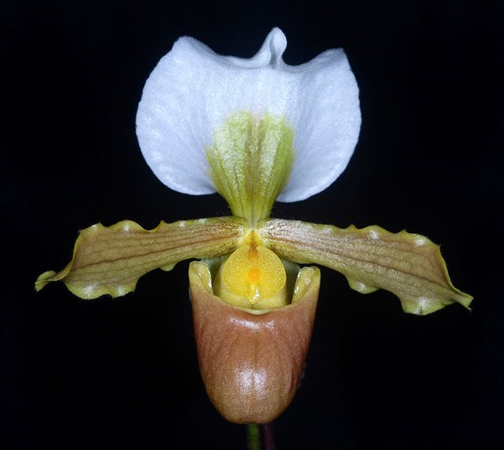
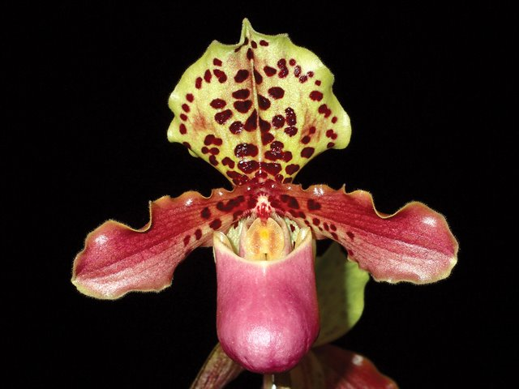
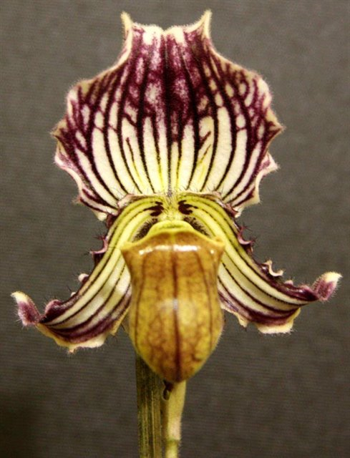
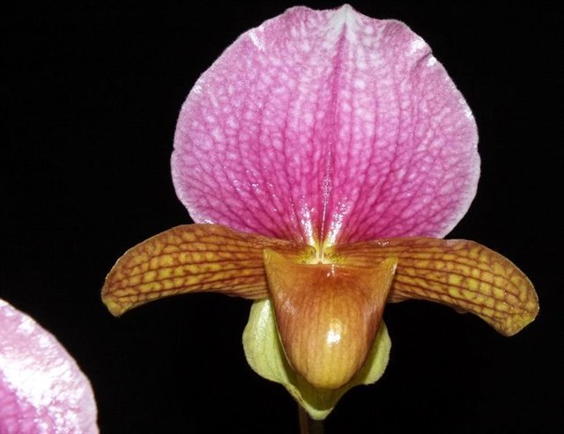
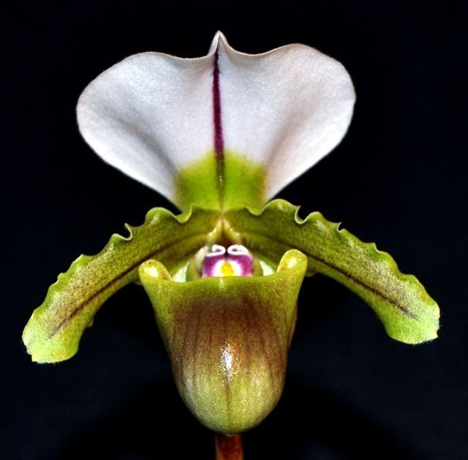
The Species
barbigerum
henryanum
fairrieanum
charlesworthii
spicerianum
Notes:
fairrieanum - 1892, India 376/9,023 130 10.5/4.5
barbigerum - 1940, Southeast Asia 27/72 26 10.2/6.0
henryanum - 1987, Vietnam and China 99/152 59 10.5/5.0
charlesworthii - 1894, Southeast Asia 265/2,851 65 9.0/5.4
spicerianum - 1888, India, Bhutan, Myanmar, South China
233/18,514 64 10.5/6.0

Slide 8
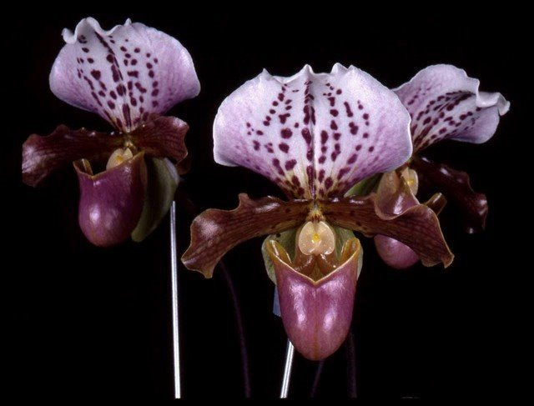
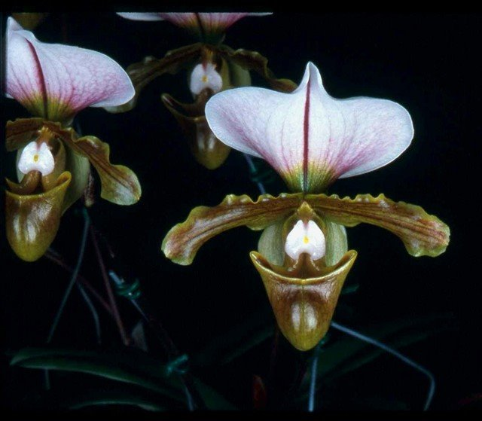
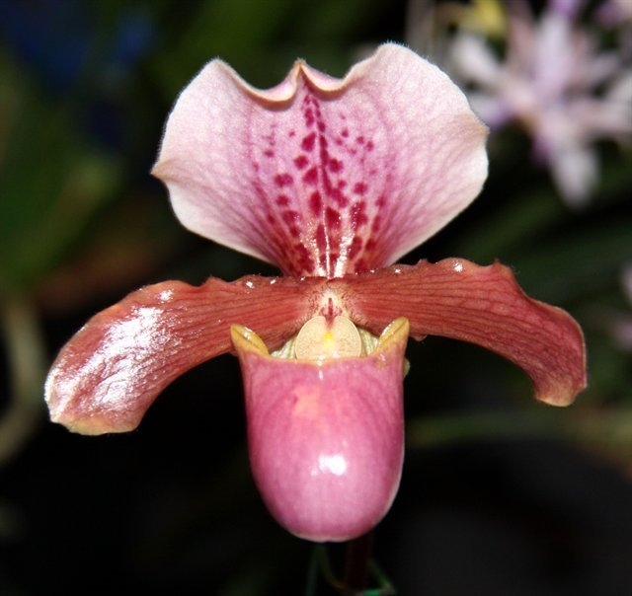
Early Hybridizing Efforts and Results
Paphiopedilum Doll’s Kobold
charlesworthii x henryanum
Paphiopedilum Memnon
charlesworthii x spicerianum
Paphiopedilum Tyke
henryanum x barbigerum

Slide 9
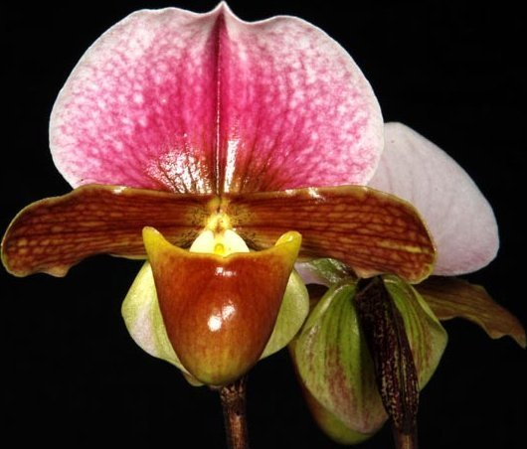
Current Hybrids
Paphiopedilum Tiny Charlie ‘Pink
HCC-78 points
October 18, 2007
Paphiopedilum Tyke (henryanum x barbigerum) x charlesworthii

Slide 10
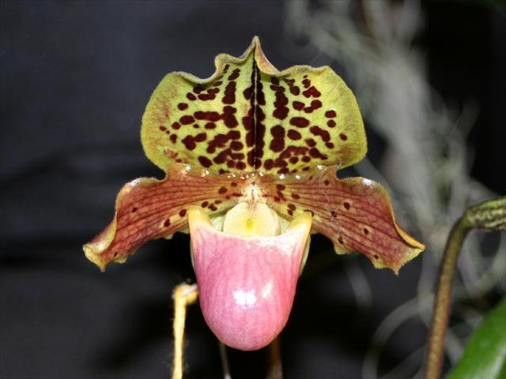
Current Hybrids
Paphiopedilum Little By Little ‘War Eagle’
HCC-76 points
October 22, 2004
Paphiopedilum Doll’s Kobold (charlesworthii x henryanum) x Paphiopedilum Tyke (henryanum x barbigerum)
Notes:
This is Norito Hasagawa hybrid

Slide 11
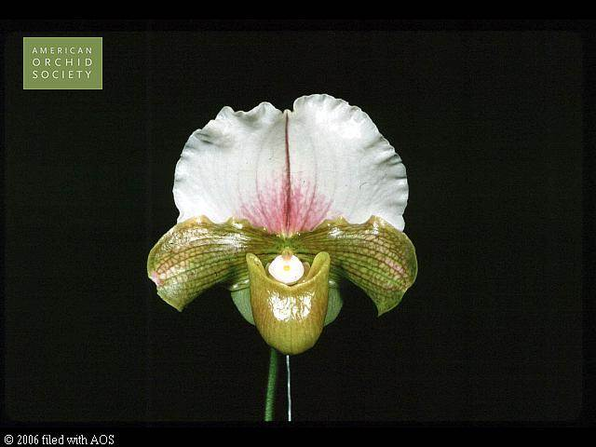
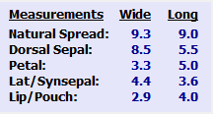
Current Hybrids
Paphiopedilum Marguerite Knox
‘Snow Blush’
HCC-77 points
November 14, 1994 (oldest of the current hybrids)
Paphiopedilum Via Variety (Paphiopedilum Via Muchos Ninos x Paphiopedilum Green Moon) x Paphiopedilum charlesworthii

Slide 12
Cross by Koopowitz in 2005 Paphiopedilum charlesworthii x Paphiopedilum Little Henry
Current Hybrids

Slide 13
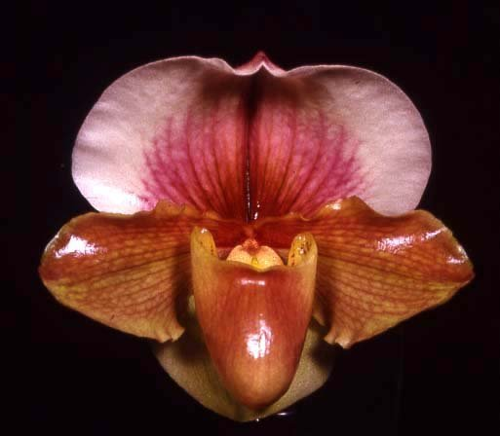
Current Hybrids
Paphiopedilum Wawana Maiden
‘Watoweena’
Paphiopedilum Hellas x Paphiopedilum charlesworthii

Slide 14
What Does the Future Hold?
Most hybridizers are not using charlesworthii directly, but use hybrids that have it in their background
One of the problems being “fixed” is that the miniature Paphiopedilums tend to have narrow petals
Crossing with smaller complex hybrids helps to increase petal width
Hybrids such as Marguerite Knox and King Charles improve flower shape
Breeding of miniatures with vinicolors to produce solid red color; using normal sized plants to obtain deep red coloration, color is at this time not solid
Paphiopedilum charlesworthii will continue to be used

Slide 15
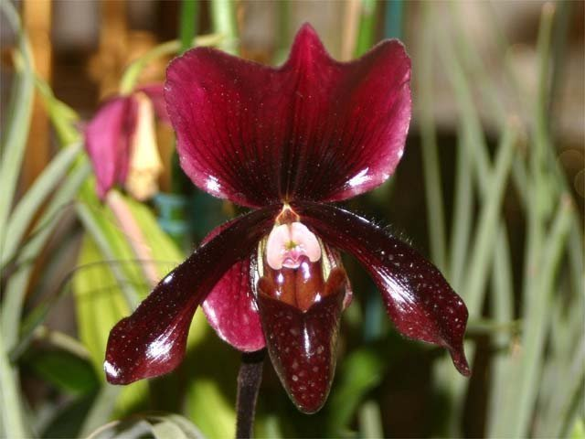
What Does the Future Hold?
NO
PICTURE
Paphiopedilum Baby Baby
Paphiopedilum Little By Little
‘War Eagle’
Paphiopedilum Blacklight

Slide 16
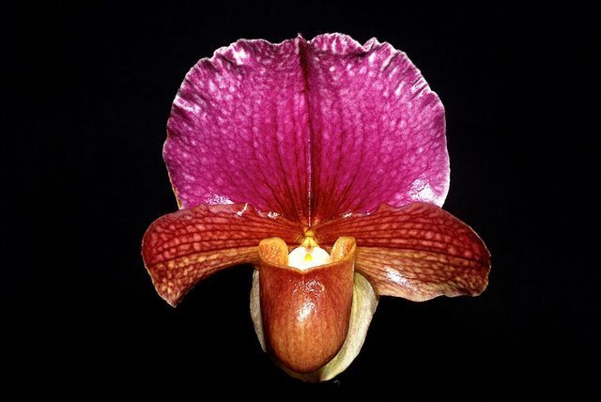
What Does the Future Hold?
Paphiopedilum King Charles ‘Lone Jack’
HCC-79 points
January 12, 2013

Slide 17
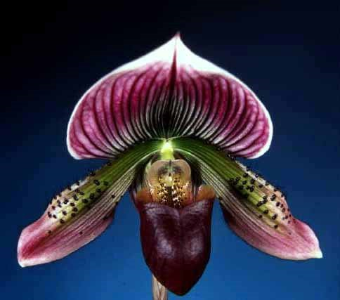
What Does the Future Hold?
Paphiopedilum Hsinying Garnet
Paphiopedilum Pulsar

Slide 18
References
Fordyce, Frank, American Orchid Society Bulletin, July 1976, Pygmy Paphs, page 576 through 585
Schwarz, Gail, Orchids, American Orchid Society, January 2013, Vol. 82, No. 1, Paphiopedilum charlesworthii, IV. Miniature and Intermediate Hybrids Plus New Directions, page 36 through 40
Koopowitz, Harold D., An Annotated Checklist of Paphiopedilum Species, Orchid Digest, Oct., Nov., Dec., 2018, pages 178 through 235
Braem, Guido J., The Genus Paphiopedilum, 2nd Edition, Bishen Singh Mahendra Pal Singh, India, 2016
OrchidsPlus, AOS
OrchidWiz

