Slide 1
Standard red Cattleya
A presentation by Vee Du

Slide 2
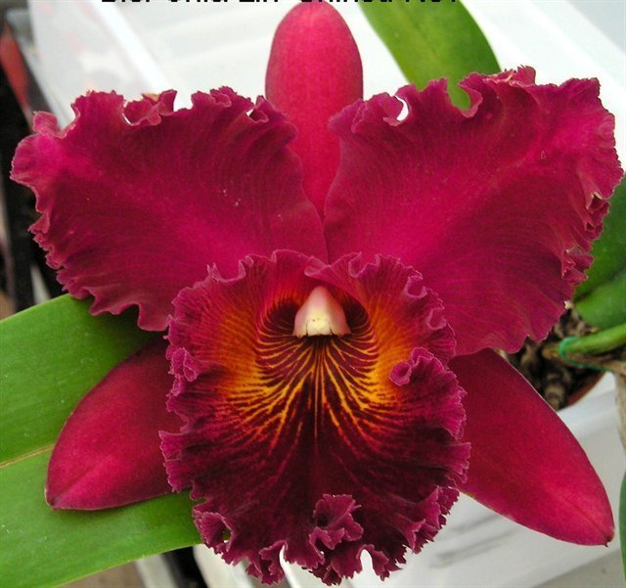
Modern red standard Cattleya
Flower size larger than 13cm and usually more than 30cm tall
Broad or trumpet-shaped frilly lip with wide segments– aka classic shape or “floofy”
Dark crimson red -a rich deep red inclining toward purple (purple undertone is inevitable). Breeding goal is true red!
Red color is very subjective, one person may call red, others may be purple/maroon/orange/etc…
Difficult to photograph, pictures from the same clone can look very different in different lighting. Deep red can appear glowing with enough back lighting
Whatever color they are, they are very alluring
Rlc. Chia Lin (Oconee x Maitland) 1989
the “gold standard” for red standard

Slide 3
This is an interesting article Dan shared a while back. It talks about color pigments in orchids specifically Cattleya species and allied, worth checking out, basically there are two group of color pigments beside chlorophyll. They are carotenoids and anthocyanins. Next slide
Matsui, S., & Nakamura, M. (1988). Distribution of Flower Pigments in Perianth of Cattleya and Allied Genera 1: Species. Japanese Society for Horticultural Science, 57(2), 222-232. Retrieved from: https://www.jstage.jst.go.jp/article/jjshs1925/57/2/57_2_222/_pdf

Slide 4
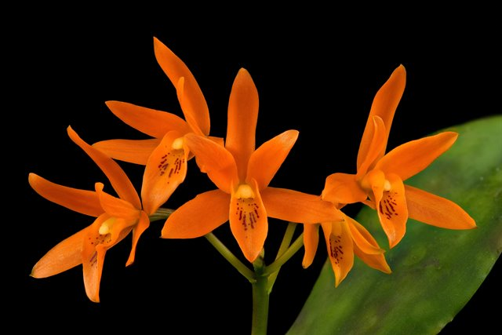
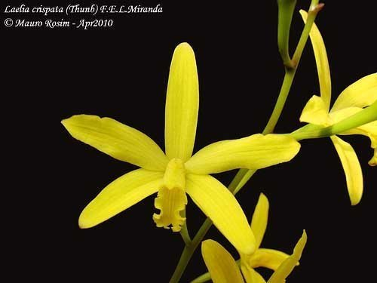
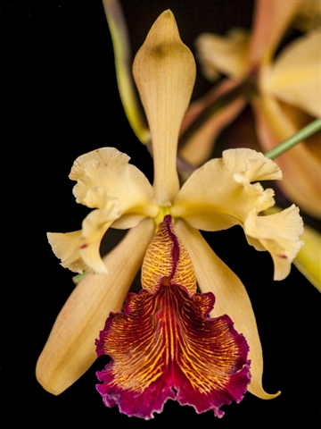
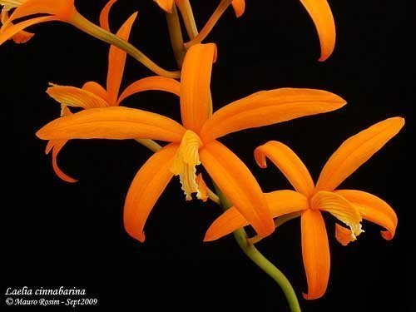
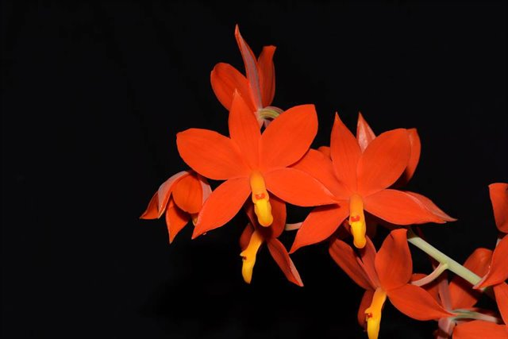
Carotenoids only species
E for epidermal aka “skin”
P for parenchymal cells aka “meat”
Carotenoids tends to lend the flowers a yellow to orange color
Gur. aurantiaca (Ce&Cp)
C. crispata (Cp only)
C. cinnabarina (Ce&Cp)
C. dowiana (Cp only)
Psh. vitellina (Ce&Cp)

Slide 5
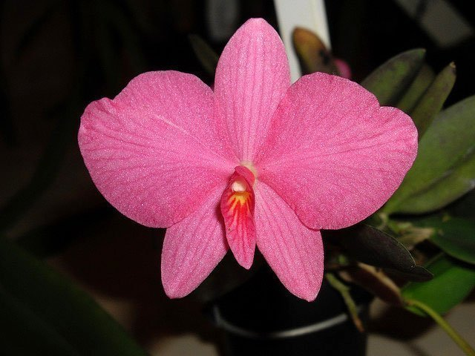
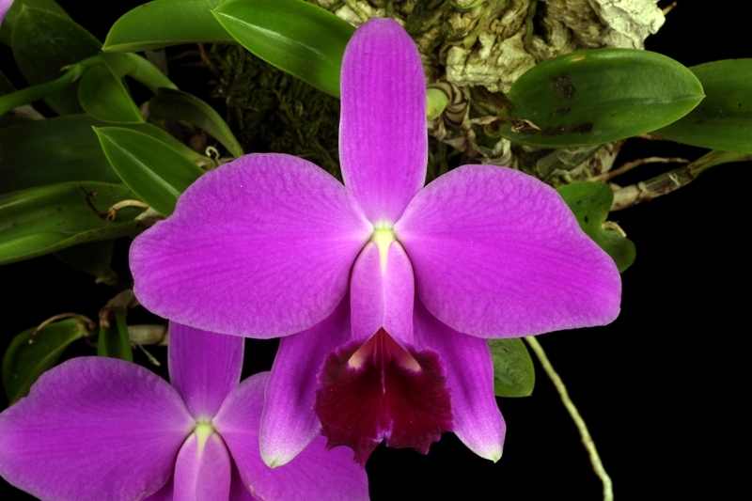
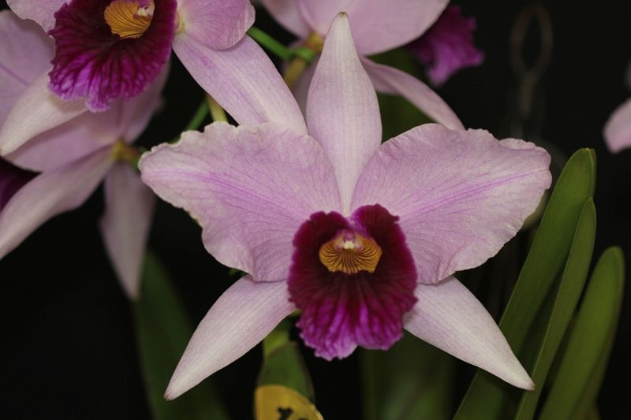
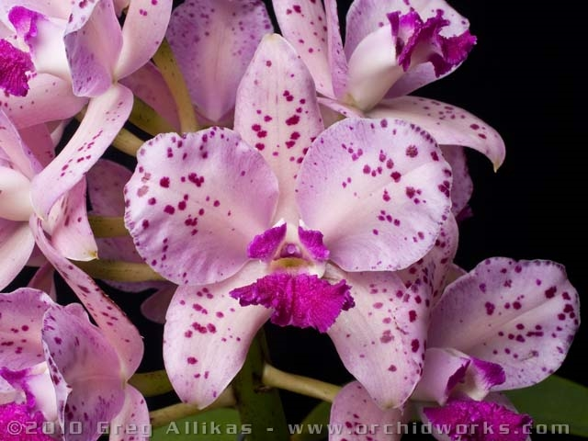
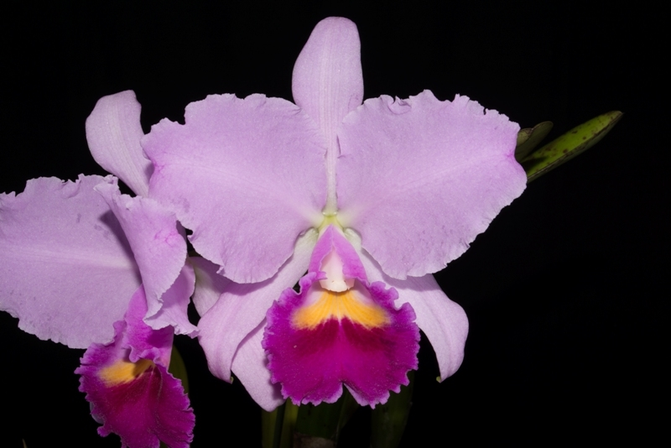
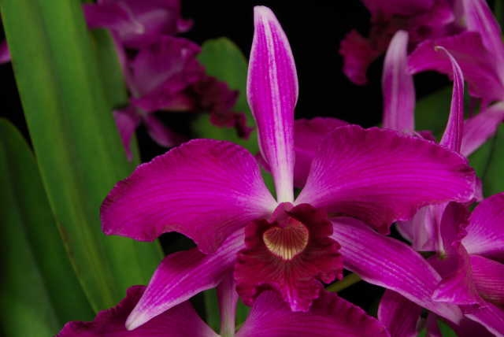
Anthocyanins only species
PH dependent for color expression
Red/Pink/purple/blue to yellow/green coloration (acid -> alkaline)
C. wittigiana (Ae only)
C. pumila (Ae&Ap)
C. purpurata (Ap only)
C. amethystoglossa (Ap only)
C. trianae (Ap only)
C. purpurata var sanguinea (Ae&Ap)

Slide 6
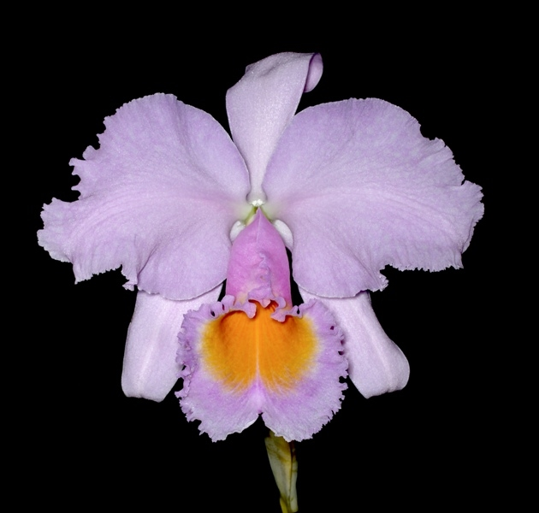
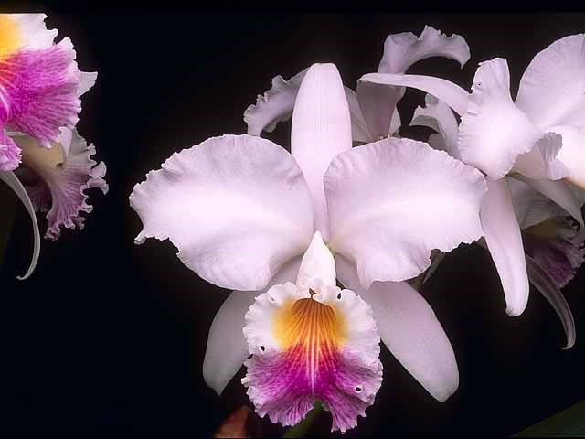
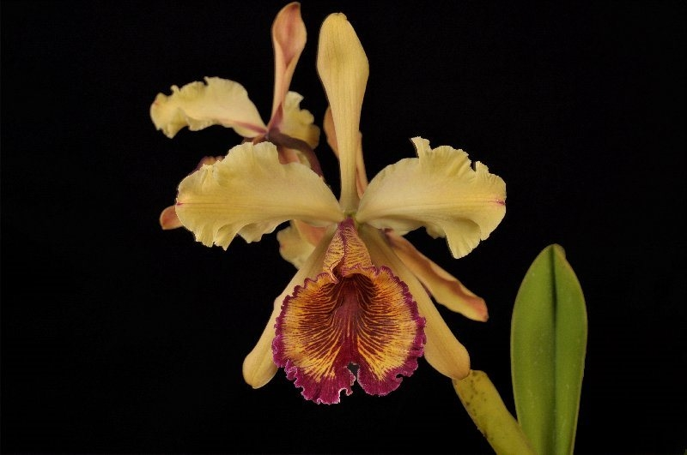
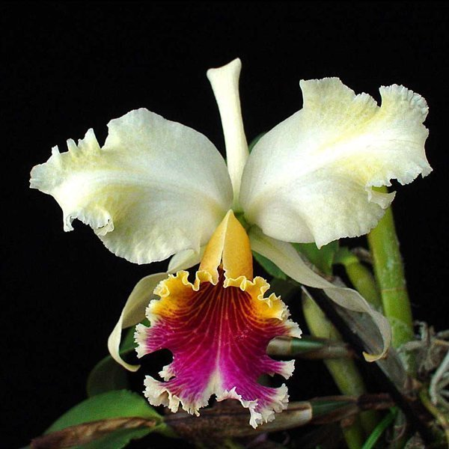
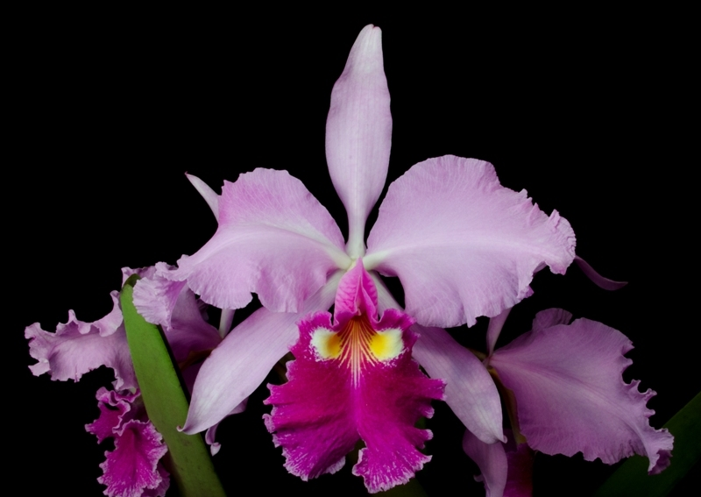
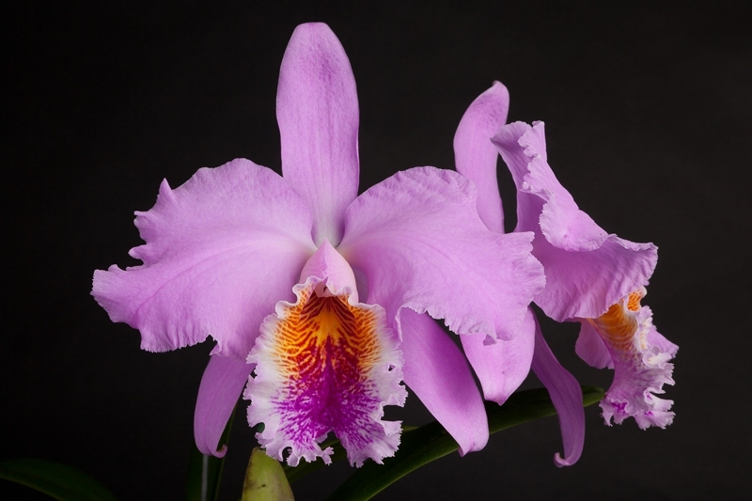
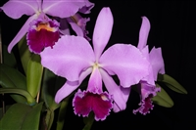
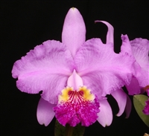
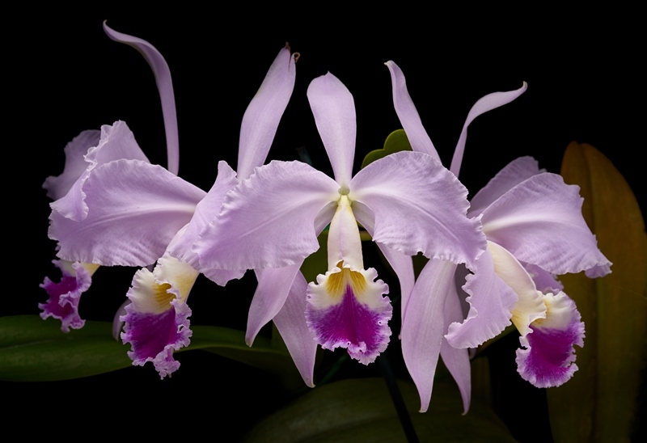
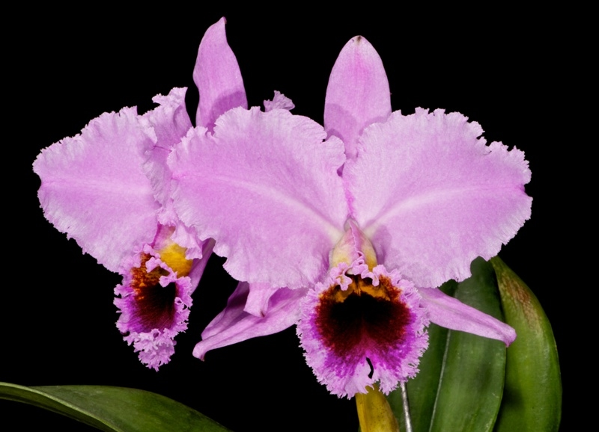
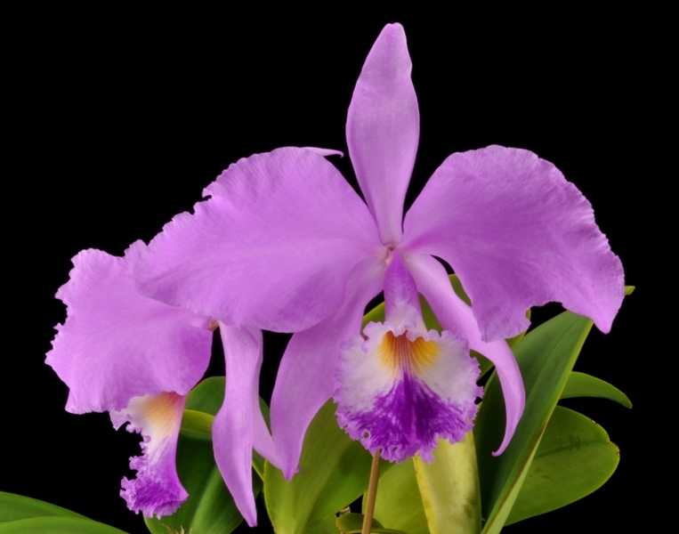
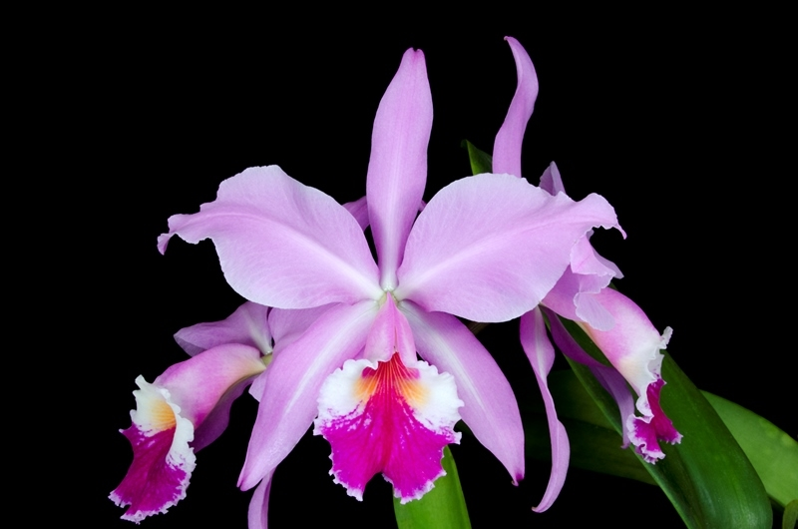
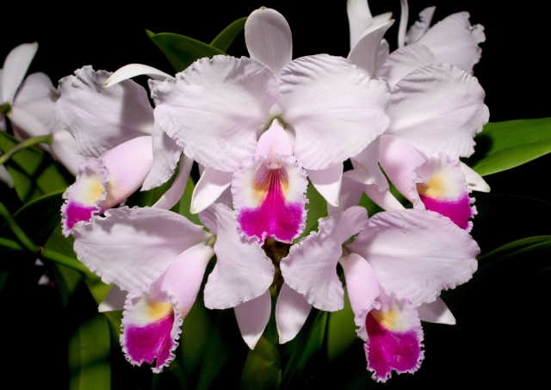
Where does red color come from?
No true red!!!!

Slide 7
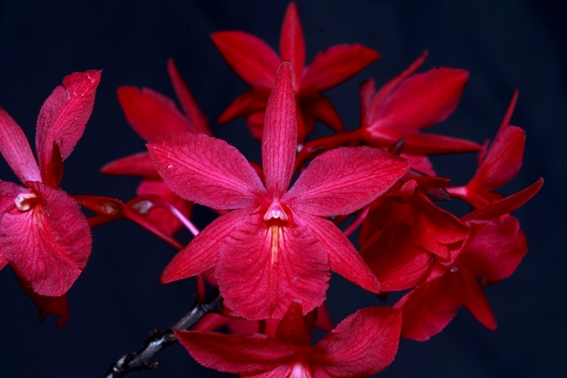
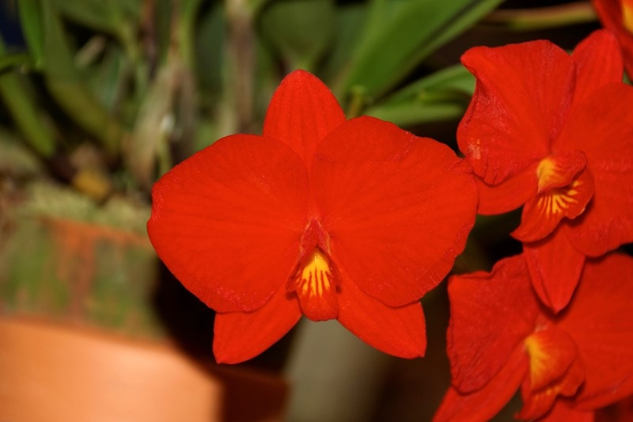
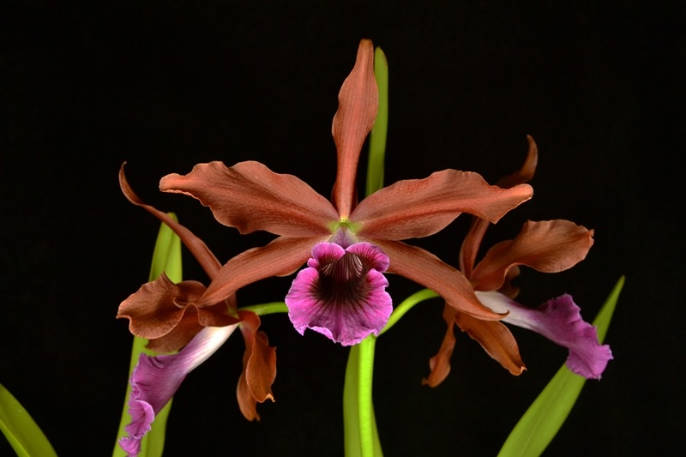
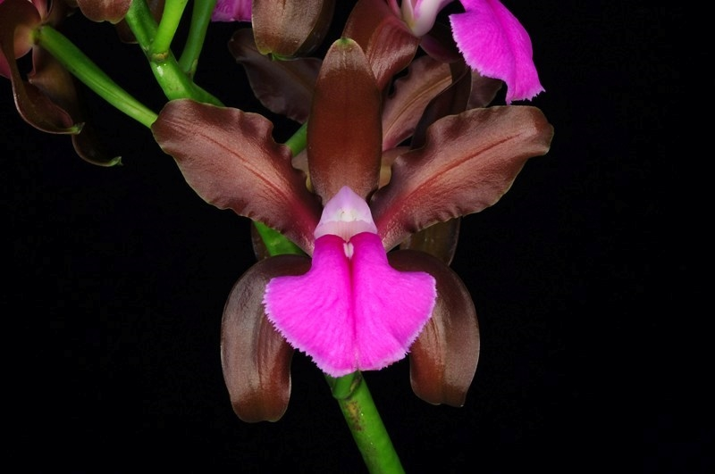
“Red flowers were ascribed to the coexistence of carotenoids and anthocyanins”.
Bro. sanguinea (Cp,Ae,Ap) –More anthocyanin
C. coccinea (Ce, Cp, Ae) –More carotenoids
What happens when you mix anthocyanins in the parenchymal tissue?
You get bronze
C. tenebrosa (Ce, Cp, Ap) –bronze red
C. bicolor (Ce, Cp, Ap) – bronze red

Slide 8
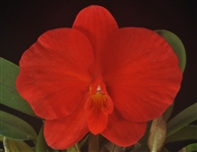
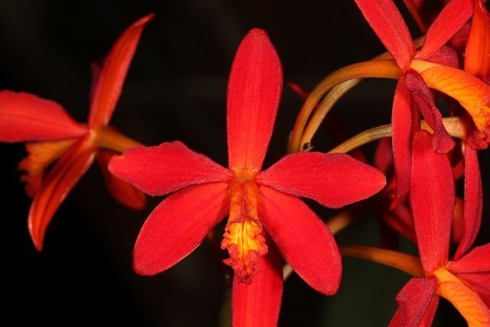
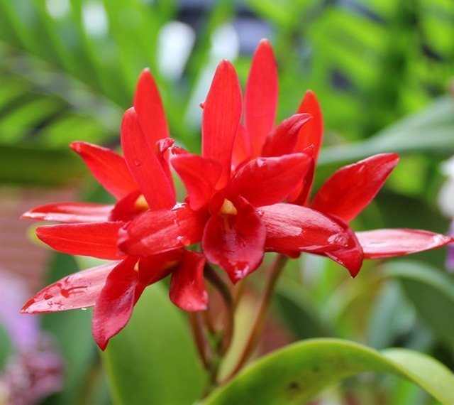
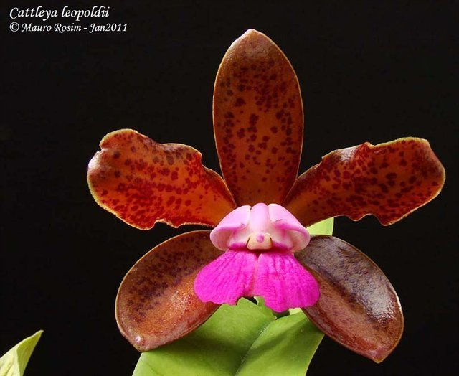
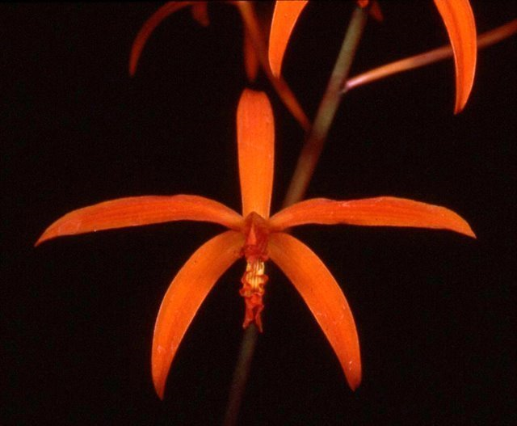
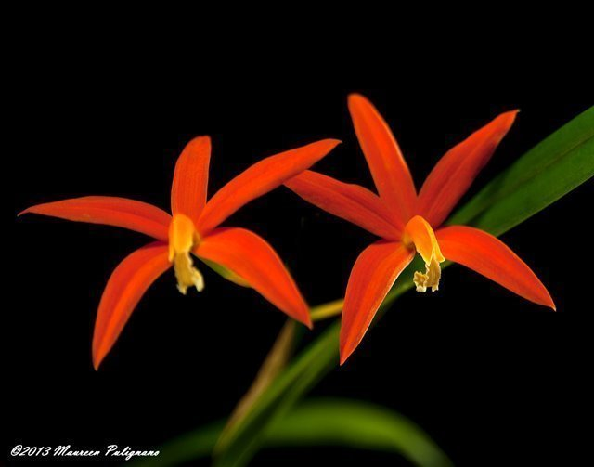
Small flowered reds….
C. coccinea? Gur. aurantiaca? C. guttata? C.milleri/cinnabarina/harpophylla?
All can breed true red free from purple overtones
The red in these species are dominant, but so is size and small lips and open form (except for C. coccinea of course)
This present a huge barrier is breeding large well-formed flowers that we desire in modern standard Cattleya
Therefore, it is only approximately less than 1% in modern standard red’s genetic composition

Slide 9
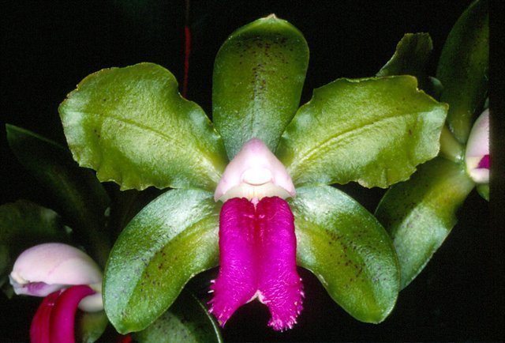
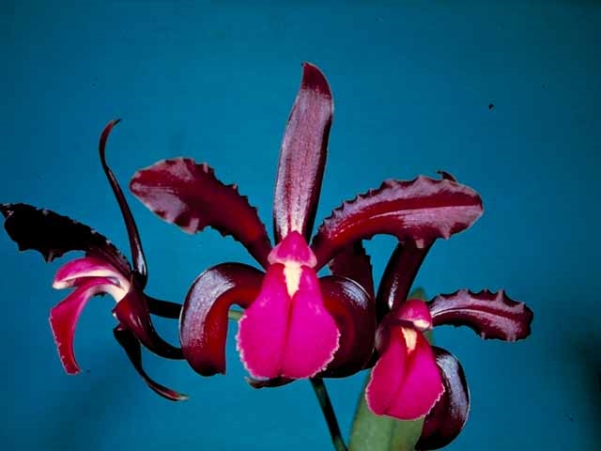
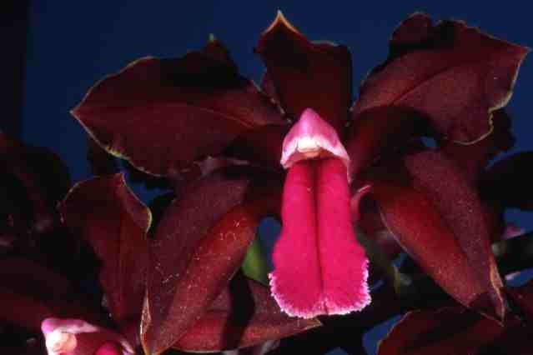
Cattleya bicolor
Cousin of C. guttata, come in a variety of colors. Larger flower, broader segments, heavy substance/glossy texture. Downside is lip lacking sidelobes
tipo vs ssp. brasilliensis
‘Black Beauty’ 84 pts AM/AOS (1968)
‘Bronze Beauty’ 81 pts AM/AOS (1999)
‘SanBar Mega’ 82 pts AM/AOS (2016)

Slide 10
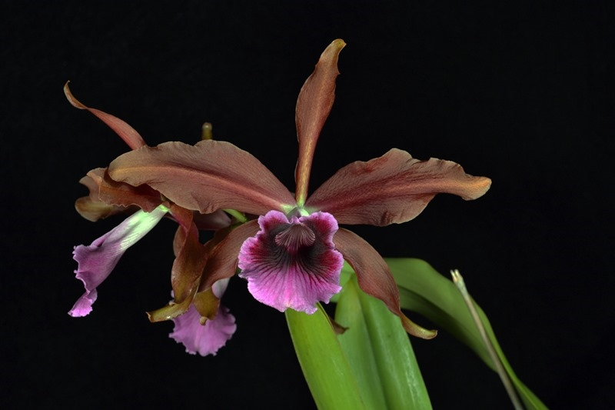
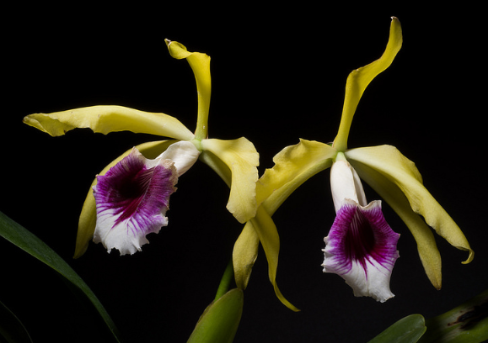
Cattleya tenebrosa
Incredibly large flower size dominant in breeding with variating degree of red coloration in the flower.Down side is poor shape without line breeding. However, some of the old drawing depicting in the past show that there are far superior natural clones to this species that doesn’t exist today
Historically forma aurea is more often used rather than forma tipo and one particular clone ‘Walton Grange’ (a very old clone exist before 1900) has figured prominently in the background of many exceptionally dark magenta and purple-red hybrids bred from C. dowiana and C. dowiana var. aurea.
‘Estrela Escura’ 88 pts AM/AOS (2015) NS 20.5cm
‘Walton Grange’ 91 pts FCC/AOS (1987) NS 19.5cm

Slide 11
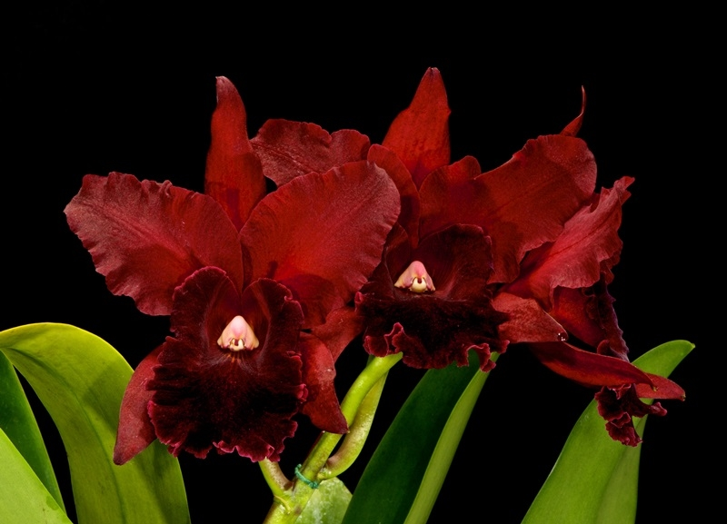
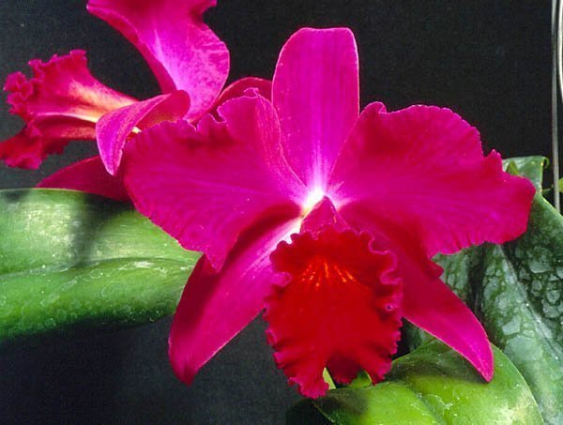
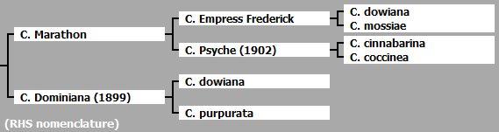
Cattleya dowiana
Interesting species, recessive when cross with purples in the first generation but will strongly exert itself when doubled with other dowiana-bred deep purples → intensify the purple and gives rise to deep purplish red
Positive trait: incredible dark lip passing on for generations. Negative trait: poorly formed flowers, also can cause crippling some early yellows.
Most modern day reds has more than 40% of C. dowiana in its genetic composition
These are the two example that shows the intensifying effect of dowiana
C. Maria Ozzella ‘Parth’ 82 pts AM/AOS (2014)
This hybrid was registered in 1958
C. Anzac ‘Orchidhurst’ FCC/RHS

Slide 12
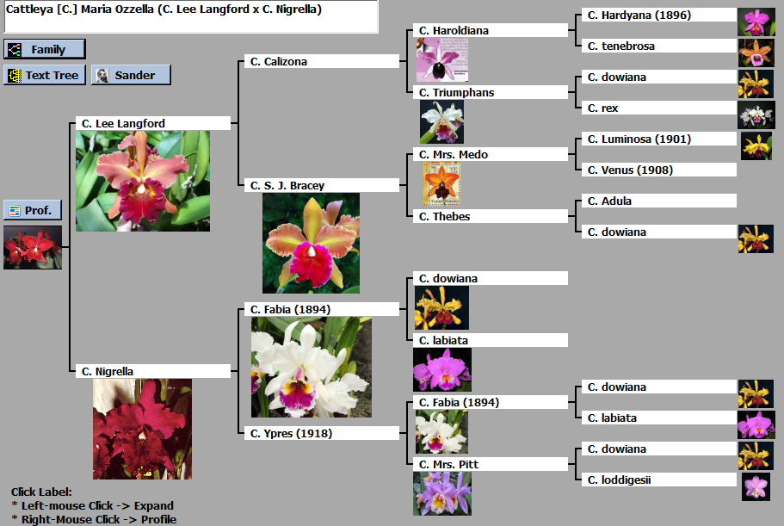

Slide 13
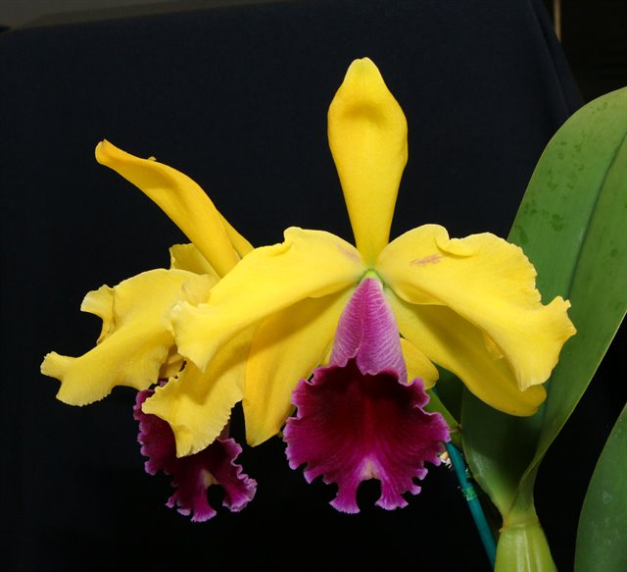
C. Iris(1901) and C. Luminosa(1901)
These are the foundation of major reds and yellows
C. Iris ‘King Edward VII’ FCC/RHS (1923)
C. Luminosa ‘Kate’ HCC/OCNZ
C. bicolor x dowiana
105 Offspring / 10763 Progeny
C. dowiana x tenebrosa
176 Offspring / 11641 Progeny

Slide 14
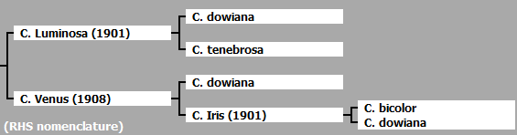
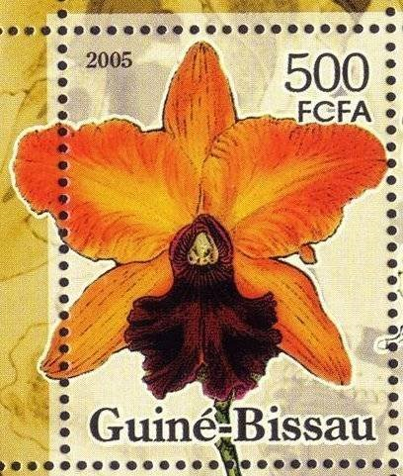
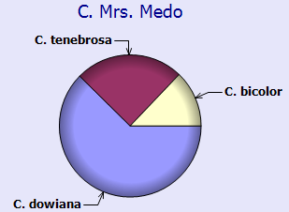
C. Mrs Medo (1922)
Most modern red standard starts out with yellow/art shade and this hybrid is the most used encompassing all 3 previously mentioned hybrids
C. Mrs. Medo ‘Low’ AM/RHS (1923)
73 Offspring /8573 Progeny

Slide 15
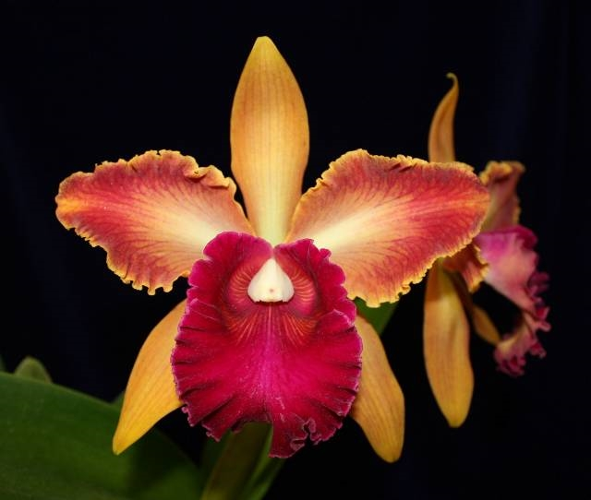
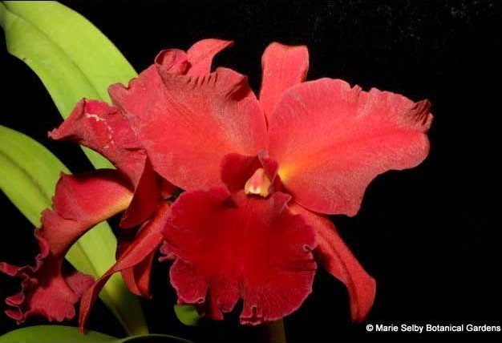



C. S. J. Bracey (1940)
This hybrid is the next stepping stones and also the start of the differentiation between reds and yellow breeding
C. S. J. Bracey ‘Wailani’ AM/AOS
Historically important clone
82 pts (1959) to 84 pts (2011)
C. Naomi Kerns (1956)
C. Maria Ozzella (1958)
C. Mrs Medo x C. Thebes
89 Offspring / 4852 Progeny
The 50s and 60s are where we are starting to see some first reds, note with smaller, more, open flowers and poorer shape
C. Mae Hawkins (1967)
C. Sally Taylor (1985)

Slide 16




C. Waianae Sunset (1963)
This Mrs. Medo hybrid
C. Dorothy Fried x (C. Mrs. Medo x C.Mysia)
112 Offspring/ 2232 Progeny
This Mrs Medo hybrid is a major breeder for rosy red/watermelon red/peach red/art shades… pre Chia Lin
C. Waianae Sunset ‘Pokai’ 83 pts AM/AOS (1966)
C. Eve Marie Barnett (1981)
‘Magnificent Watermelon Gold’ 90 pts FCC/AOS (1981)
C. Tainan City (1998)
‘General’ 83 AM/ AOS (2007)
C. Hey Song (1999)
‘Tian Mu’ 85 pts AM/AOS (2007)

Slide 17

Rlc. Oconee
Is the result of a yellow with dark red overlay Catt bred with the largest and darkest purple at the time: Rlc. Norman Bay ’Lucille’ 92 pts FCC/AOS (1964) (NS 16-17cm)

Slide 18


Rlc. Oconee (1976)
Specifically the clone Rlc. Oconee “Mendenhall” 88pts AM/AOS registered by Bill Carter at Carter and Holmes Orchids
“vibrant wine red” with “superior substance and texture” nice and fuller shape
275 Offspring/ 1189 Progeny
Everything bred with Oconee turn up very colorful and intense. And because of Norman Bay parent, this hybrid has superb size for the current state of reds with its 15 cm flower raising the standard of red to a whole new level
Regarded as one the best Cattleya parent of all time in term of quality hybrids! (Still can’t beat Bow Bell -_-) and it’s still being bred with up til today

Slide 19



Carter and Holmes Oconee trio
Rlc. Owen Holmes
(Harlequin x Oconee) (1982)
‘Mendenhall’ 84 pts AM/AOS (1991)
Rlc. Edisto
(C. Maria Ozzella x Rlc. Oconee) (1982)
‘Carol’ 84 pts AM/AOS (2018)
Rlc. Port Royal Sound
(C. Amber Glow x Rlc. Oconee) (1983)
‘Night Rider’ 83pts AM/AOS (1998)
These demonstrate the genetic power of Rlc. Oconee for deep dark color and superb forms. Velvet texture now does not only on the lip but is throughout the flowers in some instances

Slide 20




Rlc. Chia Lin (1989)
The “Golden Child” of Oconee, this is the current gold standard that all the red are judged base upon.
Velvety texture, deep or vibrant color, heavy substance, fragrance, full forms, ruffles, contrasting golden dowiana threads, size larger than 15cm. However, petals aren’t always flat
133 Offspring/ 247 Progeny
‘New City’ 80pts AM/AOS (2001)
‘PCT’ 84 pts AM/AOS (2002)
‘Shinsu#1’ 80 pts AM/AOS (2004)
‘Wilson’s Choice’ 87 pts AM/AOS
84 pts CCM/AOS (2014)

Slide 21


Rlc. Sanyung Ruby (1995)
Possible successor to Chia Lin, however, instead of deep red, more ruby red thanks for Waianae Sunset influence. Larger size, vigorous.
Rlc. Waianae Coast x Chia Lin
‘FANGtastic’ unawarded
‘Kuang Lung’ 83 pts AM/AOS (2001)
NS 17.7 cm

Slide 22



Newer hybrids – Chia Lin
And many more Chia Lin hybrids, worthy of awards. No AOS award is currently given to these cross, possibly because these hybrids are not yet widely available.
Rlc. Shinfong Beauty (1998)
(Shinfong Lisa x Chia Lin)
Rlc. Tony Marcus Bailey (2010)
(Chia Lin x Prince of Tides)
‘Amanda’ unawarded
Rlc. Village Chief Armani (2006)
(Shinfong Beauty x Tainan City)

Slide 23



Newer hybrids - Oconee
Here are more of Oconee’s progeny, noted the unusual magenta on red flare on Barney Garrison, and the unusual but still pleasing form and glossy texture of Mem Claus Graf
Rlc. Barney Garrison(2004)
(Yonges Island x Owen Holmes)
‘Walton’ 83 pts AM/AOS (2015)
Color: ruby red flared magenta
Rlc. Heaven’s Gate (2015)
(Leonard Smith x Carolina Splendor)
‘Crystelle’ 87 pts AM/AOS (2018)
Rlc. Memoria Claus Graf (2012)
(Mem. Hans Graf x Goldenzelle)
C. bicolor = 15.84%

Slide 24

C. Circle of Life
Hybridized in 1998 by Frank Fordyce, a well known compact catt breeder
Well-known hybrid for breeding bright colorful mini/compact Catts, especially reds
The hybrids crossed with standards has reached approximately 11.5cm NS flowers with a compact plant stature
This regain popularity as another starting point and major influence of modern standard reds which typically lack C. coccinea
Provide more vibrant color to its offsprings at the cost of slightly smaller flower and smaller lip.
However, do you still remember the time where the best red was less than 13cm. Who knows what the future will hold for these hybrids.

Slide 25


Hybrids with C. Circle of Life
Rlc. Memoria Frank Fordyce (2011)
(Rlc. Chia Lin x C. Circle of Life)
‘Firehouse’
Rlc. Oconee Circle (2004)
(C. Circle of Life x Rlc. Oconee)
‘Lone Jack’ 79 pts HCC/AOS (2008)
NS 11.5cm

Slide 26
Resource
Orchidwiz version 5.0
Orchid Plus Online
http://www.aos.org/orchids/collectors-items/cattleya-tenebrosa.aspx
Fordyce, F. (1967). The Well Travelled-Road to Red Cattleyas. Orchid Digest, 31(10). Retrieved from http://dvos.org/Library/Articles%20by%20Frank%20Fordyce/fordyce%207.pdf
http://keithdavisorchids.com/gallery8-myhybridslist.htm
Matsui, S., & Nakamura, M. (1988). Distribution of Flower Pigments in Perianth of Cattleya and Allied Genera 1: Species. Japanese Society for Horticultural Science, 57(2), 222-232.

