Slide 1
Spathoglottis
A presentation by Vee Du

Slide 2
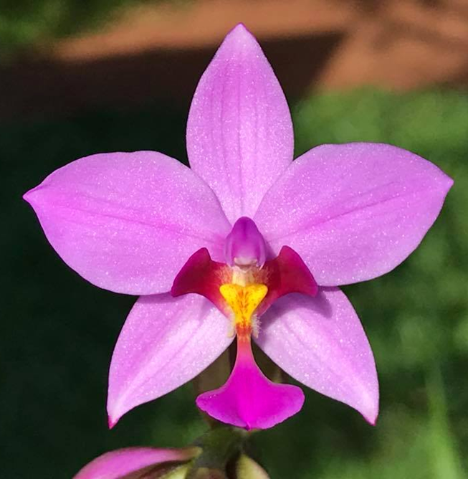
Spathoglottis plicata
“Spath”: spade-shaped, “-glottis”: tongue (lip)
Type species: Spathoglottis plicata

Slide 3
An under-appreciated gem
Fully terrestrial orchids.
Create a specimen quickly.
Beautiful plants
Hybrids comes in a variety of attractive colors
“Ever-blooming”
Commercial potential

Slide 4
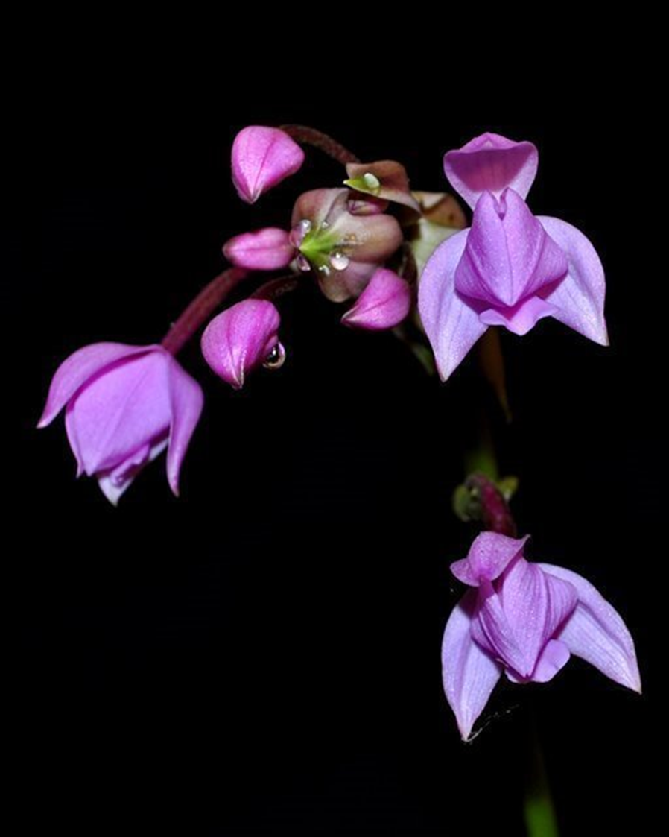
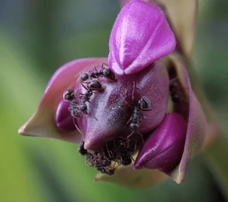
On the flipside….
Larger plant size
Not a good cut flower
Poor form
Attract ants
Lack of commercial availability
Prone to virus

Slide 5
Bletilla
Cold hardy
Thicker and broader foliage
Seasonal/bloom in spring
Terminal inflorescence
Flower shaped like a Cattleya
Commercially available
Spathoglottis
Tropical to subtropical
Narrower and arching foliage
Can bloom year round
Basal inflorescence
Flower with spade-shaped lip
Lack of commercial availability

Slide 6
Propagating Spathoglottis
Quick seed maturation
Easy germination
Short seed to flower time
More difficult artificial propagation
Commercializing potential

Slide 7
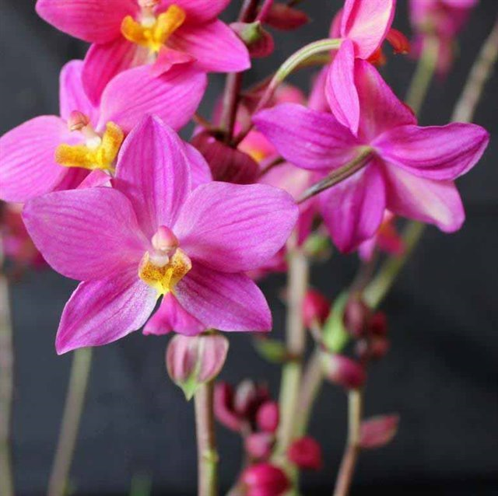
Spathoglottis plicata hybrids
Create more color variations. Spa. plicata imparts vigors
Most modern hybrids happens after the 1990s
Spa. Loretta (Ingham Red x plicata) 87.5% Spa. plicata

Slide 8
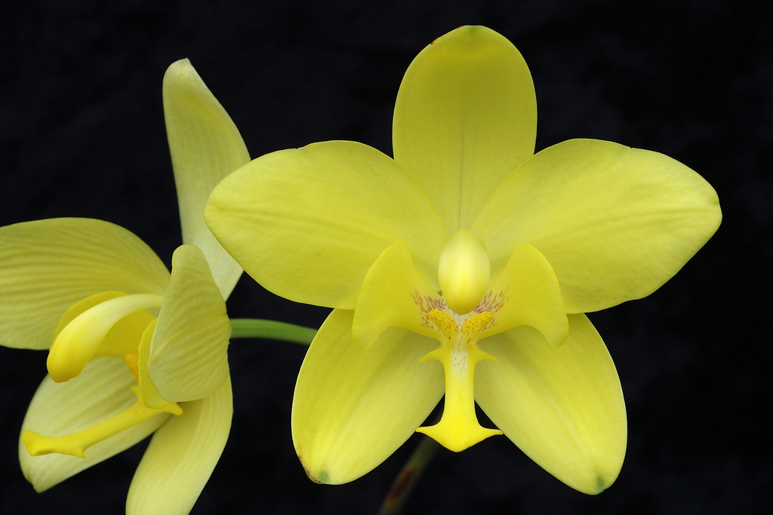
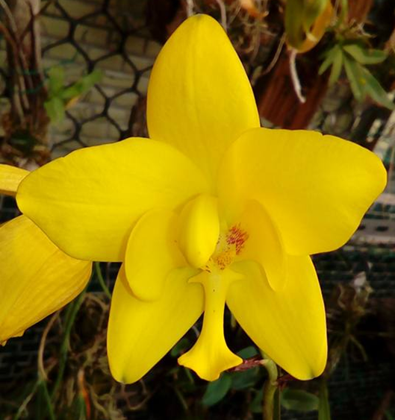
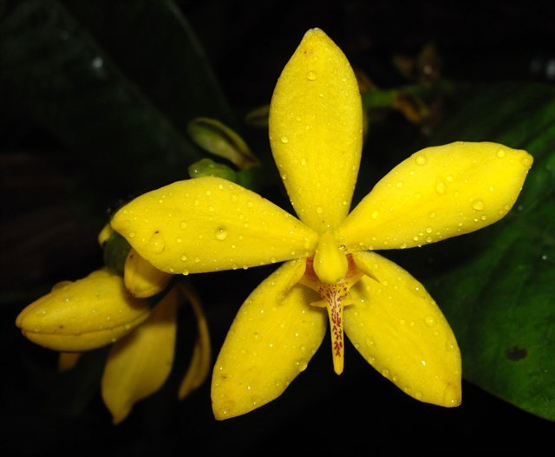
Yellow Evergreen Spathoglottis
Spa. kimballiana
Spa. gracilis
Spa. aurea

Slide 9
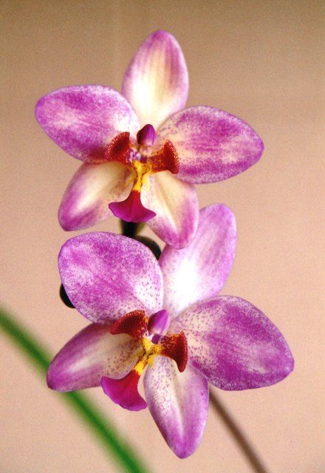
Spa. kimballiana influence
Breeding started in 1995
Create larger flowers for Spathoglottis. Can produce flowers over 3 inches.
Responsible for the yellow background color
“Freckles” appear when bred with purple
Spa. Freckle Face (kimballiana x plicata)
Spa. Golden Gift (Freckle Face x kimballiana)

Slide 10
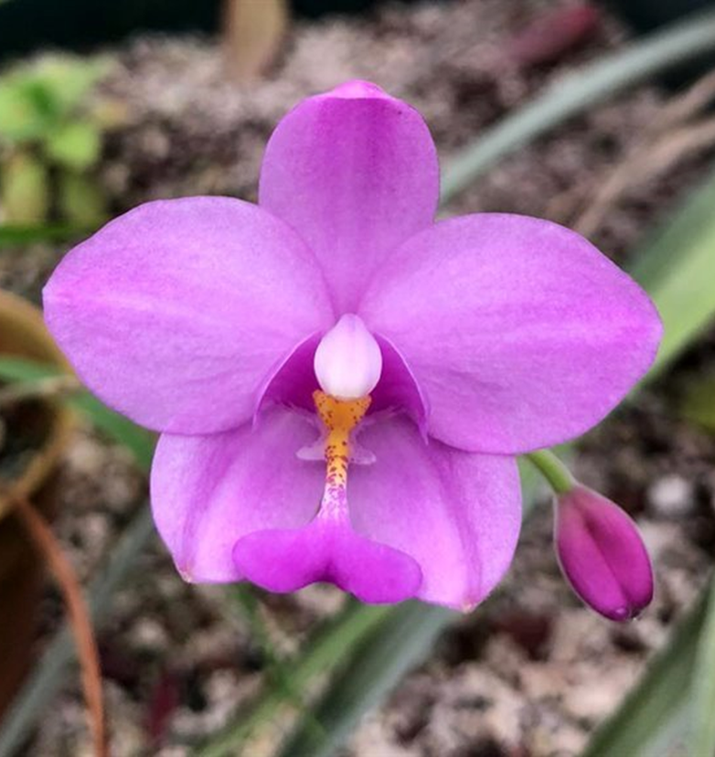
Spathoglottis tormentosa
Excellent shape
Good form is a very dominant trait
Compact plant
Leaf with velvety texture

Slide 11
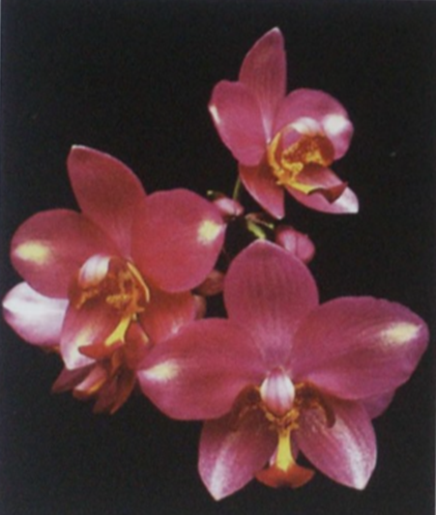
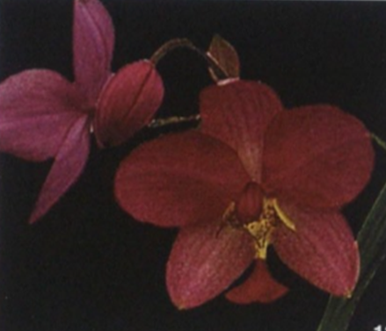
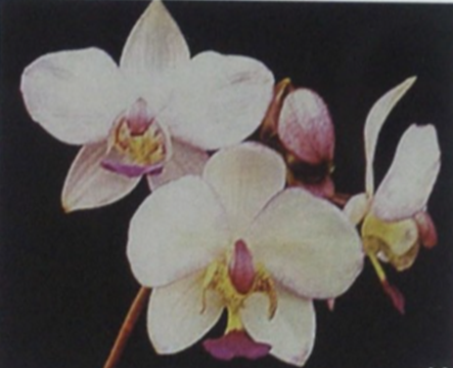
Spa. tormentosa hybrids
Spa. (tormentosa x plicata ‘Bangkok Dark’)
Spa. Ted Green
(kimballiana x tormentosa)

Slide 12
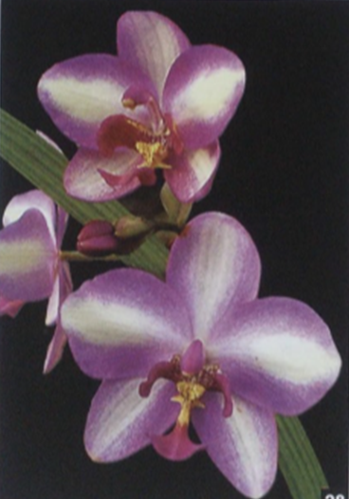
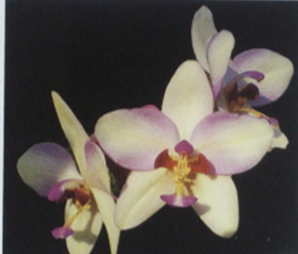
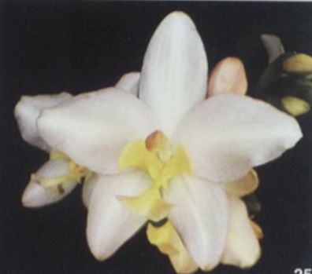
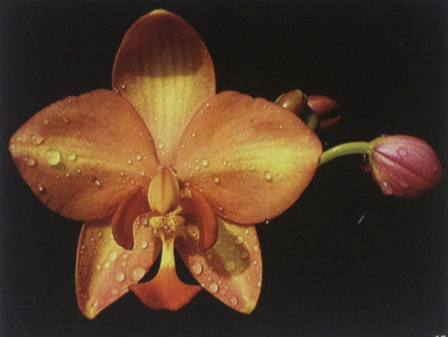
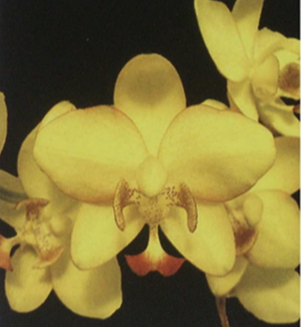
Spa. Ted Green hybrids
x Spa. plicata var alba ‘Golambo’)
x Spa. (Menehune x Rolita)
Color recessive
Bad traits including weak stem, poor flower substance
x Spa. Parsonsii ‘Amy Consuela’
x Spa. vanoverberghii

Slide 13
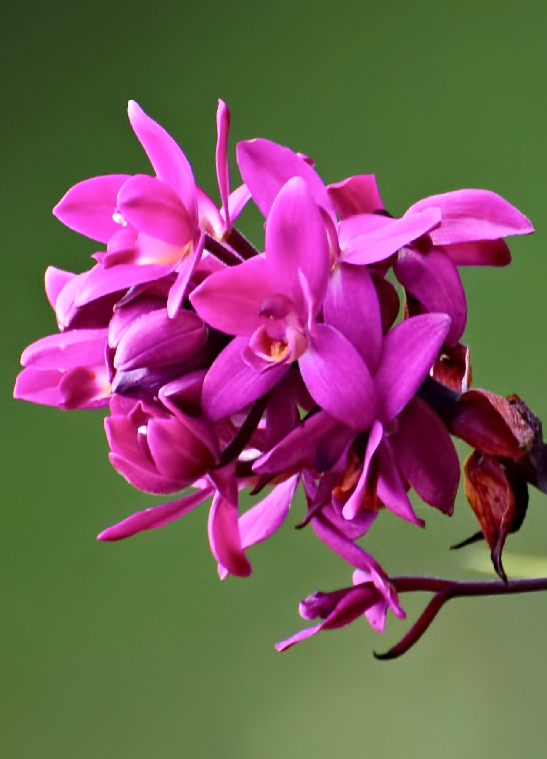
Spathoglottis unguiculata
Clusters of small cupped flowers, intense color
Good substance, and “grape juice” fragrance
Upright, strong inflorescence. Compact.

Slide 14
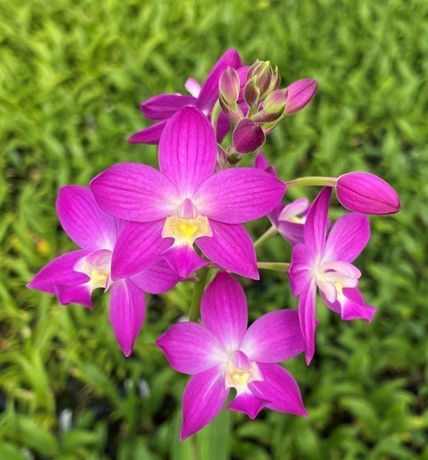
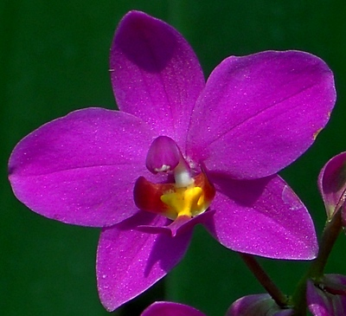
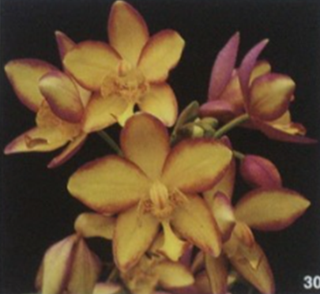
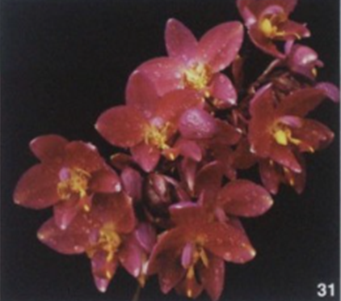
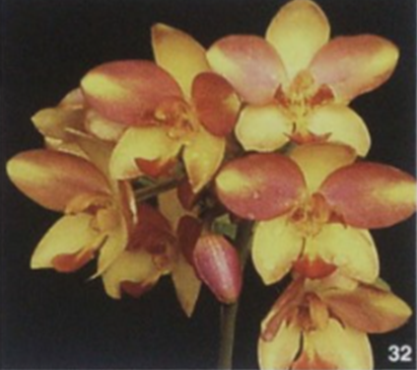
Spa. unguiculata hybrids
Underused before 2000
Upright stems
Flowers more numerous, better substance
Create more vivid flowers
Spa. Seletar Park ([unguiculata x plicata) x plicata)
Spa. Cherry Blossom
(Menehune x eburneum)
Spa. (Menehune x Rolita)
Spa. (Rolita x unguiculata)
Spa. (Menehune x Freckle Face)

Slide 15
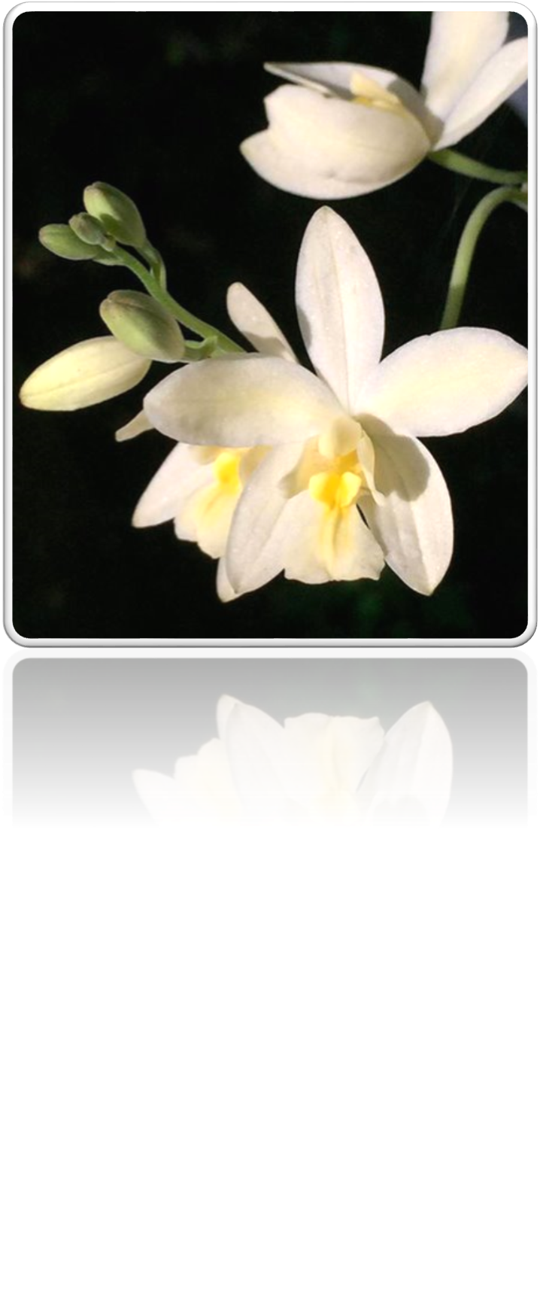
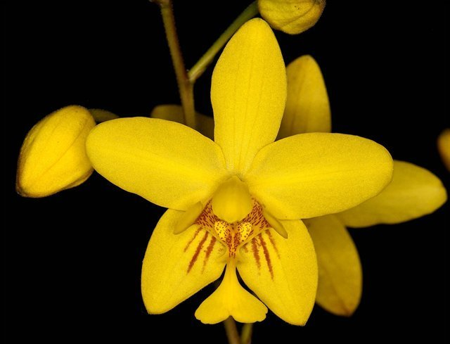
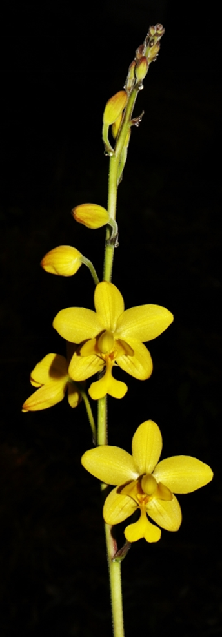
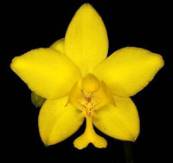
Deciduous Spathoglottis
Spa. affinis and its inflorescence
Spa. eburnea
Spa. vanoverberghii

Slide 16
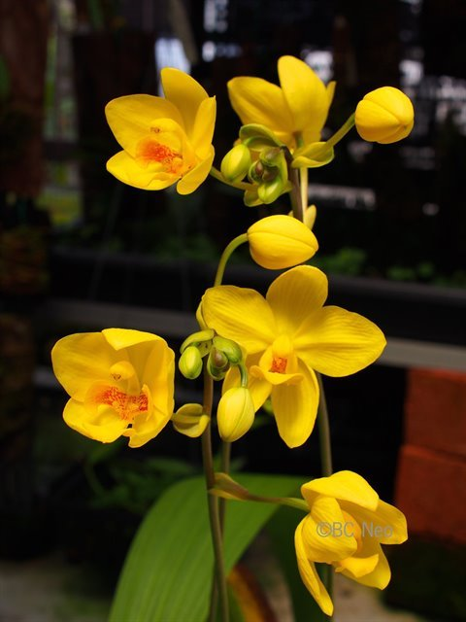
Golden Spathoglottis
A combination of :
Spa. kimballiana
Spa. aurea
Spa. gracillis
Spa. affinis
Spa. vanoverberghii
Spa. Lion of Singapore
(kimballiana x vanoverberghii)

Slide 17
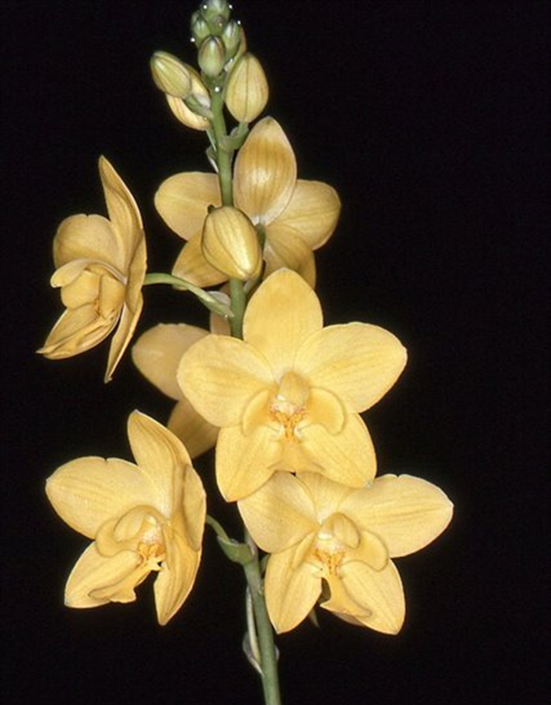
Hybrids with Spa. affinis
Create inflorescence that hold multiple open flowers at once
Can appear ratty in the fall due to deciduous genes not fully manifest
Gives stripping pattern to offsprings, can persist through generations
Spa. Burleigh Gold (affinis x kimballiana)

Slide 18
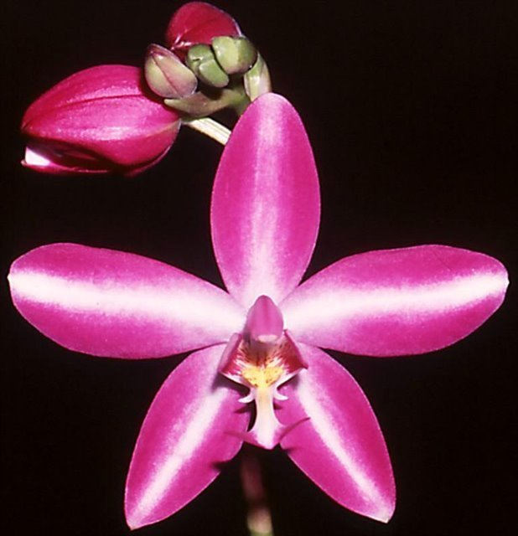
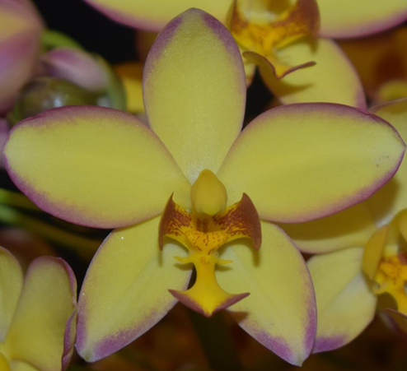
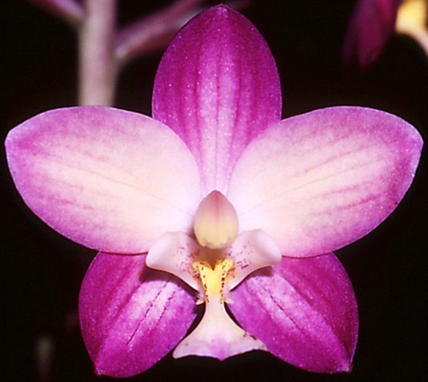
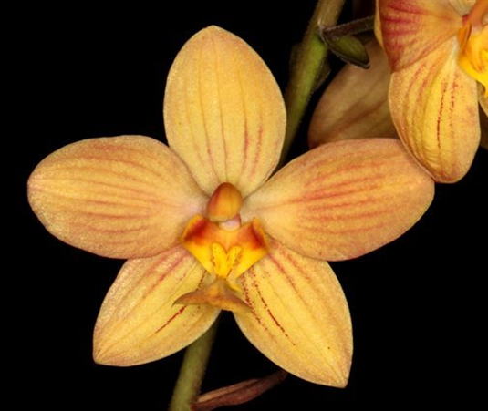
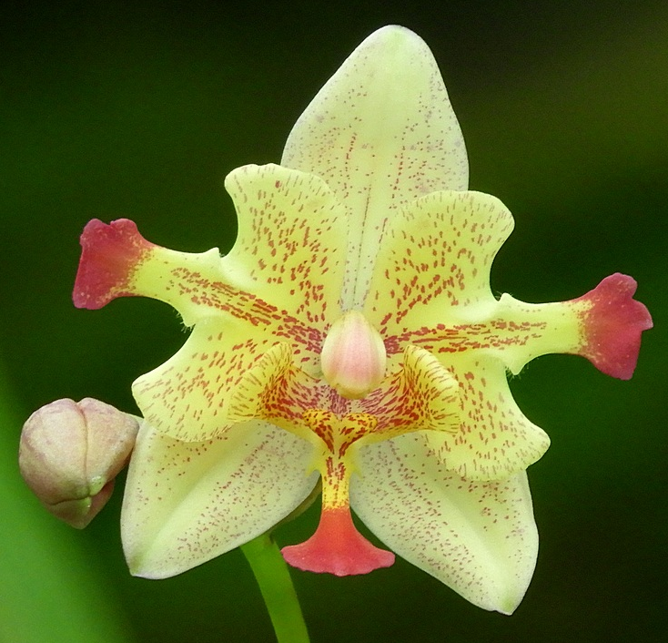
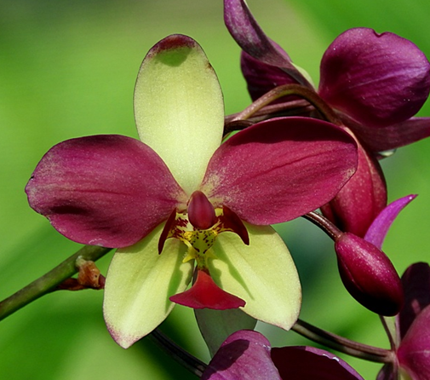
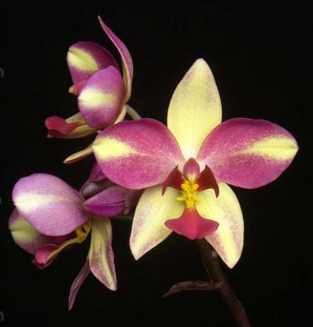
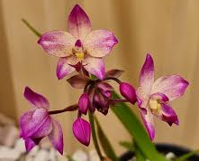
Variations of spathoglottis
Spa. Star Burst
(Freckle Face x Seletar Park)
Spa. Lueng Aroon ‘JonFi’ CCM/AOS
Spa. Caity-Brook (Seletar Park x affinis)
Spa. Sunshine (affinis x plicata)
Spa. plicata var. bicolor (?)
Spa. Chrysops
Spa. “Far Out Freckles” (NOID?)
Notes:
Starburst pattern. Picotee. White central. Stripes. Peloric. Bicolor. Flare. Apical blush

Slide 19
Source
OrchidWiz Encyclopedia version 9.1
Orchid Plus Online
The Orchids Magazine :
Hybridizing Spathoglottis. Issue September 2008, page 46-52
The Genus Spathoglottis. Issue November 1989, page 35-39
Burleigh Park Orchids
https://www.speciesorchids.com/Spathoglottis.html#Photos
Nordin, F.A.; Saibeh, K.; Go, R.; Mangsor, K.N.A.; Othman, A.S. Molecular Phylogenetics of the Orchid Genus Spathoglottis (Orchidaceae: Collabieae) in Peninsular Malaysia and Borneo. Forests 2022, 13, 2079. https:// doi.org/10.3390/f13122079

