Slide 1
Phragmipedium kovachii
A presentation by Vee Du

Slide 2
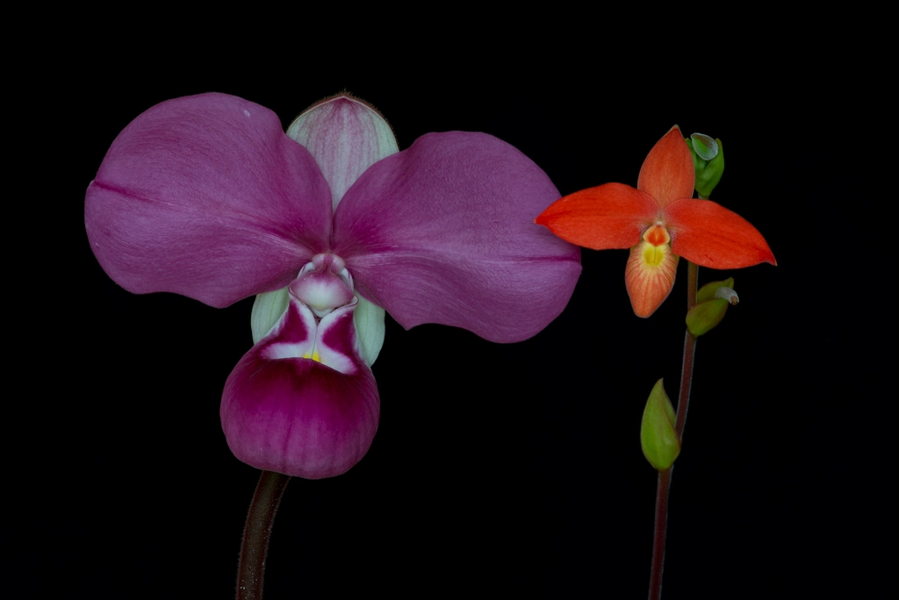
“The holy grail or orchids”
Larger than any of the species in the “colorful Phrag” section (sec. Micropetalum). In fact, it is so unique that it is separated into its own separate category (sec. Schluckebieria)
Unique color pattern especially the pouch’s dark purple and a golden rim
Almost perfect “full” “round” shape for judging standard, great breeding potential

Slide 3
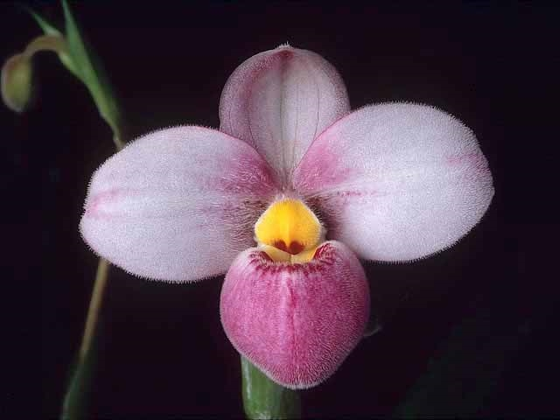
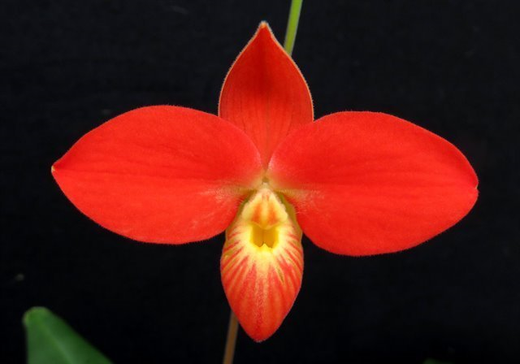
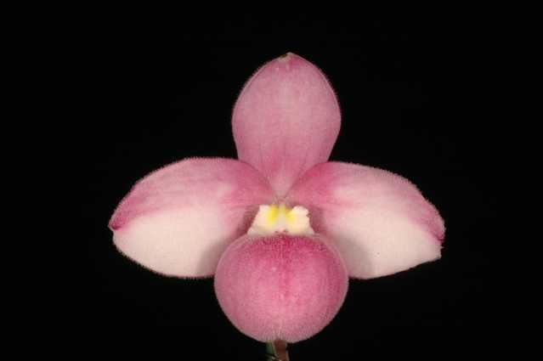
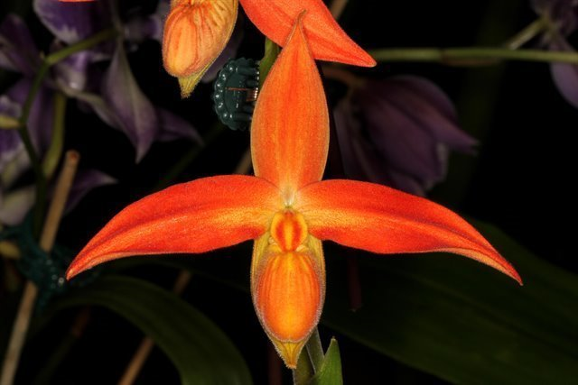
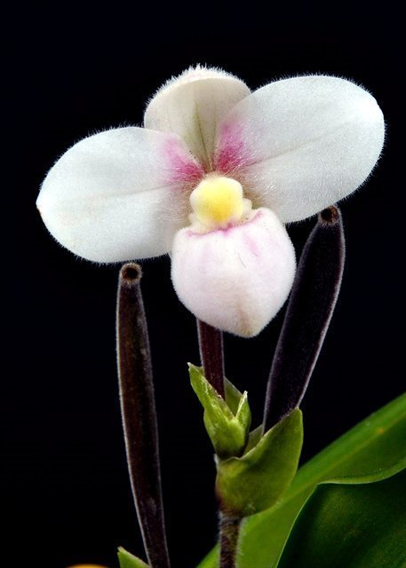
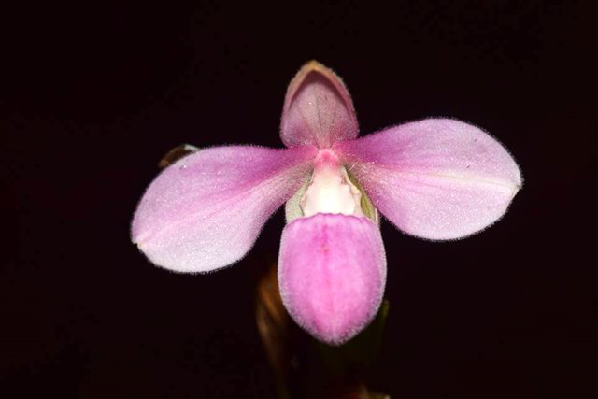
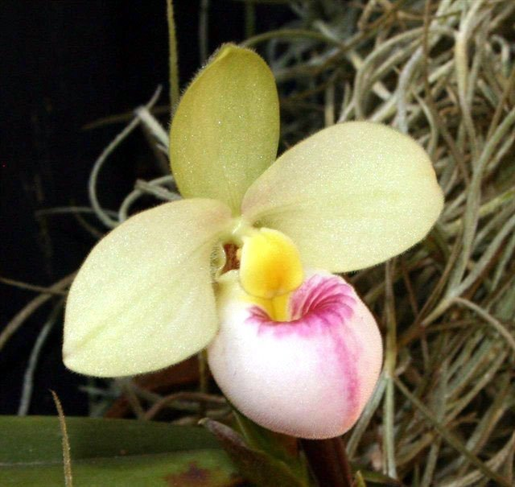
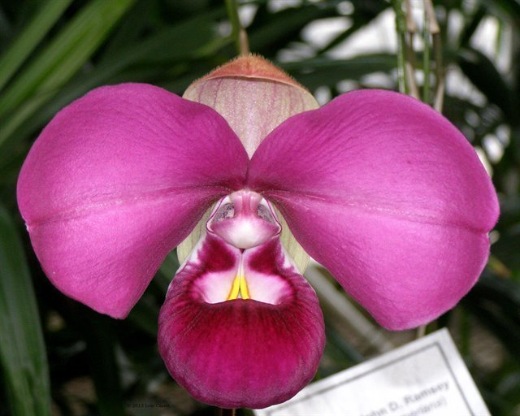
Section Micropetalum…
…..vs P. kovachii

Slide 4
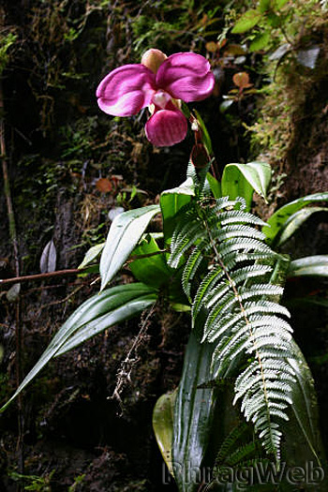
Characteristic of P. kovachii
Flower can reach up to 6+ inches across, 1-3 flowers per spike from October to March, and can self pollinate → possible inbred in nature → seedlings are VERY slow to grow and prone to sudden death
After opening, petals grow, lighten in color, and become wavy. At the peak of the development, flower can be twice larger but much poorer form and lighter color. Look best at day 3.
https://www.youtube.com/watch?v=Dy3I6L-Tb9E
It’s common for flower to have streaks/color break
Grow in tropical cloud forest on limestone rock, therefore it likes alkaline substrate rich in Calcium, plenty of clean water, constant moisture at the root and, and cool temperature (especially night time)

Slide 5
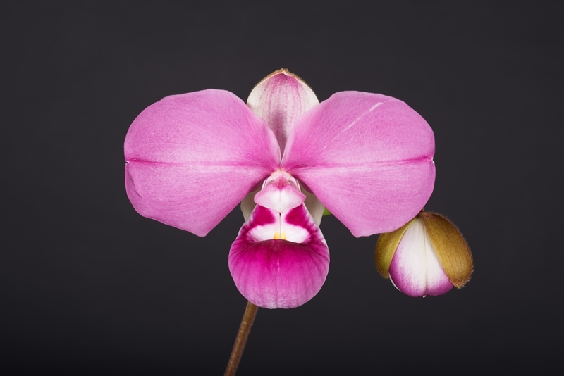
‘Birdman’ (3/2015) 91 pts FCC/AOS, NS 17cm
Notice the faint white streak on the left petal.
A very common characteristic of the species. Judges are willing to overlook flaw for size/shape/symmetry

Slide 6
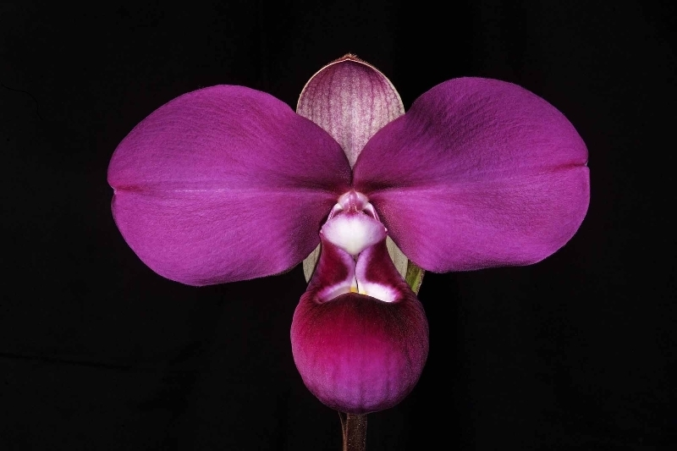
‘Katya’ (11/2015) 93 pts FCC/AOS, NS 17 cm
The highest score exhibited to date. Again noted the faint white stripe in the midrib of the right petal
Note that the dorsal is slightly cup but no obvious reflex at the base, petals are flat

Slide 7
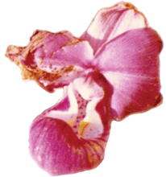
The discovery of the century
Discovered May 26th 2002
Arrived to US June 4th
Published June 17th. In July it was officially published as Phrag peruvianum, but since kovachii was published in print first, it became the official name.
Black market price $10,000
Believe me it is juicy, somebody ought to make a movie about this

Slide 8
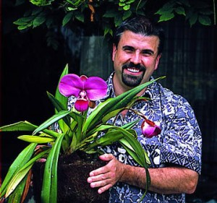
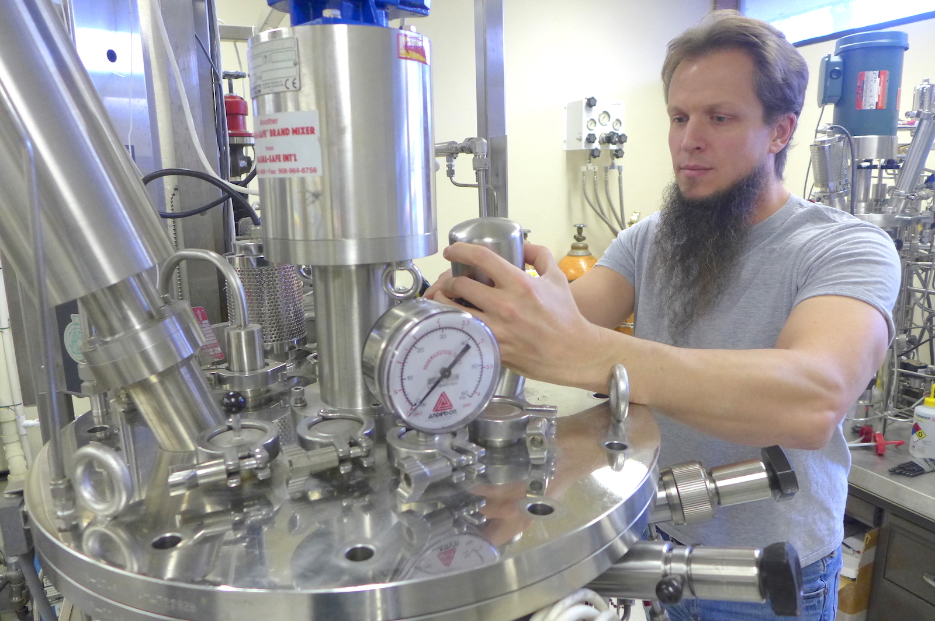
The discovery drama of the century
Decker (Piping Rock) has “minimal success” propagating the flower so he partnered up with Fritz Schomburg Ph.D., a biochemist from Tropical Propagations.
Schomburg grew 6,000 to 10,000 seedlings and shipped them to Hawaii where was to grow out the plants for sale but according to Schomburg, Decker took 2/3 of the healthiest plants terminating the partnership and leaving Schomburg with the runts
Fritz Schomburg sued Glen Decker in Federal Court.

Slide 9
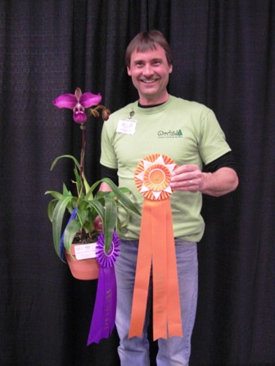
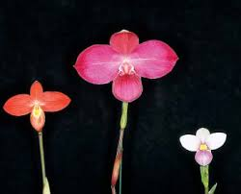
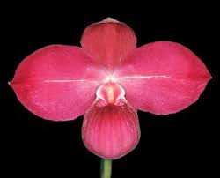
More trivias
First P. kovachii (PK) bloomed from seed (legally) in the US, by Chuck Acker in Feb 1st 2009
First PK hybrid that bloomed is Phrag. Haley Decker (kovachii x St Ouen) (2007) after only 14 months after flask
75 Offsprings/143 total Progeny. Quintal Farm is working on very first 3rd generation PK hybrid, 6 has been registered so far. (Orchidwiz 5.3)
Eric Young and Quintal Farm are the biggest breeder of modern day PK hybrids

Slide 10
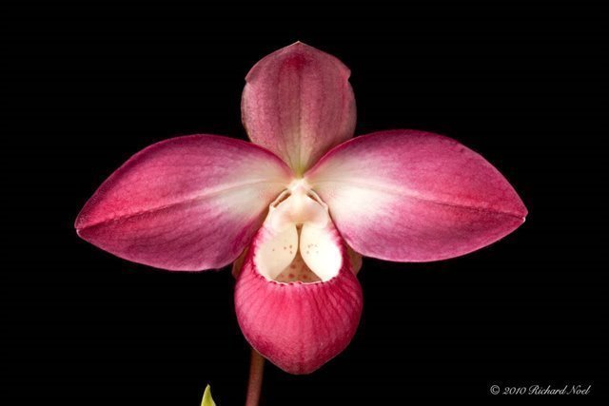
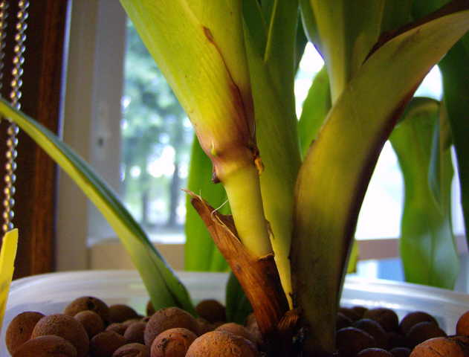
Unique breeding traits: Desirable
The goal for hybridizing with P. kovachii is to create bigger flower with shorter/stockier inflorescence on a smaller plant than that of PK that clumps unlike the climbing habit of P. besseae
Unique color (purple tones) and pattern (Central white patch, dark pouch
P. kovachii Hybrids are much easier to grow than PK
Back of P. kovachii
P. Suzanne Decker ‘Jolly Rogers’ AM/AOS
(kovachii x Cape Sunset)
Phrags do climb

Slide 11
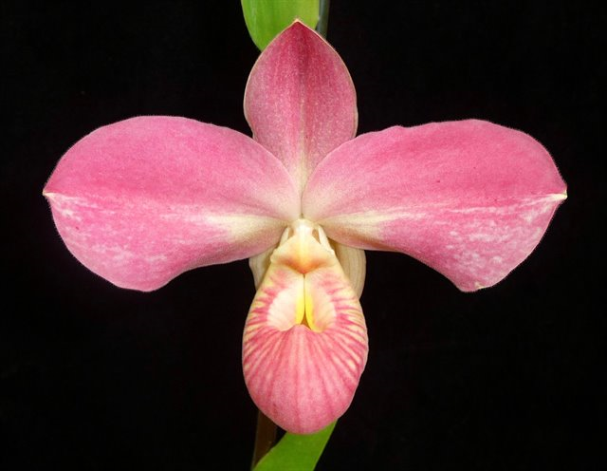
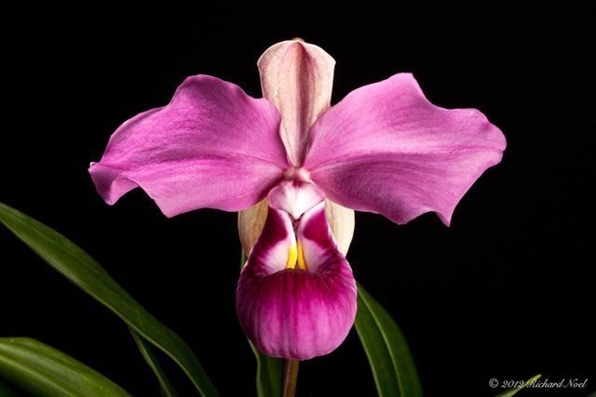
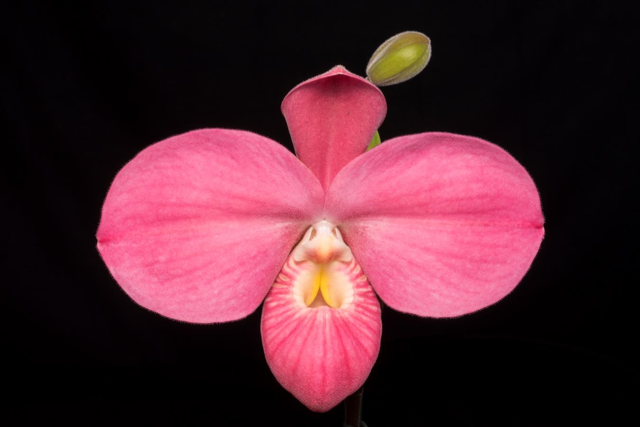
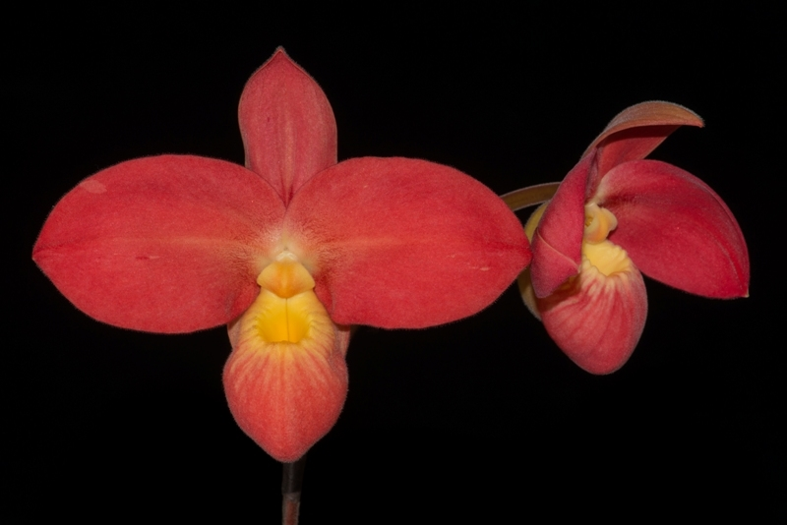
Unique breeding traits: Faults
Petals not flat, has a tendency to reflex and curl with age. Especially the proximal lower petal edge
Dorsal edge also tends to recurve at the base and cupped on top
Color breaks are common, even in hybrids especially P. Haley Decker. Size does not always carry on to second generation.
And did I mention, some PK hybrids are huge!
P. Haley Decker ‘Spring Coulee Creek’
89 pts AM/AOS
P. Fritz Schomburg ‘Haley Suzanne’
83 pts AM/AOS

Slide 12
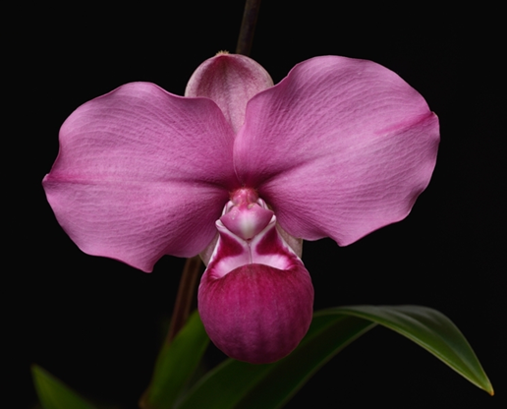
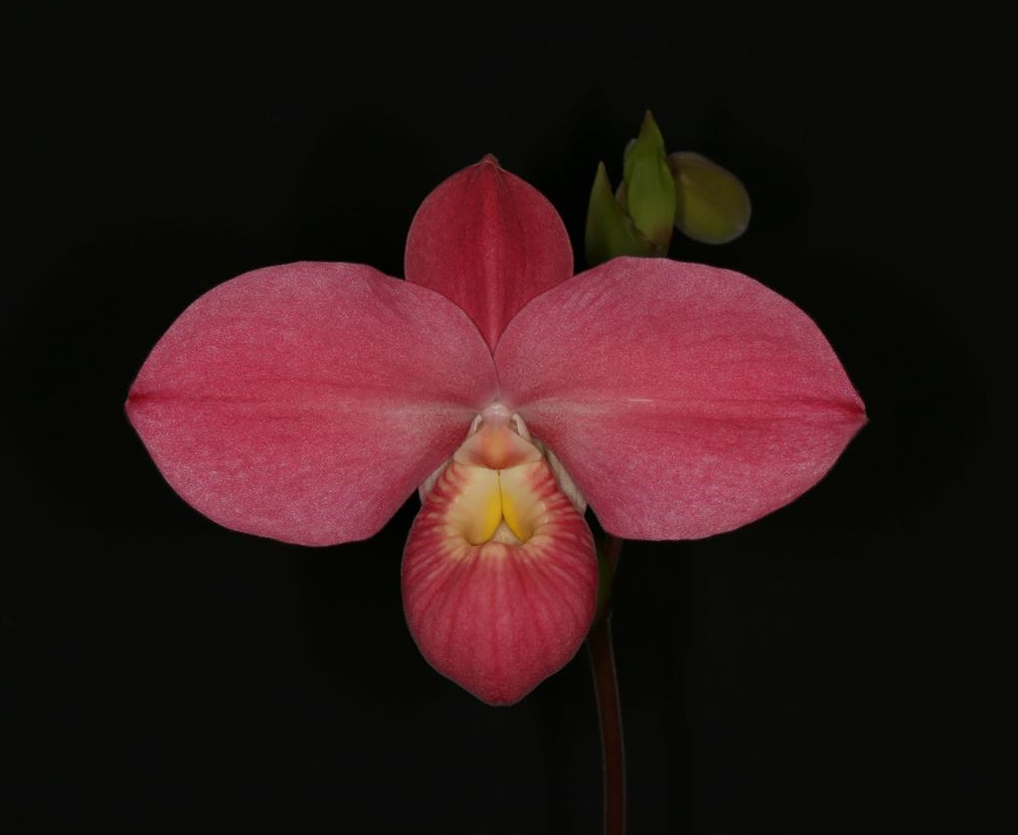
F1 hybrids: P. Fritz Schomburg
‘Eddy Lick Rum’ 93 pts FCC/AOS (3/2019)
NS 14.4cm, most Fritz Schomburg is between 10-13cm
P. kovachii x besseae

Slide 13
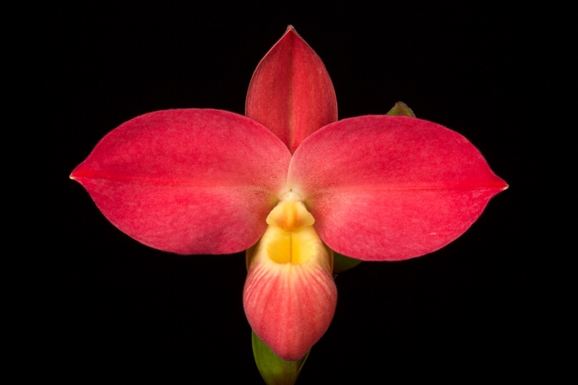
F1 hybrids: P. Fritz Schomburg
Registered 2007 by Glen Decker of Piping Rock Orchids
2 FCCs, 32 AMs, 12 HCCs, 2 CCMs, 1 JC
‘Christine Chowning’ 91 pts FCC/AOS (2/2014)
NS 13.10cm

Slide 14
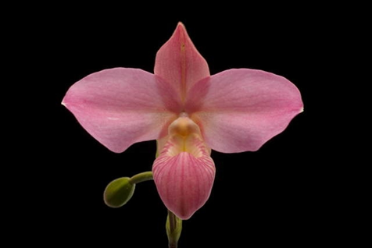
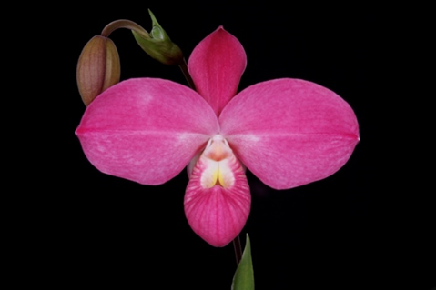
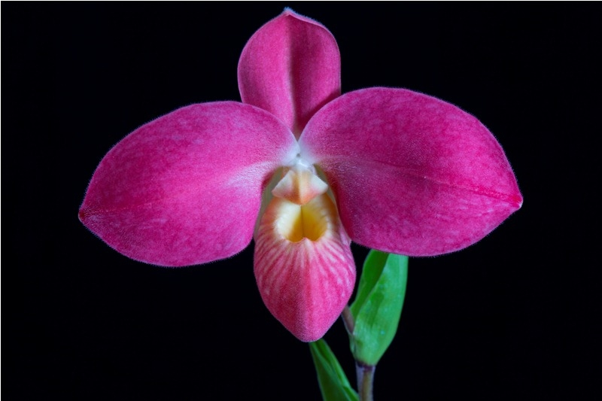
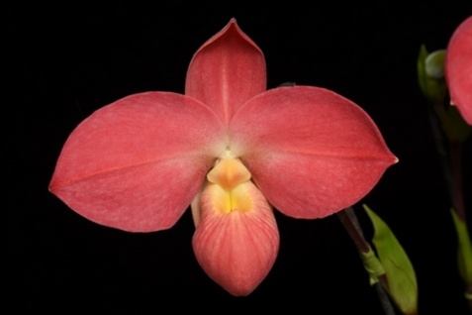
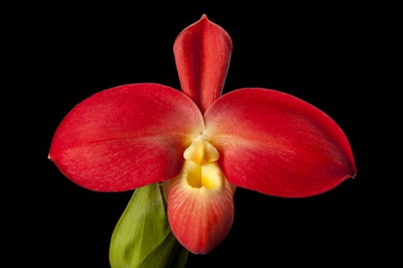
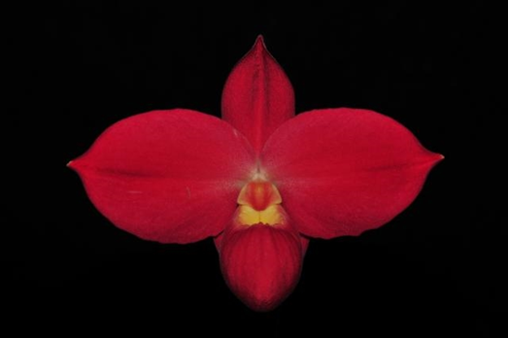
Variations of P. Fritz Schomburg
‘Penns Sunset’ 77 pts HCC/AOS
‘Pink on Pink’ 83 pts AM/AOS
‘Red Sunset’ 78 pts HCC/AOS
‘Susan’ 83 pts AM/AOS
‘Janice Yates’ 84 pts AM/AOS
June’s Orchid Estate’ 85 pts AM/AOS

Slide 15
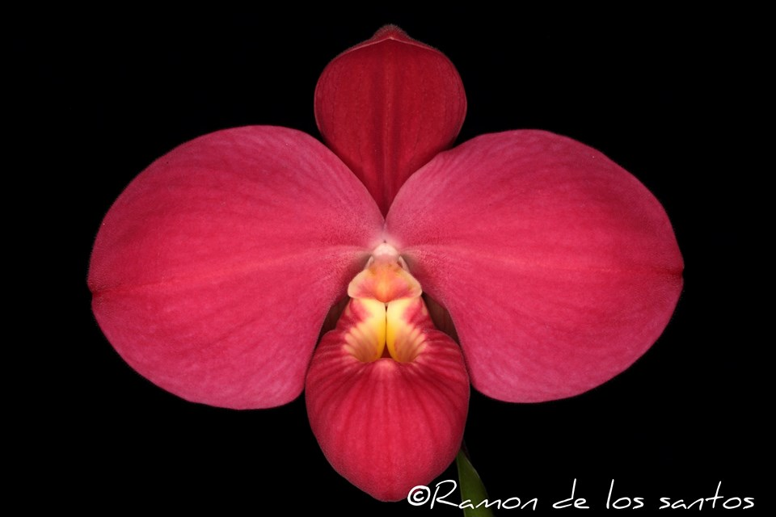
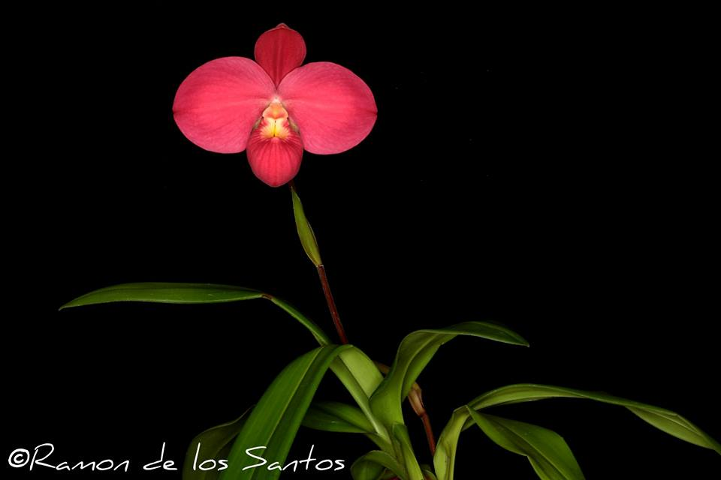
Variations of P. Fritz Schomburg
NS 13cm

Slide 16
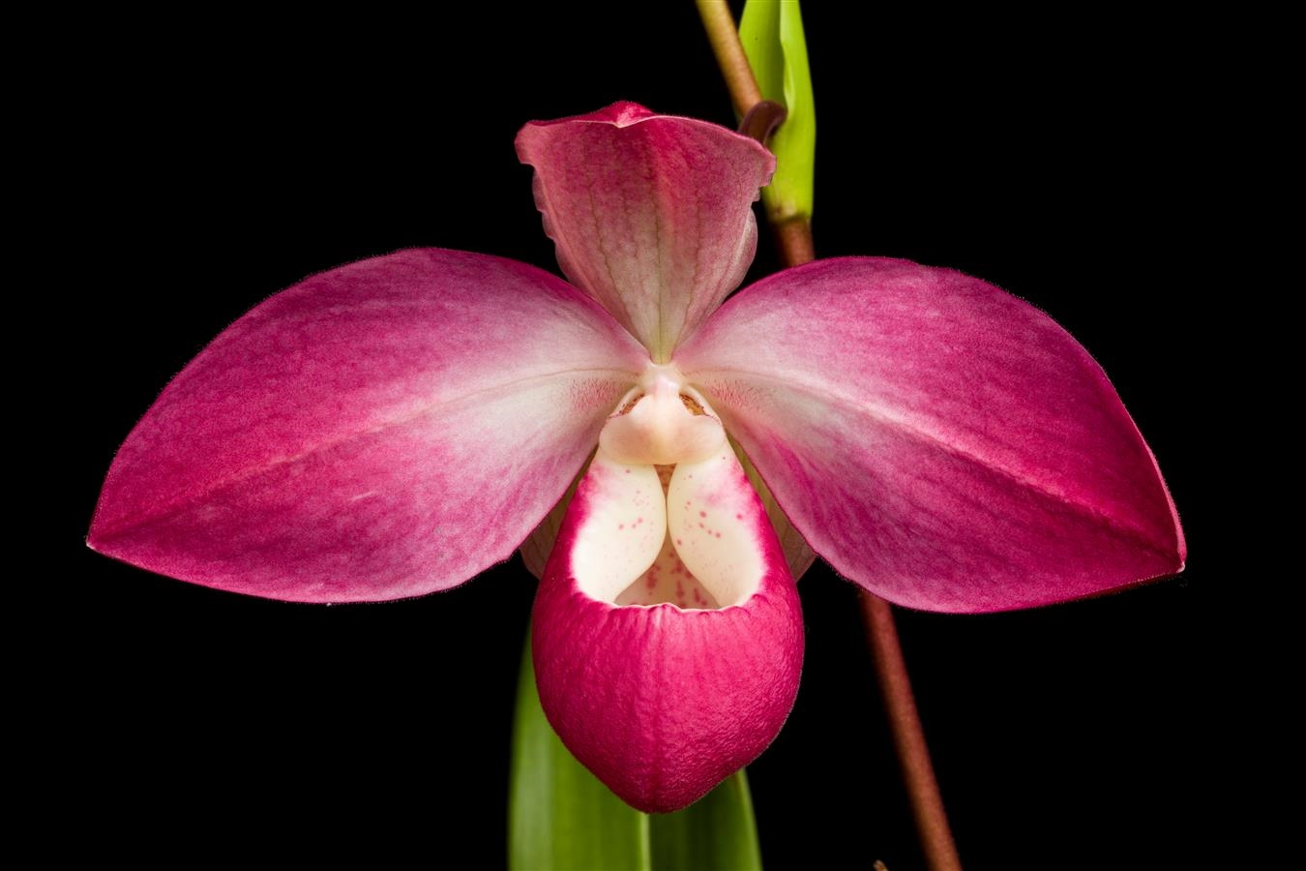
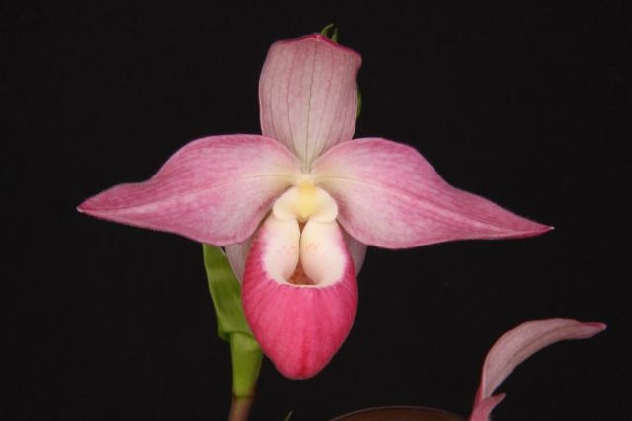
F1 hybrids: P. Suzanne Decker
P. kovachii x Cape Sunset (2007)
18 AMS, 3 HCCs, 1 CCM
‘Little Mateo’ 84 pts AM/AOS (2/2019)
NS 15 cm, most awarded Suzanne Decker is between 14-16 cm

Slide 17
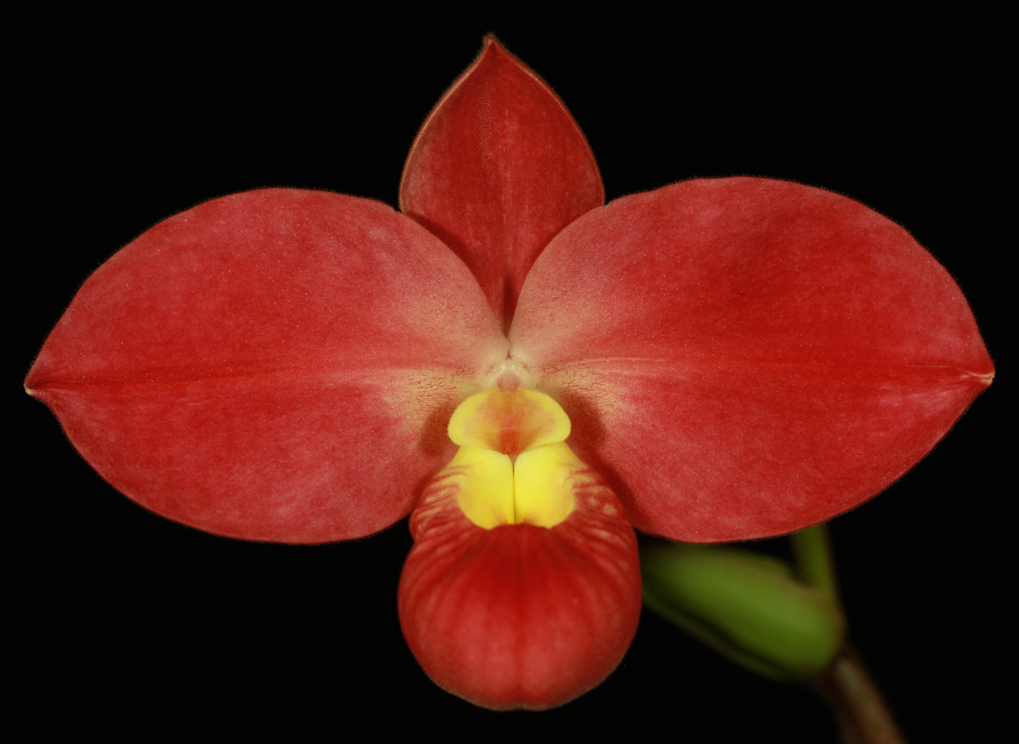
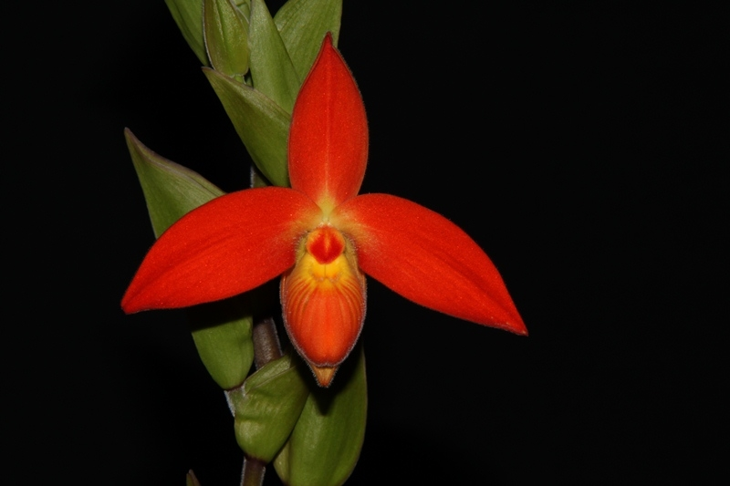
F1 hybrids: P. Peurflora’s Cirila Alca
P. kovachii x dalessandroi (2007)
7 AMs, 10 HCCs
‘Mary Daniels’ 85 pts AM/AOS (2/2017) NS 13.5 cm
Very similar to P. Fritz Schomburg but with more brightly colored offsprings

Slide 18
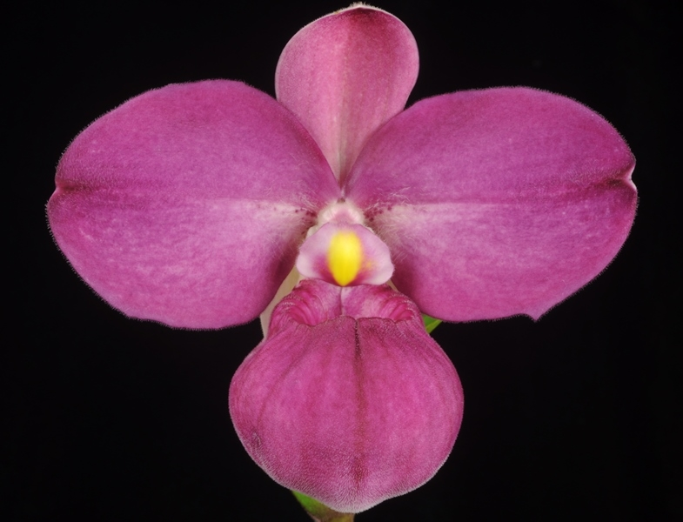
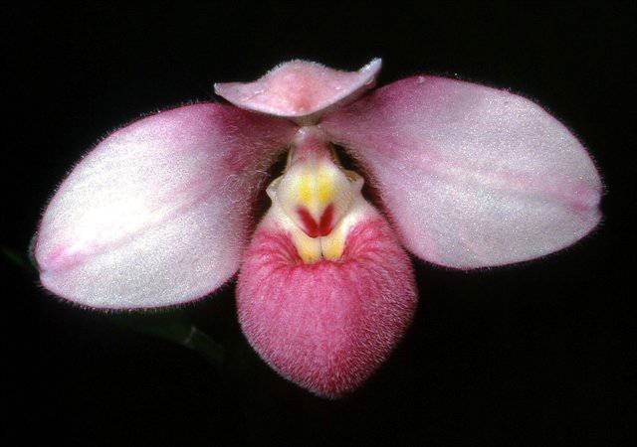
F1 hybrids: P. Eumelia Arias
P. kovachii x schlimii (2007)
6 AMs,3 HCCs
‘Q.F. Deenie’ 86 pts AM/AOS (1/2015) NS 9.3 cm
Look like a darker schlimii on steroid, however, many are poor shaped

Slide 19
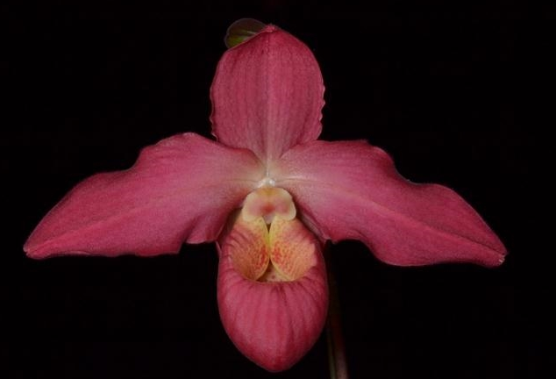
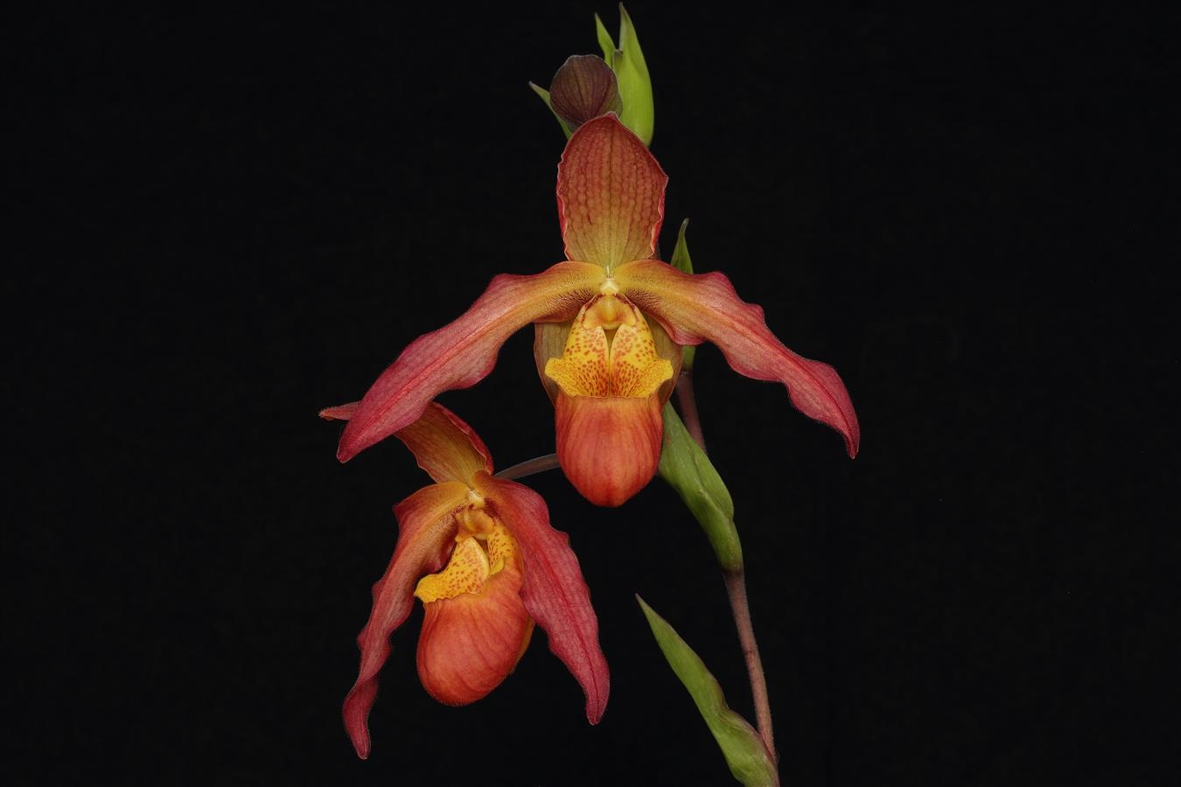
F1 hybrids: P. Peruflora’s Alison Strohm
P. kovachii x Living Fire (2007)
6 AMs,3 HCCs
‘Haley Suzanne’ 84 pts AM/AOS (3/2012) NS 15 cm
Petals of this hybrid are commonly wavy, plants are large and very vigorous

Slide 20
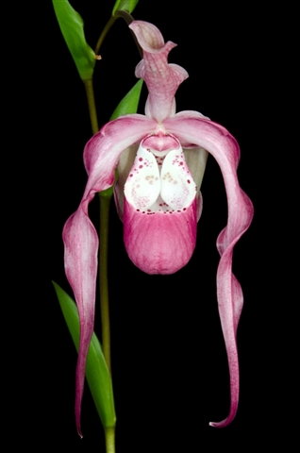
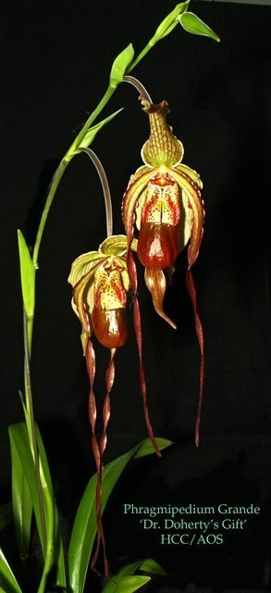
F1 hybrids: P. Frank Smith
P. Grande x kovachii (2009)
5 AMs,3 HCCs
‘Her Majesty’ 84 pts AM/AOS (3/2017)
Vertical NS 24cm, almost double that of similar hybrids using P. schlimii

Slide 21
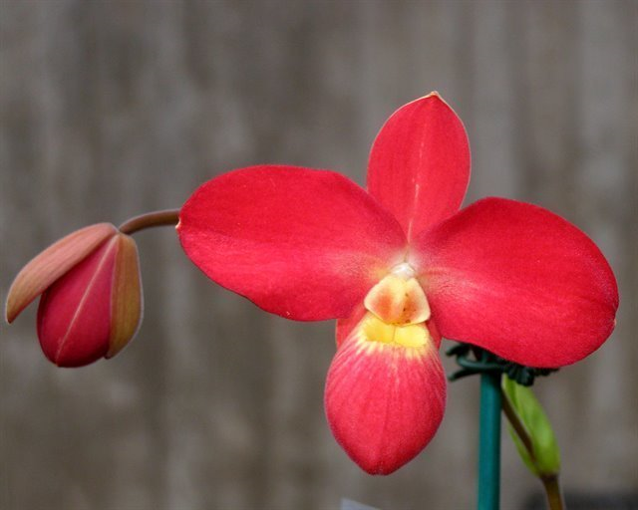
F2 generations
Usually reduced in size compared to F1, but superior in color/shape.
P. Kyle Quintal ‘Leroy Barnick QT’ 79 pts HCC/AOS NS 8.5 cm

Slide 22
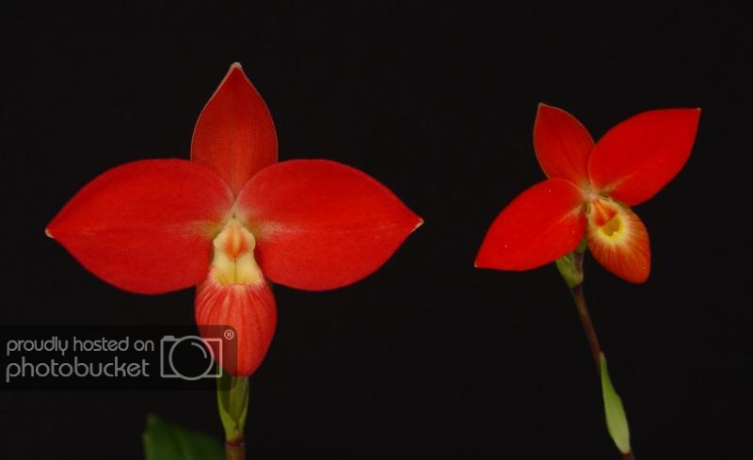
F2 generations
Double dose of besseae aka “obese besseae”
P. Robert-Jan Quene’ (3N) made with 4N besseae parent by Orchid Limited
NS close to 9cm compared to average besseae of 7.8cm

Slide 23
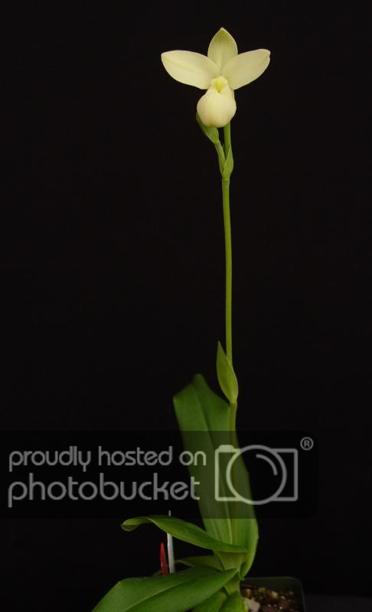
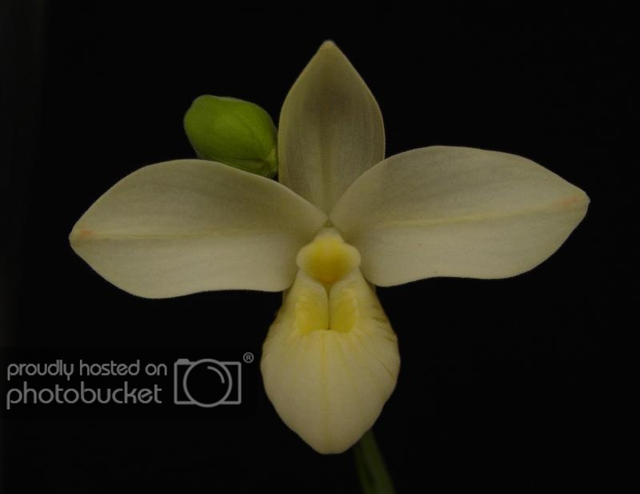
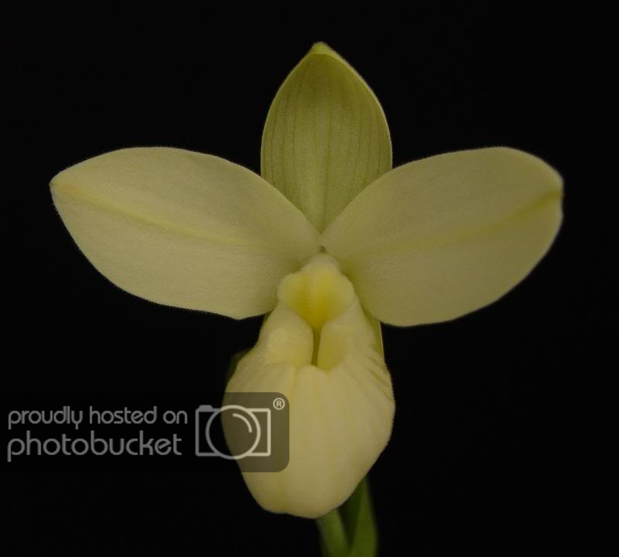
F2 generations
P. Robert-Jan Quene v. flavum
4N flavum besseae was used in both parents, suppressed production of anthocyanins
Kovachii has little yellow pigment in itself
New direction for breeding white Phrags

Slide 24
F2 generations
P. Don Wimber (left) with P. Jerry Lee Fischer (right) by Orchid Limited

Slide 25
F2 generations
Phrag Papa Frankie Quintal next to P.. kovachii

Slide 26
F2 generations

Slide 27
Source
OrchidWiz Encyclopedia version 5.2
Orchid Plus Online
The American Orchid Society - A Discussion of Phragmipedium Species and their Influence on Hybrids
http://www.aos.org/AOS/media/Content-Images/PDFs/Judges%20Forum/Schmidt-Ostrander_Ingrid_ADiscussionofPhragmipediumSpecies-Word.pdf
The Orchids Magazine
-November 2007 page 30 -37: Phragmipedium kovachii
http://www.aos.org/AOS/media/Content-Images/PDFs/Phrag_kovachii.pdf
-January 2004 page 45 – 47: Judging Phragmipedium kovachii
https://secure.aos.org/digital-library/200401orch_73-1/default.aspx#[object%20Object]
-January 2010 page 18-31: New World Slipper Orchids
https://secure.aos.org/digital-library/201001orch_79-1/default.aspx#[object%20Object]
Jay Pfahl’s Internet Orchid Species Photo Encyclopedia:
http://www.orchidspecies.com/phragkovatchii.htm
The New York Times – New Orchid Species Leaves Admirers Amazed
https://www.nytimes.com/2002/08/13/science/new-orchid-species-leaves-admirers-amazed.html
Courthouse News Service – Orchid Grower Says Partner Waltzed With Pricey Blooms Leaving Him the Runts
https://www.courthousenews.com/orchid-grower-says-partner-waltzed-with-pricey-blooms-leaving-him-the-runts/

