Slide 1
Warm-growing Cymbidium
A presentation by Vee Du

Slide 2
What is “warm-growing” Cym?
Standard Cymbidium requires cool but not cold climate to grow and bloom well. Cannot tolerate heat. These plants typically grows well in Southern California
Texas growers face struggles when it comes to keep these plants happy
Warm growing Cymbidium will bloom without the cool condition and wide diurnal temperature range

Slide 3
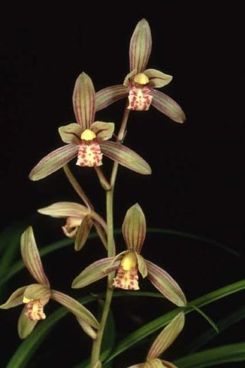
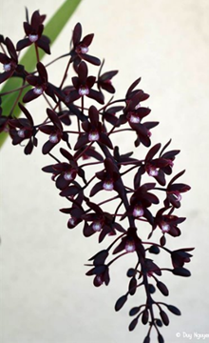
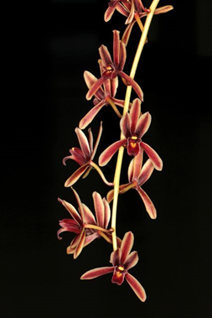
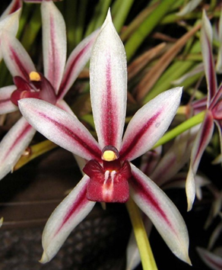
The species involved
Cym. ensifolium, Cym. sinense to a lesser degree
Cym. canaliculatum, Cym. madidum
Cym. aloifolium, Cym. findleysonianum, Cym. bicolor, Cym. atropurpureum
Cym. dayanum

Slide 4
Advantages
Disadvantages
Warmth tolerance
Free-flowering when kept warm
Can bloom multiple times a year
More flowers per inflorescence in some cases
Many are fragrant
Small flower
Open segments
Pendulous inflorescences

Slide 5
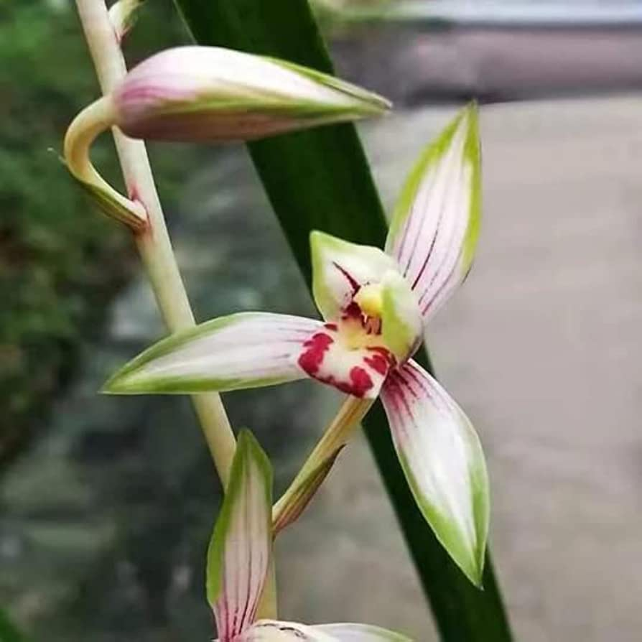
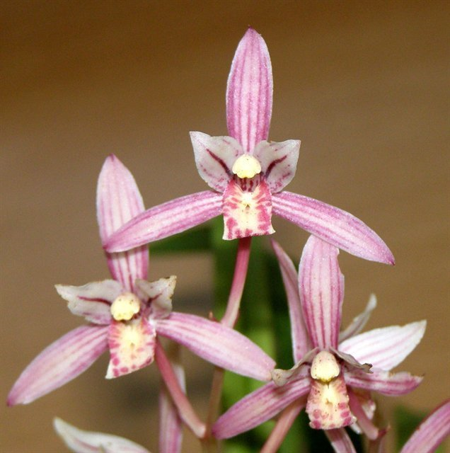
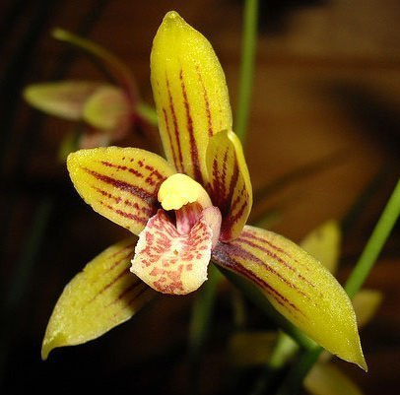
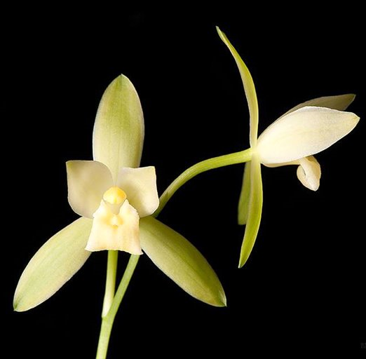
Cymbidium ensifolium
The most popular species in warm tolerating hybrids
Petals porrect and curled-under lip. Lip spotted.
Tremendous variation. Low land vs high land, not a boring species!
Hybrids are often fragrant, floriferous, tidy, capable of blooming both spring and fall. Reduced plant size, flower size, but also lower flower count. Taking in color and to an extend, shape of the other parent

Slide 6
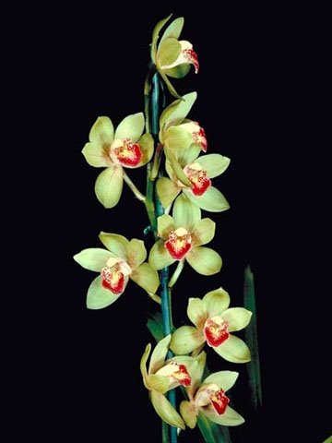
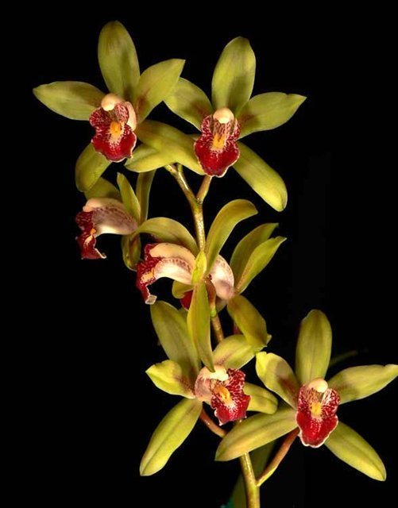
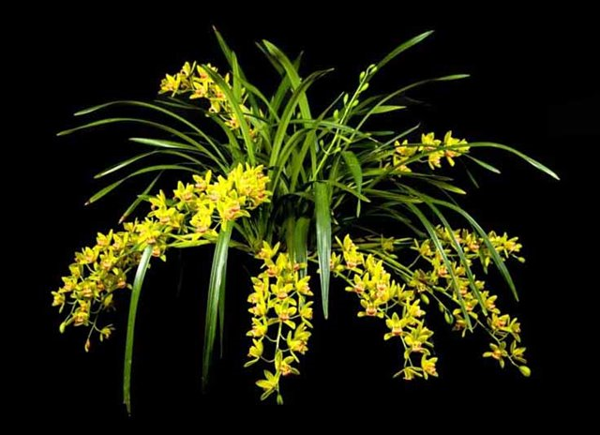
Cymbidium Peter Pan (1957)
Cym. ensifolium x Cym. Miretta
162 Offsprings, 1007 total progeny
‘Bert’ HCC/AOS (1989)
‘Greensleeves’ HCC/AOS (1965)
vs. 4N ‘Greensleeves’ ?
‘Demonette’ CCE (2018)

Slide 7
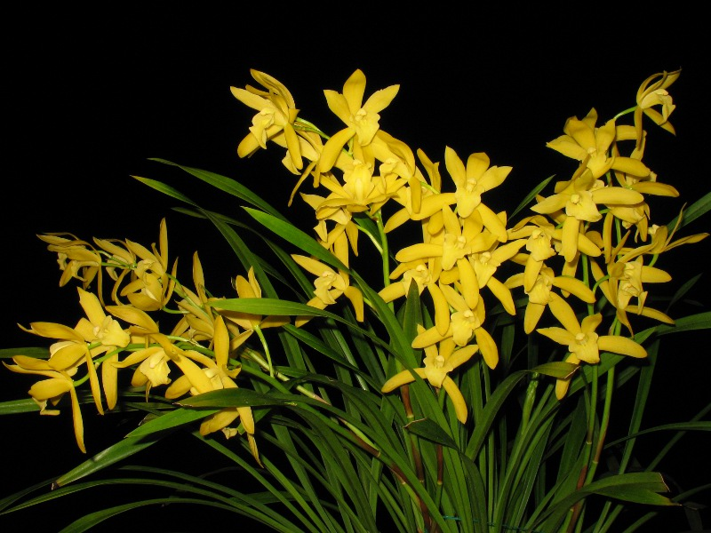
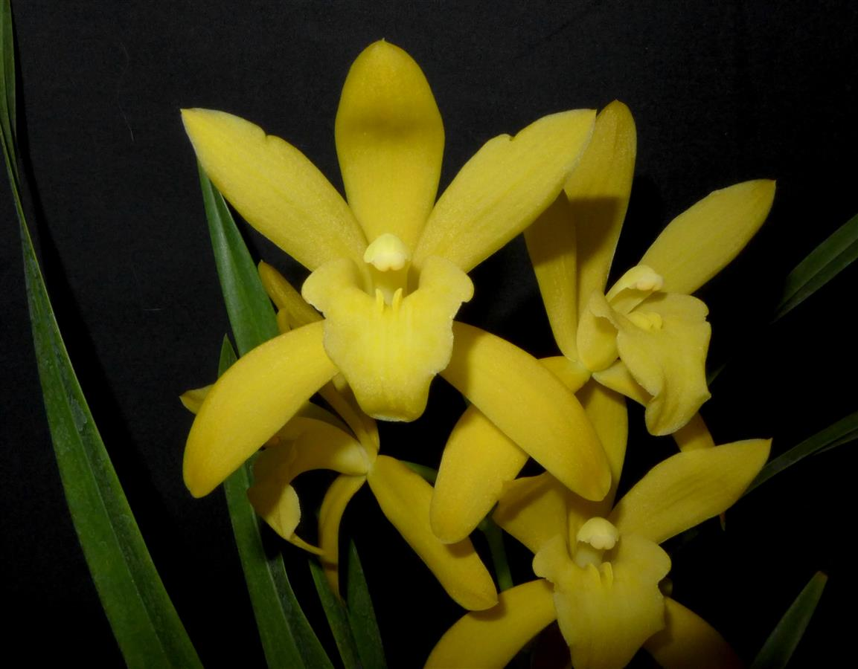
Cymbidium Golden Elf (1978)
Cym. ensifolium x Cym. Enid Haupt
106 Offsprings, 530 total progeny
‘Sundust’ HCC/AOS (1983)
‘Machiavelli’ AM/AOS (2021)

Slide 8
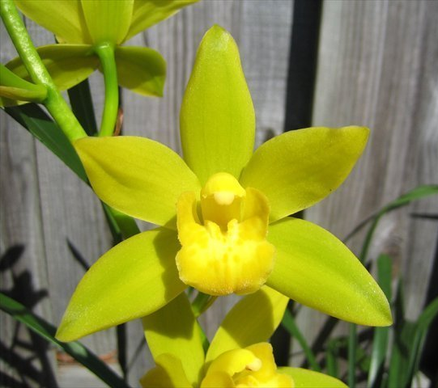
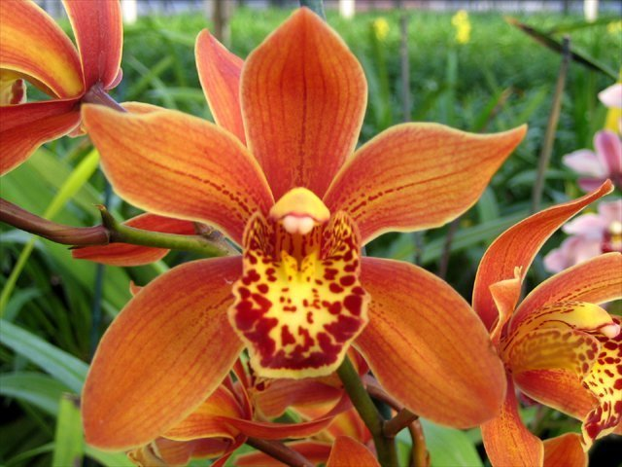
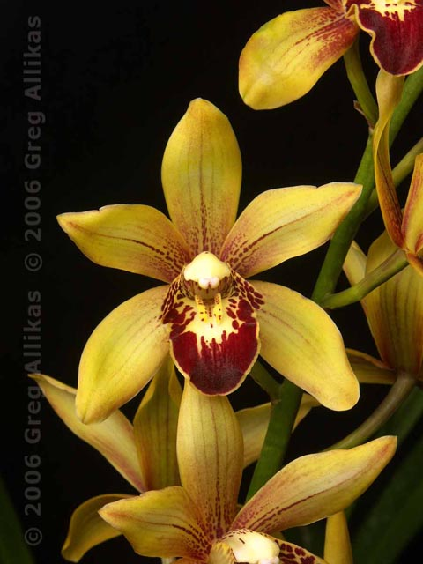
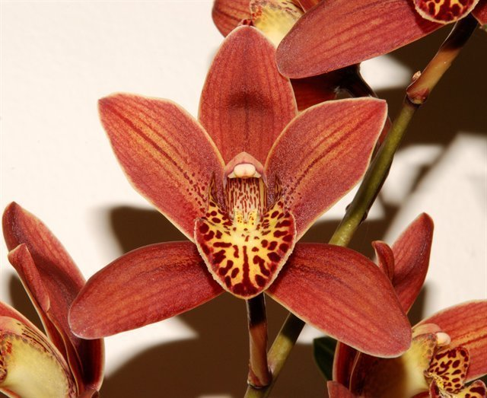
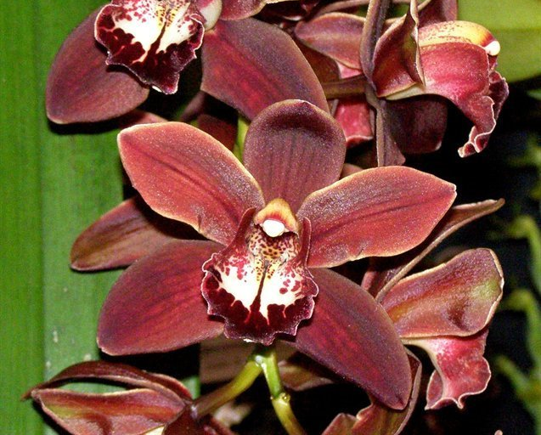
Cymbidium Kusuda Shining (1994)
51 Offsprings, 179 total progeny
‘Geyserland’ HCC/AOS (2006)

Slide 9
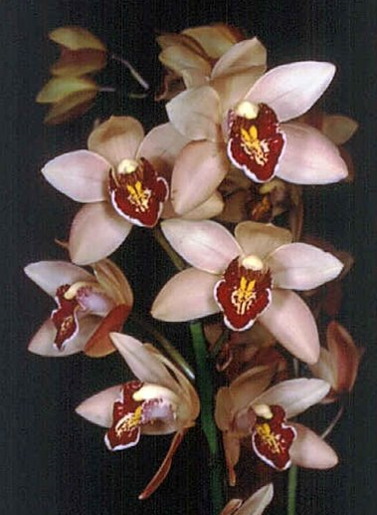
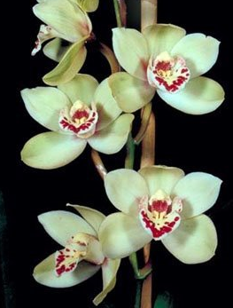
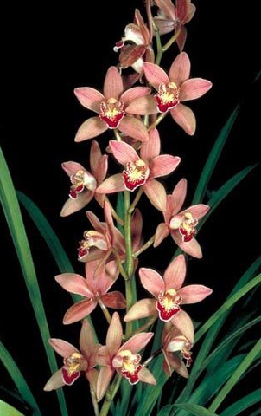
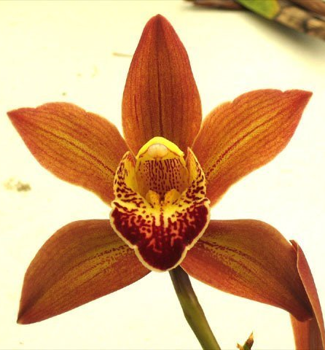
Other second generations
Cym. Rolling Stone (Peter Pan x Doris Aurea) (1986)
26 Offsprings, 227 total progeny
Cym. Sue (Show Girl x Peter Pan) (1980)
33 Offsprings, 115 total progeny

Slide 10
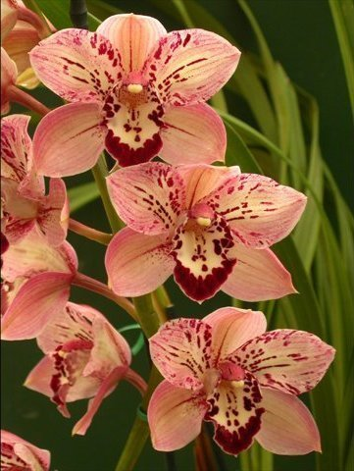
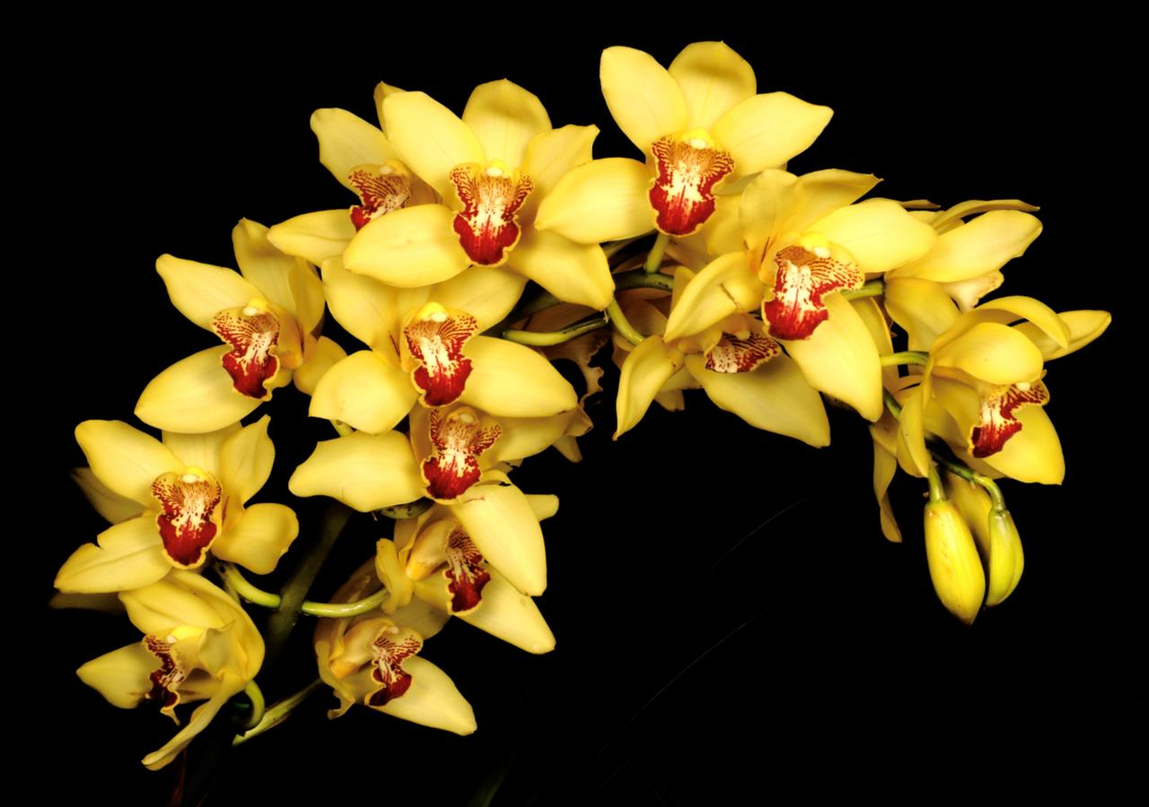
Other second generations
Cym. Milton Carpenter (Golden Elf x Via Ambarino) (1992)
‘ Florida Sunshine’ AM/AOS 87pts (2021)
Cym. Reverend Miriam Dulaney
((sanderae x ensifolium) x Candy Floss) (1996)
‘Prayer Warrior’

Slide 11
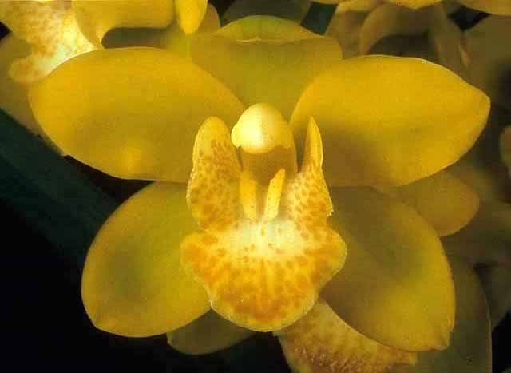
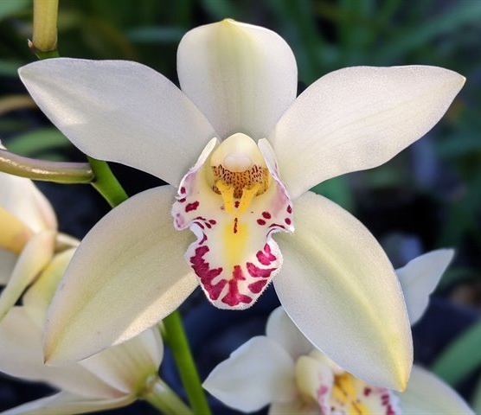
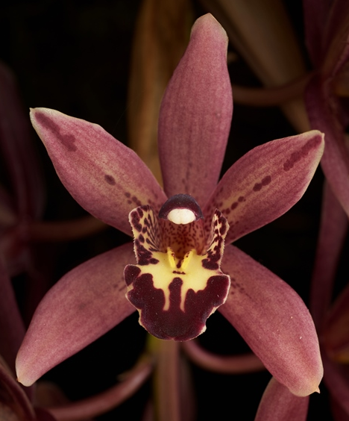
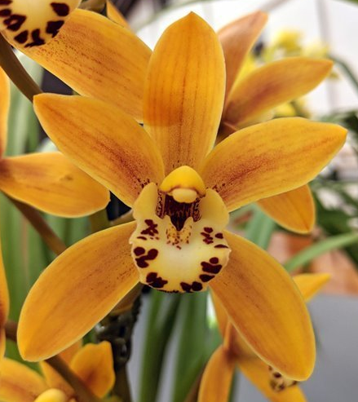
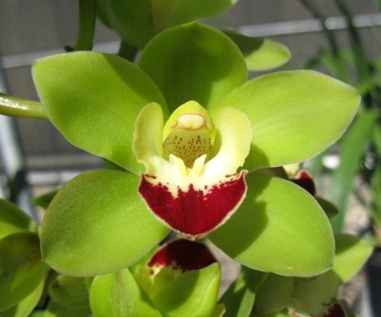
3rd generation onward
Ensifolium + floribundum combo
Cym. Blanche Ames ‘Liz’ HCC/AOS (2004)
Cym. Auntie (2020) (4N) 4th gen
Cym. Sundaani Autumn (2006) ‘Daybreak’
Cym. Cherry Kisses ‘Munchies Man’ HCC/AOS (2014) 4th gen
Cym. dayanum influence
Cym. Windy Ruler (2017) 4th gen
Cym. Cherry Cola (1993) ‘Geyserland’

Slide 12
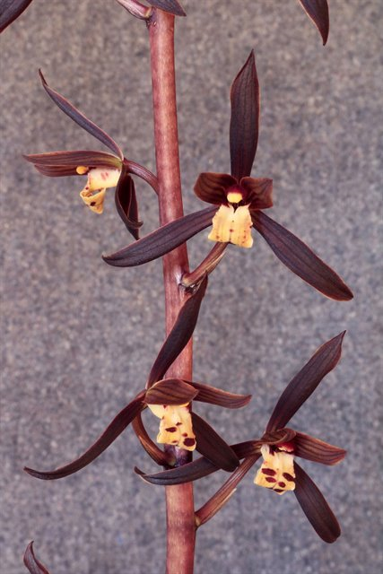
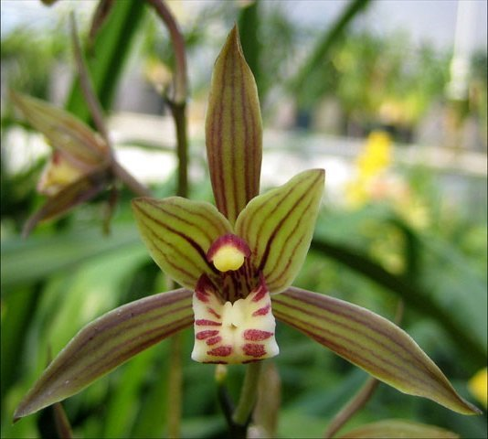
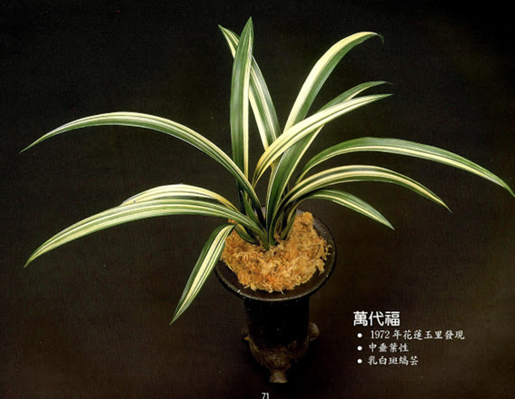
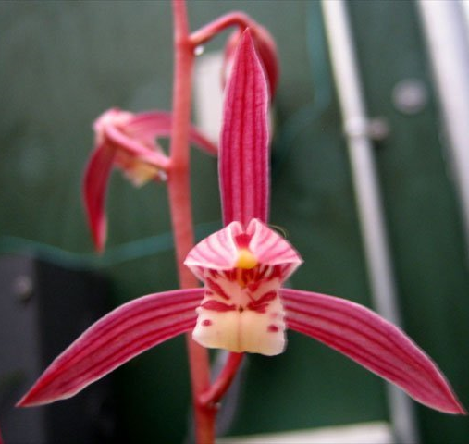
Cymbidium sinense
Has longer, more upright inflorescence with higher flower counts. Pleasing fragrant. Similarly variable
Flower not long lasting, poor form.
Create dark color hybrids (dark brown/chocolate), interesting markings.

Slide 13
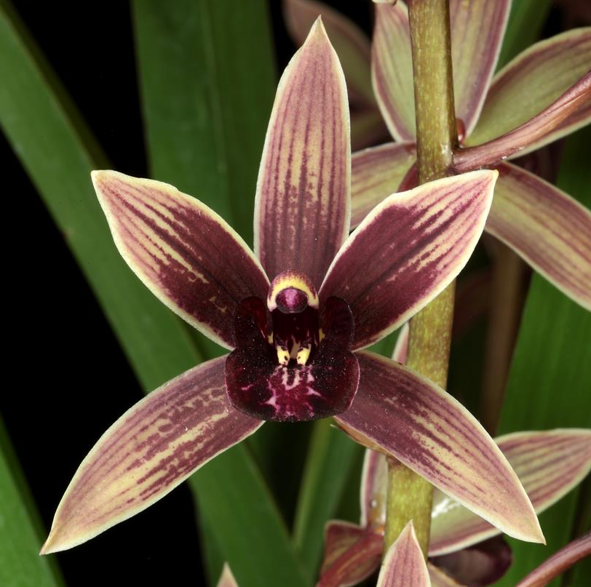
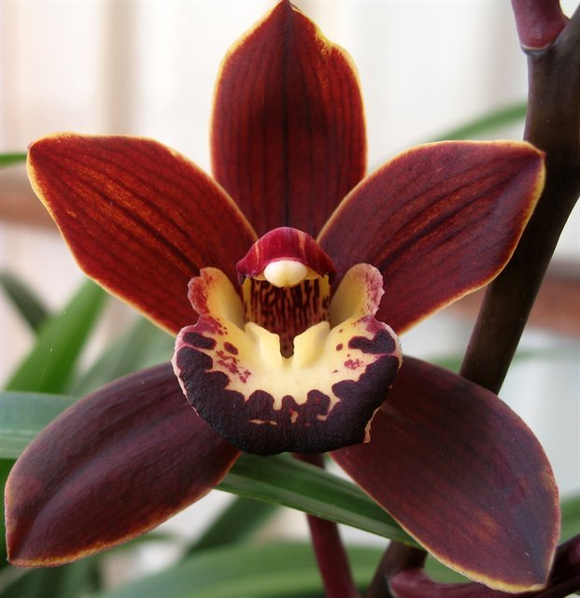
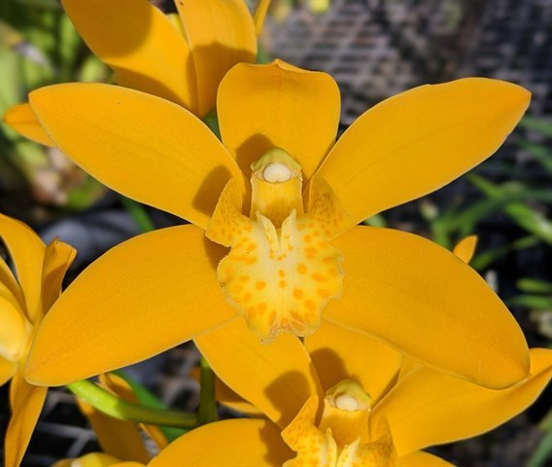
Cym. sinense hybrids
Cym. Joseph Schmidt (2015)
(Canal Parish x sinense)
‘Ori Gem’ AM/AOS (2019)
Cym. Brunette (1982) ‘ Tetra Mint’
(sinense x Volcano)
Cym. Catch The Wind (2016) 4N
3rd gen hybrid. Has Cym. sinense and Cym. Golden Elf as grandparents

Slide 14
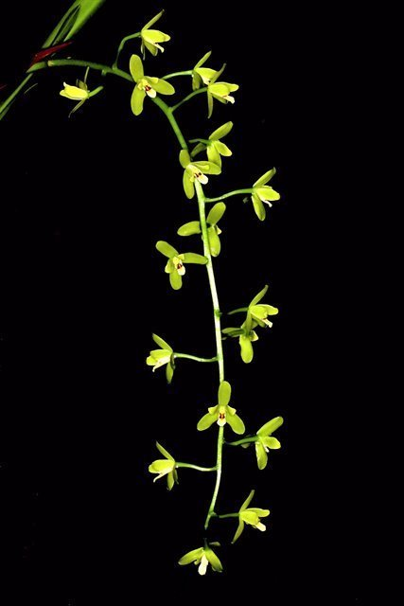
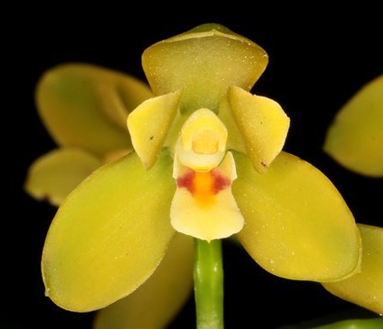
Cymbidiums madidum
“The dowiana of Cymbidium”: Intensify color of the other parent
Long spike, well displayed flowers, better shape than Chinese Cymbidiums, more flowers per inflorescence, sweet fragrance
Huge plants, small flower size.

Slide 15
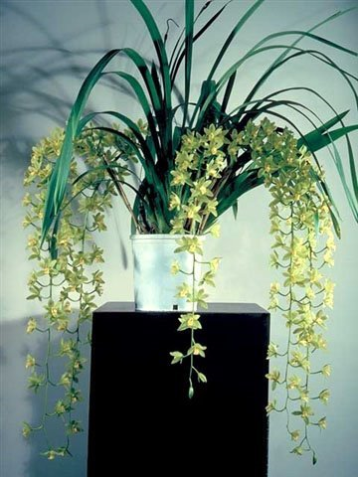
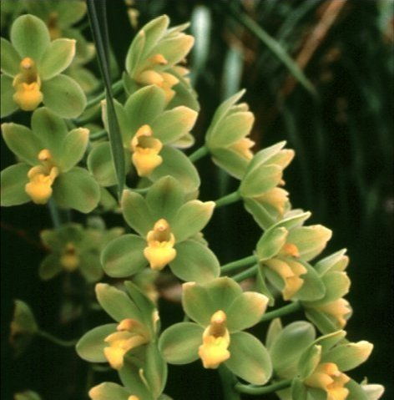
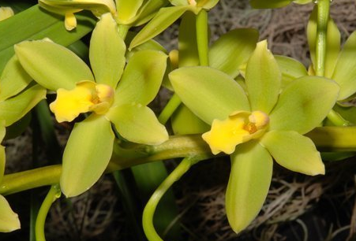
Cymbidium Fifi (1964)
Cym. madidum x Cym. Argonaut
76 Offsprings, 170 total progeny
‘Harry’ AM/AOS (1964) 4N

Slide 16
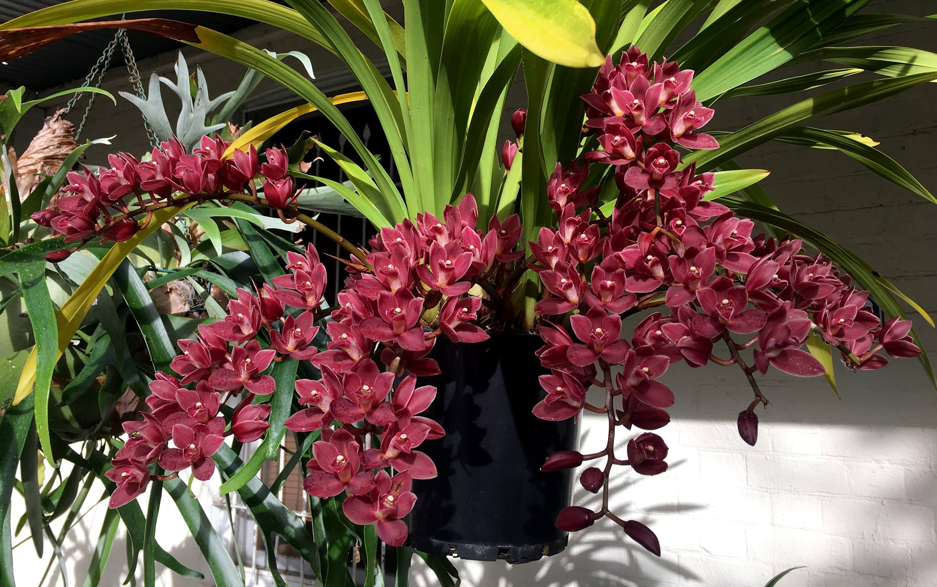
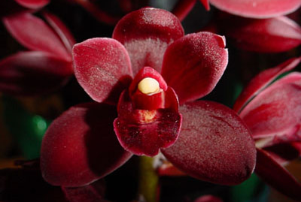
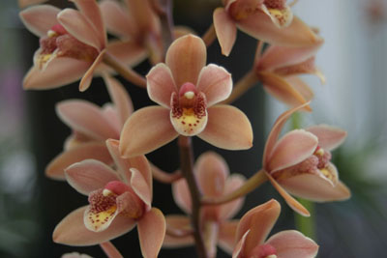
Cymbidium Phar Lap (1986)
Cym. Flame Hawk x Cym. madidum
35 Offsprings, 108 total progeny

Slide 17
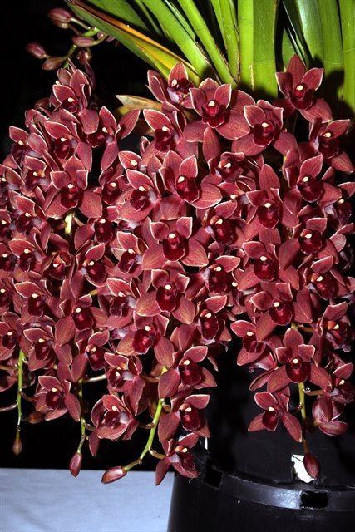
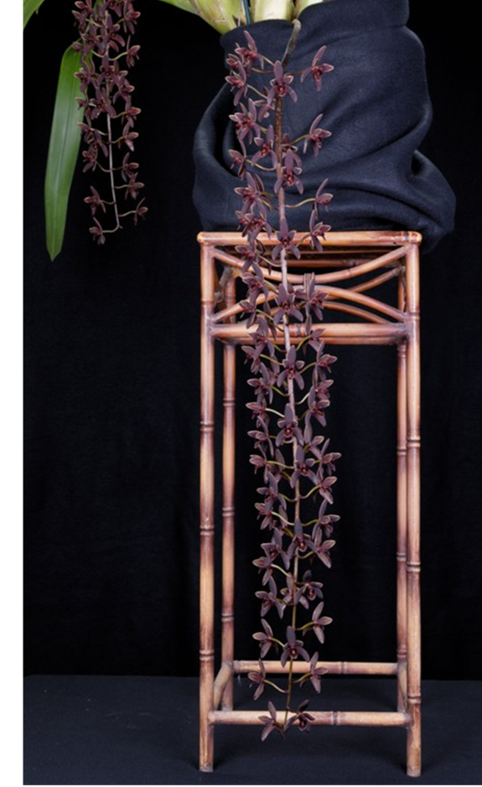
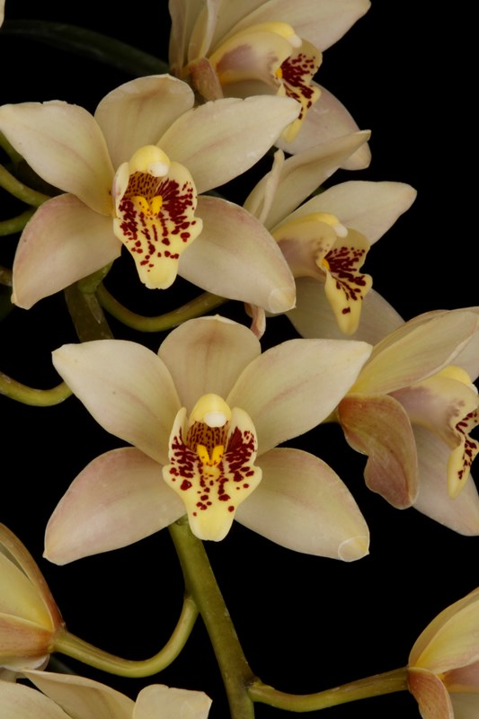
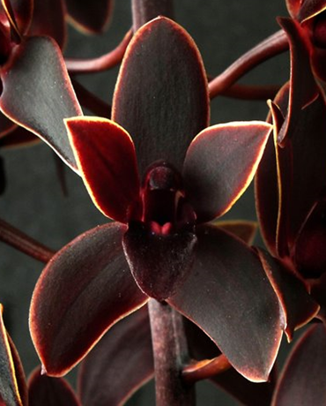
Cym. Gladys Whitesell (Fifi x sanderae) (1983)
‘Joy’ HCC/AOS (2015)
Cym. Dorothy Stockstill (1992)
(Phar Lap x Miss Muffett)
‘Forgotten Fruit’ AM/AOS (1993)
Cym. Little Beauty (1992)
((devonianum x madidum) x canaliculatum)

Slide 18
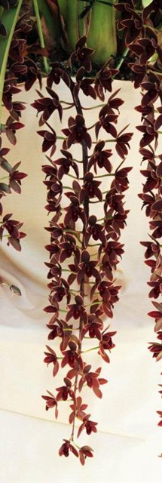
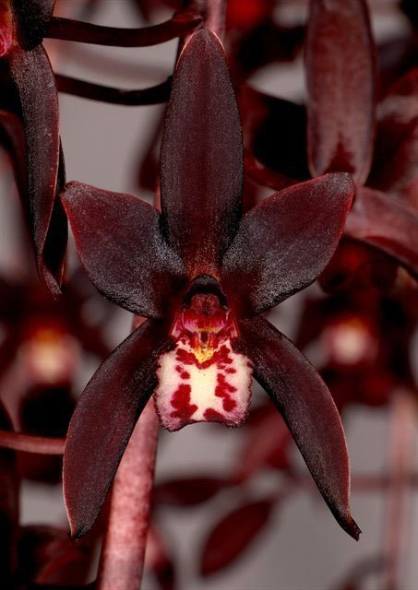
Pendulous Cymbidium
Cym. Black Forest (1999) ‘Black Label’
((aloifolium x Carbenet) x Tethys)
Cym. Australian Midnight (1991)
(canaliculatum x atropurpureum)
Cym. Black Stump (2009)
(Australian Midnight x Cricket)

Slide 19
New breeding direction: Grammatocymbidiums
Grammatophyllum does not has pendent inflorescence
Upright stem with high flower count is still more desirable in commercial hybrids
Advantage:in crease flower count, heat tolerance, long lasting bloom, exotic spots and stripes, flowers well presented, well arranged
Disadvantage: large plants, “muddy” color, small lips. Grammatocymbidiums pollens are generally not viable creating difficulty in breeding.

Slide 20
Grammatocymbidiums
Grcym. Pakkret Paronama
Grcym. Pakkret Nebula
Grcym Pakkret Nova x
Gramm. Crownfox Leopard
Grcym. Pakkret Gargoyle
Grcym. Lovely Melody
Grcym. Pakkret Adventure

Slide 21
Resource
Orchidwiz Encyclopedia version 9.1
Orchid Pro Online
Warm Growing Cymbidium
http://www.orchidpeopleofhawaii.com/warm.html
American Orchid Society Magazine
Chinese Cymbidium species, Issue July 1999, page 12 - 23
Cymbidium madidum, Supplemental Issue Oct 2018, page 18- 22
Cymbidium section Jensoa – Its species and some of their hybrids, Issue October 2018, page 30 -41
Growing Cymbidium in a Warm Climate, Issue March 2010, page 24-29
Grammatocymbidiums: An Advanced Path to Breeding Heat-Tolerant Cymbidiums, Supplemental Issue Oct 2018, page 78 - 82

