Slide 1
Warm-growing Cymbidium
A presentation by Vee Du

Slide 2
What is “warm-growing” Cym?
Standard Cymbidium requires 20-25 degree diurnal temperature differences to grow well and winter low temperature less than 57 degree for weeks to initiate flower buds. Additionally, temperature need to be less than mid 90 and above freezing. These plants typically grows well in Southern California
Texas growers face struggles when it comes to keep these plants happy
Warm growing Cymbidium will bloom without the need to have a temperature drop and without the wide range of day and night temperature differences.

Slide 3
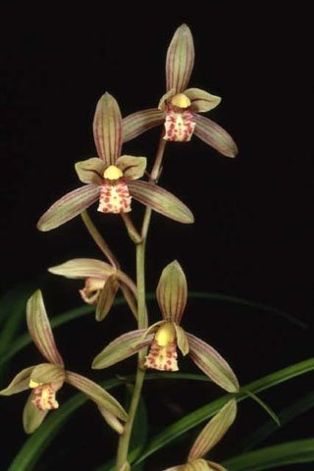
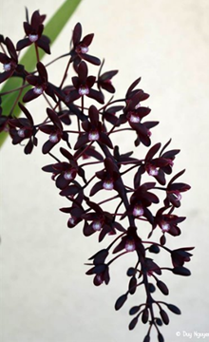
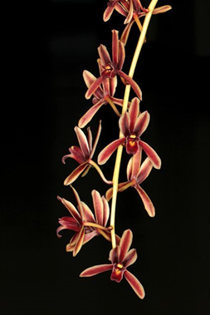
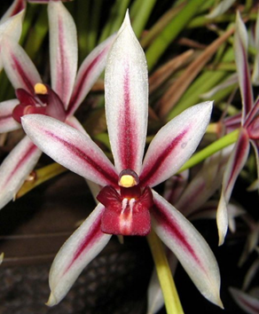
The species involved
Cym. ensifolium, Cym. sinense to a lesser degree
Cym. canaliculatum, Cym. madidum
Cym. aloifolium, Cym. findleysonianum, Cym. bicolor, Cym. atropurpureum
Cym. dayanum

Slide 4
Advantages
Disadvantages
Warmth tolerance
Free-flowering when kept warm
Can bloom multiple times a year
More flowers per inflorescence in some cases
Many are fragrant
Small flower
Open segments
Pendulous inflorescences

Slide 5
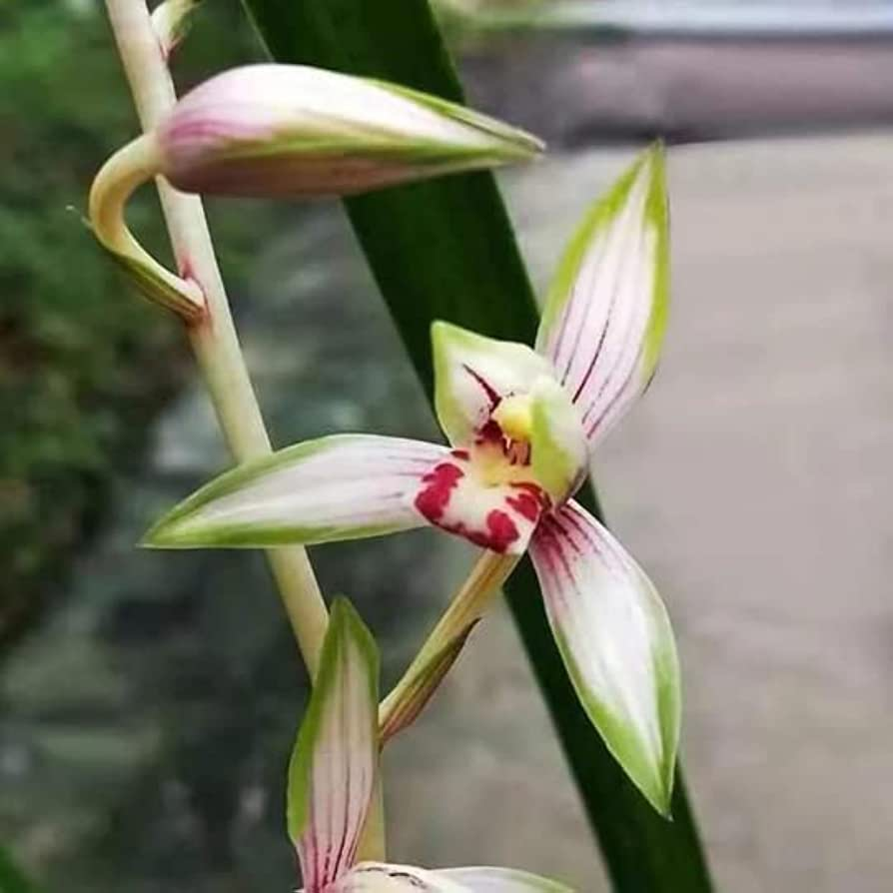
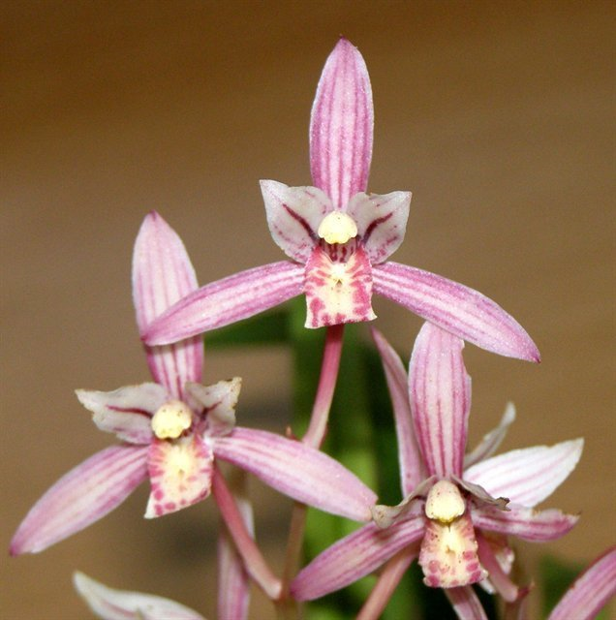
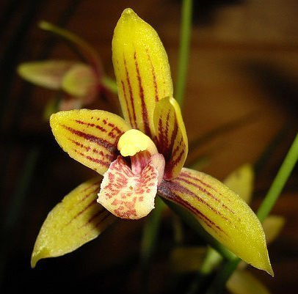
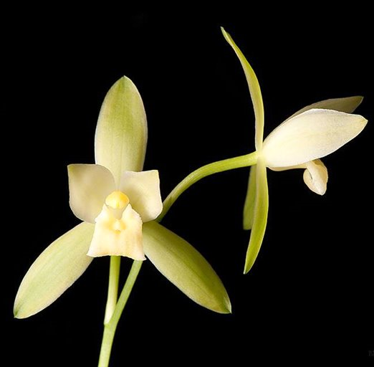
Cymbidium ensifolium
The most useful species in creating warmth tolerant hybrids. Usually bred with a standard
Petals porrect/hugging the column (recessive) and curled-under lip (this trait tends to passed down to progeny). Also spotted lips
Tremendous variation. Low land vs high land, not a boring species!
Hybrids are often fragrant, floriferous, tidy, capable of blooming both spring and fall. Reduced plant size, flower size, but also lower flower count. Taking in color and to an extend, shape of the other parent

Slide 6
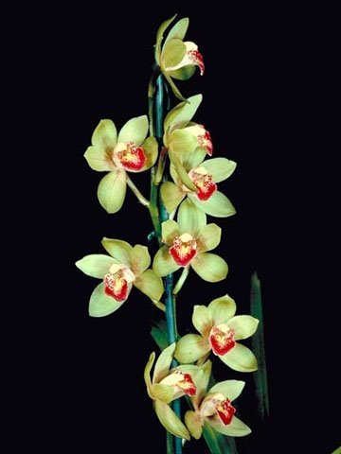
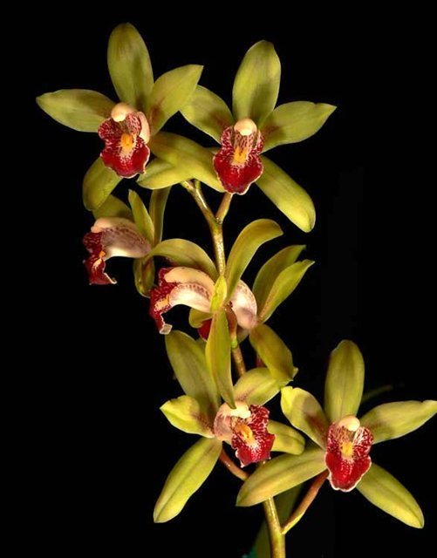
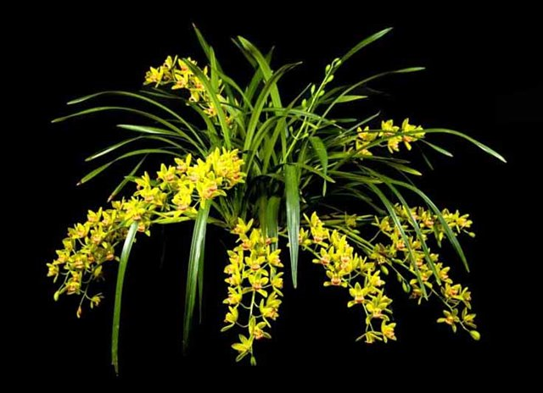
Cymbidium Peter Pan (1957)
Cym. ensifolium x Cym. Miretta
162 Offsprings, 1007 total progeny
Graceful habit, much smaller plant, floriferous
Correct bad form of ensifolium. Made into 4N
‘Bert’ HCC/AOS (1989)
(Should have been higher)
‘Greensleeves’ HCC/AOS (1965)
vs. 4N ‘Greensleeves’ ?
‘Demonette’ CCE (2018)

Slide 7
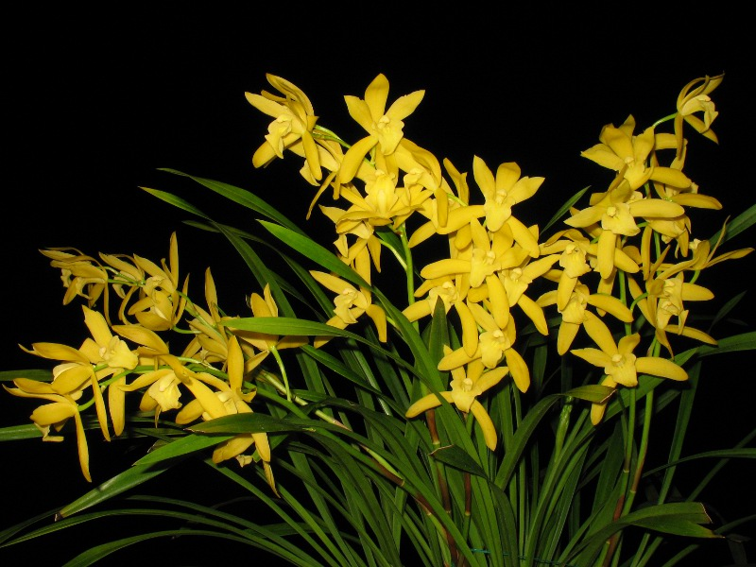
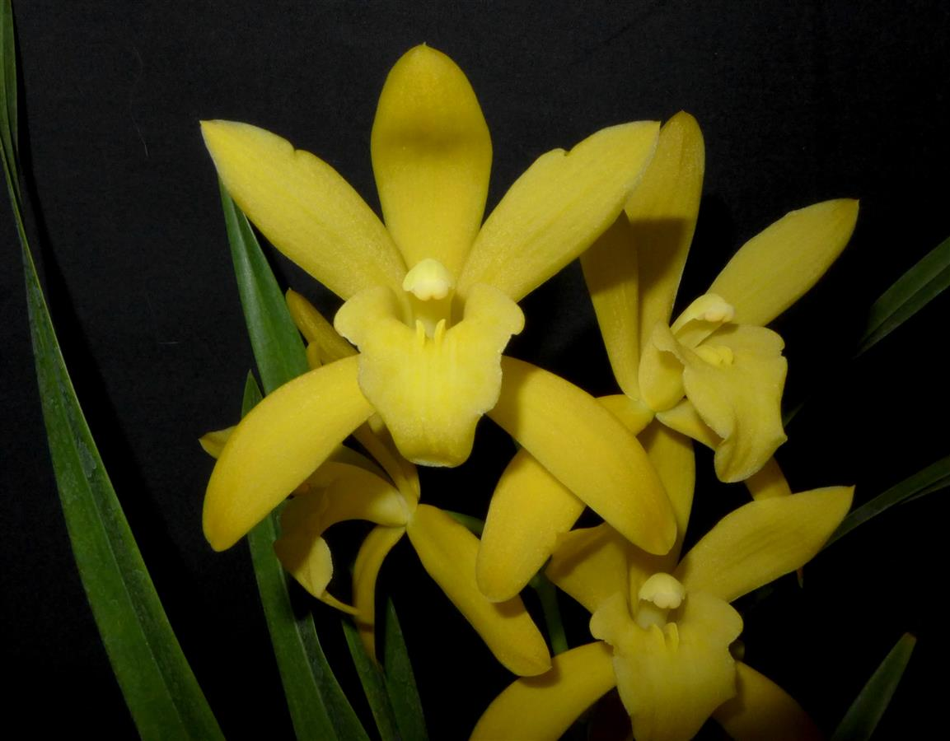
Cymbidium Golden Elf (1978)
Cym. ensifolium x Cym. Enid Haupt
106 Offsprings, 530 total progeny
Similar to Peter Pan
Remade into 4N for breeding
‘Sundust’ HCC/AOS (1983)
‘Machiavelli’ AM/AOS (2021)

Slide 8
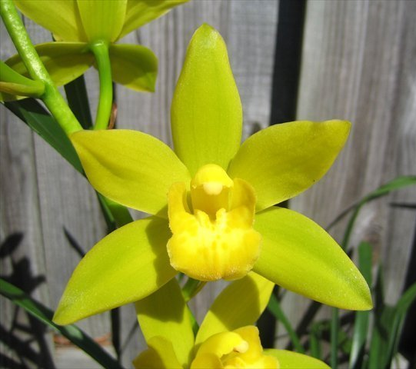
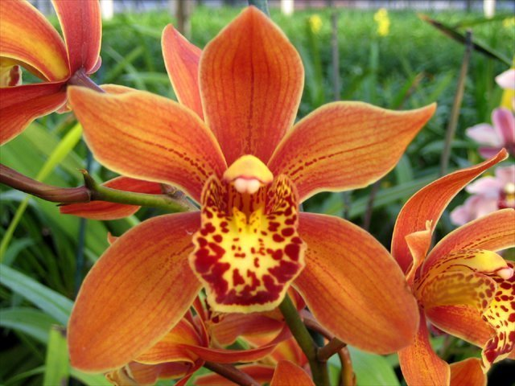
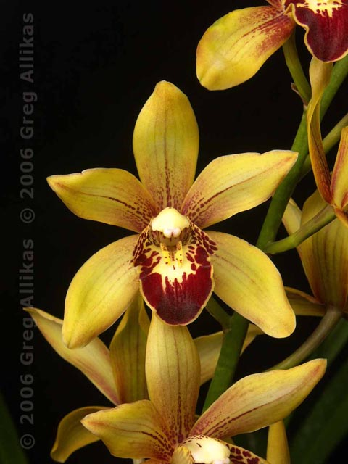
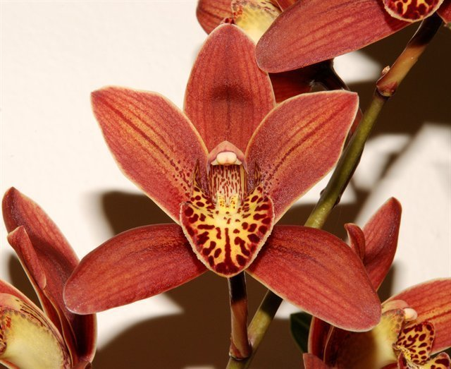
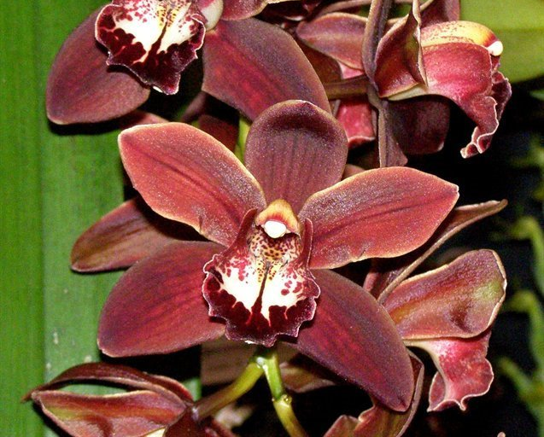
Cymbidium Kusuda Shining (1994)
Second generation, ensifolium on both side of the parents
Fuller shape, colorful variations
51 Offsprings, 179 total progeny
‘Geyserland’ HCC/AOS (2006)

Slide 9
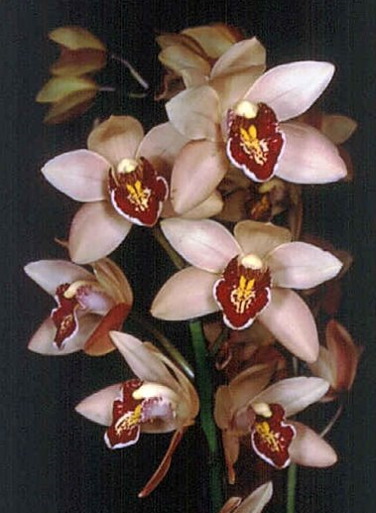
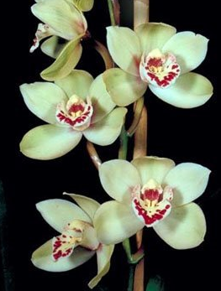
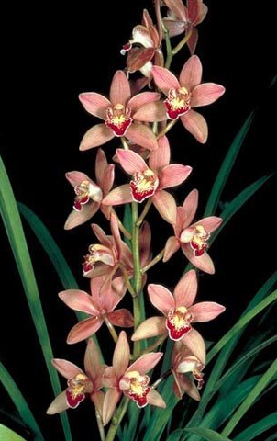
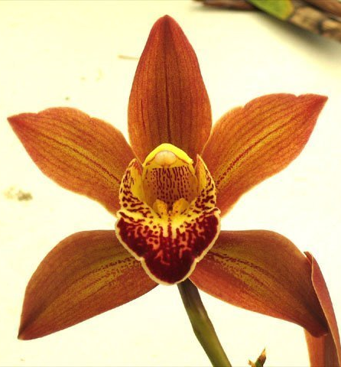
Other second generations
Cym. Rolling Stone (Peter Pan x Doris Aurea) (1986)
26 Offsprings, 227 total progeny
Cym. Sue (Show Girl x Peter Pan) (1980)
33 Offsprings, 115 total progeny

Slide 10
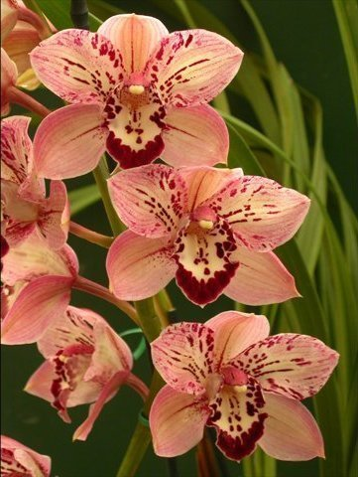
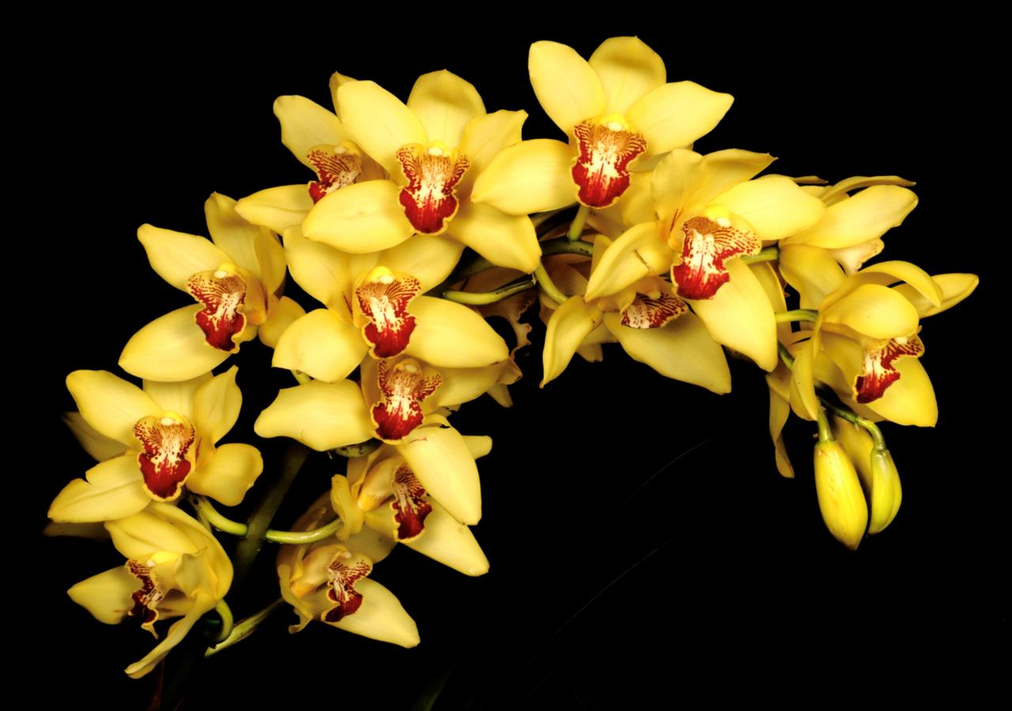
Other second generations
Cym. Milton Carpenter (Golden Elf x Via Ambarino) (1992)
‘ Florida Sunshine’ AM/AOS 87pts (2021)
Cym. Reverend Miriam Dulaney
((sanderae x ensifolium) x Candy Floss) (1996)
‘Prayer Warrior’

Slide 11
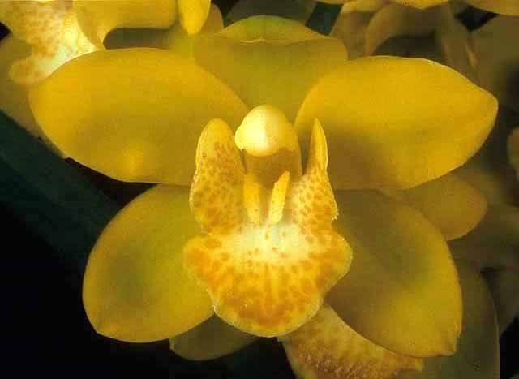
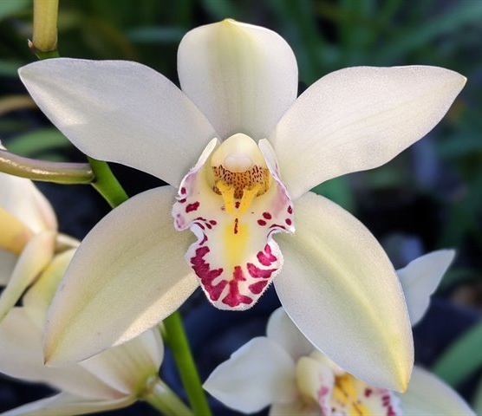
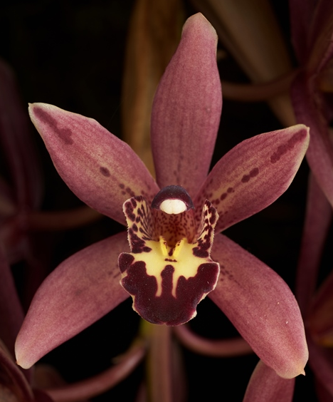
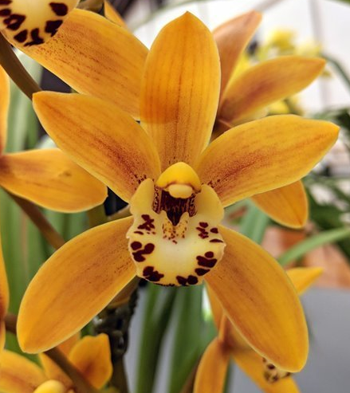
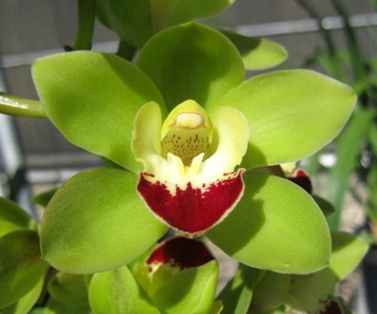
3rd generation onward
Ensifolium + floribundum combo in genetic seems to boost warmth tolerance.
Cym. Blanche Ames ‘Liz’ HCC/AOS (2004)
Cym. Auntie (2020) (4N) 4th gen
Cym. Sundaani Autumn (2006) ‘Daybreak’
Cym. Cherry Kisses ‘Munchies Man’ HCC/AOS (2014) 4th gen
Cym. dayanum influence
Cym. Windy Ruler (2017) 4th gen
Cym. Cherry Cola (1993) ‘Geyserland’

Slide 12
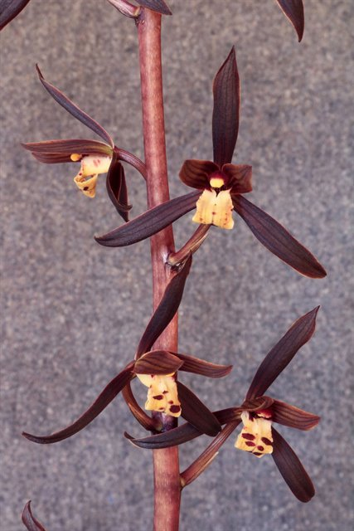
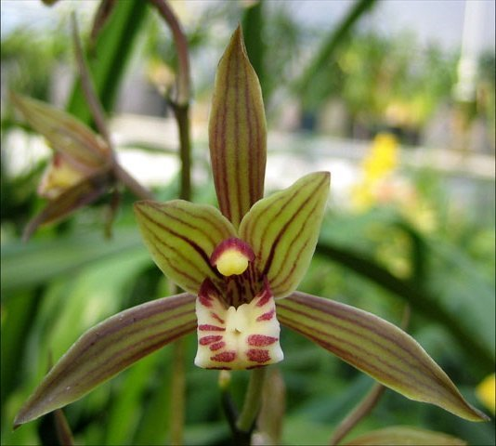
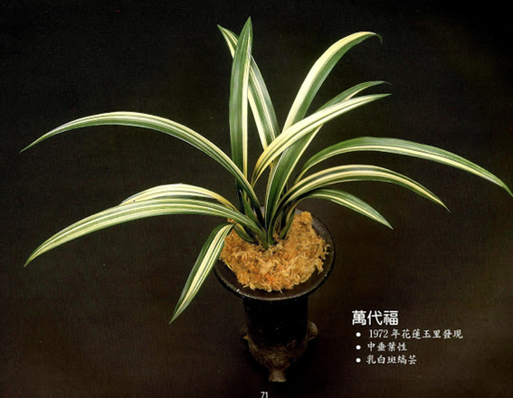
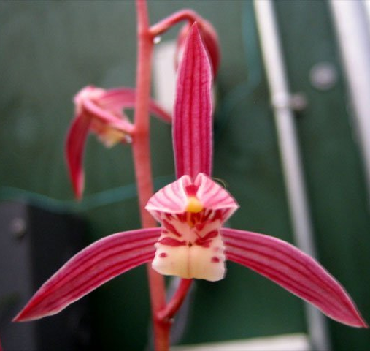
Cymbidium sinense
Has longer, more upright inflorescence with higher flower counts. Pleasing fragrant. Similarly variable
Flower not long lasting, poor form.
Useful in making darker color hybrids (dark brown/chocolate), interesting markings

Slide 13
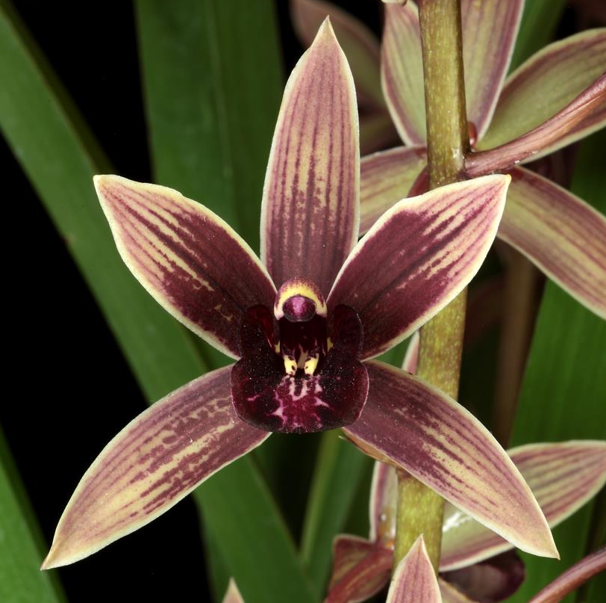
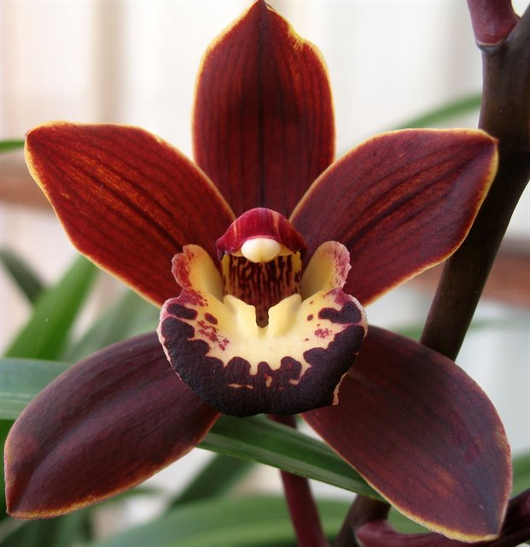
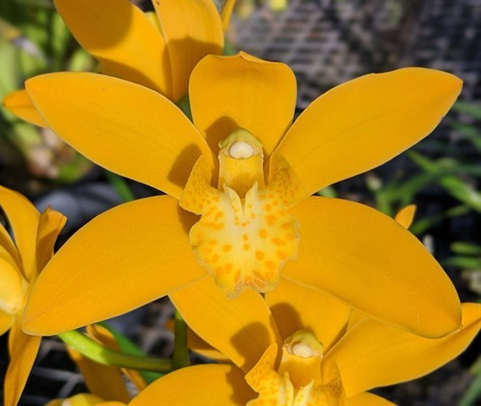
Cym. sinense hybrids
No strong push to 2nd or 3rd generation hybrids. Mostly due to no strong tetraploid progeny was developed like Peter Pan or Golden Elf.
Cym. Joseph Schmidt (2015)
(Canal Parish x sinense)
‘Ori Gem’ AM/AOS (2019)
Cym. Brunette (1982) ‘ Tetra Mint’
(sinense x Volcano)
Cym. Catch The Wind (2016) 4N
3rd gen hybrid. Has Cym. sinense and Cym. Golden Elf as grandparents

Slide 14
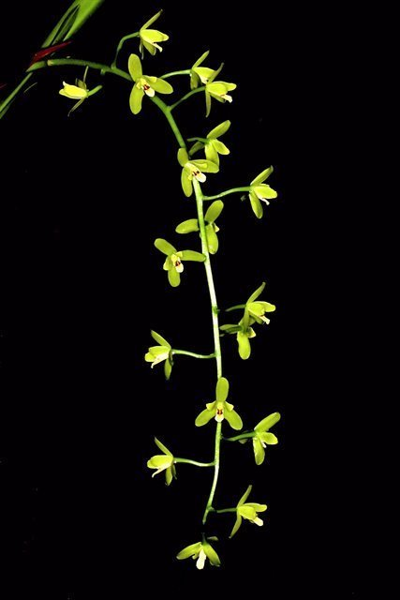
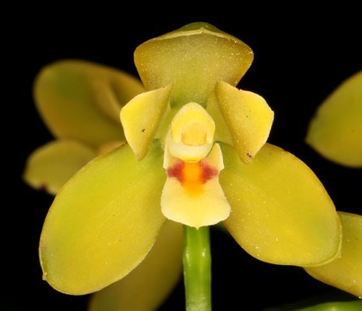
Cymbidiums madidum
“The dowiana of Cymbidium”: Intensify color of the other parent
Long pendulous spike, well spaced, well displayed, sweetly scent flowers on long pedicels. Better shape than Chinese Cymbidiums. More flowers per inflorescence. Used to increase the flowers and length of the inflorescence
Huge plants, small flower size.
When crossed with cool growing standards, tend to produce offsprings that are not as heat tolerant.

Slide 15
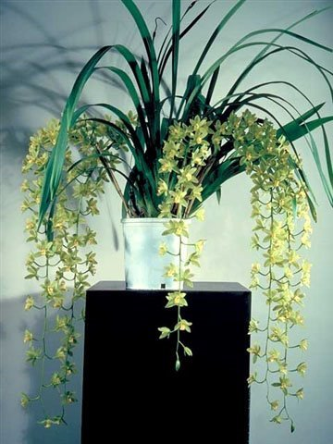
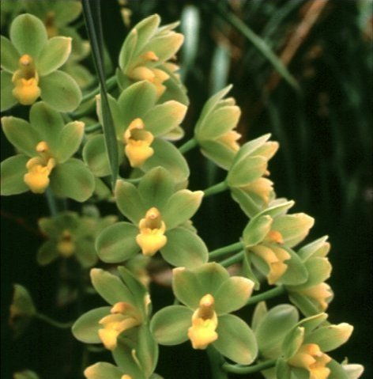
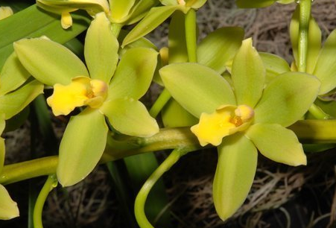
Cymbidium Fifi (1964)
Cym. madidum x Cym. Argonaut
76 Offsprings, 170 total progeny
The most used buiding blocks for madidum hybrids
Exceptional green color, good form, floriferousness, good arrangement, everything a madidum parent can contribute to its offspring.
‘Harry’ AM/AOS (1964) 4N

Slide 16
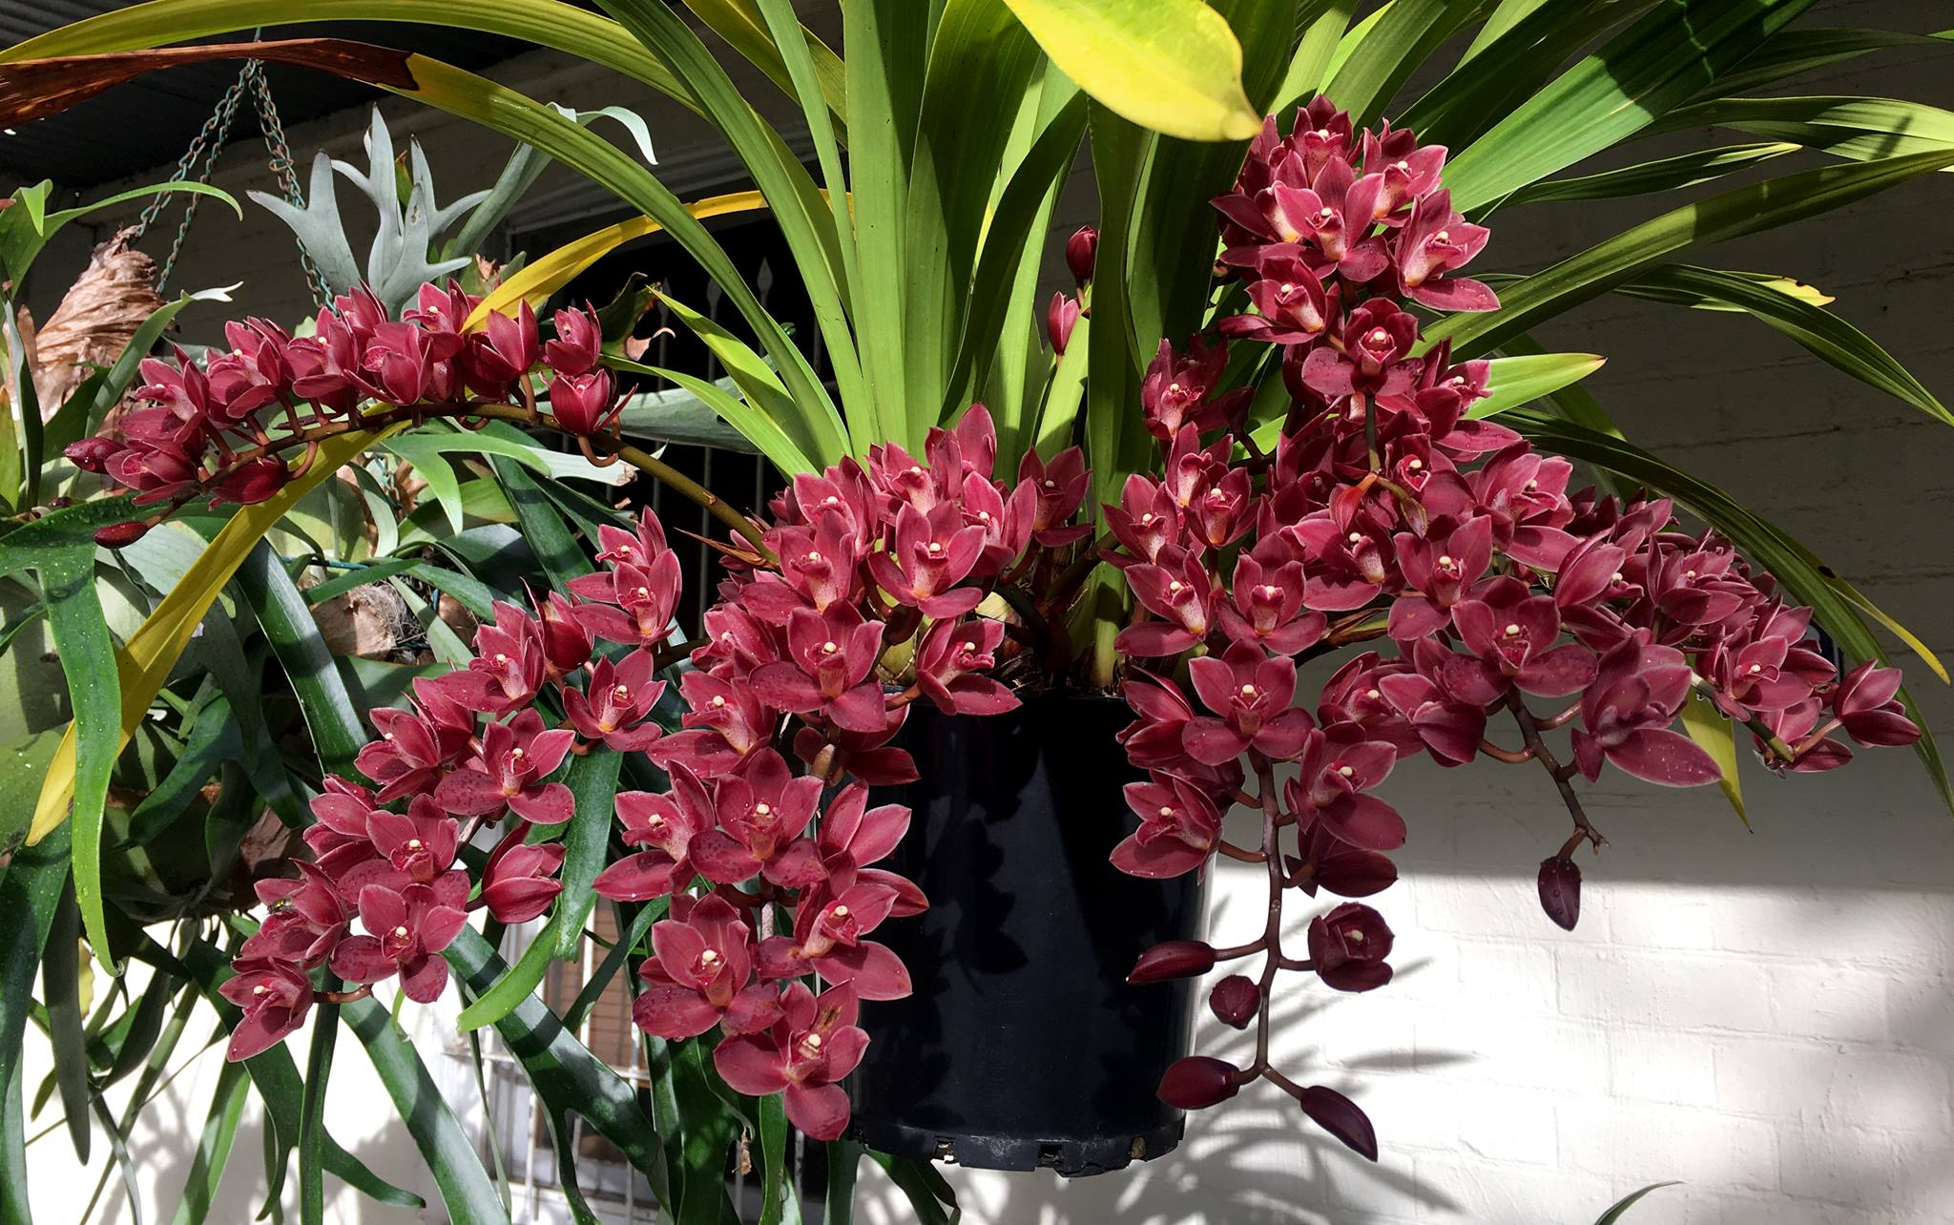
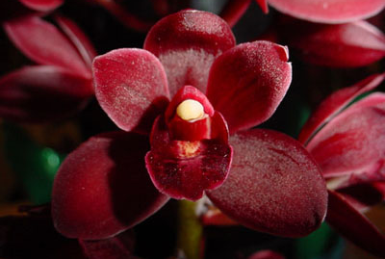
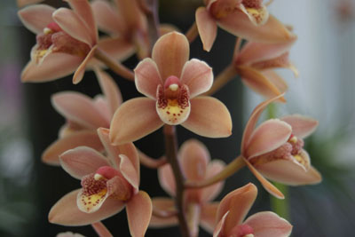
Cymbidium Phar Lap (1986)
Cym. Flame Hawk x Cym. madidum
35 Offsprings, 108 total progeny
Madidum pairs well with devonianum
Intensifying colors

Slide 17
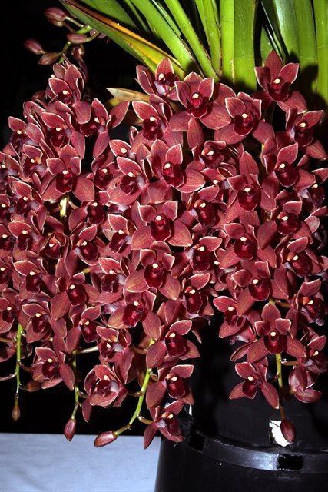
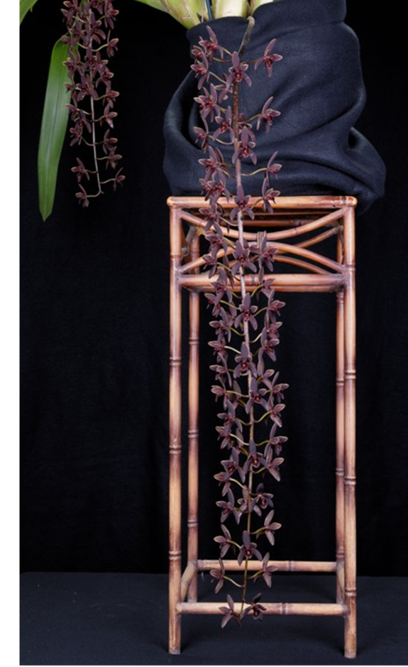
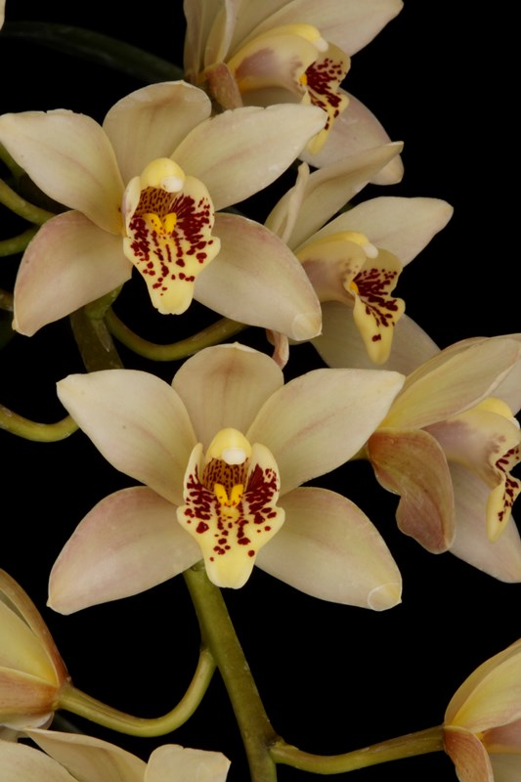
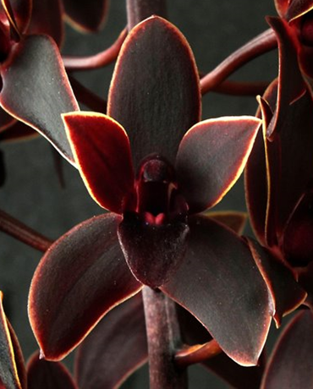
Cym. Gladys Whitesell (Fifi x sanderae) (1983)
‘Joy’ HCC/AOS (2015)
Cym. Dorothy Stockstill (1992)
(Phar Lap x Miss Muffett)
‘Forgotten Fruit’ AM/AOS (1993)
Cym. Little Beauty (1992)
((devonianum x madidum) x canaliculatum)

Slide 18
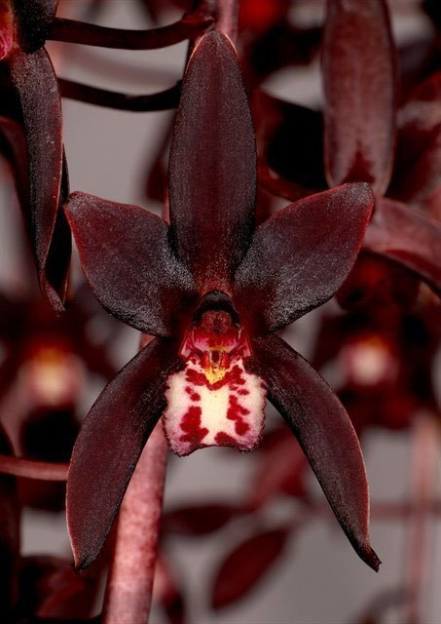
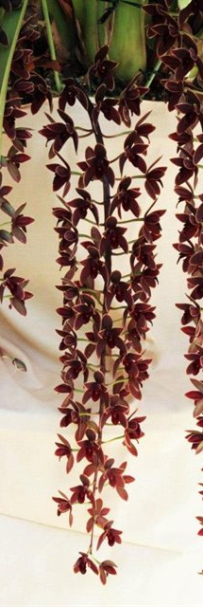
Pendulous Cymbidium
Not widely used
Can create some intensely colored hybrid with pendulous inflorescence, almost velvety in texture
Cym. Black Forest (1999) ‘Black Label’
((aloifolium x Carbenet) x Tethys)
Cym. Australian Midnight (1991)
(canaliculatum x atropurpureum)
Cym. Black Stump (2009)
(Australian Midnight x Cricket)

Slide 19
New breeding direction: Grammatocymbidiums
Grammatophyllum does not has pendent inflorescence like many warm tolerant Cymbidium listed earlier.
Upright stem with high flower count is still more desirable in commercial hybrids
Advantage:in crease flower count, heat tolerance, long lasting bloom, exotic spots and stripes, flowers well presented, well arranged
Disadvantage: large plants, “muddy” color, small lips. Grammatocymbidiums pollens are generally not viable creating difficulty in breeding.

Slide 20
Grammatocymbidiums
Grcym. Pakkret Paronama
Grcym. Pakkret Nebula
Grcym Pakkret Nova x
Gramm. Crownfox Leopard
Grcym. Pakkret Gargoyle
Grcym. Lovely Melody
Grcym. Pakkret Adventure

Slide 21
Resource
Orchidwiz Encyclopedia version 9.1
Orchid Pro Online
Warm Growing Cymbidium
http://www.orchidpeopleofhawaii.com/warm.html
American Orchid Society Magazine
Chinese Cymbidium species, Issue July 1999, page 12 - 23
Cymbidium madidum, Supplemental Issue Oct 2018, page 18- 22
Cymbidium section Jensoa – Its species and some of their hybrids, Issue October 2018, page 30 -41
Growing Cymbidium in a Warm Climate, Issue March 2010, page 24-29
Grammatocymbidiums: An Advanced Path to Breeding Heat-Tolerant Cymbidiums, Supplemental Issue Oct 2018, page 78 - 82

