Slide 1
INTRODUCTION TO RESTREPIA
Kunth (1816)
Presented by Vinh Du

Slide 2
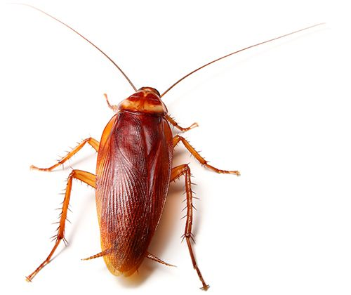
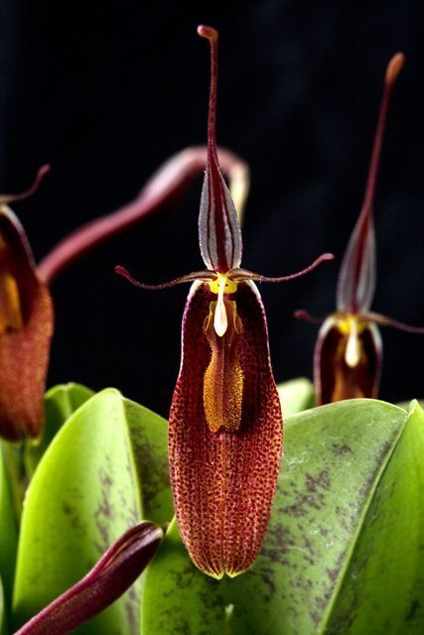
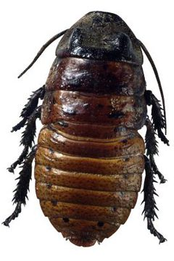
Orchid or cockroach???

Slide 3
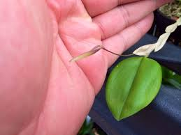
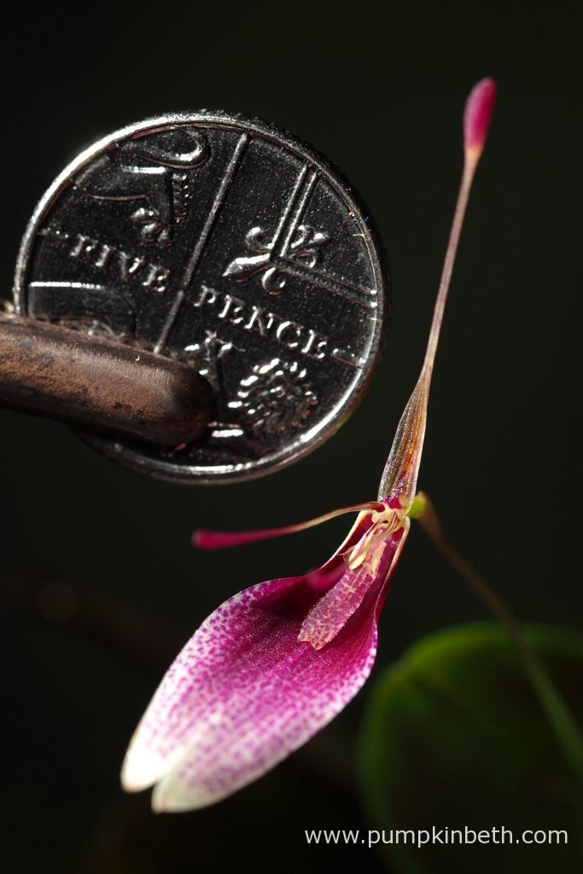
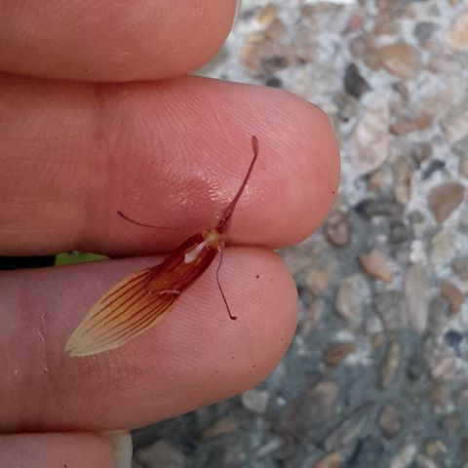
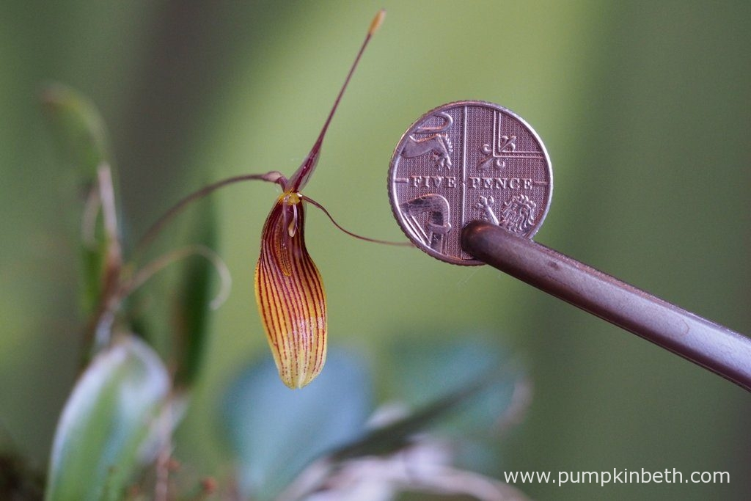

Slide 5
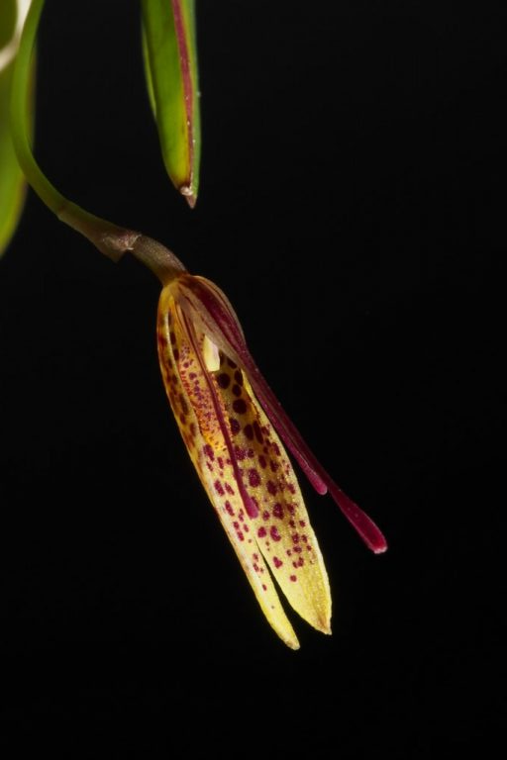
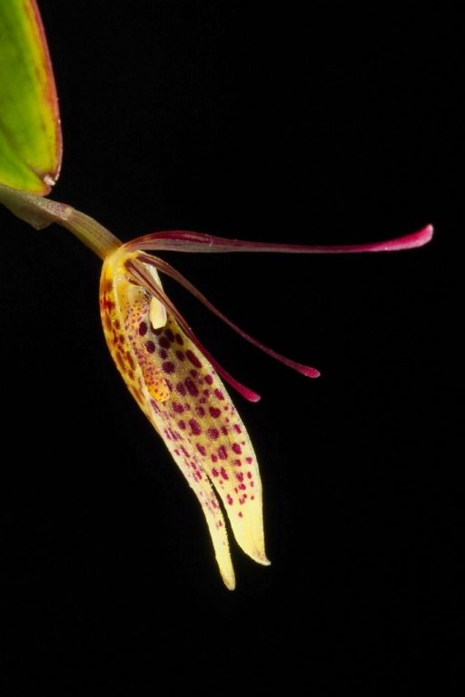
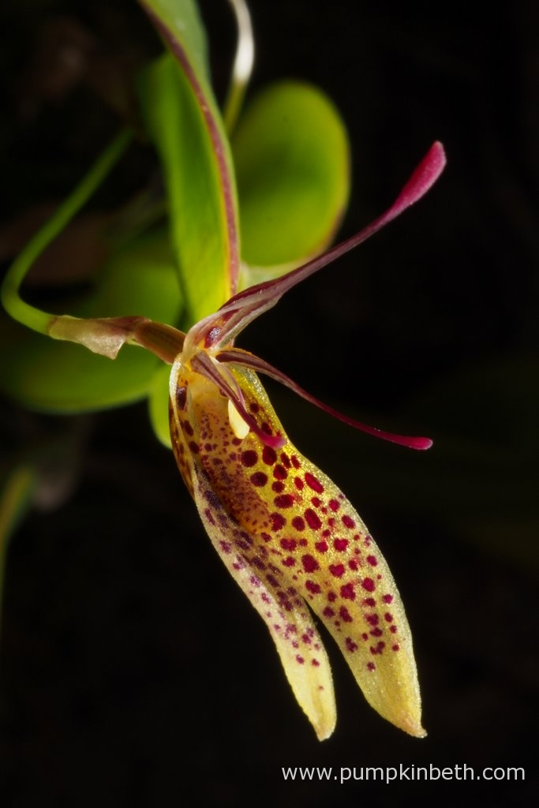
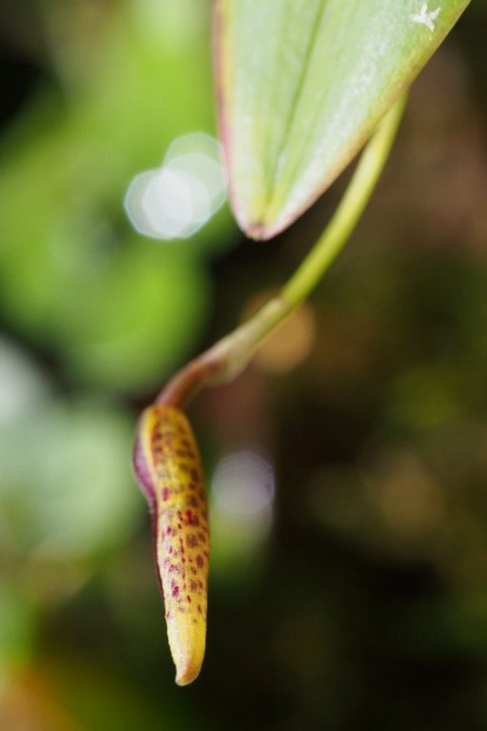

Slide 6
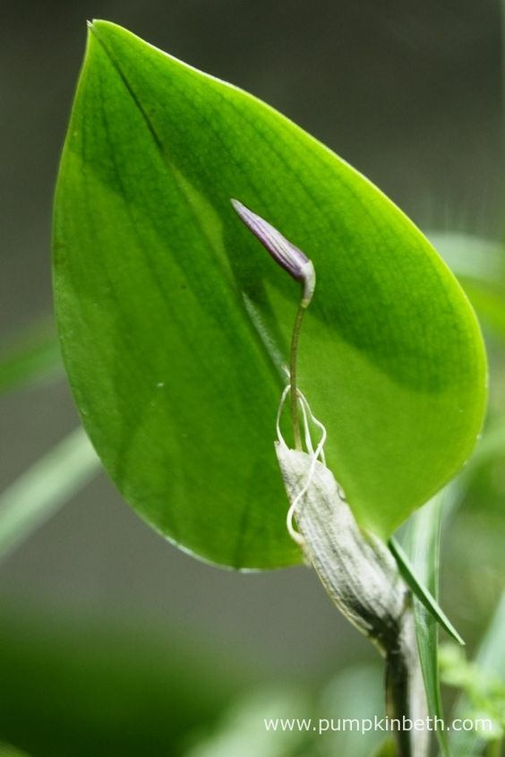
Genus characteristic
Caespitose (tuft like) growth habit
No pseudobulbs. Only a structure called ramicauls covered by papery sheath
Leaves are coriaceous (leathery), conduplicate (folded in the middle).
Single-flower inflorescence, sometimes successive. Multiple inflorescence per leaf coming out from behind the leaf
Broad, connate (fused) lateral sepals and filiform (thread like) petals
It has been one of the genera most confusing to botanists for many years, currently 57 species. Ecuador and Venezuela are the 2 richest country in terms of species
Able to withdtand a large range of temperature 0-40 Celcius

Slide 7
Anatomy/terminology Annulus/Annuli (n): the nodes at the base of the leaf giving rise to flowers/keikis. clavate(adj): club shaped (apex of petals and dorsal sepal) (a,b, and c) osmophore/s(n) microscopic fragrance gland(s) (in this case located at the clavate tips.) cirrhus/cirrhi (n) tendril(s), in this case, projecting from the sidelobes of the labellum (number 7) Callus/calli (n) thickened tissue, in this case, it indicates the structures on either side of column foot (number 3)

Slide 8
Pollination of Restrepia * Suggested pollinator is a small fly * Scent trails from osmophores will act as long distance “advertisement”, strength will increase as the insect approaching flower *Synsepal patterns guide insect in the center of flower by tactile and secretory region along stripes *Epichile Is bumpy and most active secretory region producing waxes and oils presenting itself to the insect *The calli are highly reflective (always yellow in the Genus) in addition to the concave surface of hypochile serve to attract and deceive insect for possible reward

Slide 9
Pollination of Restrepia (cont.) *Cirrhi acts as guardrails to prevent pollen from being stolen. Pollinators must be able to fit in between cirrhi and under column head. *Once there, the surface of hypochile become smoother and steeper making progressing difficult, the insect will be “trapped” and they can only exit the flower if they progress along the labellum * As the flower age, the tips of cirrhi splay out to allows easier entry for pollinators *Ratio between column length and cirrhi width varies between species, only the right proportion pollinators would be able to fit. *Lips are used to distinguished different species in the genus.

Slide 10
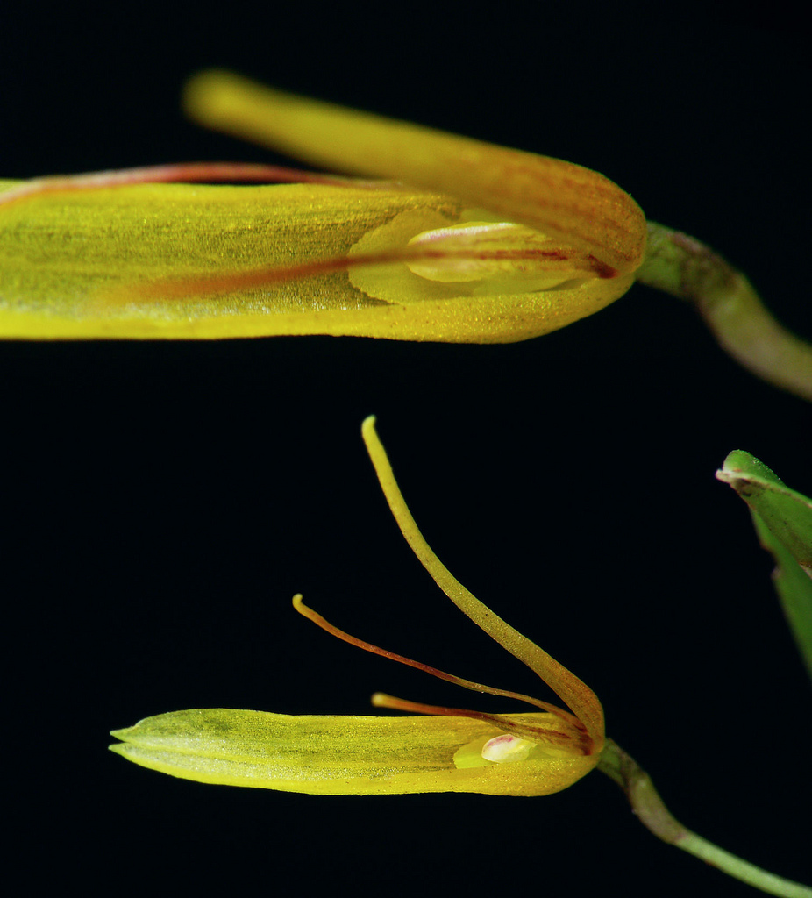
Subgenus Ecmeles
Contain 1 species: Restrepia aberrans
Characterized by dorsal sepal not terminated in drop shaped and lateral sepals not fused.
Vegetatively, it resembles small species of the genus but the floral structure seems intermediate between Pleurothallis and Restrepia
This species is rare and absent from the collections. It seems to wither quite quickly in culture

Slide 11
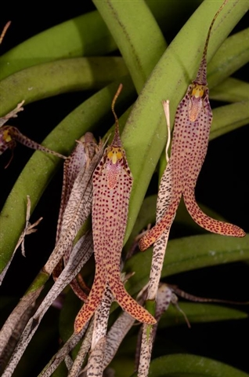
Subgenus Pachymeles
Contain 1 species: Restrepia chocoensis
It is unique, easily recognized by its long, falcate coriaceous succulent leaves.
Flowers are held vertically and synsepals is incompletely fused and being diverged at the apex
In addition, ramicauls are wrapped in imbricating sheaths that are heavily dotted purple.
It is a very sought after species because it’s very rare and unique of its kind. It is delicate, grows slowly, does not produce keikis. Grows cool to warm
‘Snake’s Tongue’ AM/AOS (2013) 85 points

Slide 12
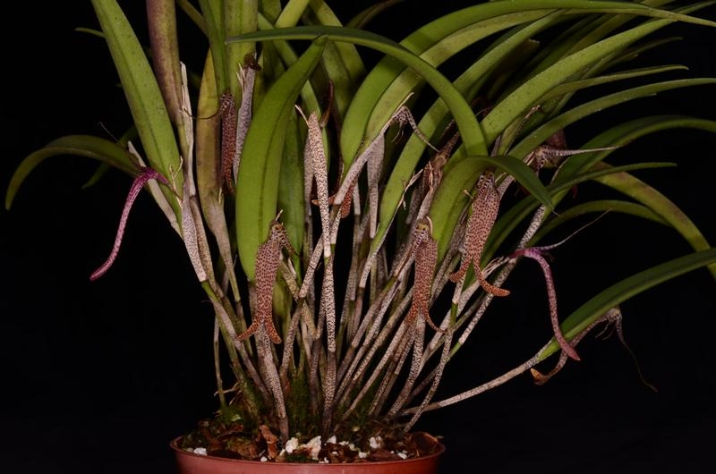
‘Snake’s Tongue’ CCM/AOS (2013) 84 points

Slide 13
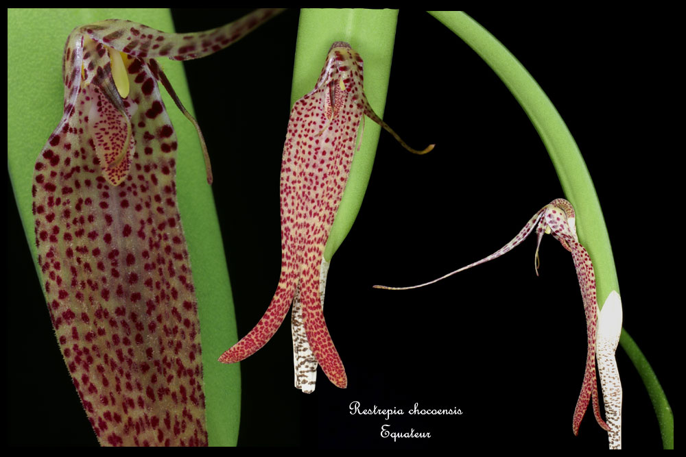

Slide 14
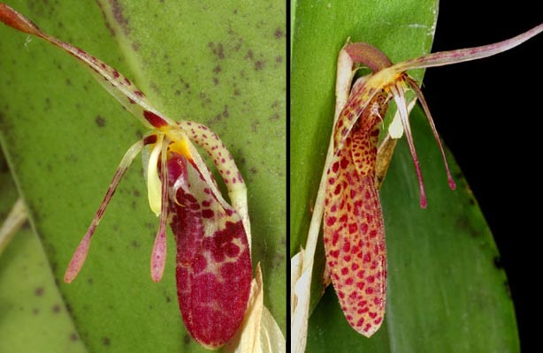
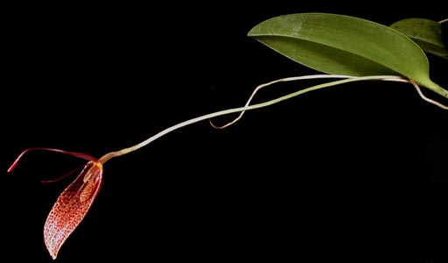
Subgenus Restrepia
Contain all other species
Divided into 2 sections depending on the length of the floral peduncles
Section Pleurothallopsis includes species with short flower stalks (less than half the length of leaves)
Section Restrepia includes species with long peduncles, sometimes taking flowers away from the leaves
Guess what the judges/ breeders love?

Slide 15
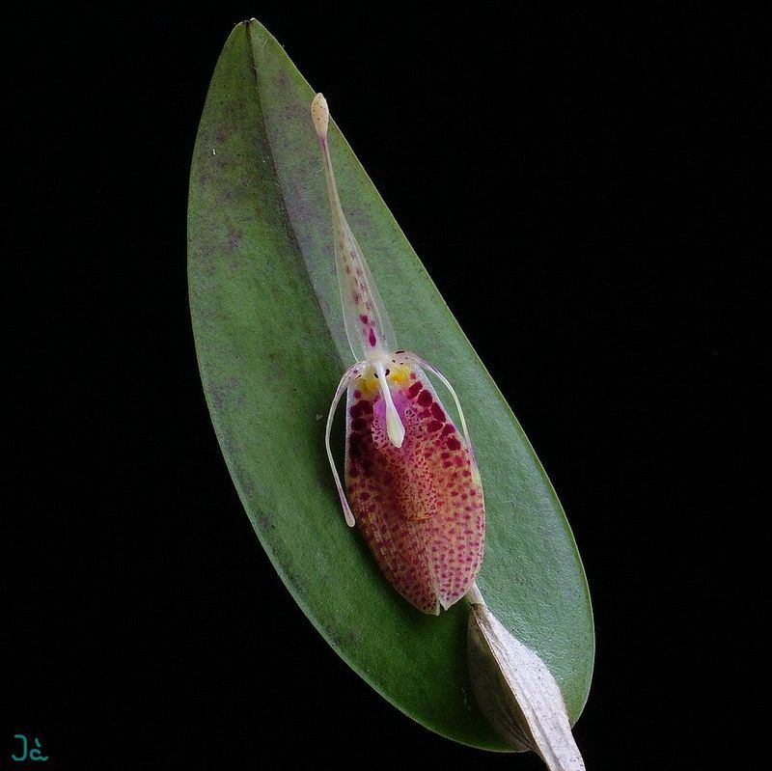
Section Pleurothallopsis
Restrepia aristulifera
Jellyfish???
Most hybridized in the section with 10 first and 12 second generation hybrids
1 CBR/AOS in 2009
Rare species in cultivation.

Slide 16
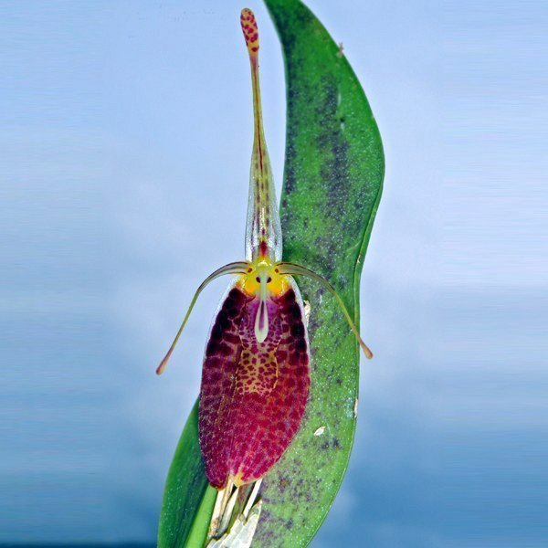
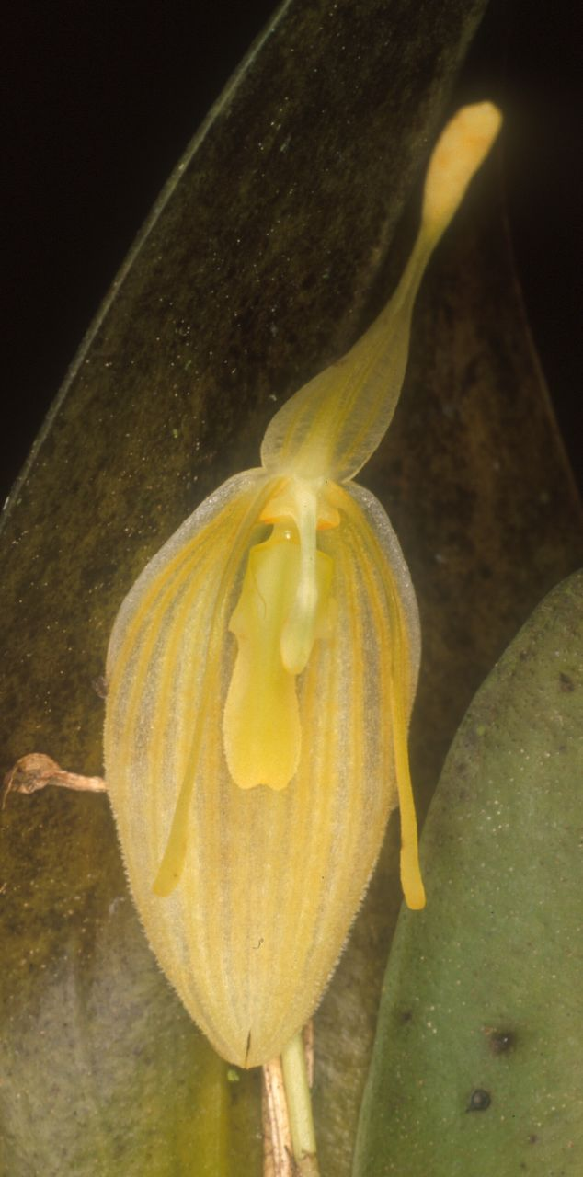
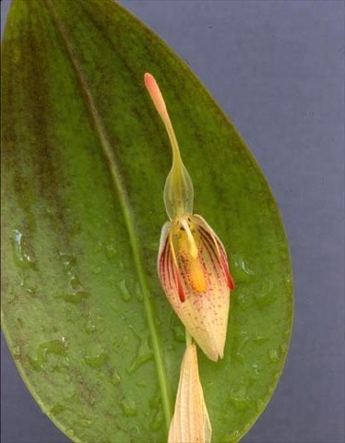

Slide 17
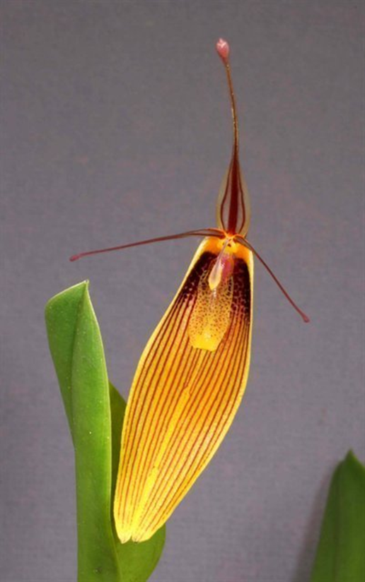
Section Restrepia
Most highly awarded in the genus
Increasing hybridization is being done, mostly by the Eric Young Foundation in Great Britain
In fact, most second and third generation hybrids was registered between the year 2015-2017 indicating an ongoing program.
US breeders?

