Slide 1
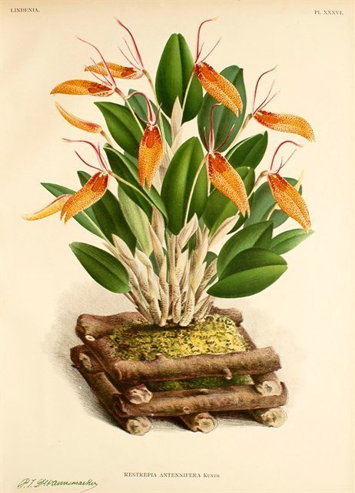
Type species: Restrepia antennifera

Slide 2
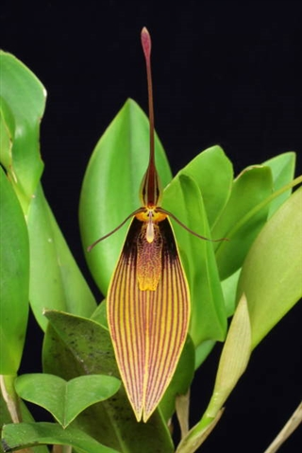
Restrepia antennifera (cont.)
This species is quite common and widespread in Venezuela, Colombia and Ecuador at altitudes of 1500 to 3000 m.
The plant is large for the genus with ramicaules sometimes exceeding 20 cm and leaves 5 to 10 cm long.
The flower is also among the largest of the genus with a synsepal exceeding sometimes 6 cm in the gigantea variety.
Bloom time: Late W-Spr and again Late Su-F
‘Cow Hollow’ AM/AOS (2010) 82 points

Slide 3
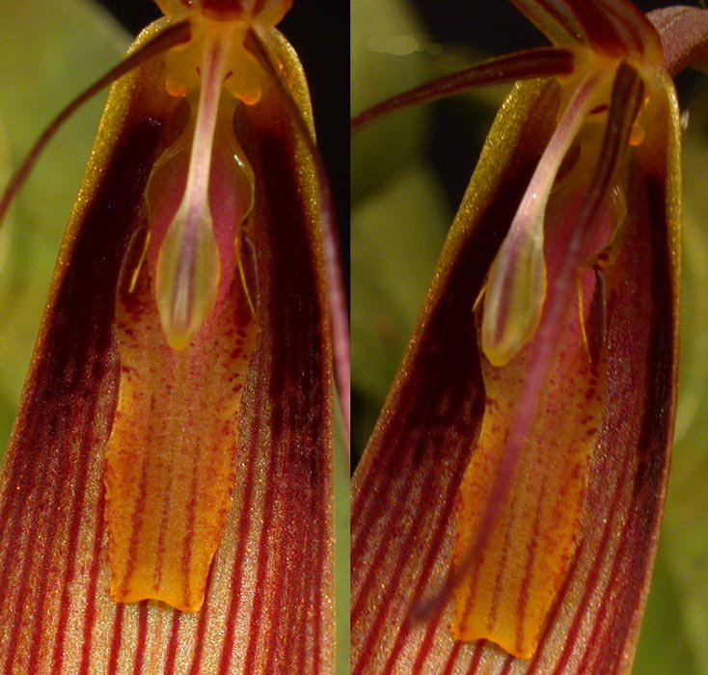
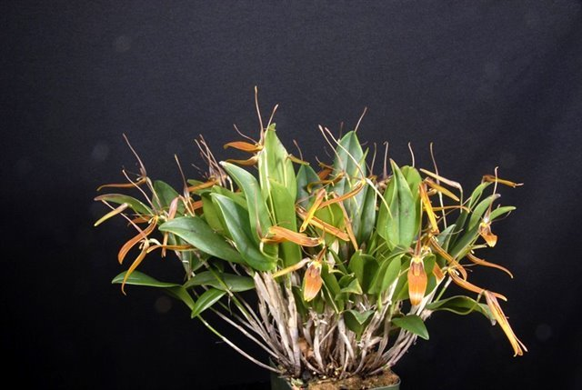
Restrepia antennifera (cont.)
Wide spread in collections
Easy to grow and make many keikis
2 AMs, 1 HCC, 2 CCMs, 2 CHMs, 1 CBR
‘Gracie’ CCM/AOS (2014) 82 points

Slide 4
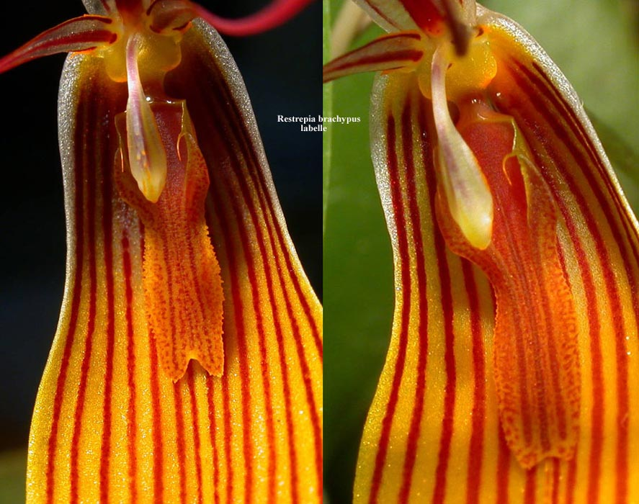
Restrepia brachypus

Slide 5
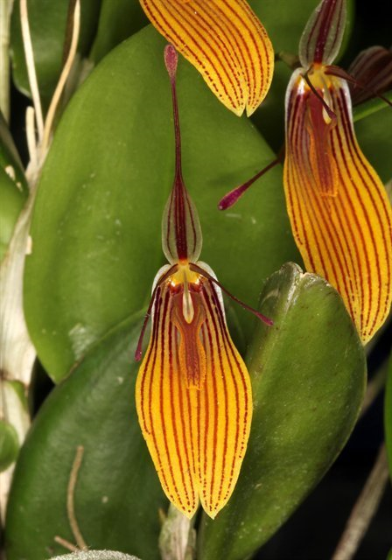
Restrepia brachypus (cont.)
Widely distributed from Venezuela to Bolivia. It is common in Colombia and Ecuador, rarer in Peru and Bolivia. It grows at altitudes of 1500 to 2500 m.
Medium in size (10 to 20 cm high). The synsepal, 2-3 cm long, is streaked with purple on a golden yellow background.
Bloom time most of the year, heavily in Spring and Fall
2 AMs, 1 CCE, 1 CCM, 1 CHM, 1 CBR

Slide 6
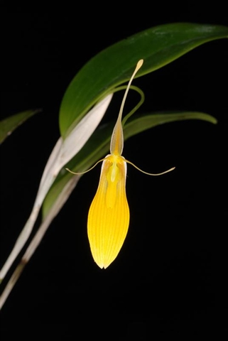
Restrepia brachypus (cont.)
It is a very widespread species in cultivation. It is recommended to all those who want to start with the genus. It is an easy-to-grow species that grows fast with abundant blooms most of the year.
Most widely bred along with R. contorta: 16 first, 17 second and 10 third generation hybrids, mostly between 2015-2017
Now would you look at that var. xanthina!?
‘Conni’s Delight’ AM/AOS (2013) 80 points

Slide 7
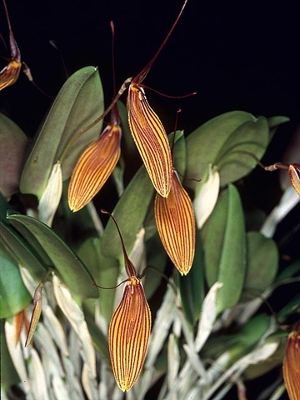
‘Schlichting’ CCE/AOS (2004) 91 points, AM/AOS (2004) 80 points

Slide 8
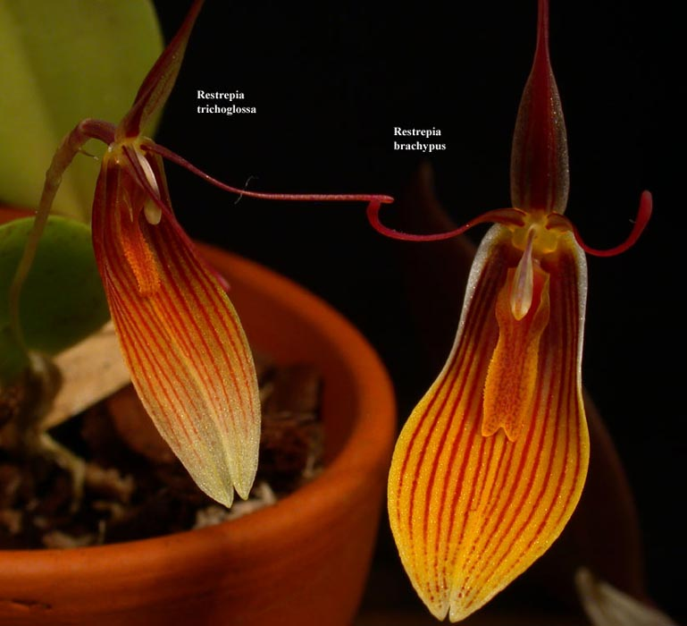
R. brachypus vs R. trichoglossa
R. trichoglossa is species with multiple variations. The synsepal can be pale yellow, dark yellow, sometimes pink. It is sometimes striated, sometimes punctuated and sometimes even entirely orange-yellow
R. brachypus may be confused with certain striated forms of R. trichoglossa. We must then examine the labellum, which is always less than 2 mm wide and is very fimbriated in R. trichoglossa

Slide 9
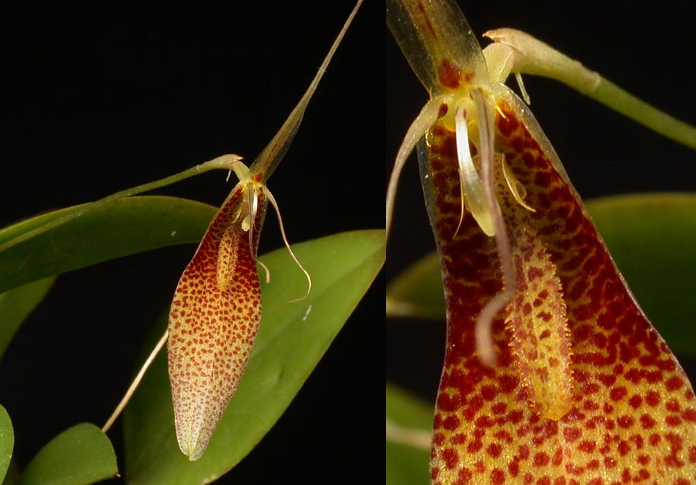
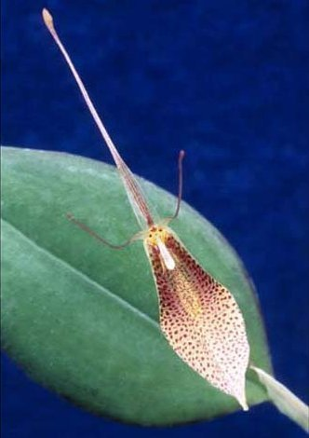
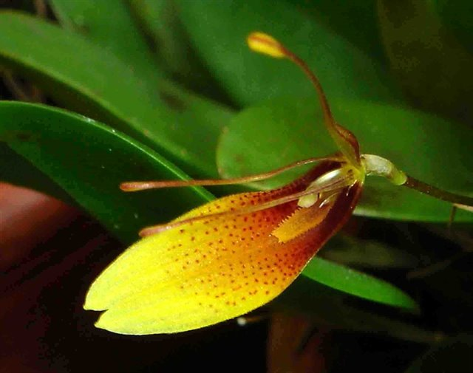
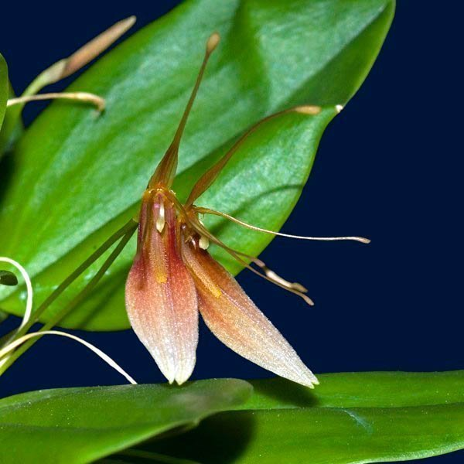
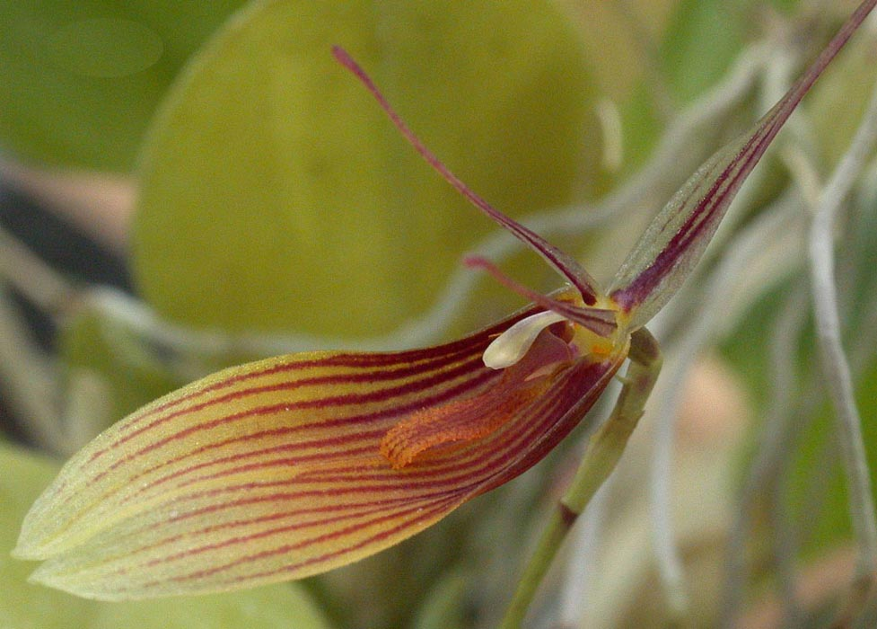
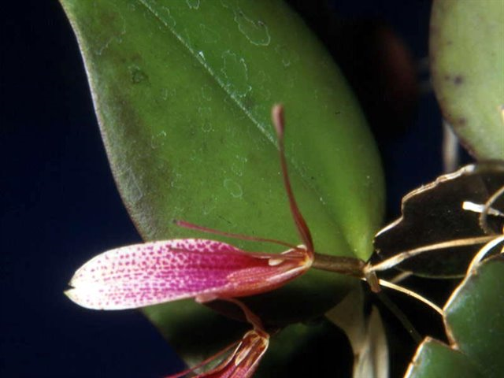
Talking about R. trichoglossa….

Slide 10
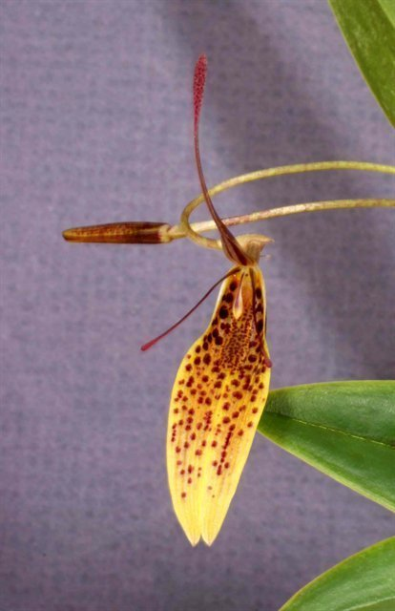
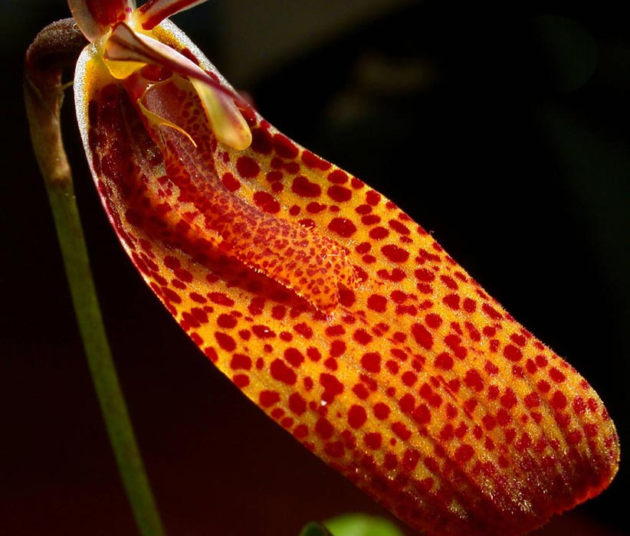
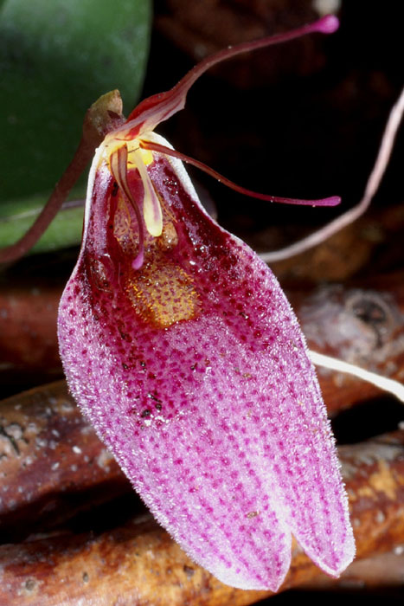
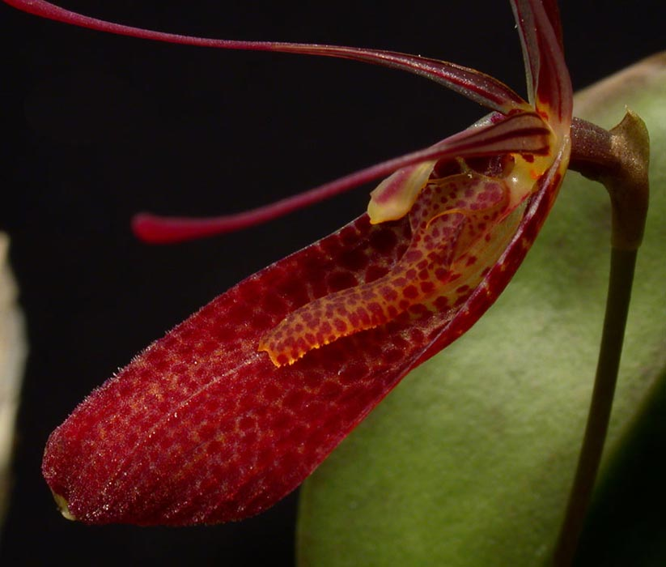
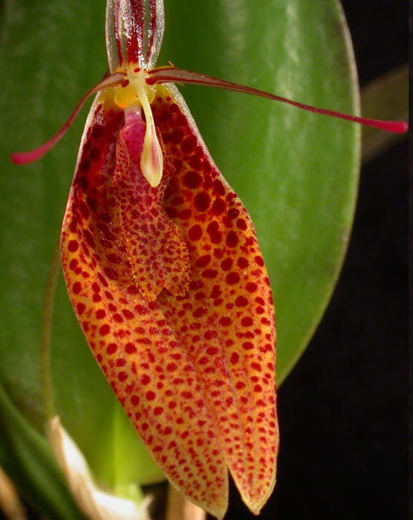
…. And there’s Restrepia contorta

Slide 11
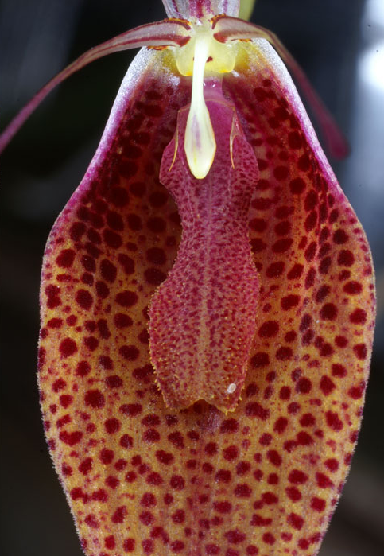
Restrepia contorta
It is very variable in size from small (2cm) to large (4cm) and as to the appearance of its flower.
The common points of all the descriptions are the spotted synsepal and the pinched labellum. Otherwise, there are all the kinds of shapes (slender to wide), colors, and marking on the synsepals.
Bloom Spr-F
1 CCM, 1 CHM, 1 CBR
Most widely bred along with R. brachypus: 17 first, 14 second, and 12 third generation hybrids, mostly between 2015-2017

Slide 12
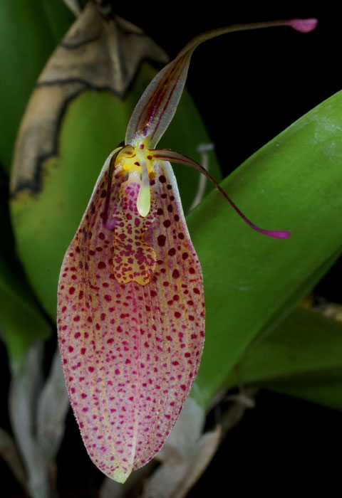
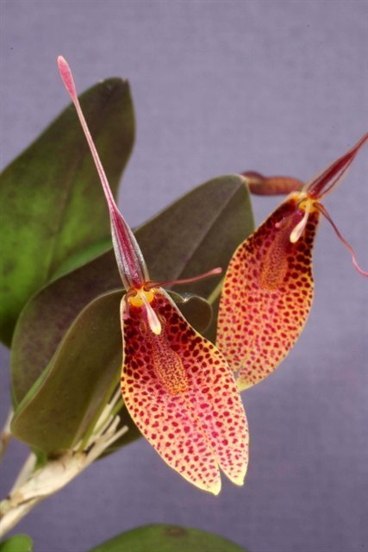
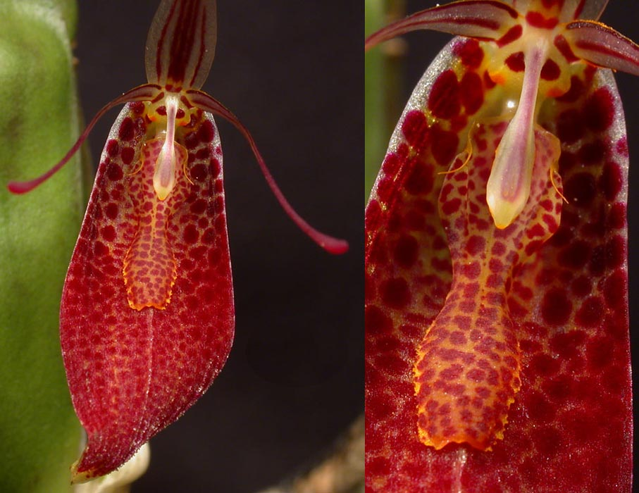
Restrepia contorta (cont.)
Wide range of distribution from Venezuela, to Peru via Columbia, and Ecuador, cool to warm growing. This can potentially mean this is an aggregation of separate species that need reclassification.

Slide 13
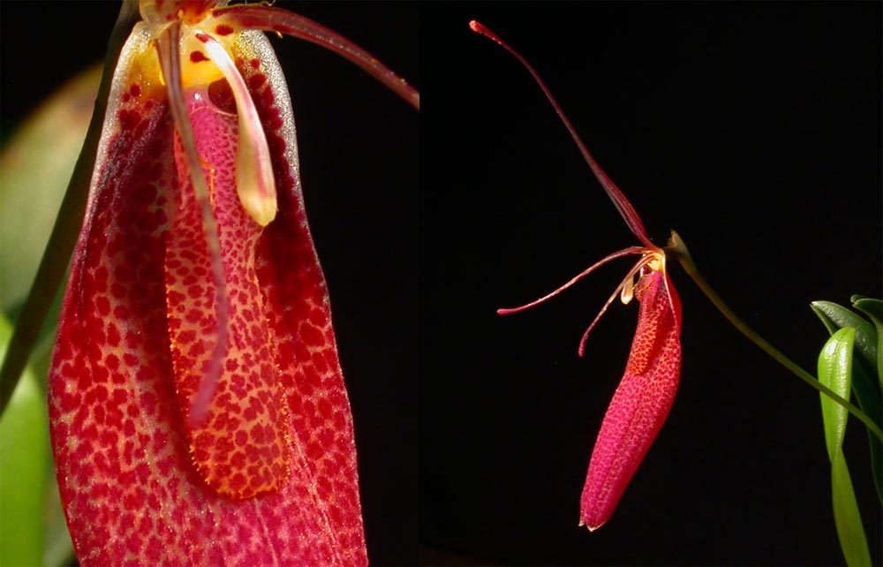
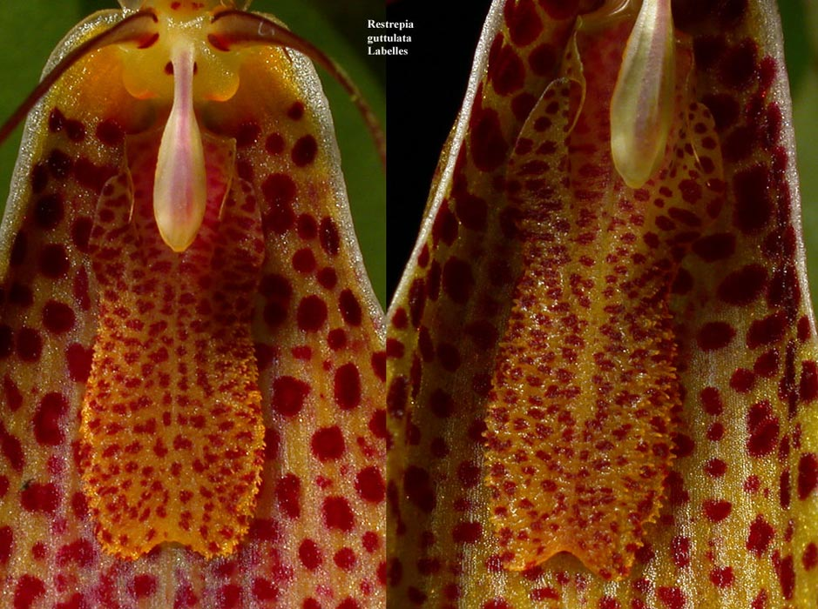
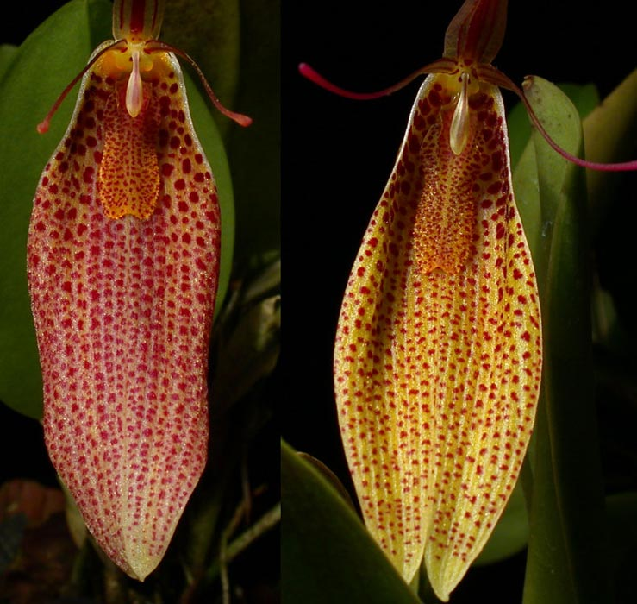
Restrepia guttulata
Easily confused with R. contorta, only the lip are shaped differently and the flowers are generally larger (3-5cm)
Lip is minimally pinched and is almost rectangular.

Slide 14
The struggle is real….

Slide 15
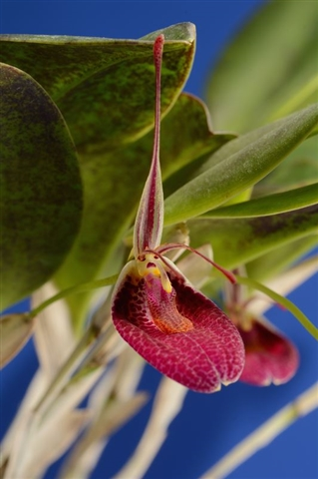
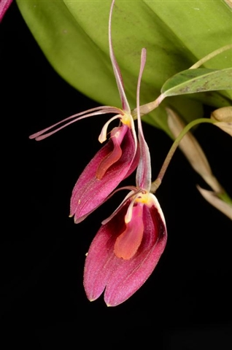
Restrepia sanguinea
This species is endemic to the Andes of Colombia where it was collected between 1500 and 2500 m altitude. (like cool)
The flower is distinguished by a white or yellowish synsepal, almost completely covered by intense purple confluent macules. 2-3 cm long and is quite wide giving a rounder appearance.
Has received the most AM/AOS (5) of all Restrepia species
‘Mario’s Choice’ AM/AOS (2014) 84 pts
‘Marsh Hollow’ AM/AOS (2012) 85 pts

Slide 16
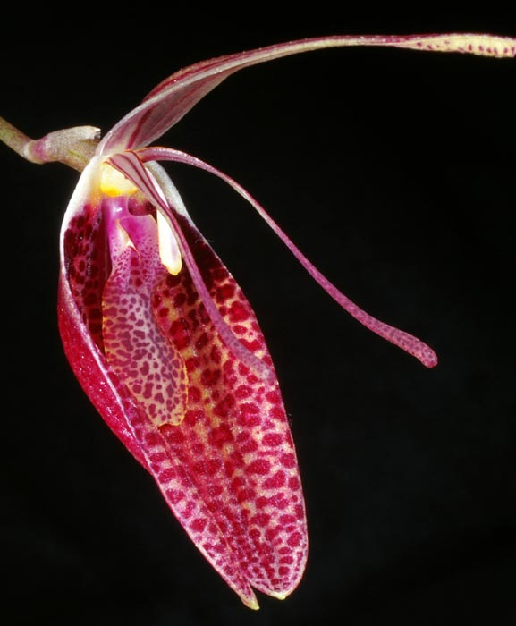
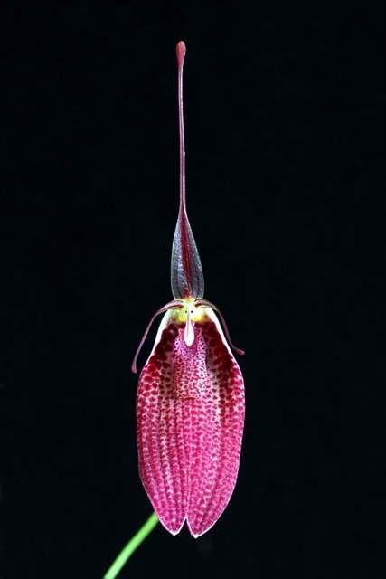
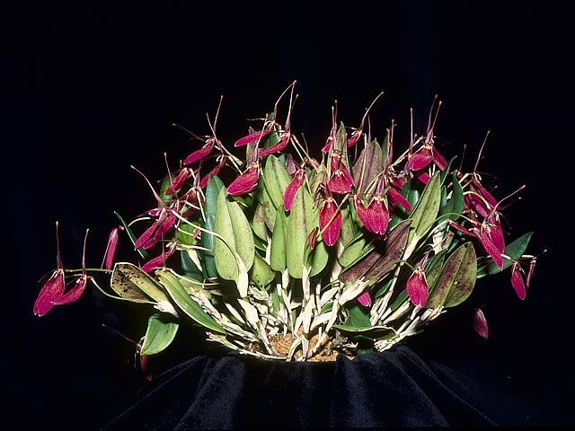
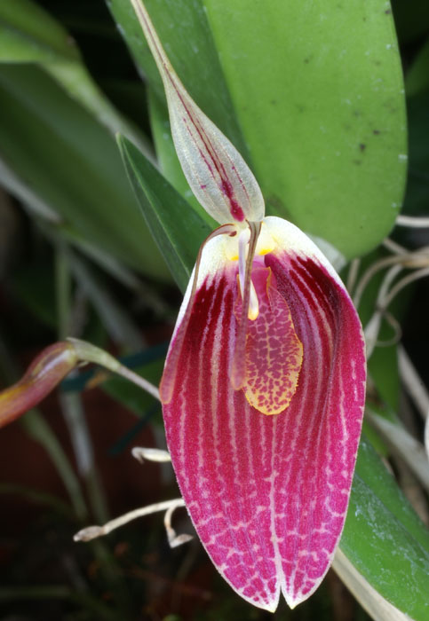
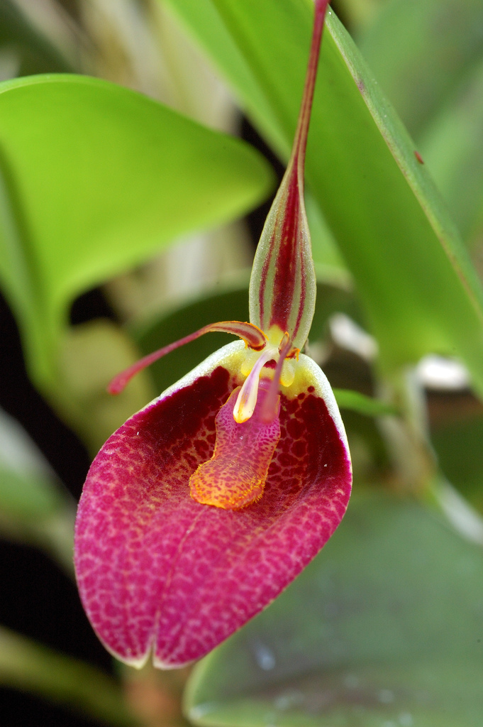
Restrepia sanguinea
5 AMs, 3 HCCs, 1 CCE, 3 CCMs, 1 CBM
12 first generation and 7 second generation hybrids
‘Walter’ CCE/AOS (2004) 91 points

Slide 17
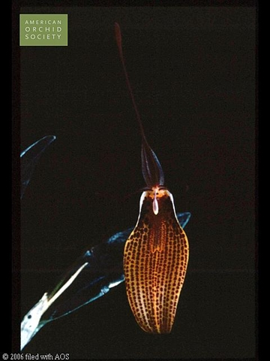
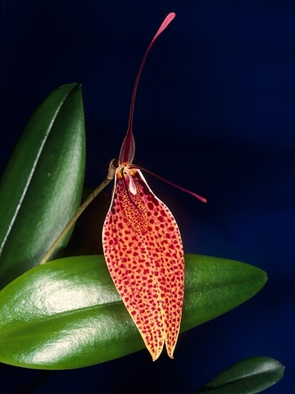
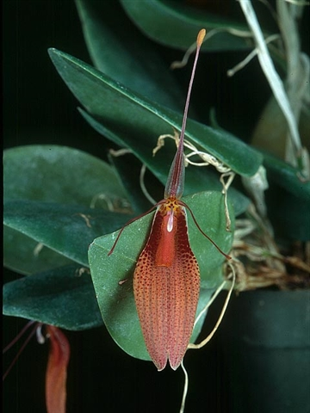
Awarded Restrepia hybrids
Restrepia Tattoo (antennifera x guttulata) registered 1990: 2 AMs, 1 JC
Restrepia Frank Feysa (sanguinea x guttulata) registered 2004: 1 AM, 1 HCC
Restrepia Coup D’Etat (cuprea x dodsonii) registered 2005: 1 HCC, 1 AM
R. Tattoo ‘Thanx Carl’ AM/AOS (1997) 84 pts
R. Frank Feysa ‘Gaetano Ferrusi’ AM/AOS (2003) 81 pts
R. Coup D’Etat ‘Are You Serious?’ AM/AOS (2004) 80 pts

Slide 18
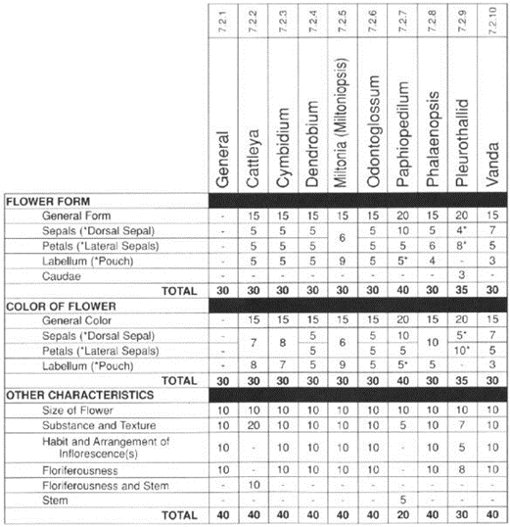
Judging Restrepia
Judging is done using modified Pleurothallid judging scale
Replace ‘Dorsal Sepal’ with ‘Labellum’. Replace ‘Caudae’ with ‘Dorsal Sepal and Petals’
‘Dorsal Sepal’ also includes ‘Labellum’

Slide 19
So how do we grow them???
Tolerant of extreme condition for short period of time (0-40 Celcius)
Most prefer cool, high humidity, high moisture medium that drains well
Handle brighter light, drier condition, warmer temp better than most Pleurothallids but don’t abuse it ☺, must never be totally dried out.
Propagate by division, keikis, or leaf cuttings: remove leaf with some stem attached and plant in moss. Mature leaf that have flowered once or twice gives best result.
Under favourable conditions a small plant will develop from a leaf cutting into an attractive specimen plant carrying twenty or thirty flowers within four or five years!

Slide 20
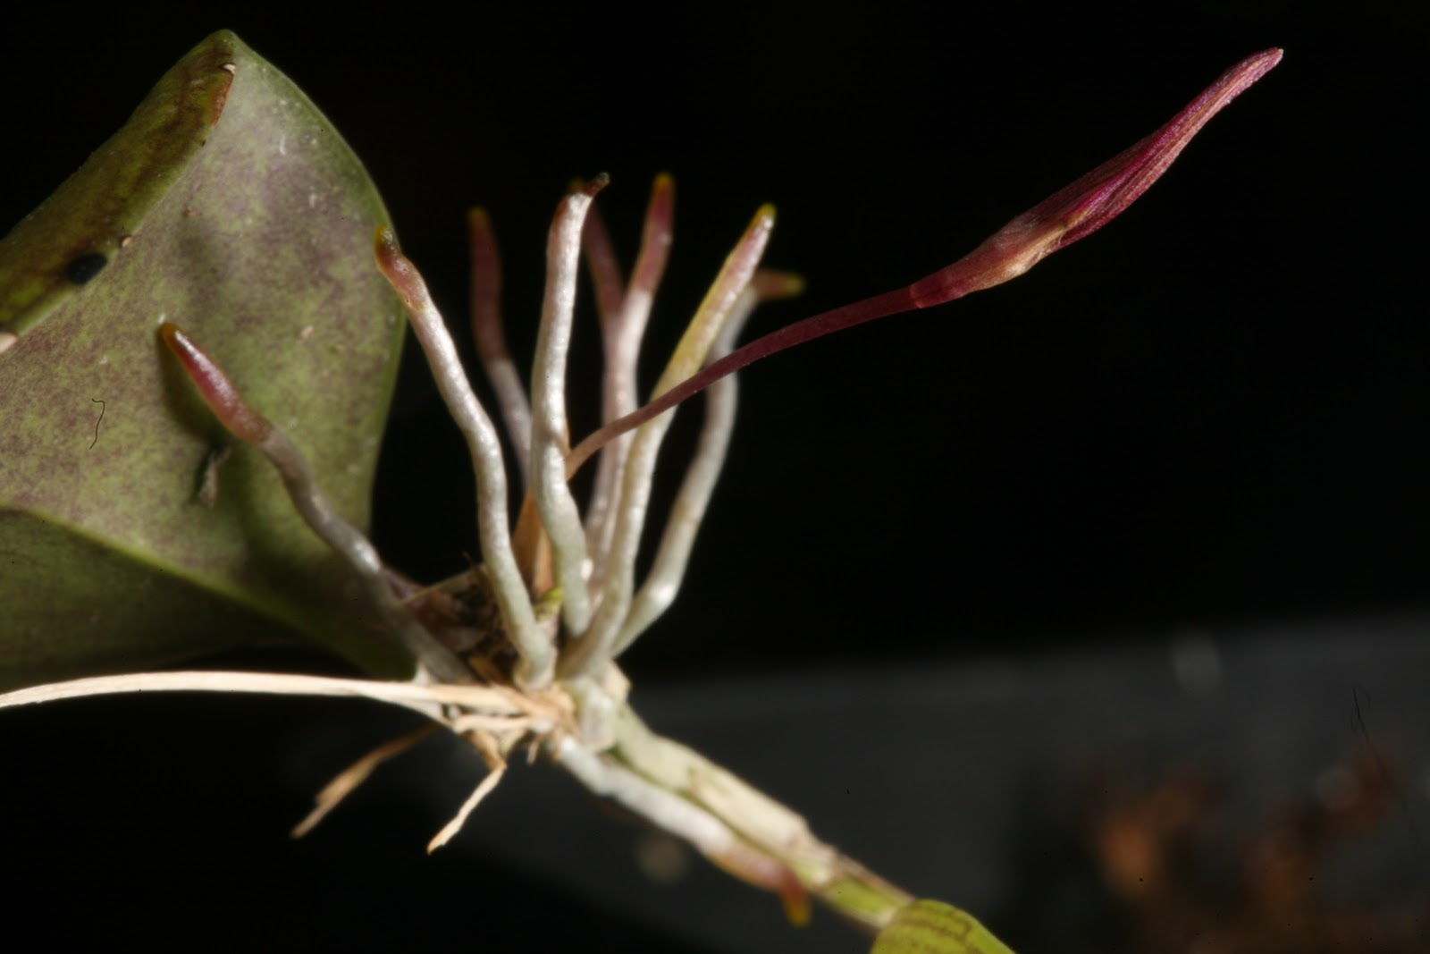

Slide 21
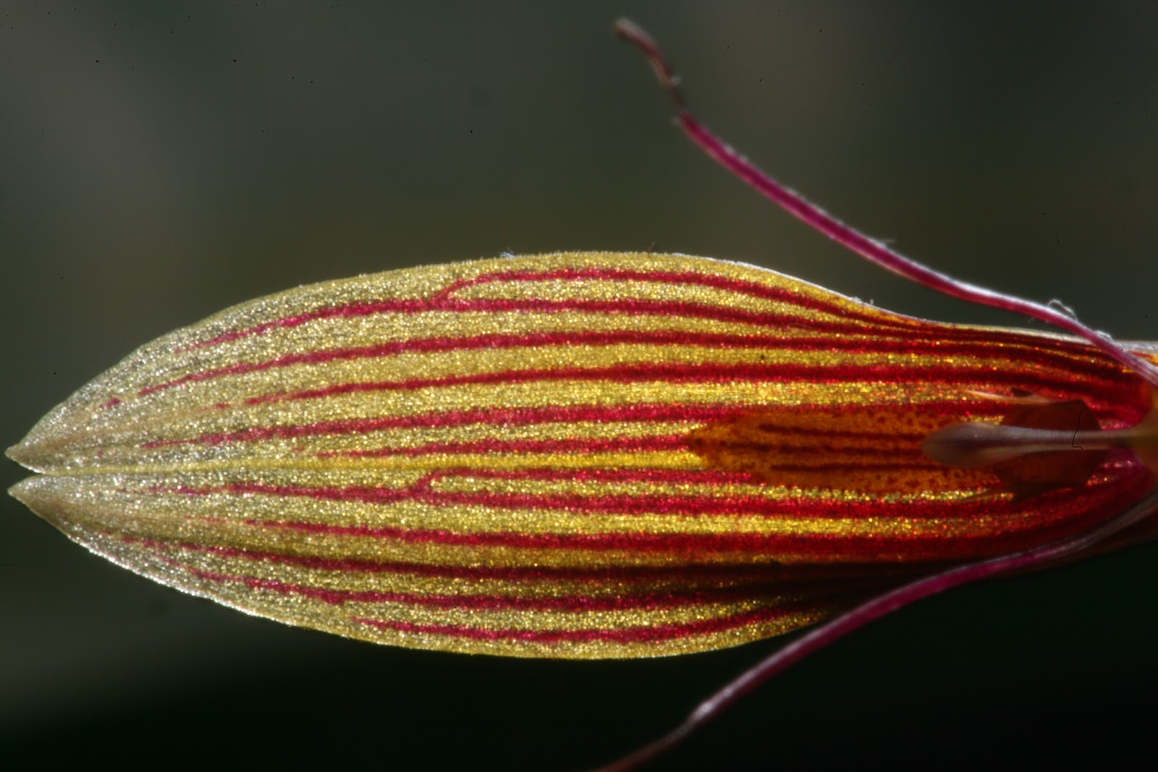

Slide 22
References
Orchidwiz x4.0
Orchid Plus Online
http://www.aos.org/orchids/orchids-a-to-z/letter-r/restrepia.aspx
http://www.sciencedirect.com/science/article/pii/S0367253016301426
http://www.orchid-nord.com/restrepia/genre_restrepia/restrepia.htm
https://www.jstor.org/stable/2443293?seq=1#page_scan_tab_contents
http://www.orchidspecies.com/indexqrsel.htm
http://www.oscov.asn.au/articles3/restrep.htm
https://www.pumpkinbeth.com/2017/10/restrepia-citrina/
https://orchids-on-a-balcony.blogspot.com/2011/04/restrepia-trichoglossa-in-bloom.html

