Slide 1
Indoor Phragmipedium culture
A presentation by Vee Du

Slide 2
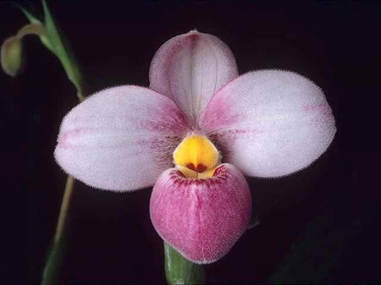
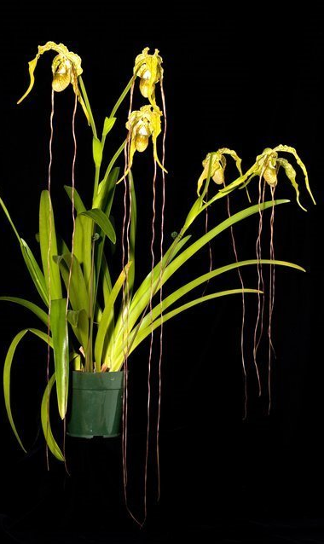
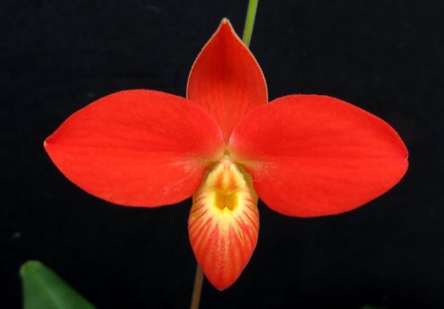
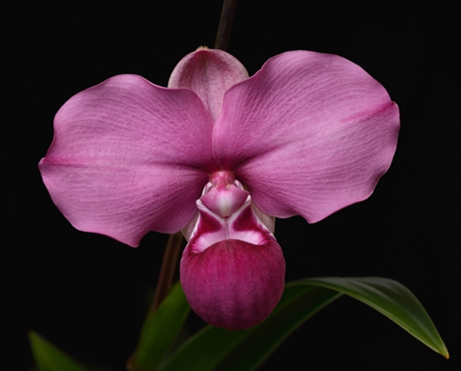
Why growing Phrag ?
Gorgeous to exotic flower.
These are some Phrag species!

Slide 3
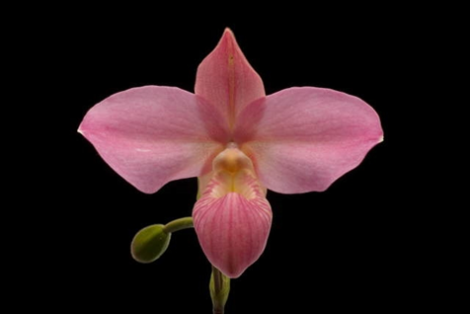
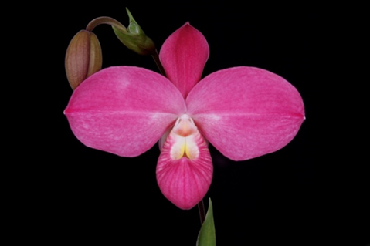
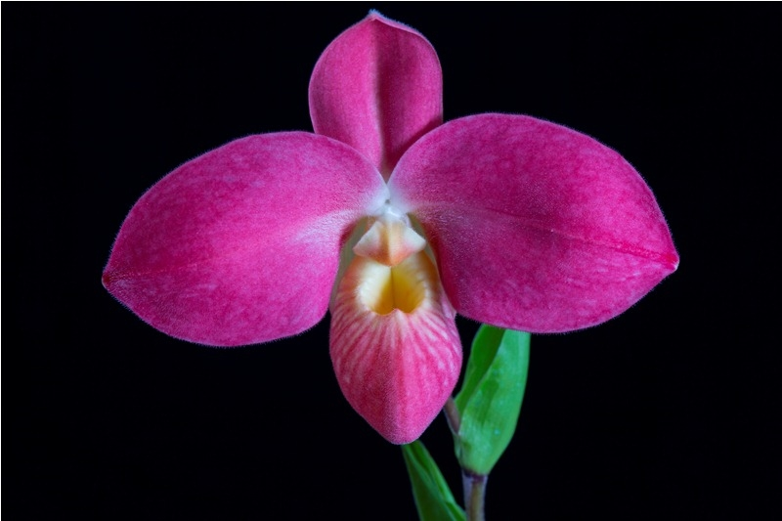
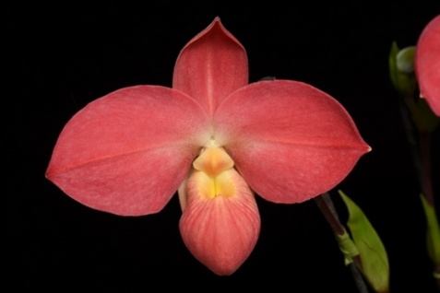
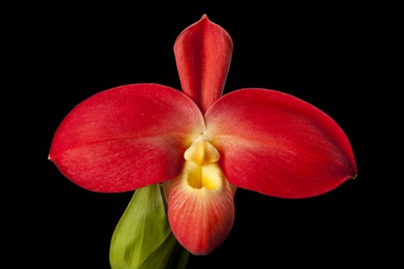
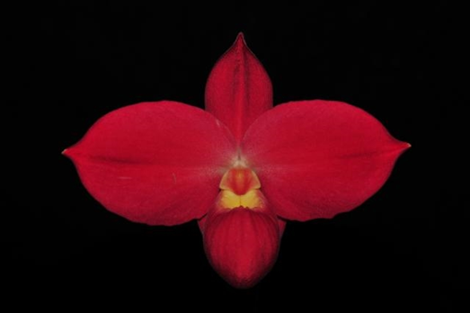
P. Fritz Schomburg (besseae x kovachii)
‘Penns Sunset’ 77 pts HCC/AOS
‘Pink on Pink’ 83 pts AM/AOS
‘Red Sunset’ 78 pts HCC/AOS
‘Susan’ 83 pts AM/AOS
‘Janice Yates’ 84 pts AM/AOS
June’s Orchid Estate’ 85 pts AM/AOS

Slide 4
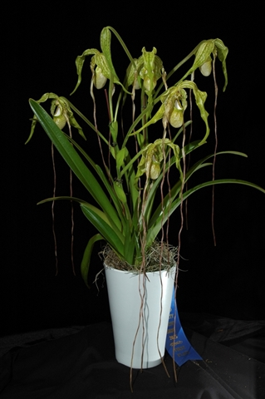
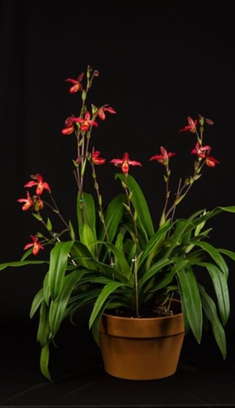
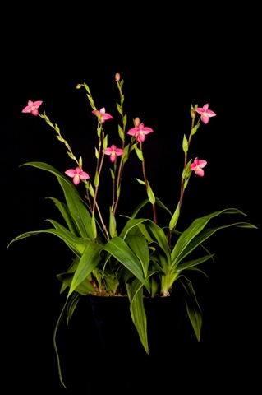
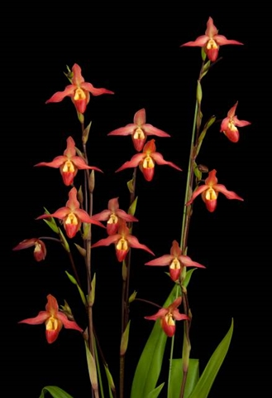
Why growing Phrag ?
Phragmipedium vs Phalaenopsis

Slide 5
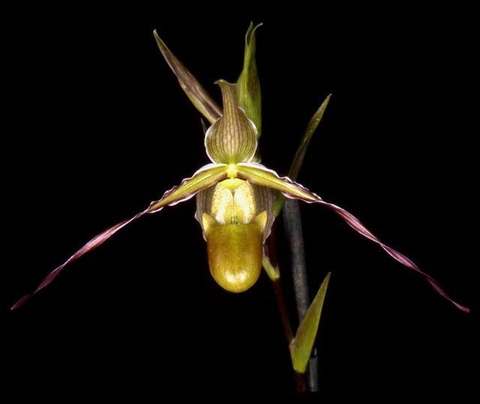
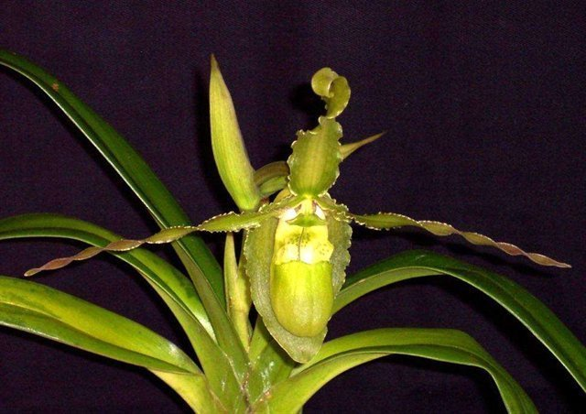
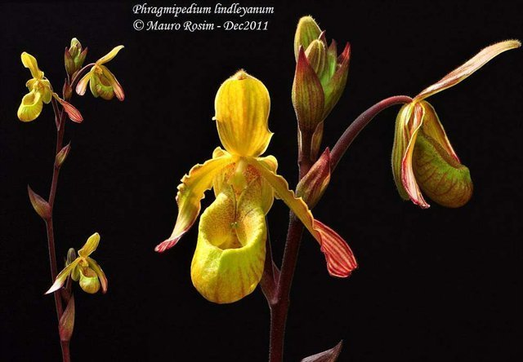
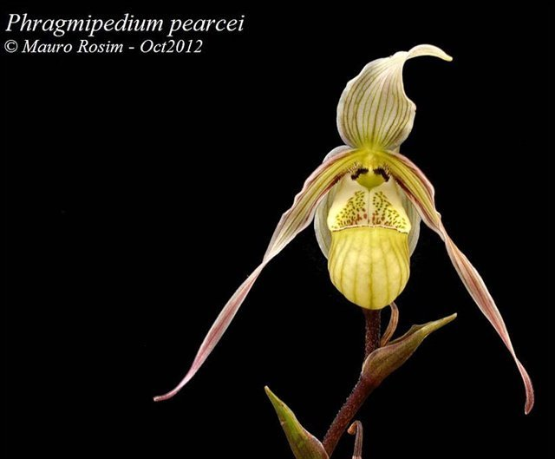
Your first Phrag…
Start with hybrids!
Hybrids with the green/brown flowered or grassy species in the background:
P. longifolium, P. boissierianum…
P. sargentianum, P. lindleyanum…
P. pearcei, P. caricinum…

Slide 6
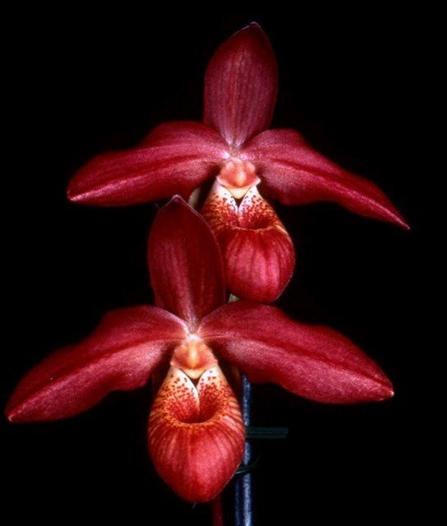
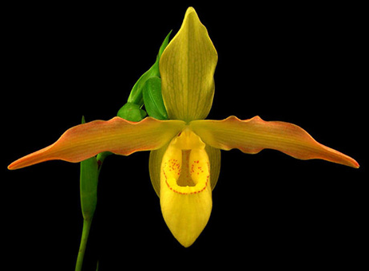
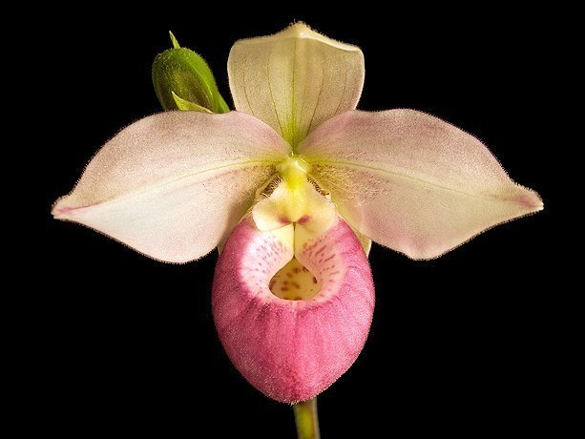
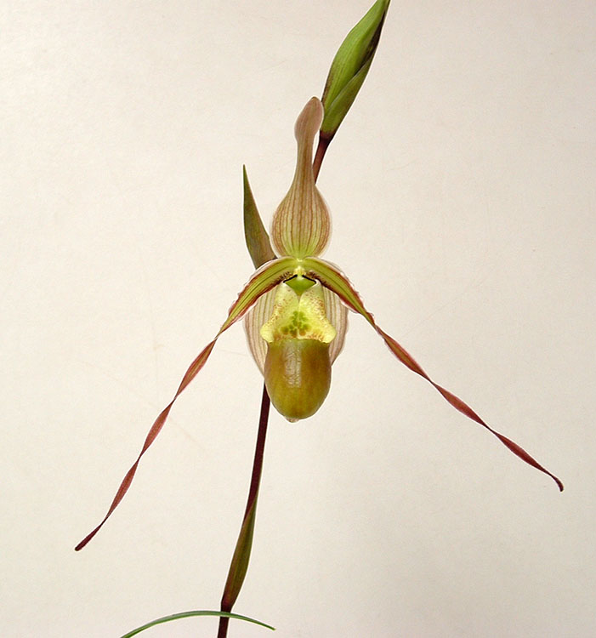
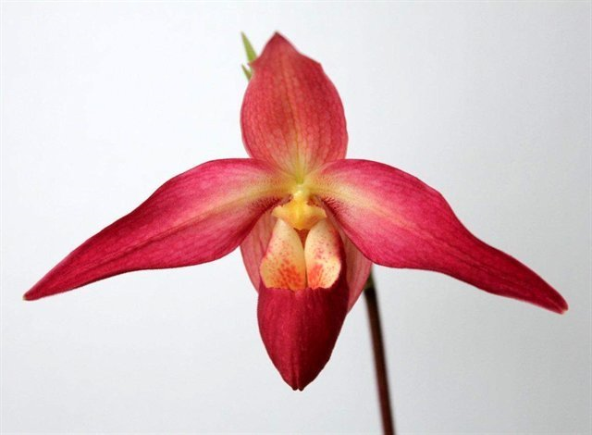
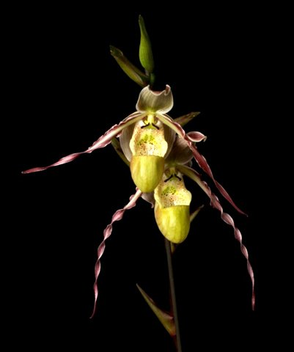
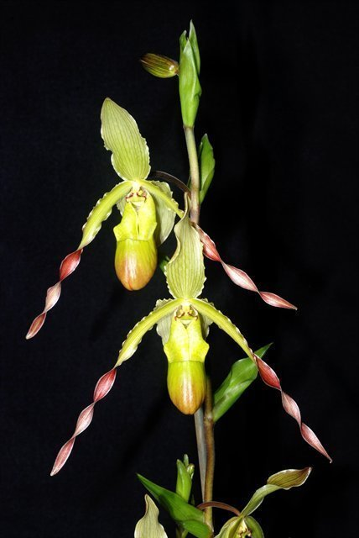
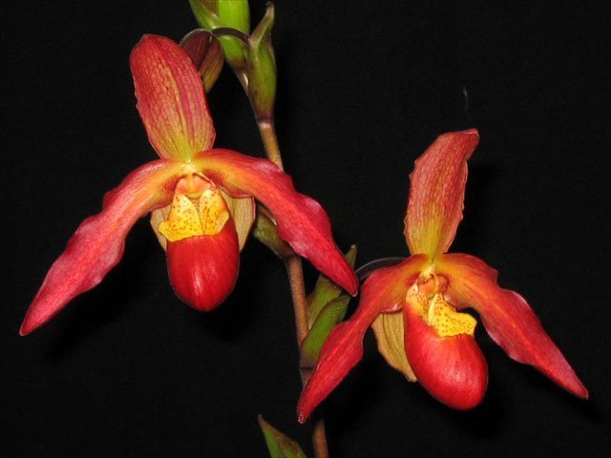
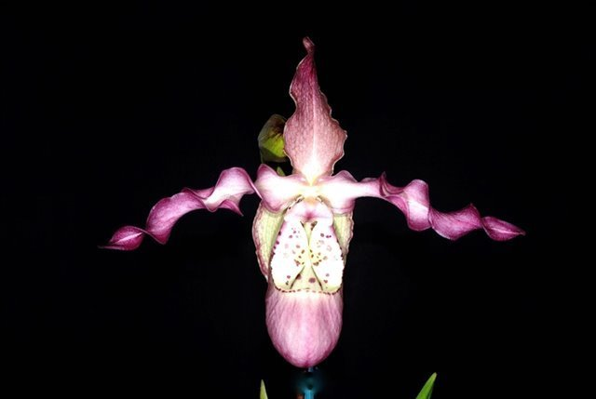
Your first Phrag…

Slide 7
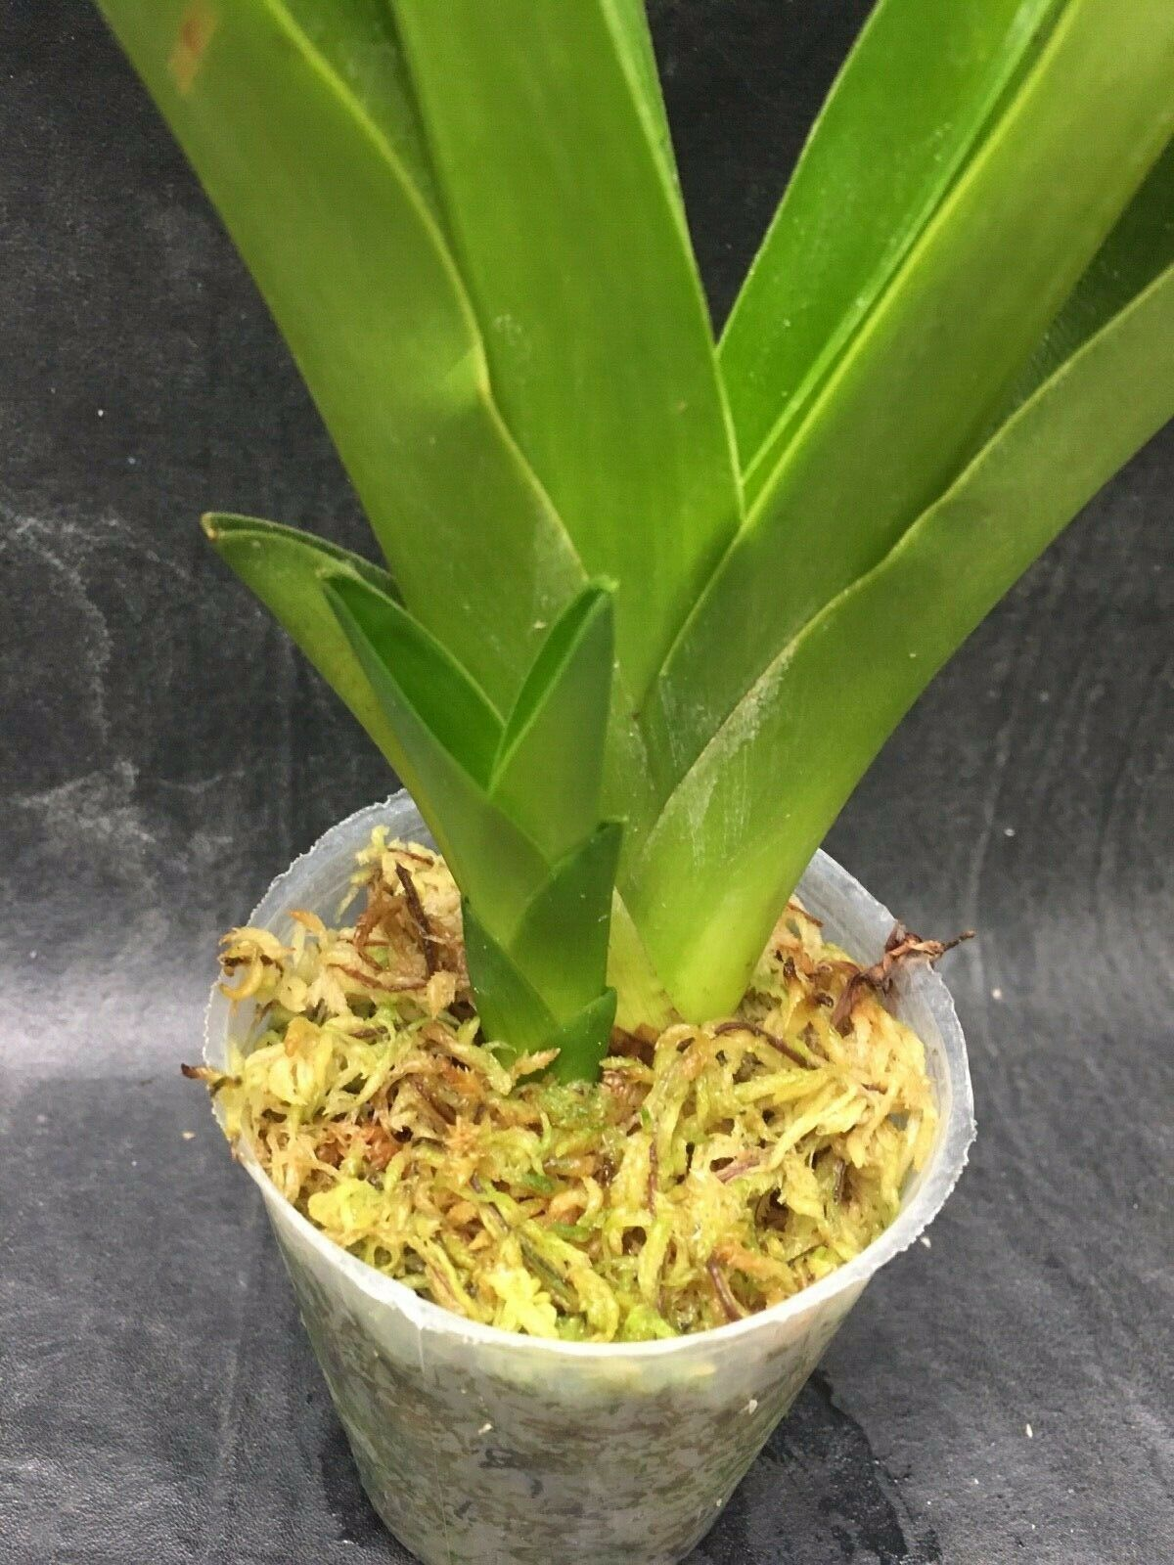
So you got a new Phrag, what then?

Slide 9
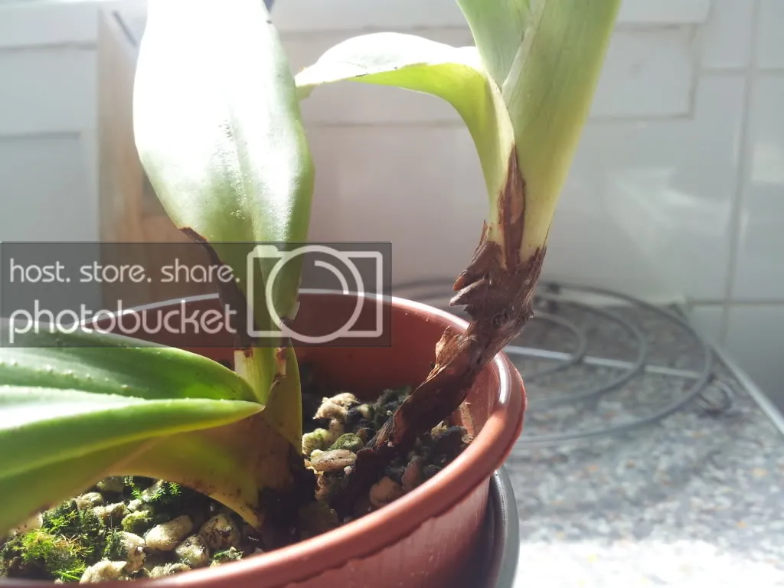
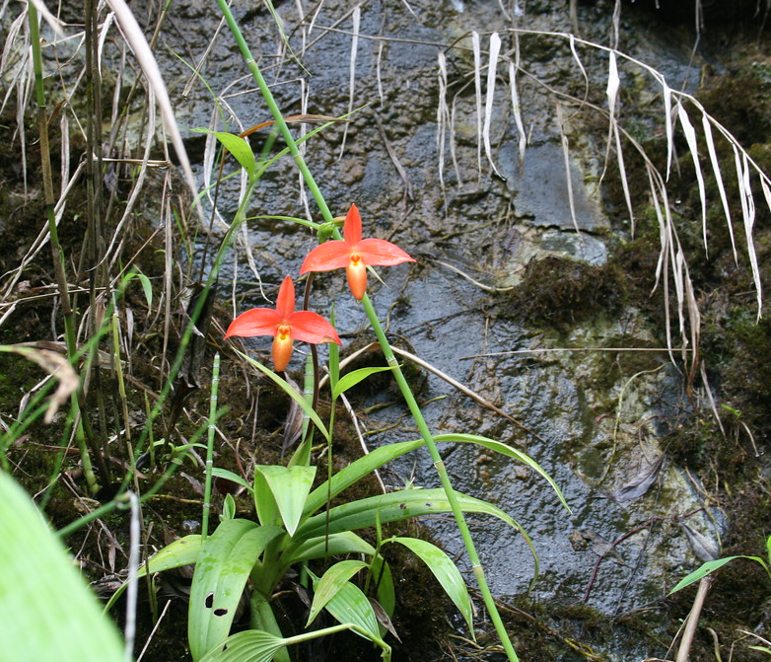
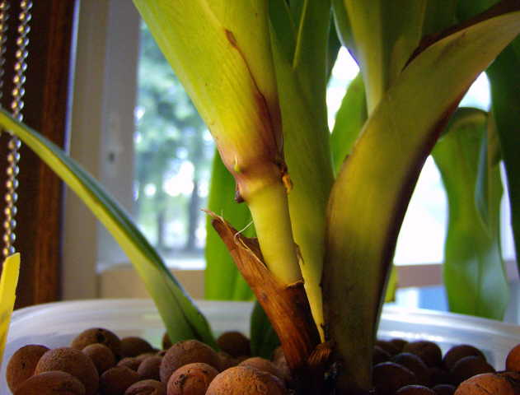
What if they climb?

Slide 10
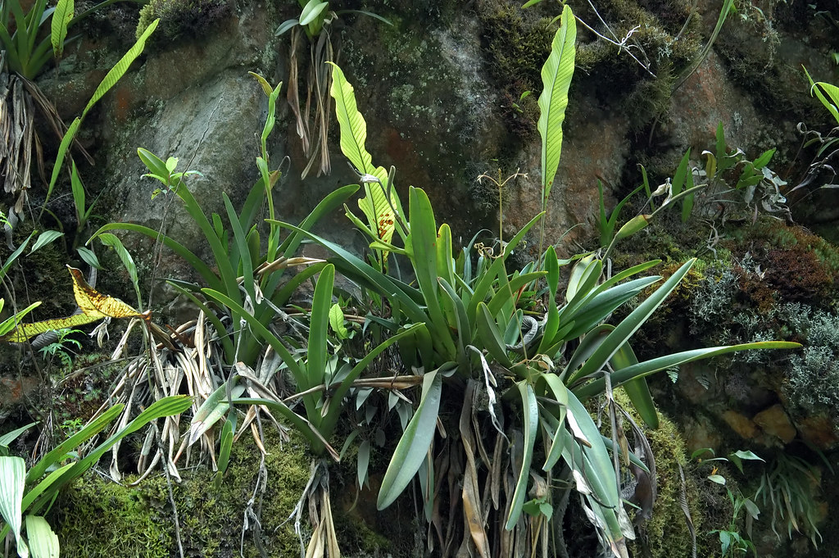
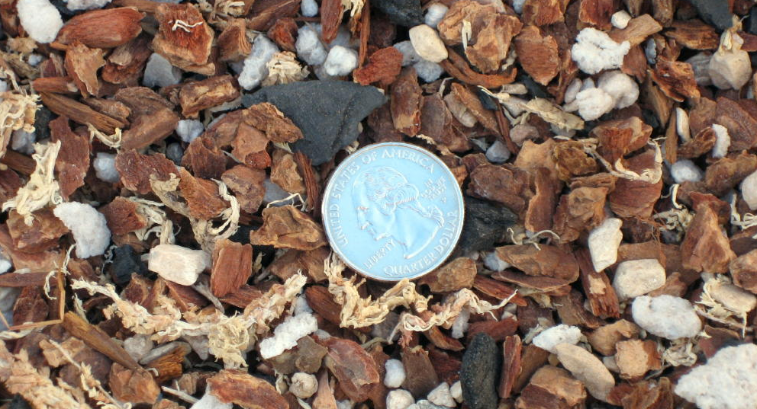
Moisture
Phrags like water!
Wet vs dry species
The dry group: the really long petals species
People grow them like a multifloral Paph with more open, fast draining mixes and let dry slightly between watering.

Slide 11
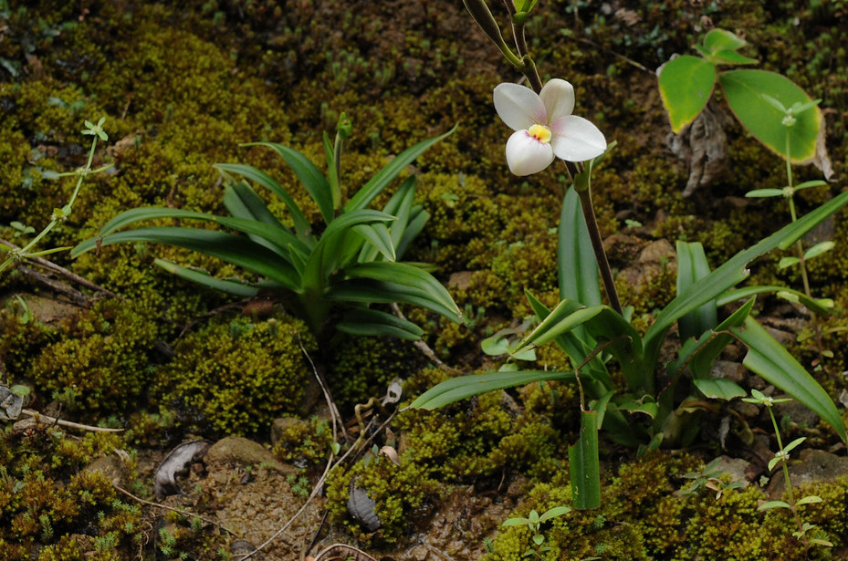
Moisture
The wet group (the majority of the Phrags) prefer water available to them at all time.
When in doubt, water!

Slide 12
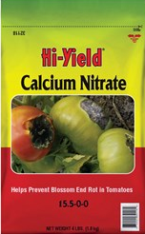
LECA
Light Expanded Clay Aggregate (aka clay pebbles)
Even moisture
Very airy medium
Need prior soaking
Rinse with water
Make a solution of Calcium Nitrate and Epsom Salts at a concentration of 1 tsp/gallon
Soak LECA for 24 hours
Rinse and use

Slide 13
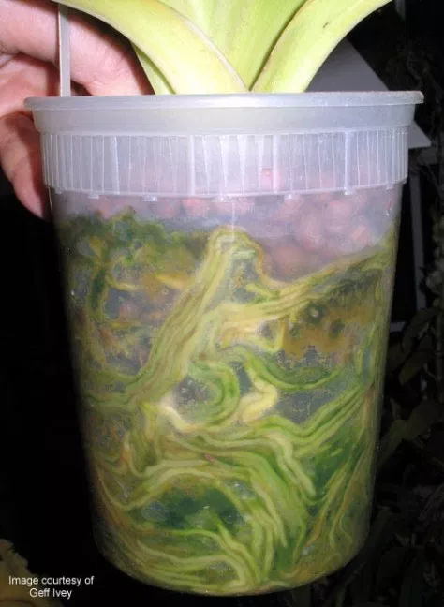
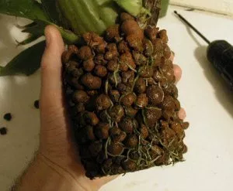
Semi-hydroponic method
Phrag is the perfect candidate for semi-hydroponic. Especially the wet group
The easiest repotting you have ever done!
www.firstrays.com

Slide 14
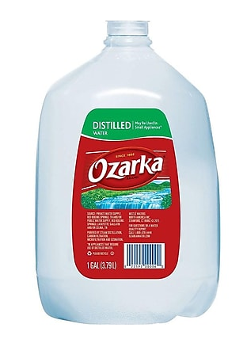
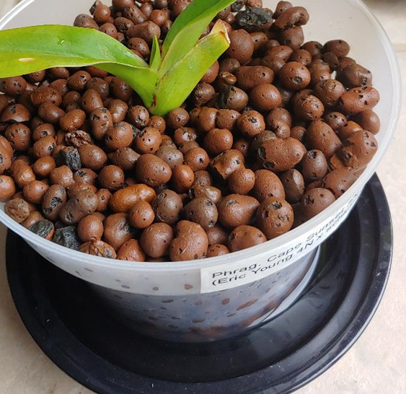
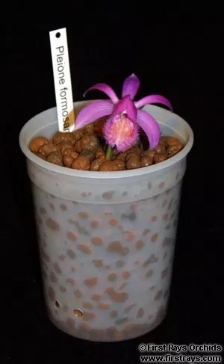
So how to water?
Phrag loves pure water!
Phrag also loves fresh water!
Dumping out old water and pour in fresh water
Wait until reservoir is empty, then fill up reservoir again (the lazy way)
The saucer method
Squat pot vs taller pot
Specialized semi-hydroponic pots

Slide 15
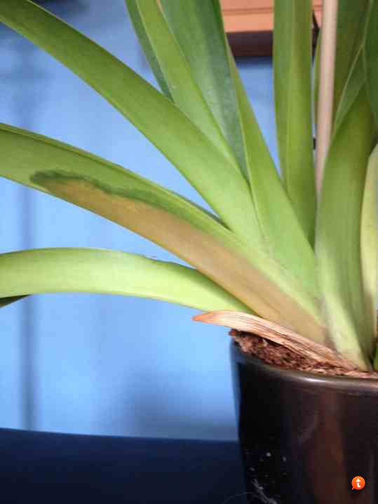
Troubleshoot
The golden rule for growing orchids: Don’t let water standing in the crown of the plant!
Bacterial rot: tan/brown water soaked appearance, spread quickly, can be fatal
The dry group are more susceptible.

Slide 16
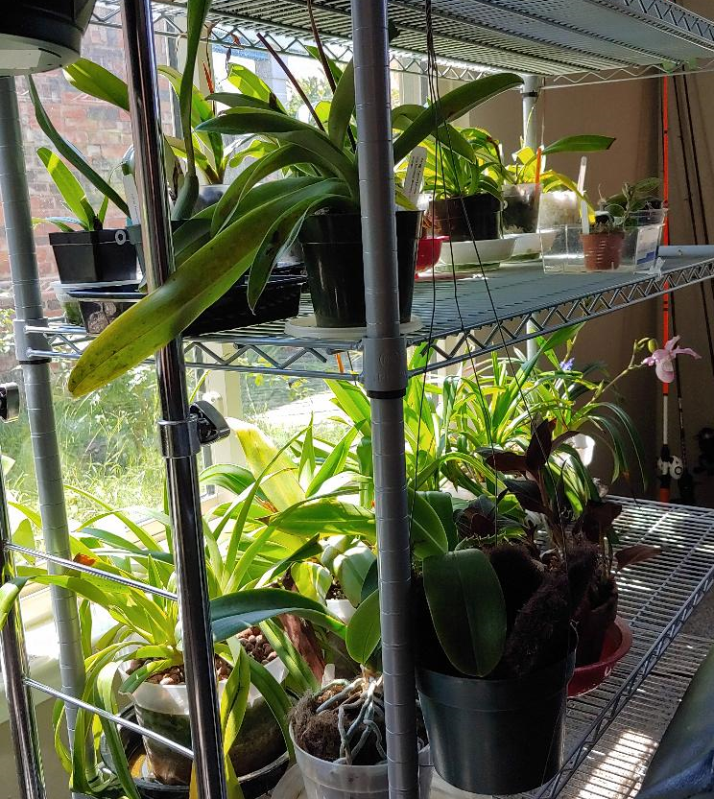
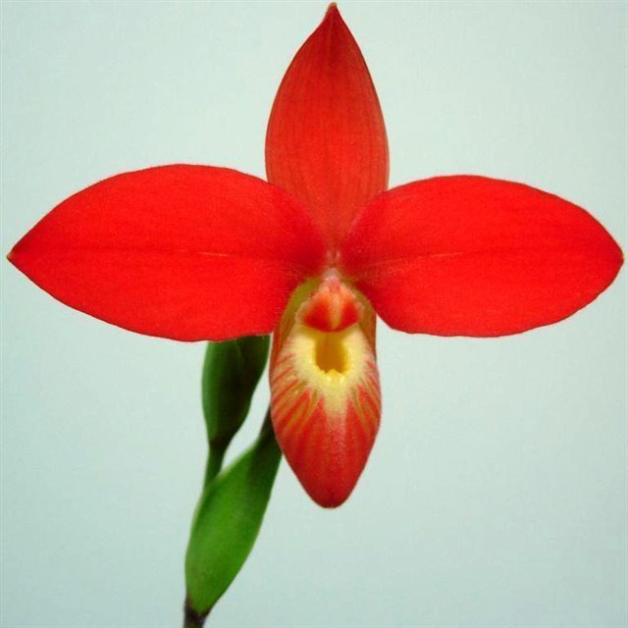
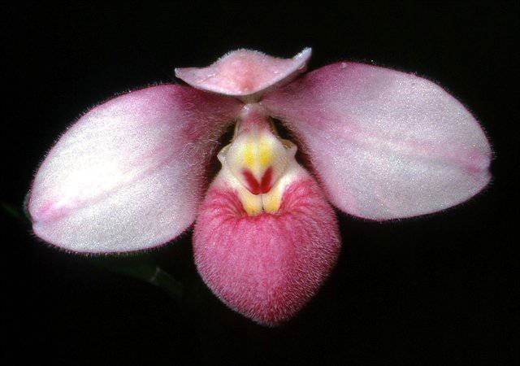
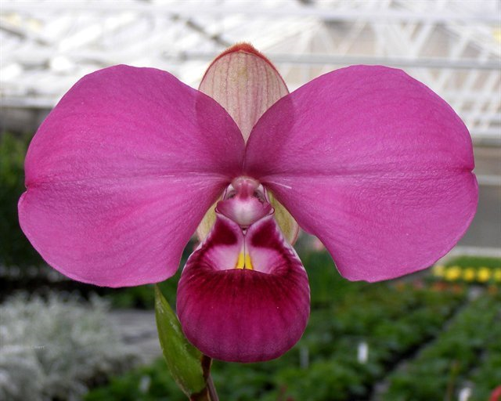
Light and temperature
Light: They are sun lovers. Provide Cattleya level.
Low light = slow growth and no flowers
Some tolerate lower light levels (P. schlimii, P. besseae)
Temperature: If you are comfortable, they should be as well (60-80 F)
Cooler temp = better color.
Can tolerate more heat if roots kept cool.
Some species prefer cooler ends (P. kovachii)

Slide 17
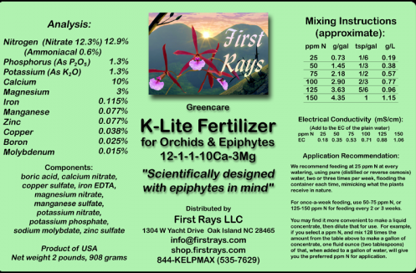
Other cultural consideration
Humidity/airflow:
Tolerate low indoor humidity well if well-watered.
Increase airflow on hot days
Fertilizer:
Fertilize with every refill of reservoir.
Use very weak solution! 1/4 or less the recommended concentration in the label.
Use complete fertilizer with Cal and Mag and micronutrients

Slide 18
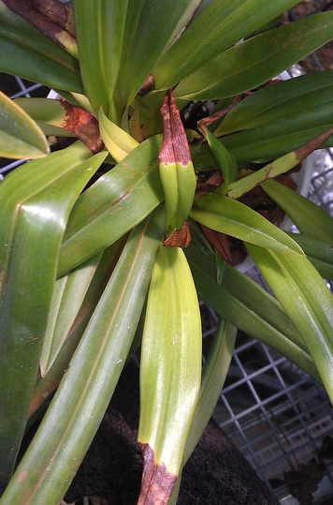
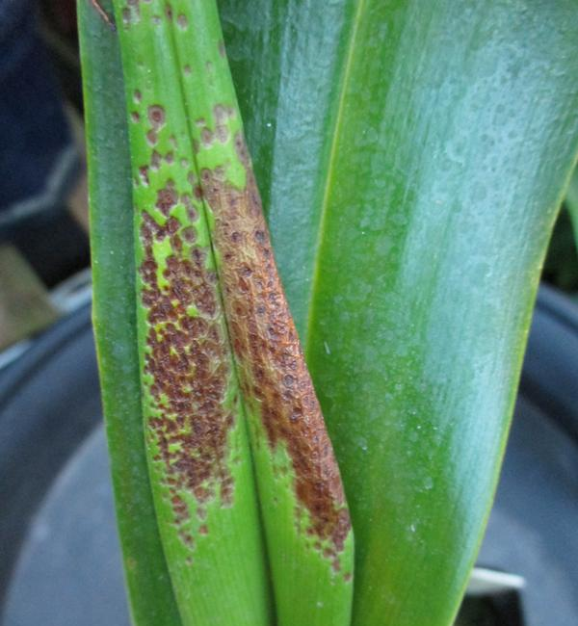
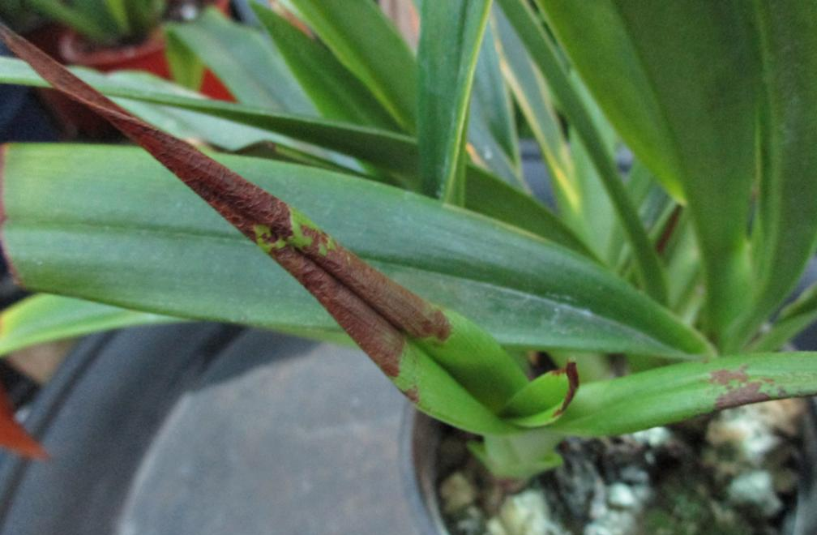
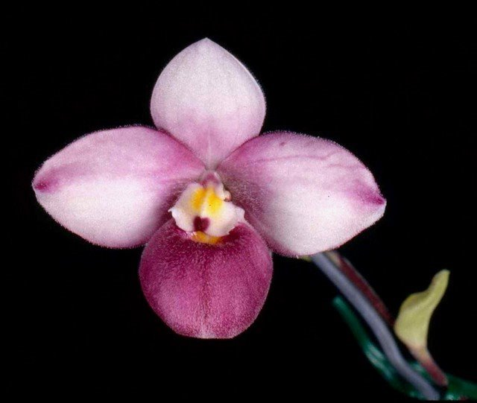
Common issue
Leaftip burns/spots: very common in Phrag!
Some Phrag needs additional supplement of Calcium (P. kovachii, P. fischeri, P. andreettae)

Slide 19
Pests
Scales and mealybugs magnet
Not the first choice of spider mites.
Always isolate new plants before introducing into collection!!!
These insects are master of hiding!
Lots of foliage = lots of places for insect to hide

Slide 20
Phrags are not intimidating!
Back in April I have received a baby Phrag from George growing in fine bark/charcoal.
Phrag. Cape Sunset 3N (Eric Young 4N x schlimii)

Slide 21
Root growth in semi-hydroponic
My own root growth in S/H

Slide 22
Progress!
Then and now

